Slide 1

ECE 220 Computer Systems & Programming
Lecture 11: Pointers and Arrays
February 19, 2019
Notes:
ECE Main Slide

Slide 2
Outline
Chapter 16
Key concepts
Passing by reference with pointers
Arrays basics

Slide 3
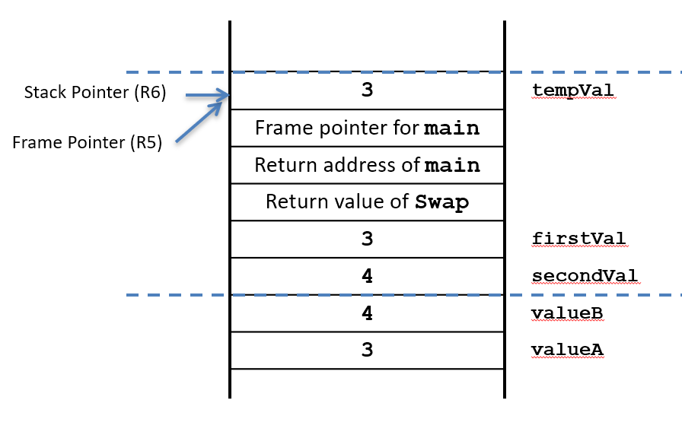
Function Swap
#include<stdio.h>
void Swap(int firstVal, int secondVal);
int main()
{
int valueA = 3;
int valueB = 4;
1. printf("%d %d\n”, valueA, valueB);
2. Swap(valueA, valueB);
3. printf("%d %d\n", valueA, valueB);
4. return 0;
}
void Swap(int firstVal, int secondVal)
{
int tempVal;
5. tempVal = firstVal;
6. firstVal = secondVal;
7. secondVal = tempVal;
}

Slide 4
Function NewSwap
#include<stdio.h>
void NewSwap(int *firstVal, int *secondVal);
int main()
{
int valueA = 3;
int valueB = 4;
1. printf("%d %d\n”, valueA, valueB);
2. NewSwap(&valueA, &valueB);
3. printf("%d %d\n", valueA, valueB);
4. return 0;
}
void NewSwap(int *firstVal, int *secondVal)
{
int tempVal;
5. tempVal = *firstVal;
6. *firstVal = *secondVal;
7. *secondVal = tempVal;
}

Slide 5
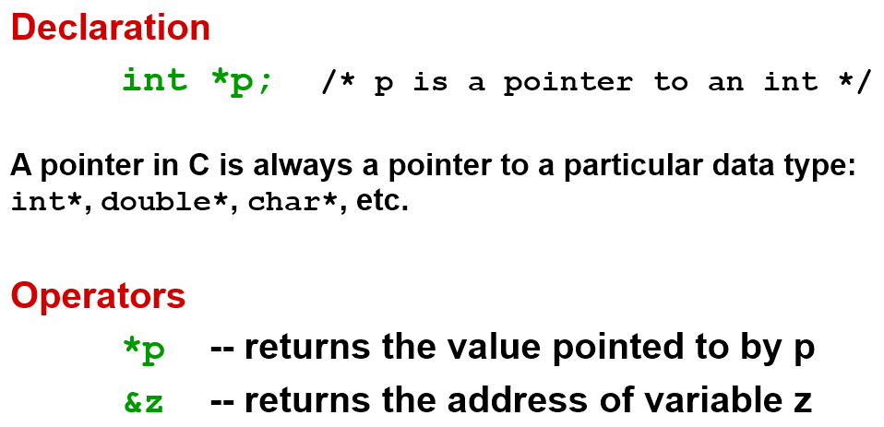
Pointers

Slide 6
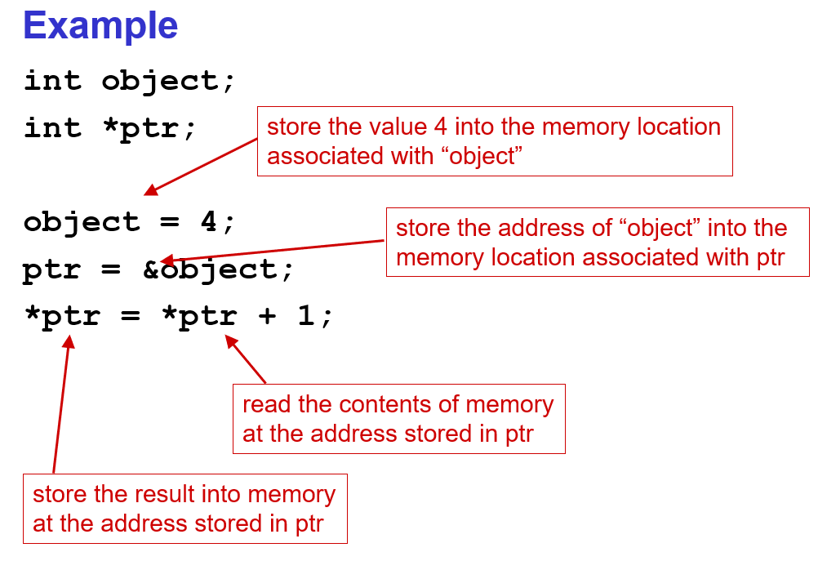

Slide 7
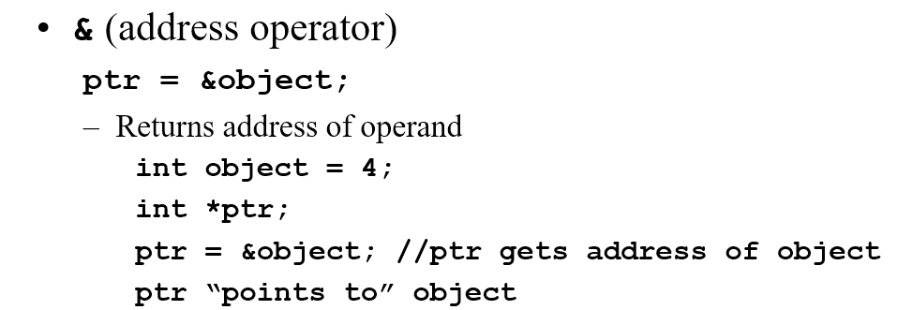
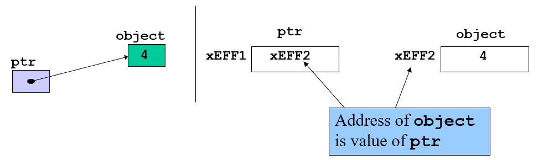


Slide 8
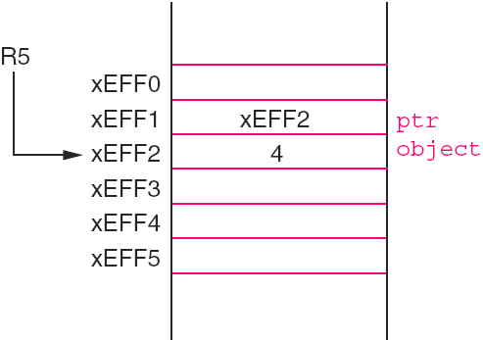
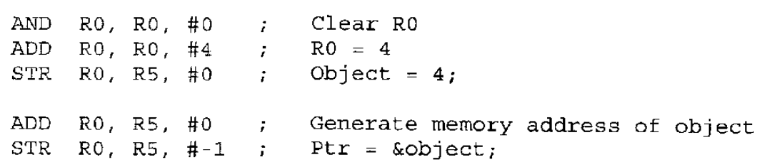
Pointers in LC3
The indirection operator ‘*’
int object = 4;
int *ptr;
ptr = &object;

Slide 9
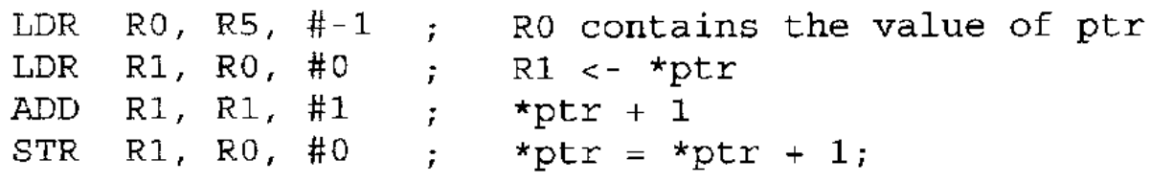
Pointers in LC3

Slide 10
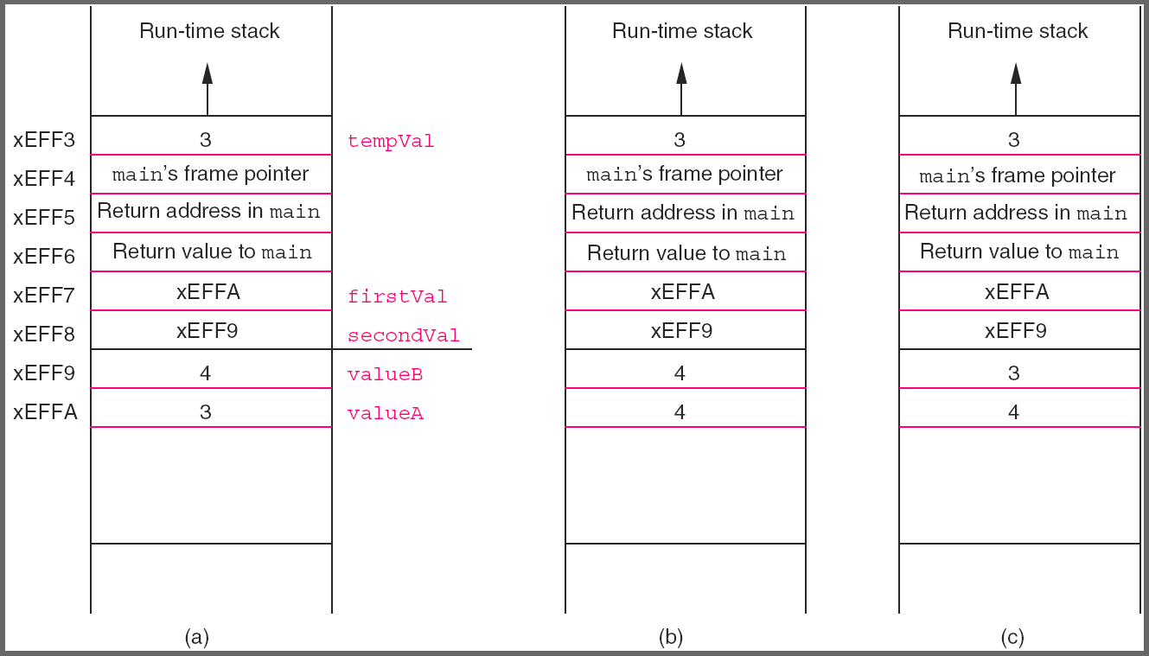
Function NewSwap
#include<stdio.h>
void NewSwap(int *firstVal, int *secondVal);
int main()
{
int valueA = 3;
int valueB = 4;
1. printf("%d %d\n”, valueA, valueB);
2. NewSwap(&valueA, &valueB);
3. printf("%d %d\n", valueA, valueB);
4. return 0;
}
void NewSwap(int *firstVal, int *secondVal)
{
int tempVal;
5. tempVal = *firstVal;
6. *firstVal = *secondVal;
7. *secondVal = tempVal;
}
More Examples on Github: CallByValue, CalByReference

Slide 11
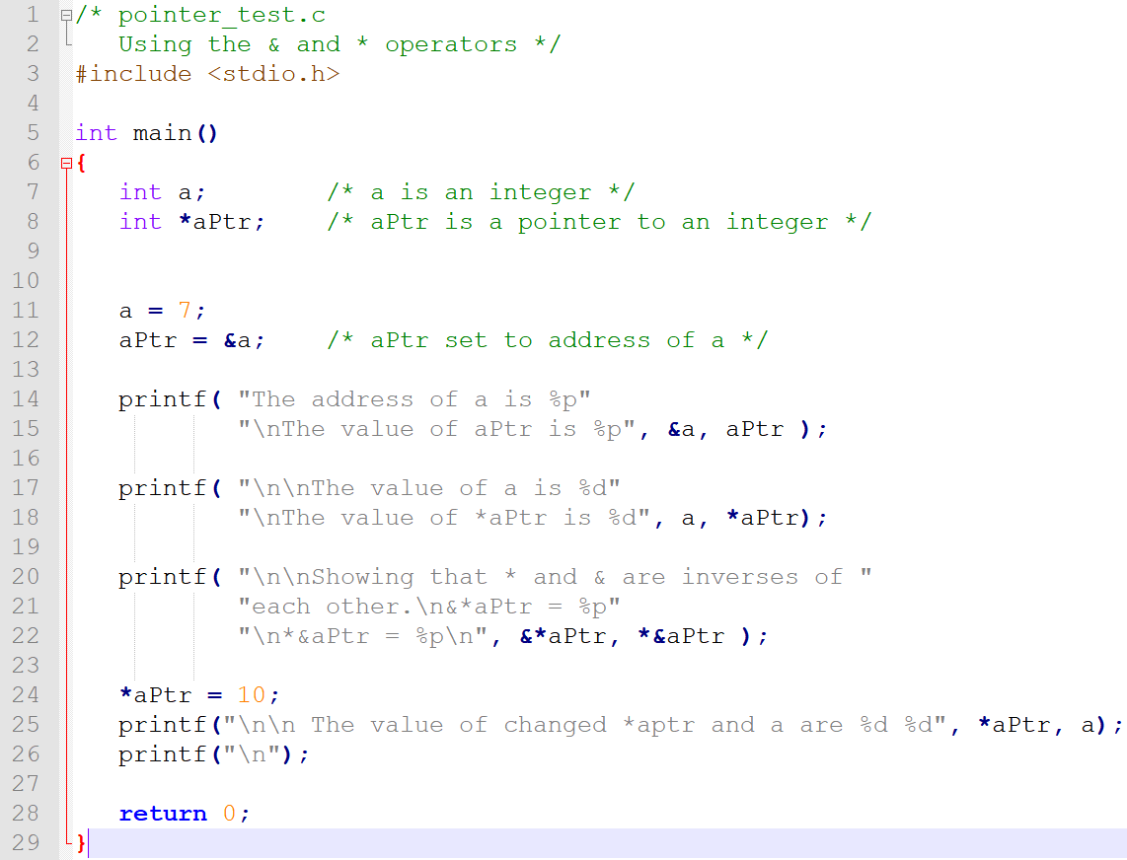
Exercise:

Slide 12
Arrays: Basic Concept
Initial Location
Sequentially arranged data of same type
Offset

Slide 13
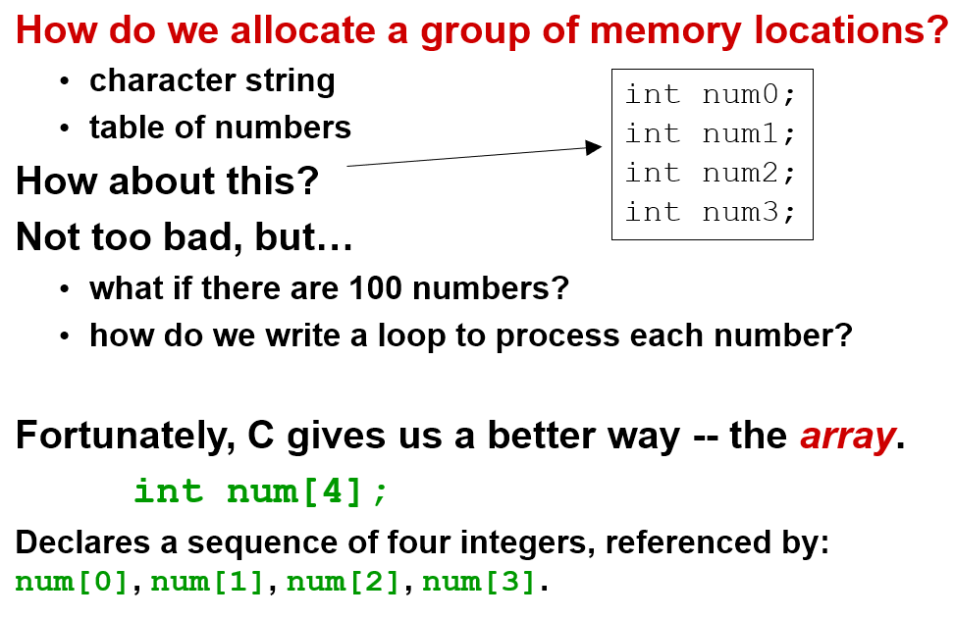
Arrays: Basic Concept

Slide 14
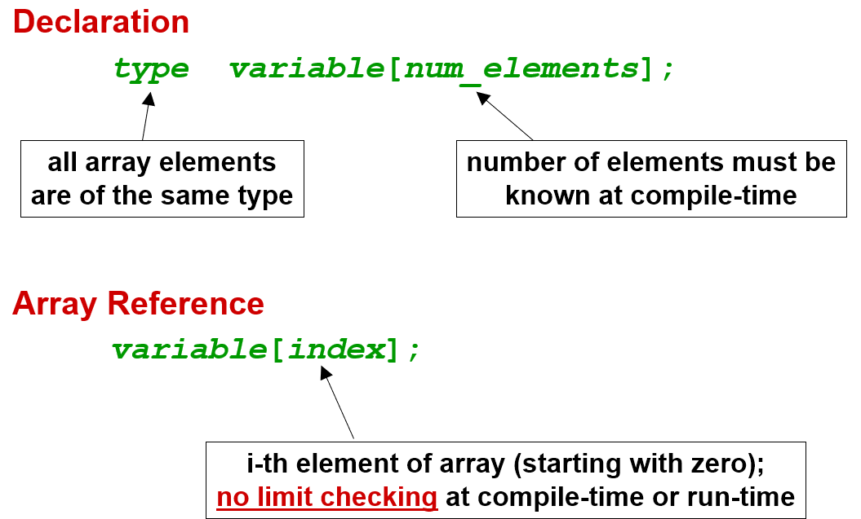
Arrays: Syntax

Slide 15
Arrays in C
int main()
{
int histogram[100];
char name[9];
double values[1024];
.
.
histogram[6] = histogram[6] + 1;
i = 0;
while (name[i] != ‘\0’)
i++;
.
.
}
values[0]
histogram[99]
name[0]
name[1]
name[2]
name[3]
name[4]
name[5]
name[6]
name[7]
name[8]

Slide 16
Arrays Example
Declaring and using Arrays
int grid[10] = {0,1,2,3,4,5,6,7,8,9};
grid[6] = grid[3] + 1;
int i;
for(i=0;i<2;i++)
{
grid[i+1] = grid[i] + 2;
}
8

Slide 17
Passing Array as Arguments
C passes arrays by reference
the address of the array (i.e., address of the first element) is written to the function's activation record
otherwise, would have to copy each element
[]indicate to the compiler that the corresponding parameter will be the base address of an array of the specified type.
int main(){
int array[10];
int result;
result = average(array);
return 0;
}
int average(int array[]);
9

Slide 18
Array Concepts (Next Class)
Bounds checking
Assignment of arrays
Passing Arrays as parameters in functions
Pointers and Arrays

