Slide 1

ECE 220 Computer Systems & Programming
Lecture 14 – Recursion
March 5, 2019
Notes:
ECE Main Slide

Slide 2
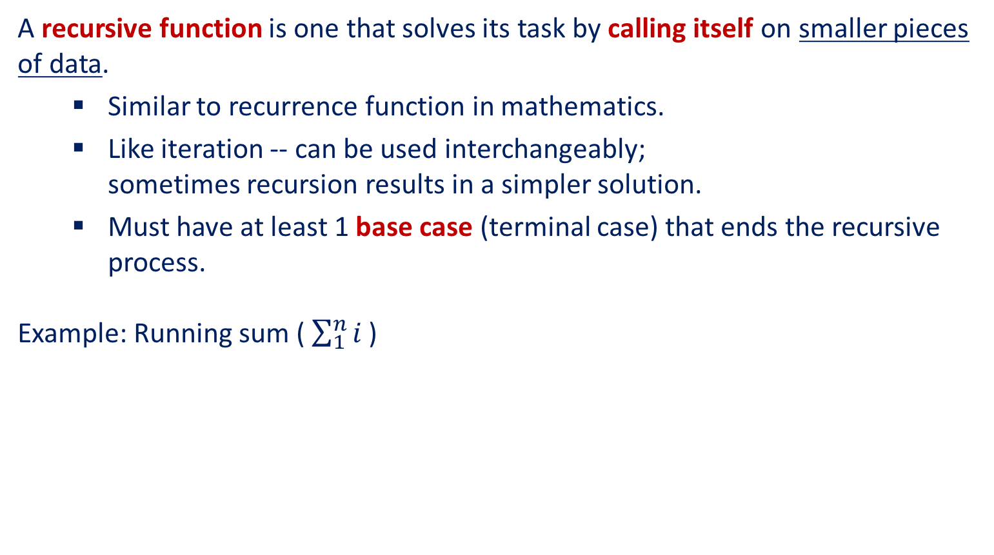
Recursion
A recursive function is one that solves its task by calling itself on smaller pieces of data.
Similar to recurrence function in mathematics.
Like iteration -- can be used interchangeably; sometimes recursion results in a simpler solution.
Must have at least 1 base case (terminal case) that ends the recursive process.
Example: Running sum ($\sum_{1}^{n}{i}$ )
Mathematical Definition:
RunningSum(1) = 1 RunningSum(n) = n + RunningSum(n-1)
Recursive Function:
int RunningSum(int n) { if (n == 1) return 1; else return n + RunningSum(n-1); }
4

Slide 3
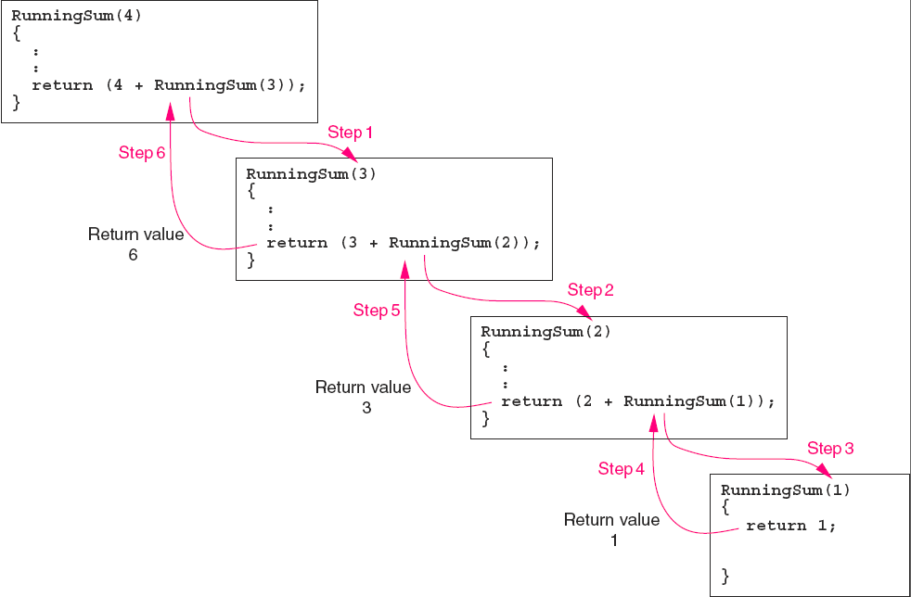
Running sum Recursion

Slide 4
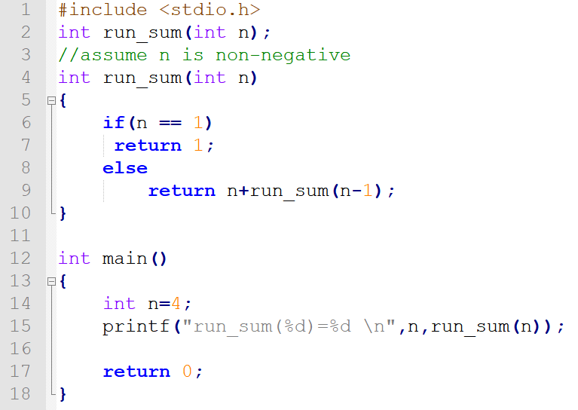
Running sum (code)

Slide 5
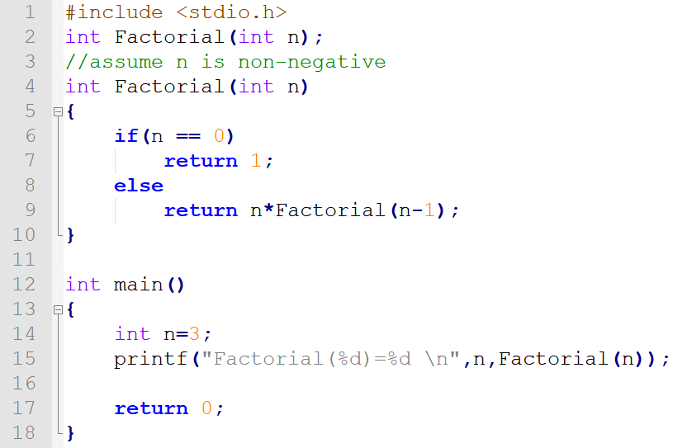
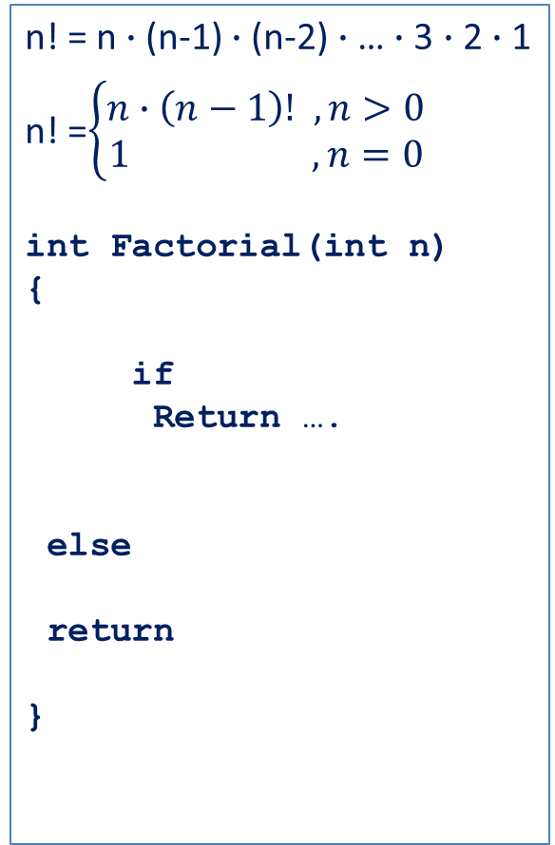
Factorial
n! = n$∙$(n-1) $∙$(n-2) $∙$… $∙$3 $∙$2 $∙$1
n! =$\left\{\begin{aligned}n∙\left(n−1\right)! ,n>0 \\ 1 ,n=0\end{aligned}\right.$
int Factorial(int n)
{
if
Return ….
else
return
}
10

Slide 6
Executing Factorial
Observation:
Each invocation solves a smaller version of the problem;
2) Once the base case is reached,
recursive process stops.
Factorial(3);
return value = 6
Factorial(3)
return 3 * Factorial(2);
return value = 2
Factorial(2)
return 2 * Factorial(1);
return value = 1
Factorial(1)
return 1 * Factorial(0);
return value = 1
Factorial(0)
return 1;
11

Slide 7
Run-Time Stack During Execution of Factorial
main calls Factorial(3)
Factorial(3) calls Factorial(2)
Factorial(2) calls Factorial(1)
Factorial(1) calls Factorial(0)
R6
Fact(0)
R6
Fact(1)
Fact(1)
R6
Fact(2)
Fact(2)
Fact(2)
R6
Fact(3)
Fact(3)
Fact(3)
Fact(3)
main
main
main
main
12

Slide 8
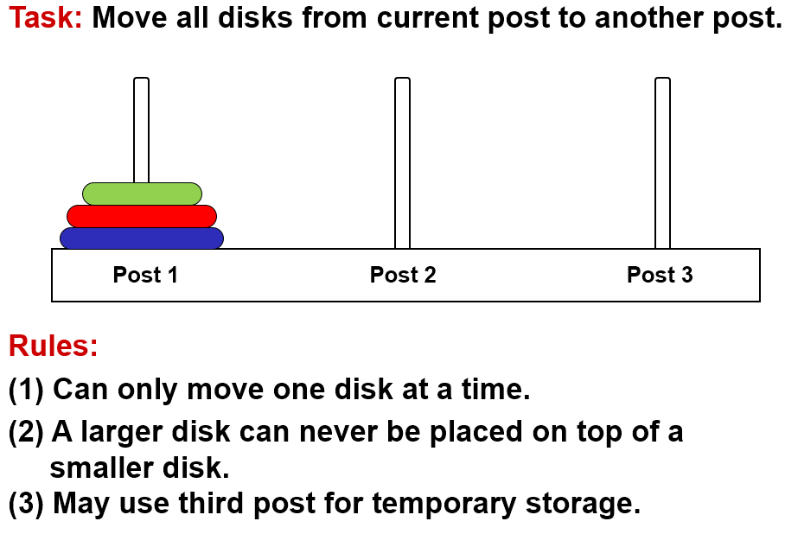
Towers of Hanoi Problem

Slide 9
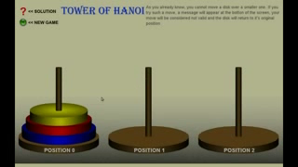
Tower of Hanoi (Animation)

Slide 10
Task Decomposition
Suppose disks start on Post 1, and target is Post 3.
1. Move top n-1 disks to Post 2.
2. Move largest disk to Post 3.
3. Move n-1 disks from Post 2 to Post 3.
1
2
3
1
2
3
1
2
3

Slide 11
Task Decomposition (cont.)
Task 1 is really the same problem, with fewer disks and a different target post.
"Move n-1 disks from Post 1 to Post 2."
And Task 3 is also the same problem, with fewer disks and different starting and target posts.
"Move n-1 disks from Post 2 to Post 3."
So this is a recursive algorithm.
The terminal case is moving the smallest disk -- can move directly without using third post.
Number disks from 1 (smallest) to n (largest).

Slide 12
Towers of Hanoi: Pseudocode
MoveDisk(diskNumber, startPost, endPost, midPost) { if (diskNumber > 1) { /* Move top n-1 disks to mid post */ MoveDisk(diskNumber-1, startPost, midPost, endPost); printf("Move disk number %d from %d to %d.\n", diskNumber, startPost, endPost); /* Move n-1 disks from mid post to end post */ MoveDisk(diskNumber-1, midPost, endPost, startPost); } else printf("Move disk number 1 from %d to %d.\n", startPost, endPost); }

Slide 13
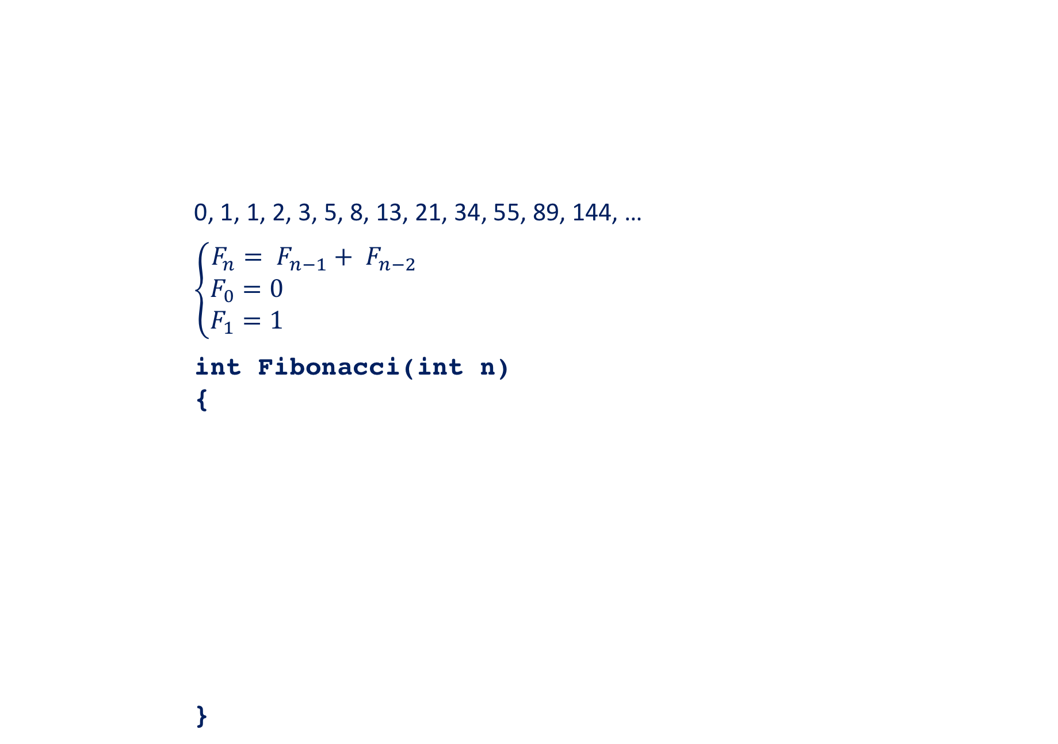
Fibonacci Number
0, 1, 1, 2, 3, 5, 8, 13, 21, 34, 55, 89, 144, …
$$\left\{\begin{aligned}F_{n}= F_{n−1}+ F_{n−2} \\ F_{0}=0 \\ F_{1}=1 \end{aligned}\right.$$
int Fibonacci(int n)
{
}
5

Slide 14
Fibonacci with Look-up Table
int table[100];
/* each element will be initialized to -1 in main */
int fibonacci(int n){
/*if fibonacci(n) has been calculated, return it*/
/*otherwise, perform the calculation, save it to table
and then return it*/
}
6

Slide 15
Binary Search
/*This function takes four arguments: pointer to a sorted array, the search item, the start index and the end index of the array. If the search item is found, the function returns its index in the array. Otherwise, it returns -1.*/
int binary(int array[], int item, int start, int end)
{
}
7

Slide 16
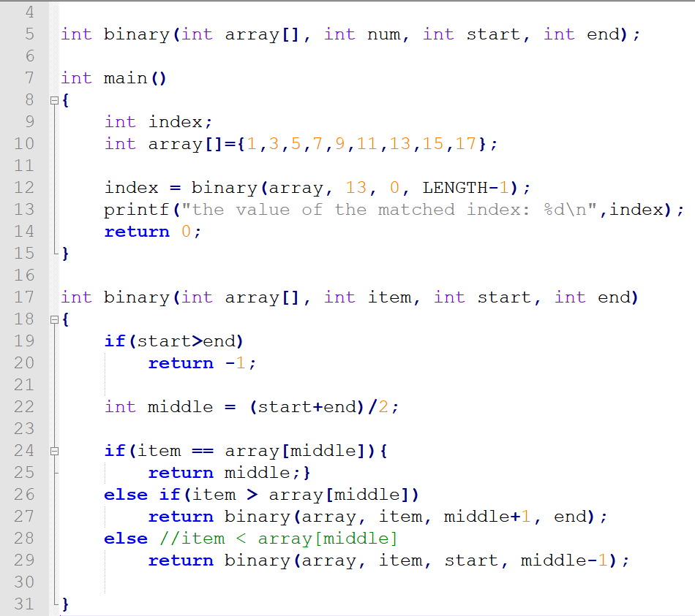

Slide 17
Quick Sort: also called divide-and-conquer
1) pick a pivot and partition array into 2 subarrays;
2) then sort subarrays using the same method.
Pivot Element p
3 | 5 | 2 | 1 | 4
<p
>p
2 | 1 | 3 | 5 | 4
1 | 2
4 | 5
1
4
Sorted Array
1 | 2 | 3 | 4 | 5
8

Slide 18
Quick Sort
/* Assume partition() function is given and it returns the index of the pivot after partitioning. */
int partition(int array[], int start, int end);
/* This function takes 3 arguments: a pointer to the array, the start index of the array and the end index of the array. */
void quicksort(int array[], int start, int end){
}
9

