Slide 1

ECE 220 Computer Systems & Programming
Lecture 6 – Interrupts & Exceptions
Notes:
ECE Main Slide

Slide 2
Outline
Interrupt driven I/O
Interrupts and exceptions
Machinery for processing interrupts
Concepts
New hardware to support new feature
Saving processor state

Slide 3
Polling V.S. Interrupt Driven I/O
interrupt enable bit
15
14
0
ready bit
13
KBSR
interrupt signal to processor
Software sets “interrupt enable” bit in device register
When Ready bit and IE bit are both set, interrupt is signaled
2

Slide 4
Interrupt Driven I/O
An I/O device can:
Force currently executing program to stop
Have the processor carry out the need of the I/O device
Resume the stopped program as if nothing had happened
3

Slide 5
Interrupt Driven I/O: 4 Steps
Generation of interrupt signal (INT)
Set-up for servicing interrupt
Interrupt Service Routine
Resume execution main program
3

Slide 6
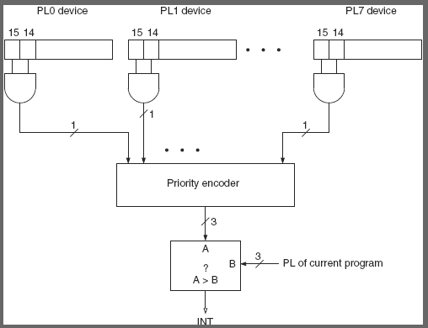
Step 1. Generation of Interrupt Signal
Three conditions must be true for an I/O device to interrupt the processor:
The I/O device must want service (Ready Bit in KBSR)
The device must have the right to request service (IE bit in KBSR)
The device request must be more urgent than what the processor is currently doing

Slide 7
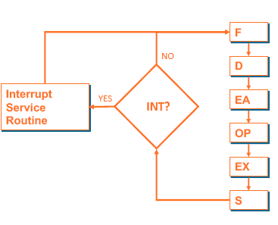
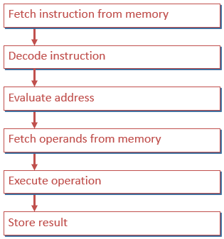
Step 2: Instruction Cycle and Interrupt
If INT is not asserted
The usual instruction cycle
Ends with check for interrupt
If INT is asserted, control unit does 2 things before fetching the next instruction:
Store state of the program
Service the interrupt
4

Slide 8
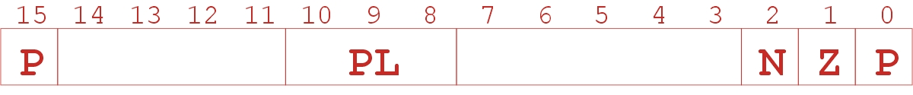
Processor Status Register (PSR)
Enough state info saved for interrupted program to resume later
Enough state info loaded for the interrupt service routine to begin service
State of a Program:
Contents of all GPRs (should be saved by ISR, callee-saved)
PC
PSR (processor status register)
User Stack Pointer
PSR[15] – privileged (supervisor - 0) or unprivileged (user - 1) mode
PSR[10:8] – priority level, PSR[2:0] – condition code
Where to save state information?
5

Slide 9
Supervisor Stack (where the state is saved)
Suppose the user program uses a stack, and the stack pointer is stored in R6
A special region of memory used as the stack (why?) for interrupt service routines.
Supervisor Stack Pointer (SSP) stored in Saved.SSP
Another register for storing User Stack Pointer (USP) Saved.USP
When switching from User mode to Supervisor mode (as result of interrupt), save R6 to Saved.USP
Access both Stacks using R6 as the stack pointer.
6

Slide 10
2. Invoking the Service Routine
I/O device transmits Interrupt Vector (INTV, 8-bit) along with interrupt signal and priority level (PL0..PL7). When an interrupt is taken:
If Priv = 1 (user), i.e. PSR[15] =1 Saved.USP = R6, then R6 = Saved.SSP.
Push PSR and PC to Supervisor Stack.
Set PSR[15] = 0 (supervisor mode).
Set PSR[10:8] = priority of interrupt being serviced. (keyboard PL4)
Set PSR[2:0] = 0.
Set MAR = x01vv, where vv = 8-bit interrupt vector provided by interrupting device (e.g., keyboard = x80).
Load memory location (M[x01vv]) into MDR.
Set PC = MDR; now first instruction of ISR will be fetched.
7

Slide 11
Step 3: Interrupt Service Routine
PC contains the starting address of the ISR.
Callee-save for general purpose registers.
Execute code for servicing the interrupt
There may be other interrupts during this execution (in which case go back to Step 2)

Slide 12
Step 4: Returning from interrupt
Special instruction (RTI) – restores state
Pop PC from supervisor stack. (PC = M[R6]; R6 = R6 + 1)
Pop PSR from supervisor stack. (PSR = M[R6]; R6 = R6 + 1)
If PSR[15] = 1, R6 = Saved.USP. (If going back to user mode, need to restore User Stack Pointer.)
RTI is a privileged instruction.
Can only be executed in Supervisor Mode.
If executed in User Mode, causes an exception.
8

Slide 13
Nested Interrupts

Slide 14
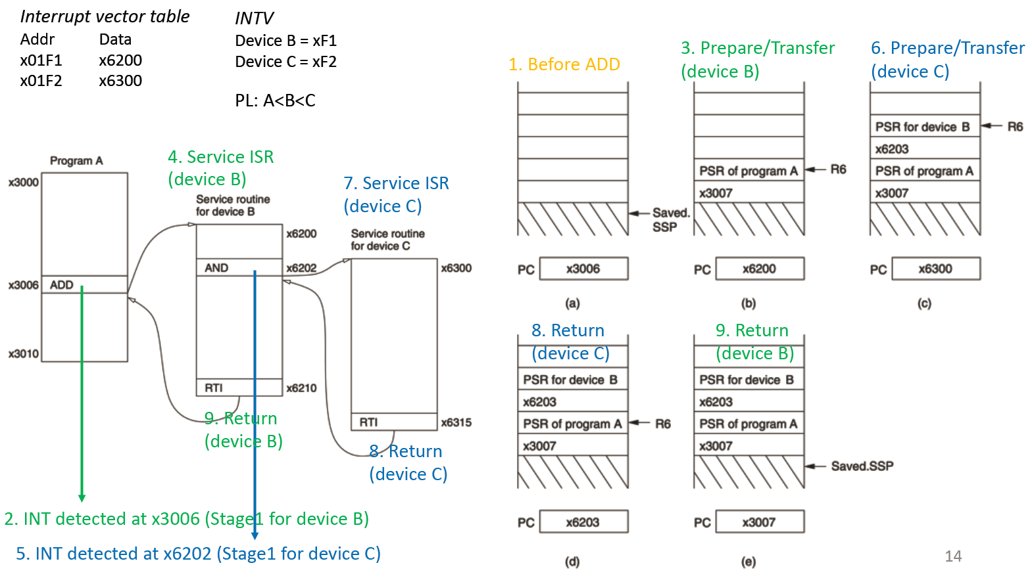

Slide 15
Example Code: (See Github)

Slide 16
Exceptions: Internal Interrupt
When something unexpected happens inside the processor, it may cause an exception.
Examples of Exception in LC-3:
Privileged operation (e.g., RTI in user mode)
Executing an illegal opcode (Bits[15:12] = 1101)
Handled just like an interrupt
Vector is determined internally by type of exception
Priority is the same as running program
Interrupt Vector Table
Exception Service Routines – x0100 to x017F
Interrupt Service Routines – x0180 to 01FF
9

