Slide 1

ECE 220 Computer Systems & Programming
Lecture 4: Introduction to Stack Data Structures
Jan 24th 2019
Notes:
ECE Main Slide

Slide 2
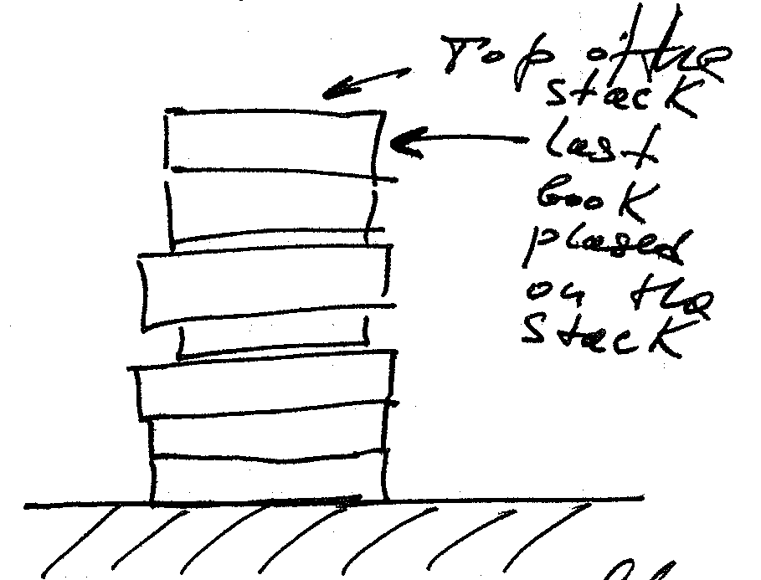
Palindromes:
Examples of palindromes
Madam
Kayak
Was it a car or a cat I saw?
Aibohphobia
How can we test for palindromes?

Slide 3
Outline
What is a stack?
How to implement a stack?
POP and PUSH Subroutines in LC-3
Chapter 10 in textbook

Slide 4
Coin Holder Example
First coin in is the last coin out
5

Slide 5
A Hardware Implementation
Data items move in memory, top of stack is fixed
Empty:
Yes
Empty:
No
Empty:
No
Empty:
No
/ / / / / /
/ / / / / /
/ / / / / /
/ / / / / /
/ / / / / /
/ / / / / /
#18
/ / / / / /
/ / / / / /
/ / / / / /
#31
/ / / / / /
/ / / / / /
/ / / / / /
#5
#18
/ / / / / /
TOP
#18
TOP
#12
TOP
#31
TOP
Initial State
After
One Push
After Three
More Pushes
After
Two Pops
6

Slide 6
A Software Implementation
Data items don’t move in memory, just our idea about where the top of the stack is.
By convention, R6 holds the Top of Stack (TOS) pointer
x3FFB
/ / / / / /
/ / / / / /
/ / / / / /
/ / / / / /
x3FFC
/ / / / / /
/ / / / / /
#12
TOP
#12
x3FFD
/ / / / / /
/ / / / / /
#5
#5
x3FFE
/ / / / / /
/ / / / / /
#31
#31
TOP
x3FFF
/ / / / / /
#18
TOP
#18
#18
R6
x4000
TOP
x3FFF
R6
x3FFC
R6
x3FFE
R6
Initial State
After
One Push
After Three
More Pushes
After
Two Pops
7

Slide 7
Why are Stack Data Structures useful?
Saving and Restoring of registers when we call a subroutine
PUSH to save when we enter
POP to restore when before we return
Stacks enable subroutines (and functions and methods) to be re-entrant*
They can be interrupted
They can call other subroutines, and have control return back to them, possibly recursively*
Part of the foundation for multi-threading*
*These are big new concepts for many of you, and you’ll be exposed to them in more detail later in this course and in others

Slide 8
Basic Push and Pop Code
x3FFB
/ / / / / /
x3FFC
#12
TOP
Using Software Implementation of Stack
Push (R0 contains the data to be pushed)
ADD R6, R6, #-1 ; decrement stack ptr
STR R0, R6, #0 ; store data (to Top of Stack)
Pop (R0 contains the data after popped)
LDR R0, R6, #0 ; load data from stack ptr
ADD R6, R6, #1 ; increment stack ptr
What if we Push when the stack is full? Overflow
What if we Pop when the stack is empty? Underflow
x3FFD
#5
x3FFE
#31
x3FFF
#18
8
Notes:
Input: A B C
Output: B C A
Sequence: Push A, Push B, Pop B, Push C, Pop C, Pop A

Slide 9
Overflow and Underflow
Given STACK_TOP, STACK_END, STACK_START, how do we determine…
Overflow?
Underflow?
Label/address
x3FEF
x3FFB | XXXXXXXXXXXX
… | XXXXXXXXXXXX
x3FFD | XXXXXXXXXXXX
x3FFE | XXXXXXXXXXXX
x3FFF | XXXXXXXXXXXX
x4000 | XXXXXXXXXXXX
STACK_TOP | x3FEB
STACK_START | x4000
STACK_END | x3FFB
A Full Stack

Slide 10
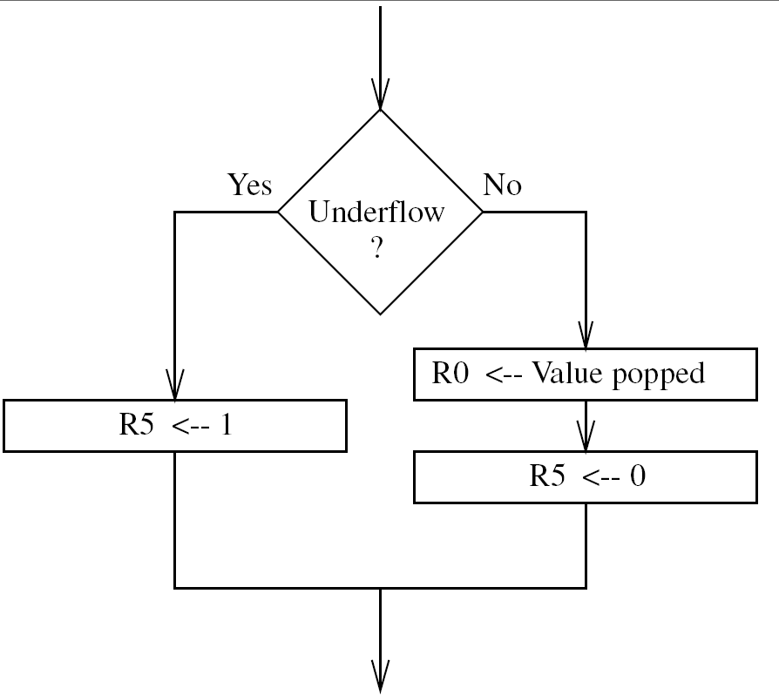
Figure 10.4 POP routine including the test for underflow

Slide 11
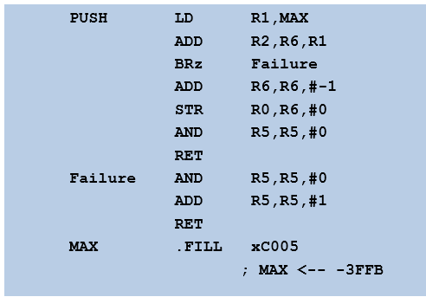
Underflow, Overflow detection:
POP LD R1,EMPTY
ADD R2,R6,R1
BRz Failure
LDR R0,R6,#0
ADD R6,R6,#1
AND R5,R5,#0
RET
Failure AND R5,R5,#0
ADD R5,R5,#1
RET
EMPTY .FILL xC000
; EMPTY <-- -x4000
Stack_Start x4000
Top of the Stack – R6 (Stack Pointer)
Load – R0 (value to be popped)
Output – R5 (success / fail)
Stack_End x3FFB
Top of the Stack – R6 (Stack Pointer)
Load – R0 (value to be popped)
Output – R5 (success / fail)

Slide 12
Our implementation
STACK_START: beginning of stack in memory
STACK_END: end of stack in memory
STACK_TOP: Location of most recent element pushed
Address/Label
x3FFB | ;end of stack
…
x3FFF | ; Base of the stack
X4000 | ; start of stack
STACK_END | .FILL x3FFB
STACK_START | .FILL x4000
STACK_TOP | ….

Slide 13
Push 18
Address/Label
x3FFB | ;end of stack
…
x3FFF | 18
x4000
STACK_END | .FILL x3FFB
STACK_START | .FILL x4000
STACK_TOP | x3FFF

Slide 14
Push 31
Address/Label
x3FFB | ;end of stack
…
x3FFE | 31
x3FFF | 18
X4000
STACK_END | .FILL x3FFB
STACK_START | .FILL x4000
STACK_TOP | x3FFE

Slide 15
Push 5
Address/Label
x3FFB | ;end of stack
…..
x3FFD | 5
x3FFE | 31
x3FFF | 18
X4000
STACK_END | .FILL x3FFB
STACK_START | .FILL x4000
STACK_TOP | x3FF3D

Slide 16
Pop (return 5)
Address/Label
x3FFB | ;end of stack
…..
x3FFD | 5
x3FFE | 31
x3FFF | 18
X4000
STACK_END | .FILL x3FFB
STACK_START | .FILL x4000
STACK_TOP | x3FF3E

Slide 17
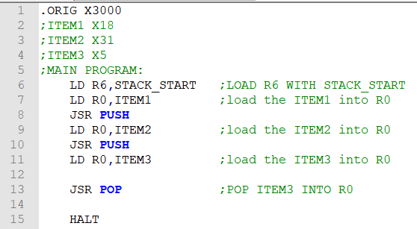
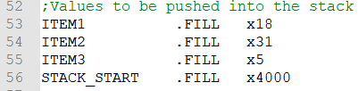
Simple example
Pushes three values into the stack, and pops one value from the stack.
JSR PUSH

Slide 18
