Slide 1

ECE 220 Computer Systems & Programming
Lecture 1 – Course Overview & LC-3 Review
January 15, 2019
Prof. Ujjal Kumar Bhowmik
Office Hours: Tuesdays, 12pm-1pm, ECEB 2054
Email: ubhowmik@illinois.edu
Section BL3 Instructor
Course Wiki: https://wiki.illinois.edu/wiki/display/ece220/Home
Notes:
ECE Main Slide

Slide 2
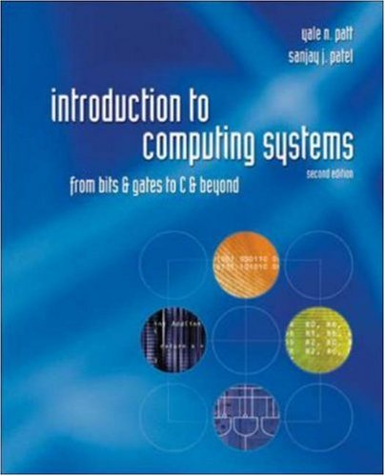
Course Logistics
4 Lectures to choose from (Hu, Chen, Bhowmik, Moon)
Programming Studio on Fridays (10 makeup pts/week towards MPs)
MPs: due every Thursday @ 10pm (100 pts each, late penalty 2pts/hour)
Quizzes: 6 programming quizzes, lowest score dropped
Exams: 2 midterms and a final Exam (paper format)
Textbook: Patt & Patel, Introduction to Computing Systems: from bits to gates to C and beyond, 2nd Edition.
Academic Integrity
Grading Mechanics:
MPs: 10%
Quizzes: 20%
Midterms: 22% x 2
Final Exam: 26%
2

Slide 3
Tools & Resources
Course wiki – course info, MP write-up, exam info, etc.
Github – MP/LAB release and submission
Piazza – discussion board monitored by TAs
Compass – online grade book
CBTF – facility for taking programming quizzes, reserve your seat 10 days in advance at https://cbtf.engr.illinois.edu
Emergency response
Resources: CARE, counseling center, DRES
3

Slide 4
Levels of Transformation in Computing Systems
Problems
Algorithms
Language
Instruction Set Architecture
Microarchitecture
Circuits
Devices
Electrons
4

Slide 5
LC-3 Review – The von Neumann Model
Memory
Processing Unit
Input
Output
Control Unit
5

Slide 6
LC-3 Review - Memory
Load and Store Using
MAR: Memory Address Register ( __________ -bit)
MDR: Memory Data Register (__________ -bit)
Load Data from Memory Address X
Step 1: place address x in _______________
Step 2: send _______________ signal to memory
Step 3: data in _______________ is placed in _______________
Store Data to Memory Address Y
Step 1: place address Y in _______________, place data in _______________
Step 2: send _______________ signal to memory
Step 3: data is ______________________________
6

Slide 7
LC-3 Review – Processing Unit, Input/Output, Control Unit
Processing Unit
The Arithmetic and Logic Unit (ALU) only has ______, ______, ______ operations
Temporary Storage using general-purpose registers: ____________
Input – Keyboard (use 2 registers)
1.
2.
Output – Monitor (use 2 registers)
1.
2.
Control Unit
IR: instruction register – ______________________________
PC: program counter – _______________________________
7

Slide 8
LC-3 Review – ISA (Instruction Set Architecture)
Memory Organization
Address space (# of distinct memory locations): _________
Addressability (# of bits stored in each memory location): _________
Register Set
Eight 16-bit general-purpose registers: R0, R1, …R7
special-purpose register: __________, __________
8

Slide 9
LC-3 Review – ISA (Instruction Set Architecture)
Instruction Set
Data Types: 16-bit 2’s complement integers
Addressing Modes (how the location of operand is specified):
Non-memory addresses – immediate (part of instruction), register
Memory address – PC-relative, base+offset, indirect
Opcodes (16-bit, bits 12-15 used to specify the opcode):
Operate instructions: ADD, AND, NOT
Data movement instructions: LD, LDI, LDR, LEA, ST, STR, STI
Control instructions: BR, JSR/JSRR, JMP, RET, TRAP, RTI
Condition codes: N (negative), Z (zero), P (positive)
9

Slide 10
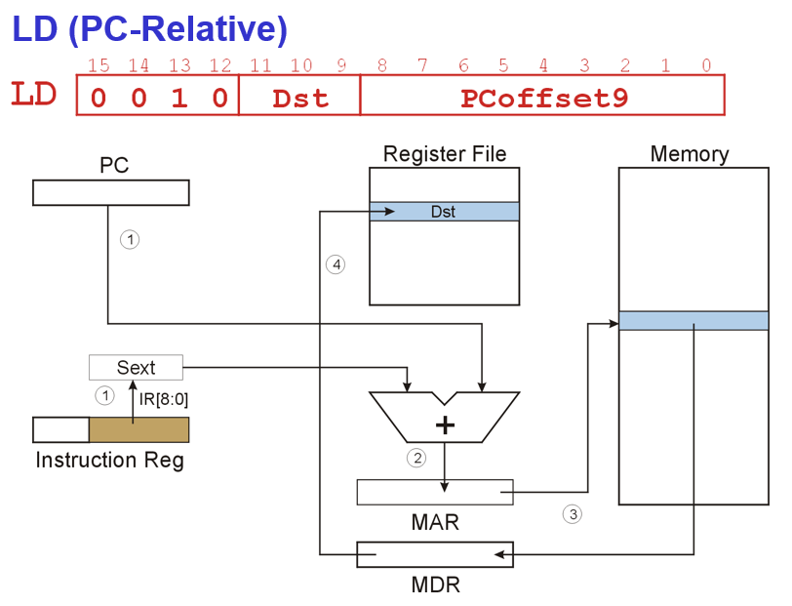
Using LD, LDI, LDR, LEA
.ORIG x3000
LD R6, LABEL
LDI R6, LABEL
LDR R2, R6, #0
LEA R2, LABEL
LABEL .FILL x4000
.END
; Assume the following
; Address Content
; x4000 x5000
; … …
; x5000 x6000
10

Slide 11
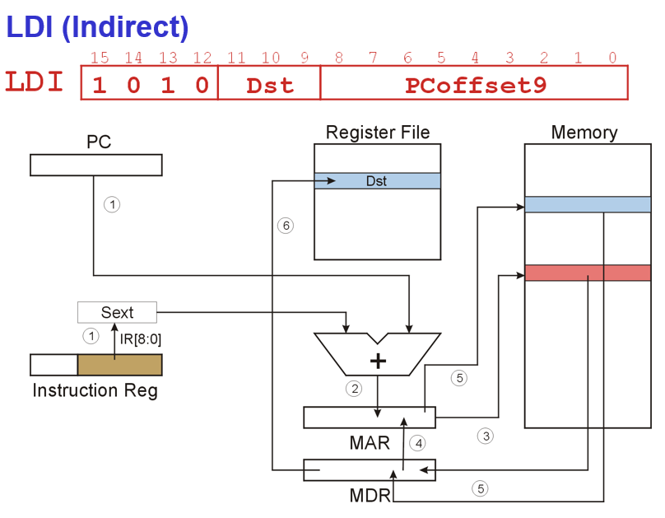
Using LD, LDI, LDR, LEA
.ORIG x3000
LD R6, LABEL
LDI R6, LABEL
LDR R2, R6, #0
LEA R2, LABEL
LABEL .FILL x4000
.END
; Assume the following
; Address Content
; x4000 x5000
; … …
; x5000 x6000
10

Slide 12
LC-3 Exercise
Initialize a register
Copy value from one register to another
Compute 5 - 3
Compute 4 x 3
11

Slide 13
MP1 – Printing a Histogram
ASCII Table
12

