Slide 1

ECE 220 Computer Systems & Programming
Lecture 15 – Recursion with Backtracking
March 7, 2019
Notes:
ECE Main Slide

Slide 2
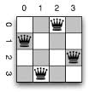
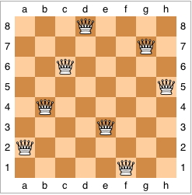
N queens problem using recursive Backtracking
0 | 0 | 1 | 0
1 | 0 | 0 | 0
0 | 0 | 0 | 1
0 | 1 | 0 | 0
Place N queens on an NxN chessboard so that none of the queens are under attack;
Brute force: total number of possible placements:
~N² Choose N ~ 4.4 B (N=8)

Slide 3
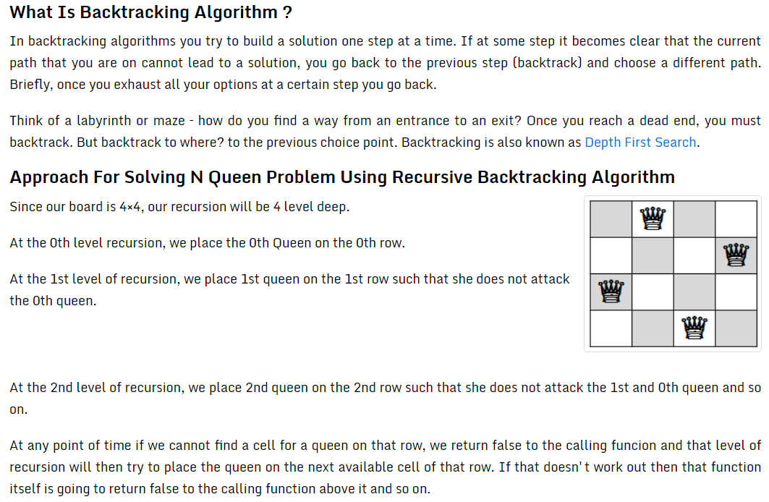
Ref: https://codepumpkin.com/n-queen-problem/

Slide 4
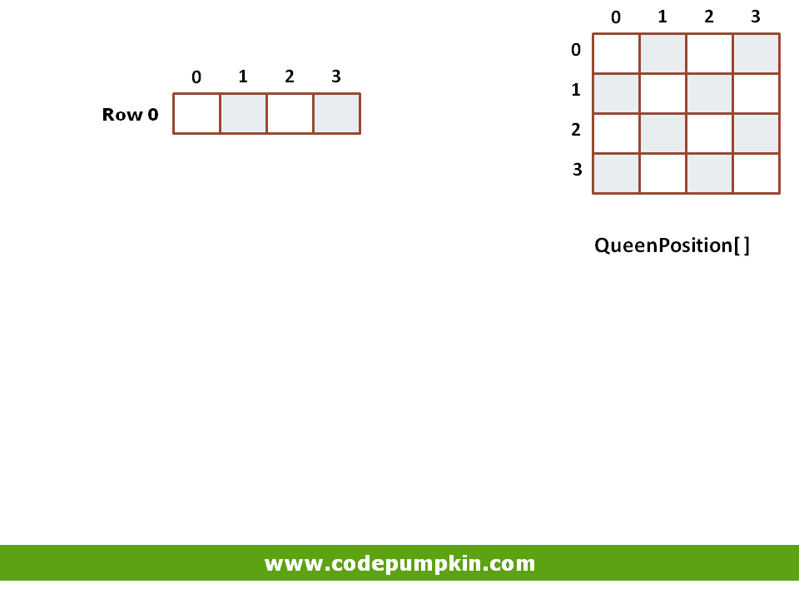

Slide 5
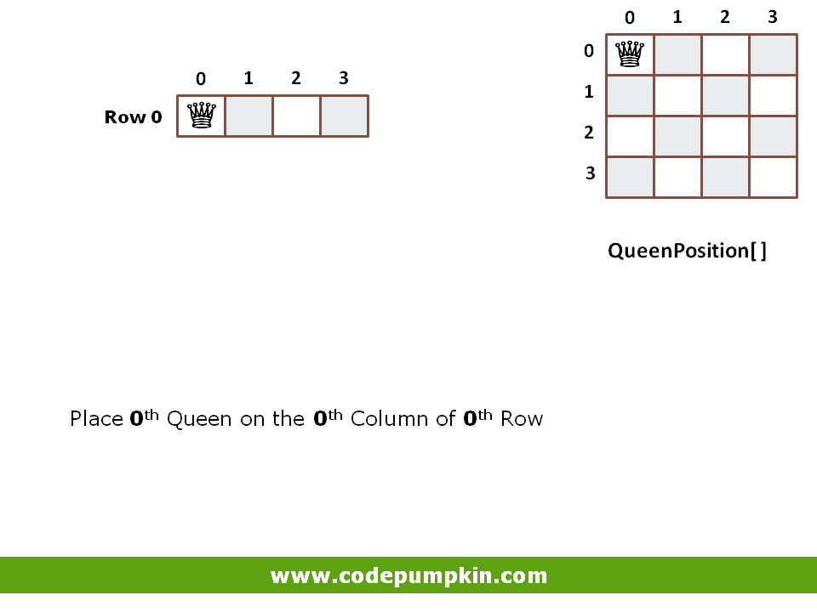

Slide 6
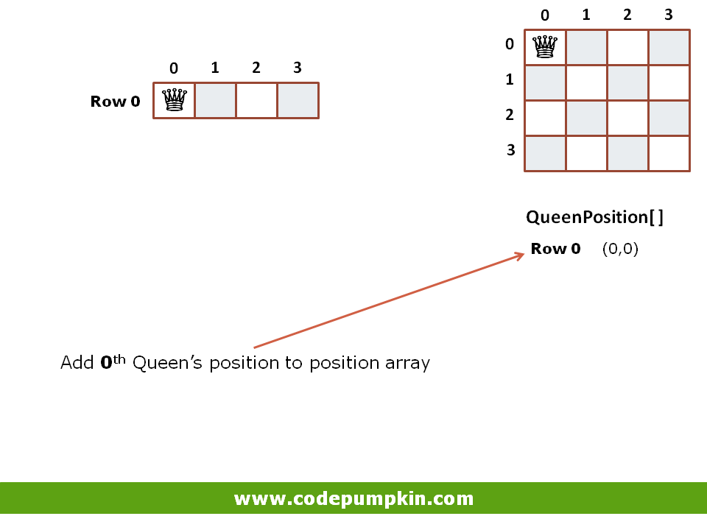

Slide 7
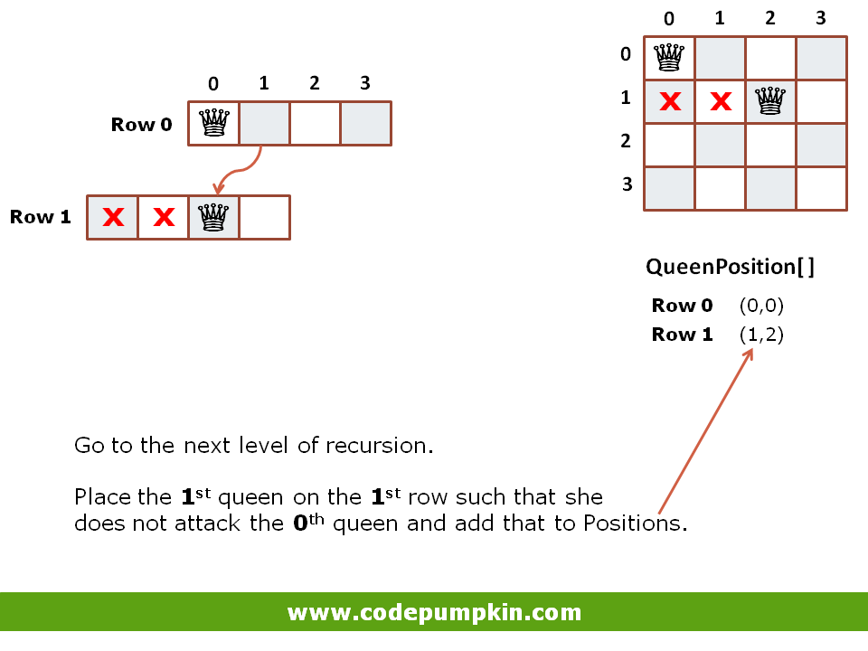

Slide 8
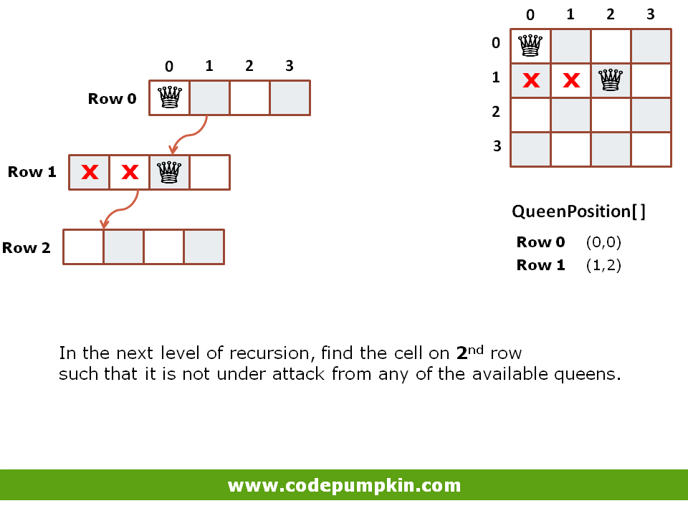

Slide 9
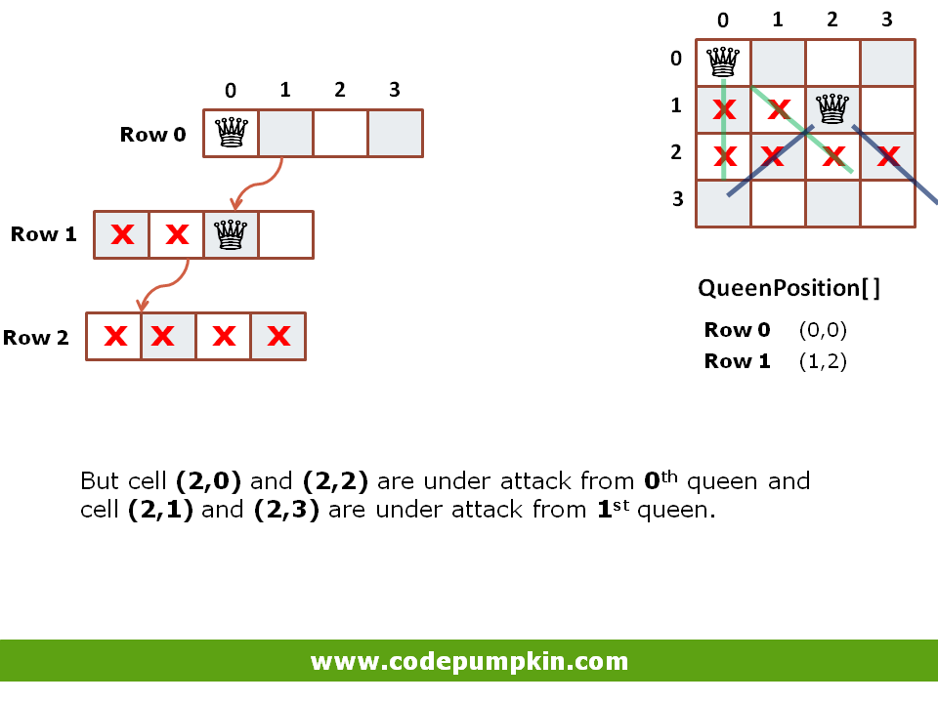

Slide 10
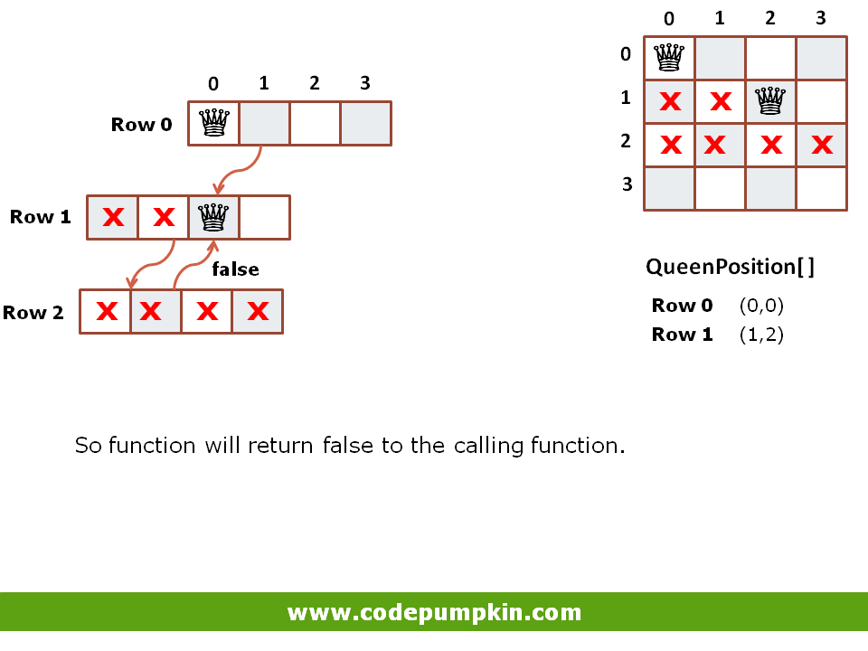

Slide 11
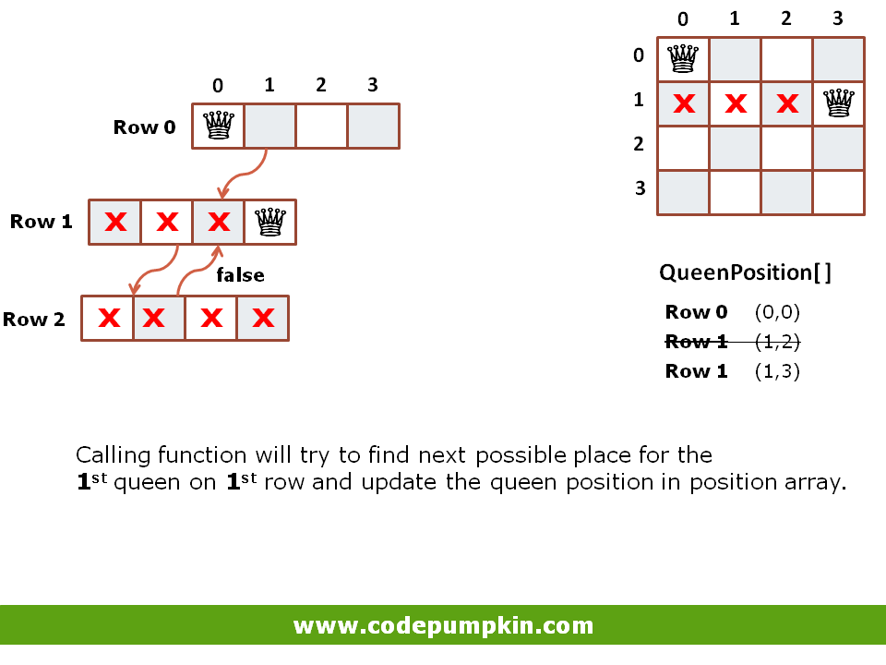

Slide 12
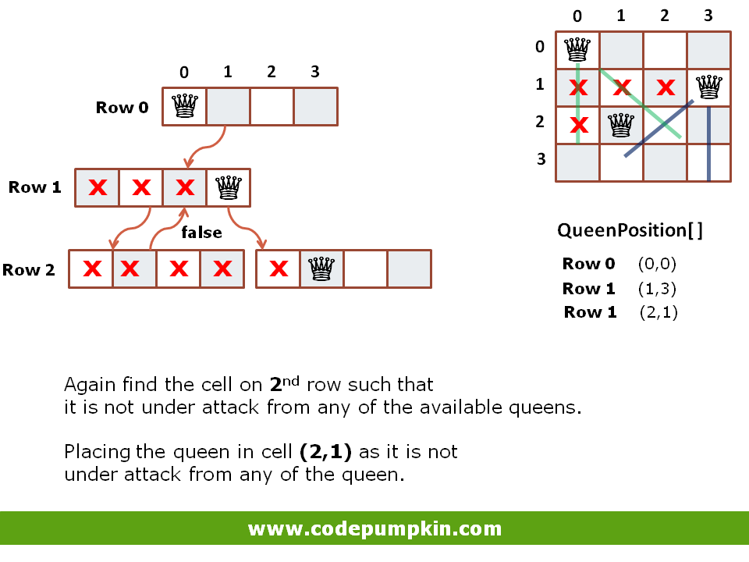

Slide 13
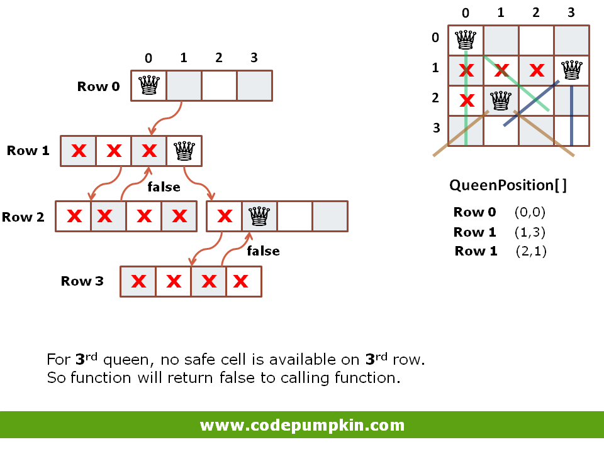

Slide 14
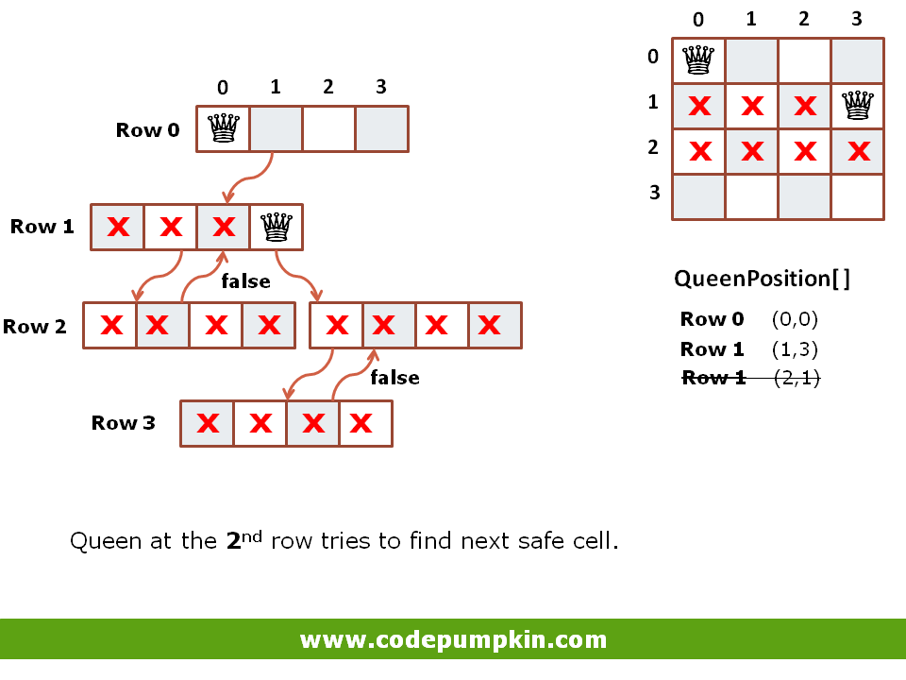

Slide 15
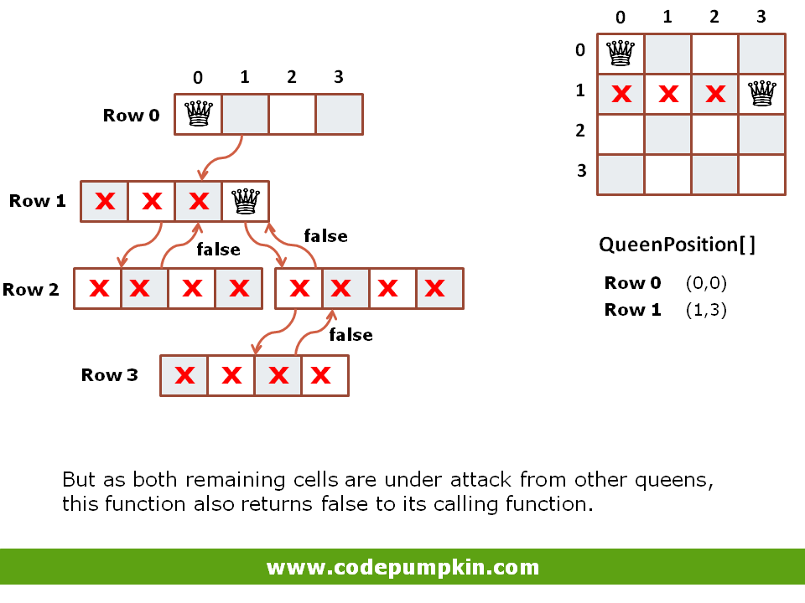

Slide 16
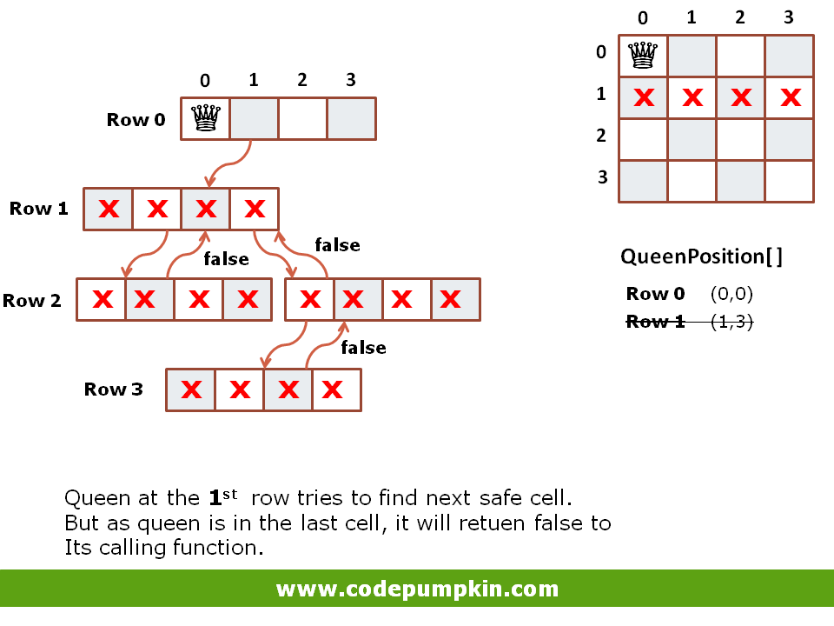

Slide 17
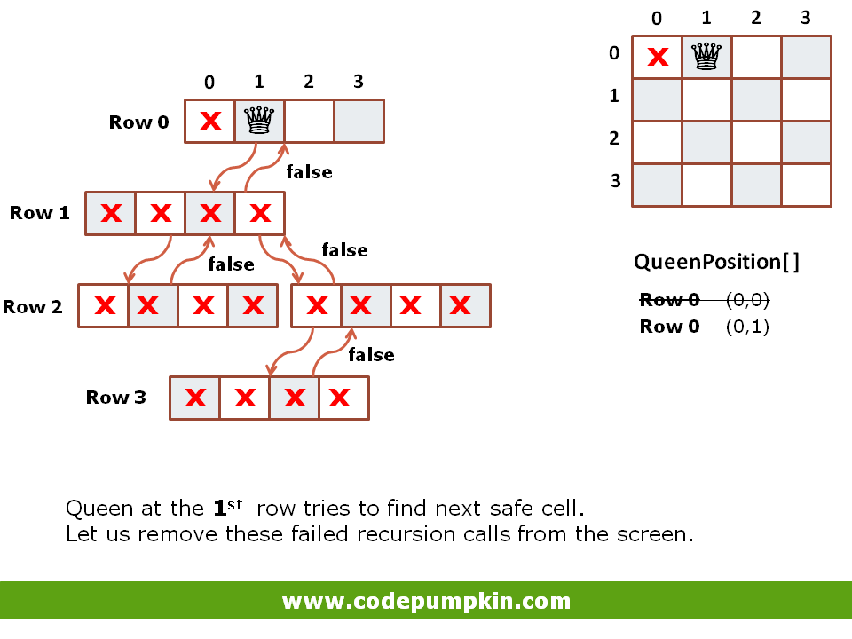

Slide 18
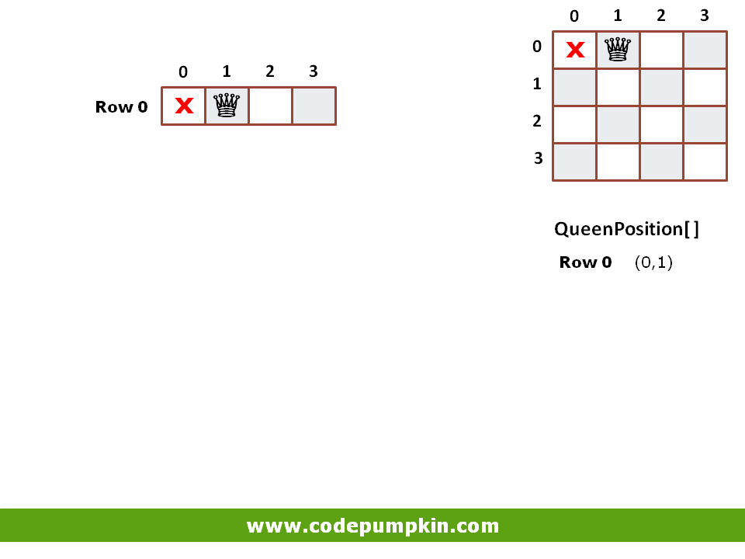

Slide 19
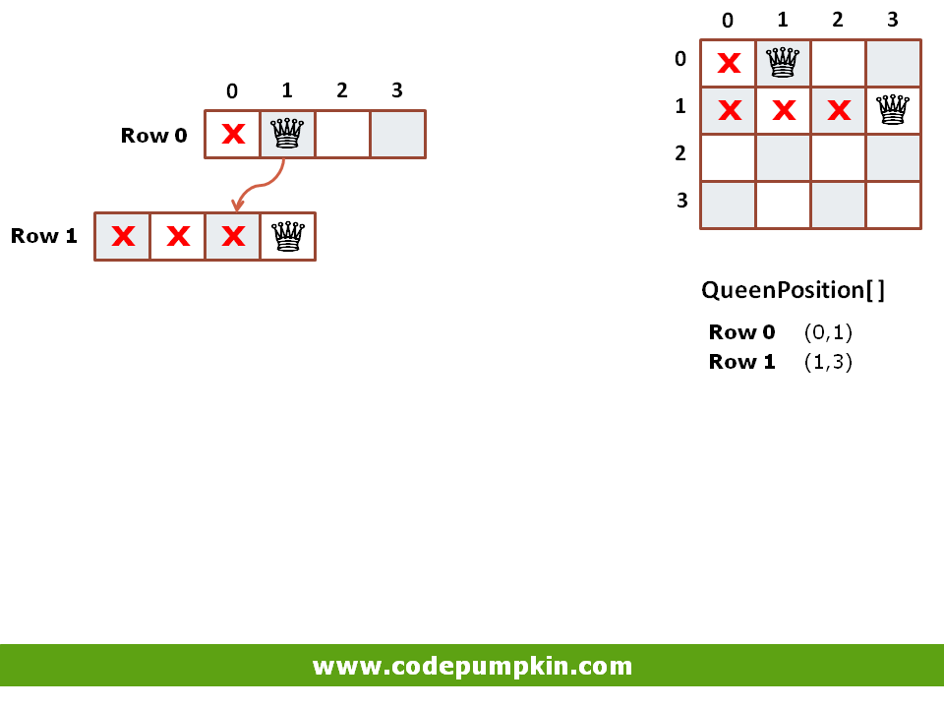

Slide 20
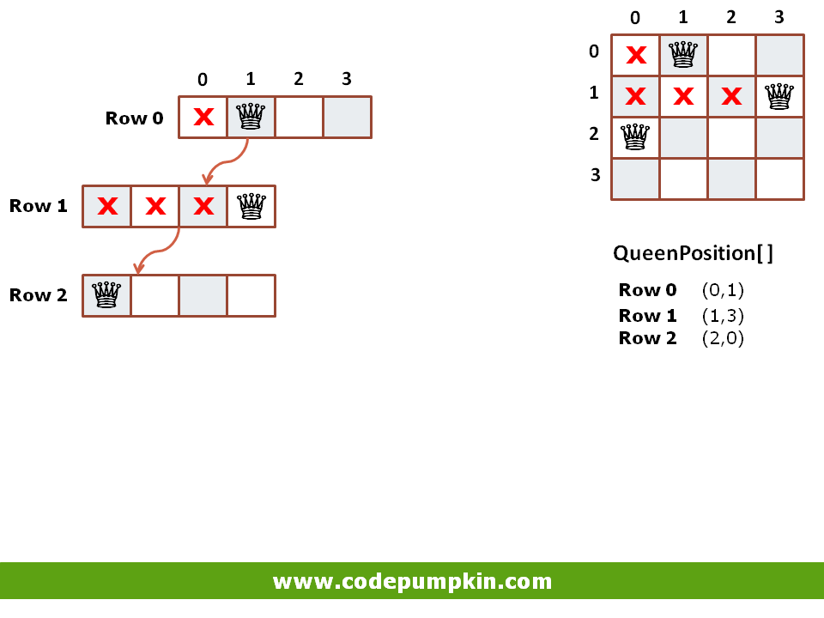

Slide 21
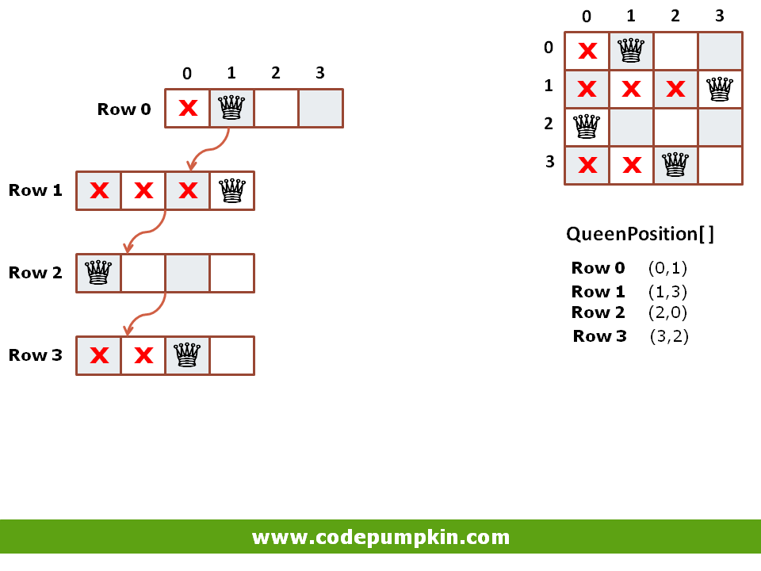

Slide 22
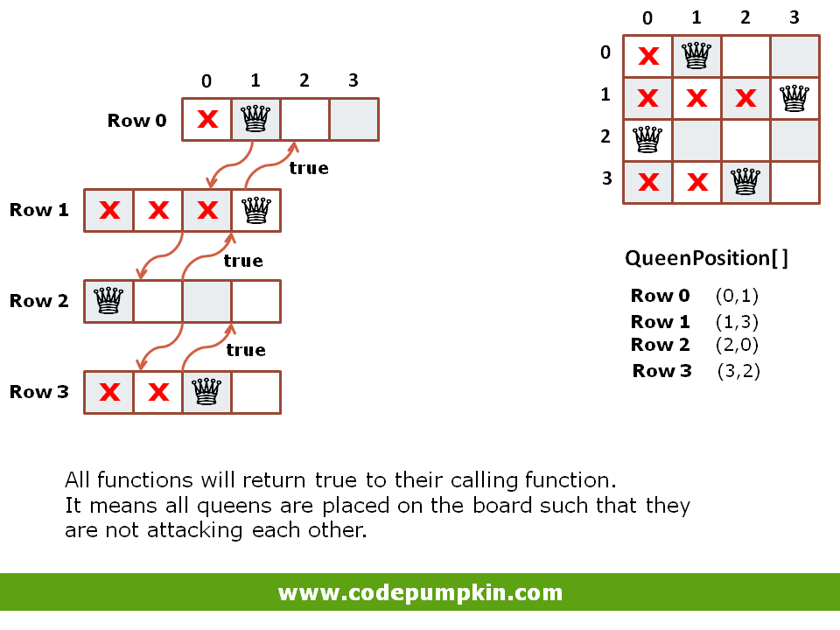

Slide 23
Recursion with Backtracking: n-Queen Problem
Find a safe column (from left to right) to place a queen, starting at the first row;
If we find a safe column, make recursive call to place a queen on the next row;
If we cannot find one, backtrack by returning from the recursive call to the previous row and find a different column.
 | 0 | 1 | 2 | 3
0 |  | Q
1 |  |  |  | Q
2 | Q
3 |  |  | Q
 | 0 | 1 | 0 | 0
 | 0 | 0 | 0 | 1
 | 1 | 0 | 0 | 0
 | 0 | 0 | 1 | 0
2

Slide 24
N Queens with backtracking
0 | 0 | 0 | 0
0 | 0 | 0 | 0
0 | 0 | 0 | 0
0 | 0 | 0 | 0
int board[N][N] represents placement of queens
board[i][j] = 0: no queen at row i column j
board[i][j] = 1:queen at row i column j
Initialize, for all i,j board[i][j] = 0
Functions
PrintBoard(board): Prints board on the screen
IsSafe(borad, row, col): returns 1 iff new queen can be placed at (row,col) in board
Solve(board,col): recursively attempts to place (N-col) queens; returns 0 iff it failes
Initial board
Solve(board,3) returns 0
1 | 0 | 0 | 0
0 | 0 | 0 | 0
0 | 1 | 0 | 0
0 | 0 | 0 | 0

Slide 25
Warm up
1 | 0 | 0 | 0
0 | 0 | 0 | 0
0 | 1 | 0 | 0
0 | 0 | 0 | 0
1 | 0 | 0 | 0
0 | 0 | 0 | 0
0 | 1 | 0 | 0
0 | 0 | 0 | 0
PrintSolution(board): prints the board
int isSafe(board, row, col) checks if it is safe to place a queen at (row,col) within the given board.
Returns 1 if it can be placed
Returns 0 otherwise
1 | 0 | 0 | 0
0 | 0 | 0 | 0
0 | 1 | 0 | 0
0 | 0 | 0 | 0
1 | 0 | 0 | 0
0 | 0 | 0 | 0
0 | 1 | 0 | 0
0 | 0 | 0 | 0
1 | 0 | 0 | 0
0 | 0 | 0 | 0
0 | 1 | 0 | 0
0 | 0 | 0 | 0

Slide 26
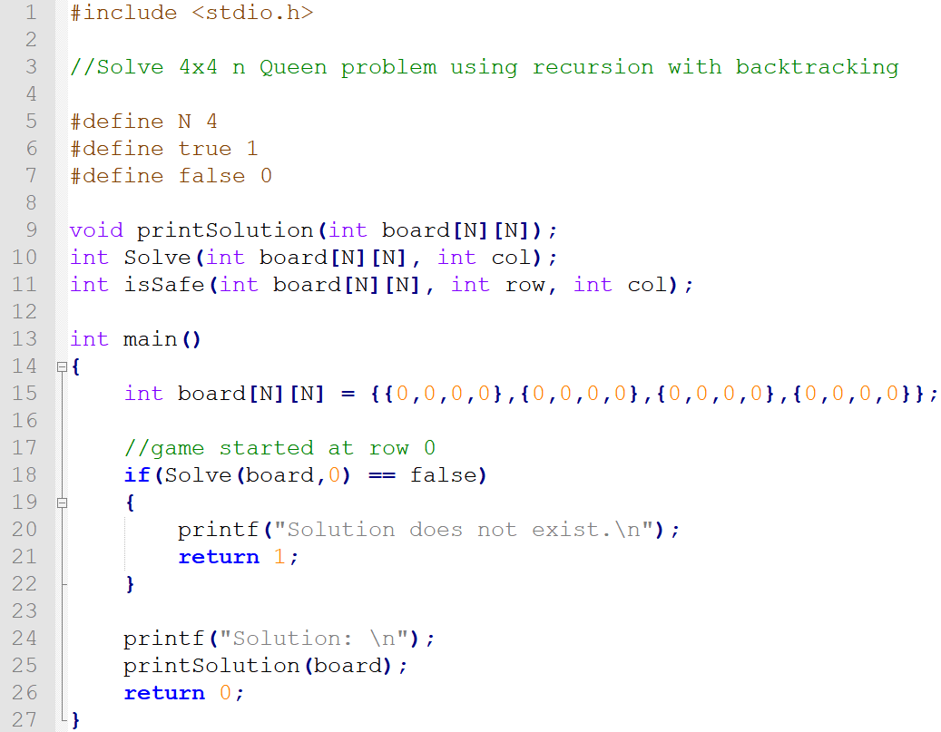
N-Queen (4x4) Backtracking – CODE (Main function)

Slide 27
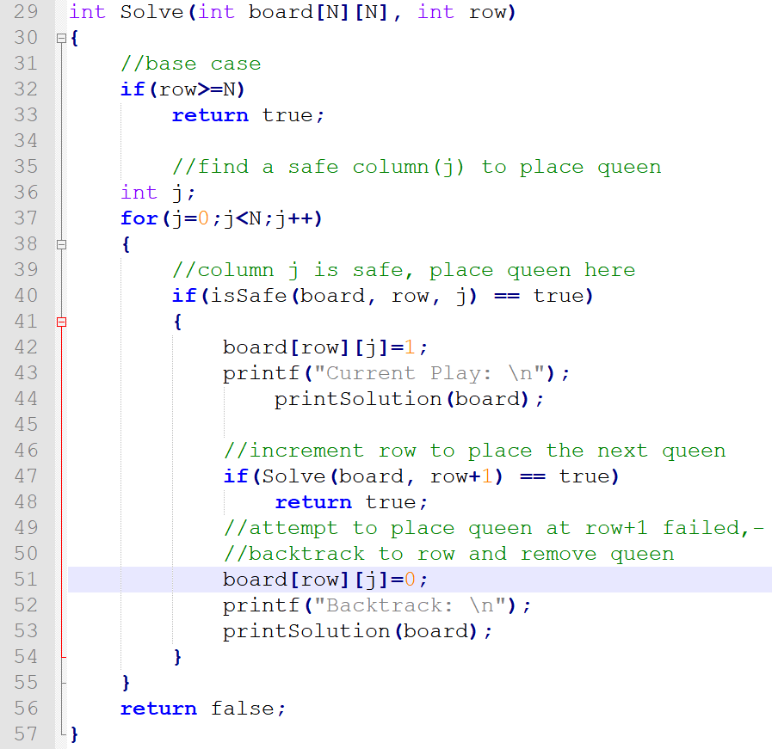
N-Queen (4x4) Backtracking – CODE (Solve function)

Slide 28
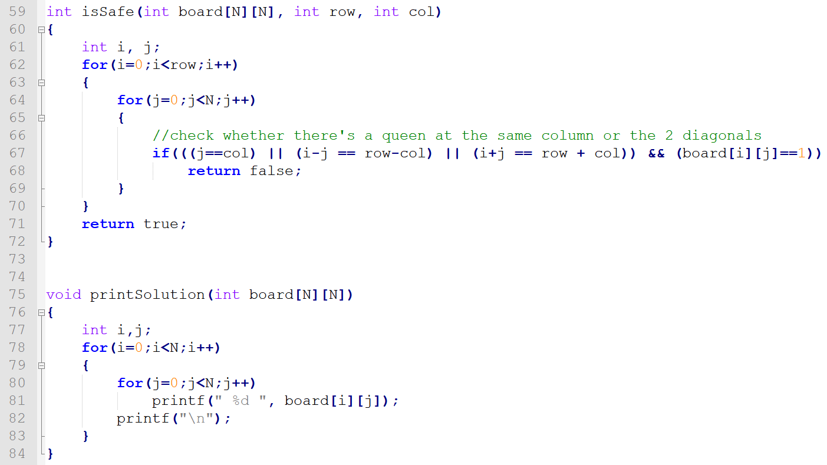
N-Queen (4x4) Backtracking – CODE (isSafe & PrintSolution functions)

Slide 29
Example: 4x4 n-Queen
row 0:
row 1:
row 2:
Q
Q
Q
Q
 | Q
Q
 |  | Q
Q
 |  | Q
Q
Q
 |  | Q
 | Q
Q
 |  | Q
 |  | Q
Q
 |  | Q
 |  |  | Q
3

Slide 30
Q
 |  | Q
Q
 |  |  | Q
Backtrack
to row 1 and
make a new
choice:
row 2:
row 3:
Backtrack
to row 2 and
make a new
choice:
Q
 |  |  | Q
Q
Q
 |  |  | Q
 | Q
Q
 |  |  | Q
 | Q
Q
Q
 |  |  | Q
 | Q
 | Q
Q
 |  |  | Q
 | Q
 |  | Q
Q
 |  |  | Q
 | Q
 |  |  | Q
Q
 |  |  | Q
 |  | Q
Q
 |  |  | Q
 |  |  | Q
4

Slide 31
**Backtrack to row 1, but no columns left
Backtrack
to row 0 and
make a new
choice:
row 1:
row 2:
row 3
Q
 | Q
 | Q
Q
 | Q
 | Q
 | Q
 |  | Q
 | Q
 |  |  | Q
 | Q
 |  |  | Q
Q
 | Q
 |  |  | Q
Q
Q
 | Q
 |  |  | Q
Q
 | Q
 | Q
 |  |  | Q
Q
 |  | Q
5

