Slide 1

ECE 220 Computer Systems & Programming
Lecture 5 – Programming with Stack
January 29, 2019
Notes:
ECE Main Slide

Slide 2
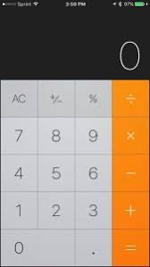
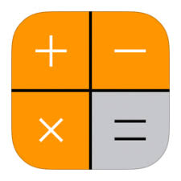
X- Exit the Simulation
D- Display the Result from Stack Top
C-Clear Stack
+ Perform Addition
- Negate the top element on the stack
* Perform Multiplication
Enter – Push the typed data onto the stack

Slide 3
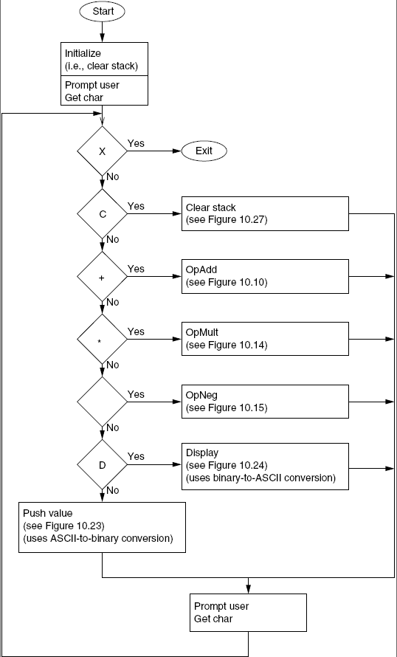
Flow Chart of the Calculator
X- Exit the Simulation
D- Display the Result from Stack Top
C-Clear Stack
+ Perform Addition
- Negate the top element on the stack
* Perform Multiplication
Enter – Push the typed data onto the stack

Slide 4
What are the different subroutines we need?
OpAdd (Adder subroutine)
OpMult (Multiplication subroutine)
OpNeg (Negate subroutine)
Range Check (integers in the range -999 and +999)
AsciitoBinary (input data type conversion)
BinarytoAscii (output data type conversion)
PushValue subroutine (which push input onto the Stack)
OpDisplay (Which pop the result from stack and display Ascii result on the screen)
OpClear (which clear the stack)

Slide 5
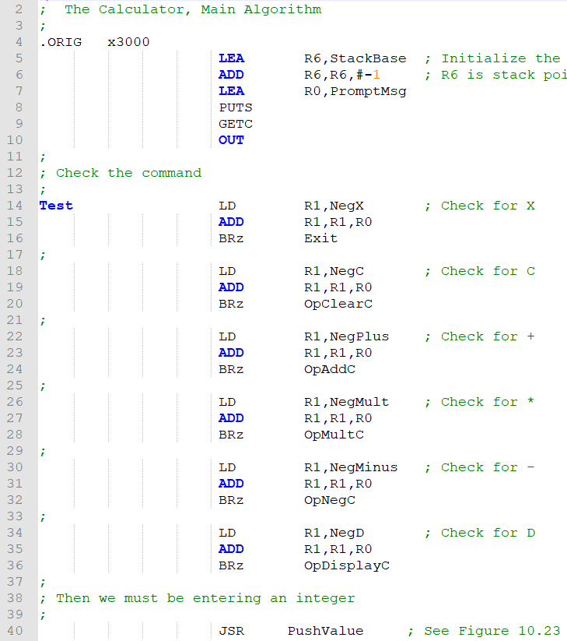
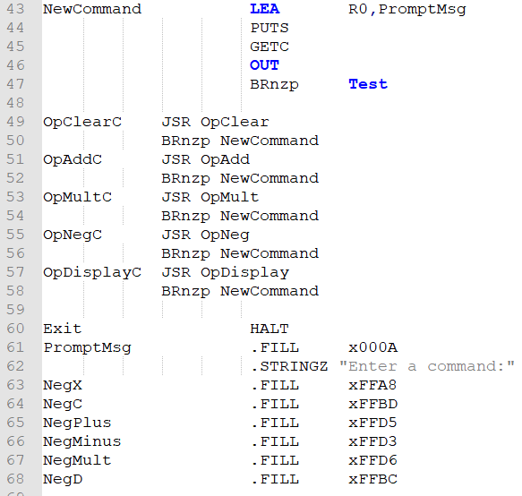
Main Function:

Slide 6
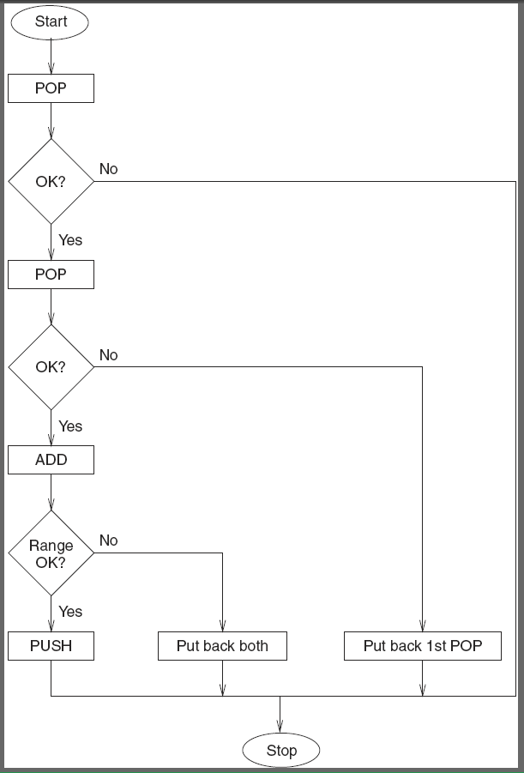
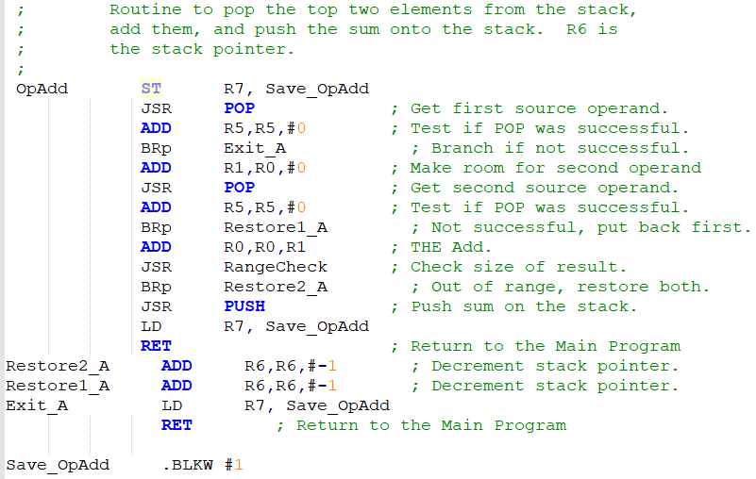
OpAdd

Slide 7
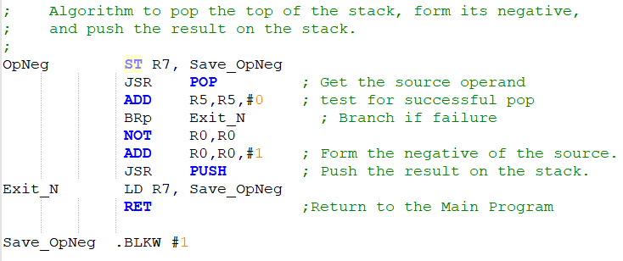
OpNeg Subroutine

Slide 8
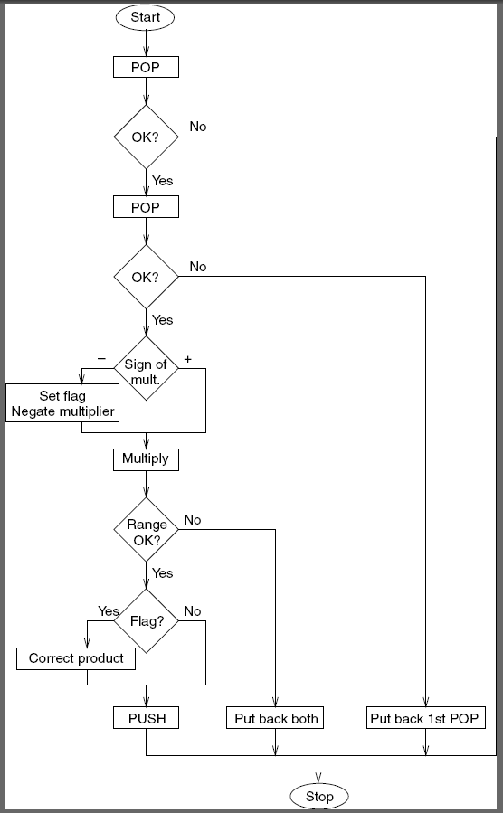
OpMult:

Slide 9
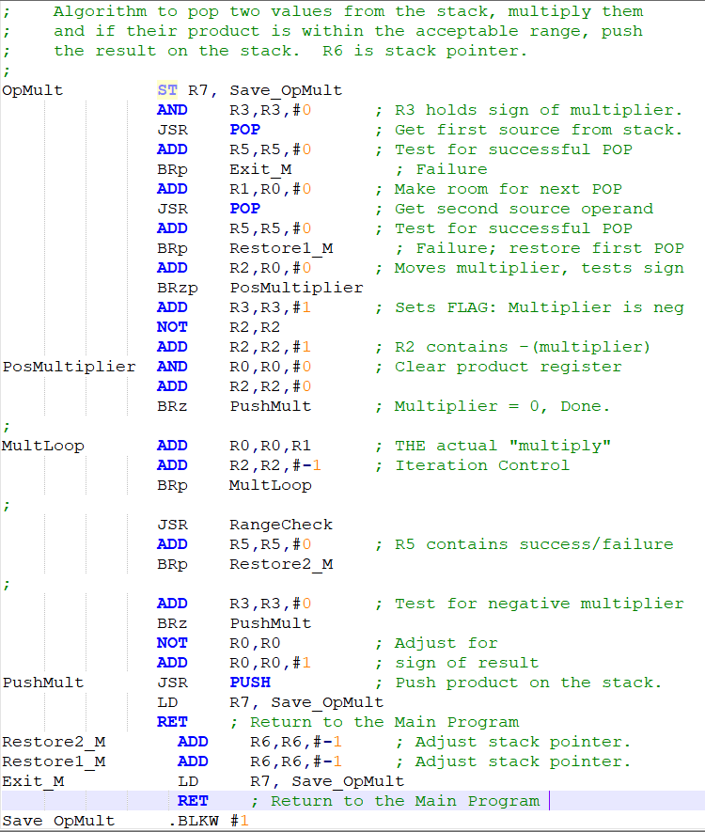
OpMult (code)

Slide 10
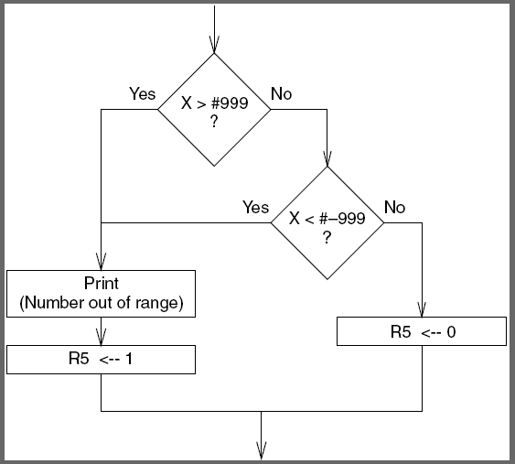
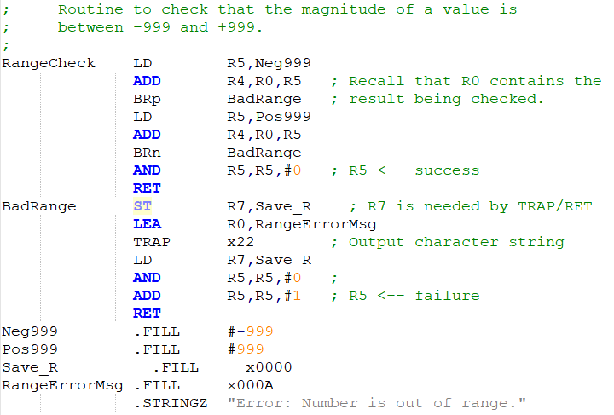
RangeCheck

Slide 11
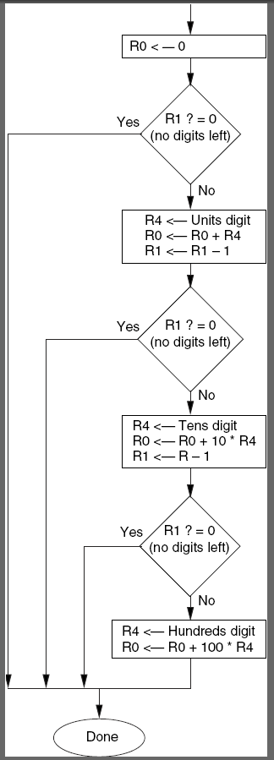
AsciitoBinary

Slide 12
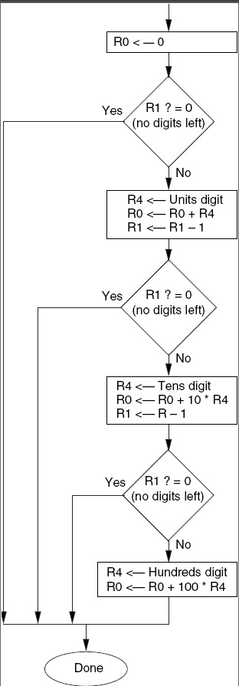
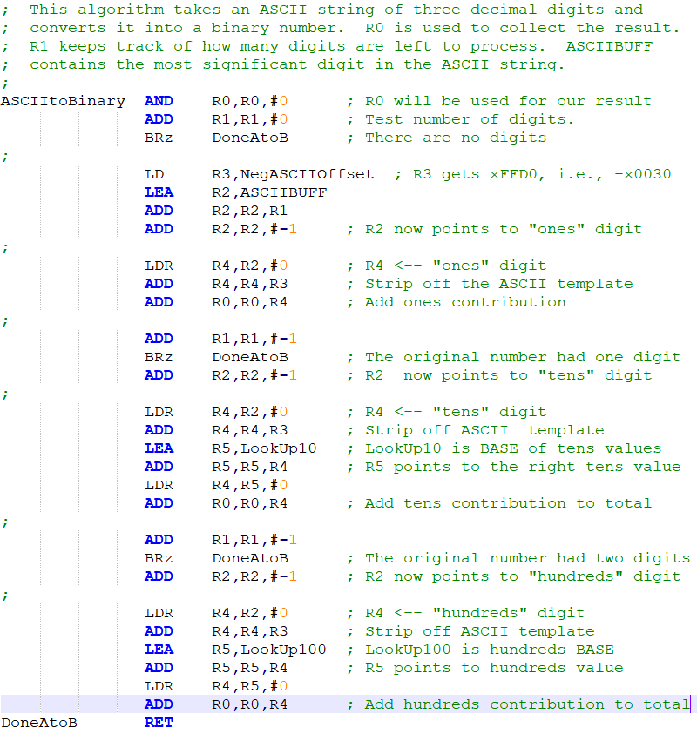
AsciitoBinary (Code)

Slide 13
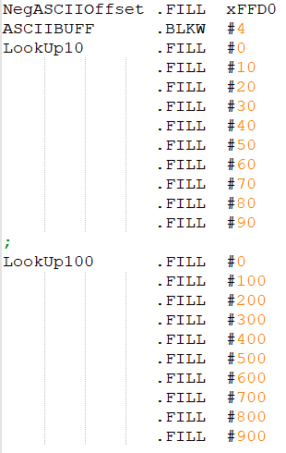
AsciitoBinary (Continued)

Slide 14
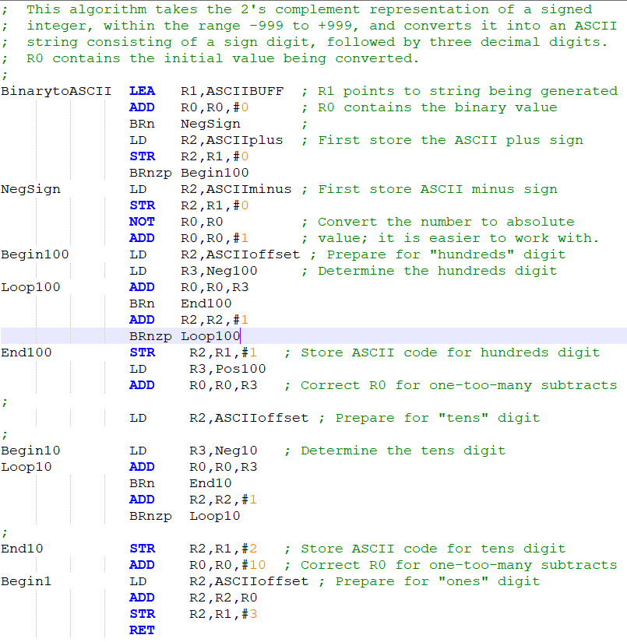
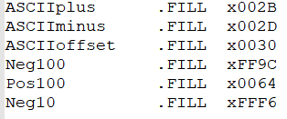
BinarytoAscii

Slide 15
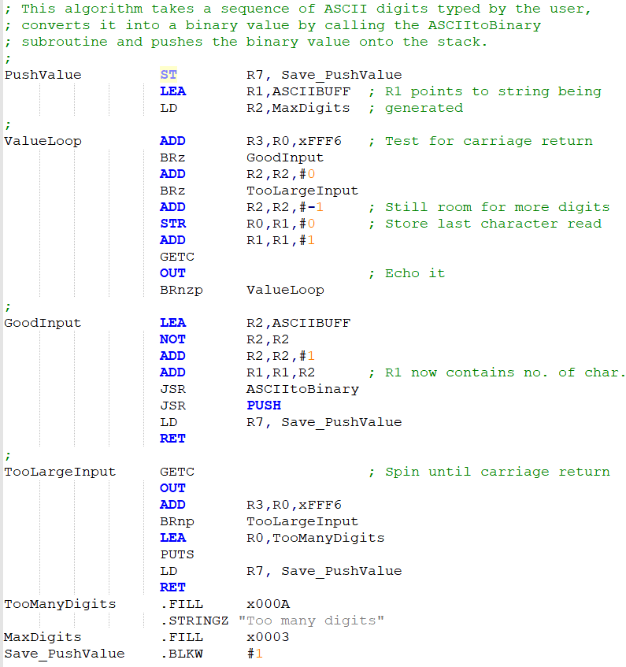
PushValue

Slide 16
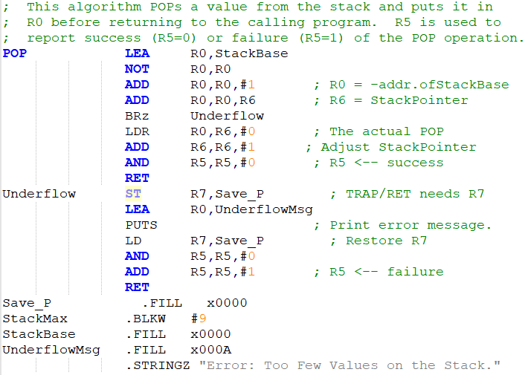
POP Subroutine

Slide 17
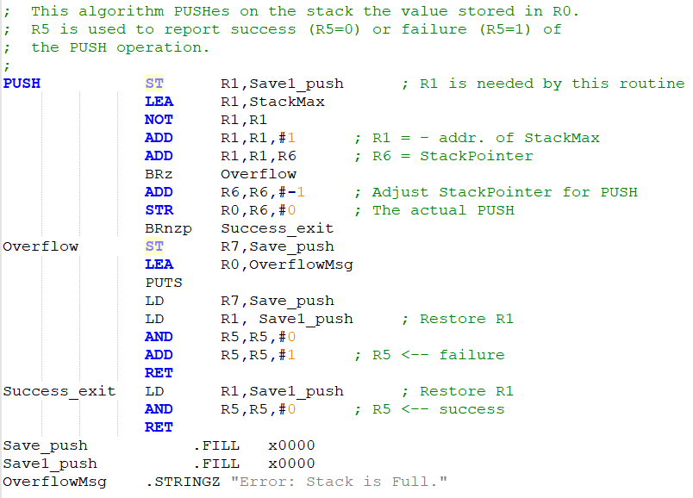
PUSH Subroutine

Slide 18
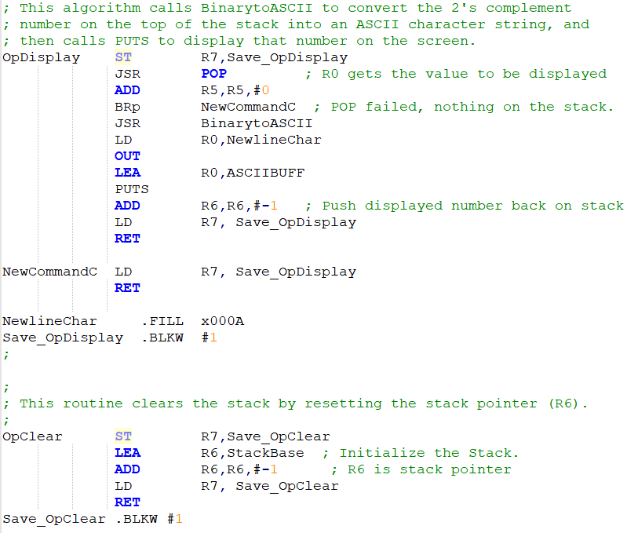
OpDisplay and OpClear

Slide 19
Exercise:
Palindrome Checker
Arithmetic Postfix Evaluation

Slide 20
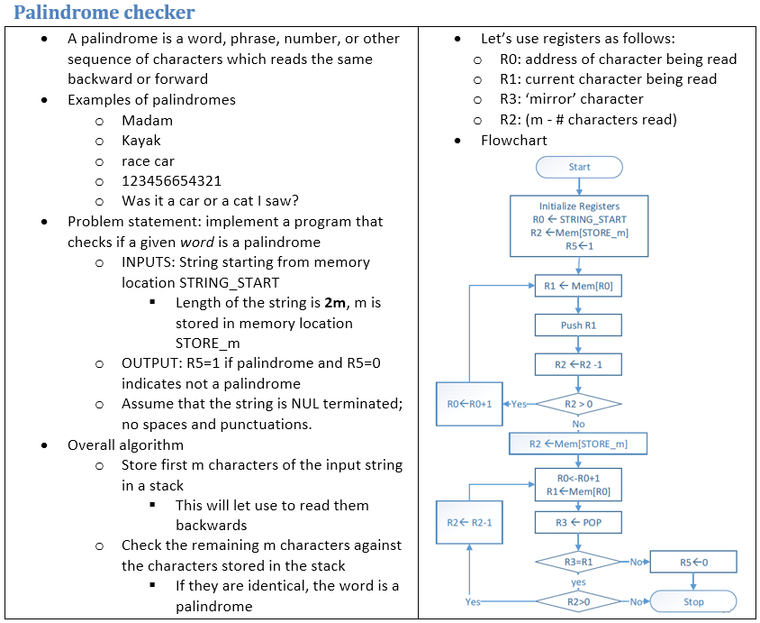

Slide 21
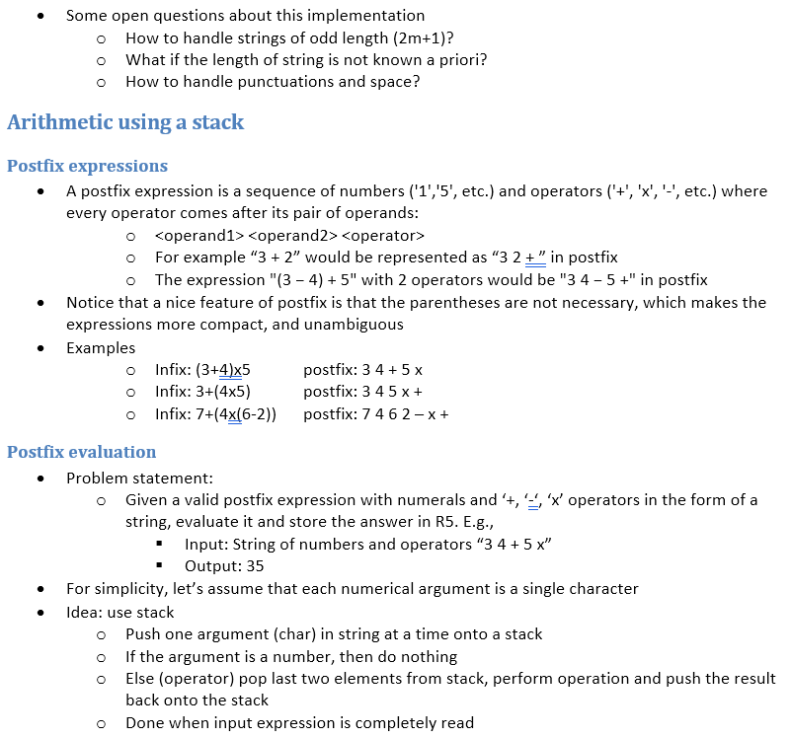

Slide 22
