Slide 1

ECE 220 Computer Systems & Programming
Lecture 3 – Repeated Code: TRAPs and Subroutines
January 22, 2019
MP1 due Thursday, 1/24, by 10pm
Schedule mock quiz for extra credit
Notes:
ECE Main Slide

Slide 2
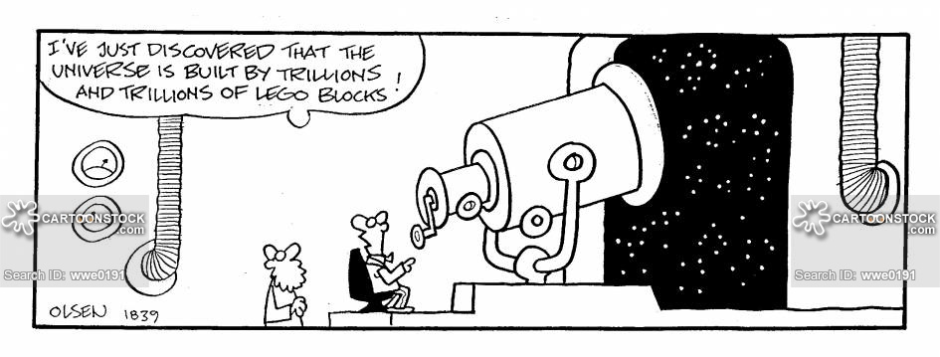
Key Concept: Abstraction

Slide 3
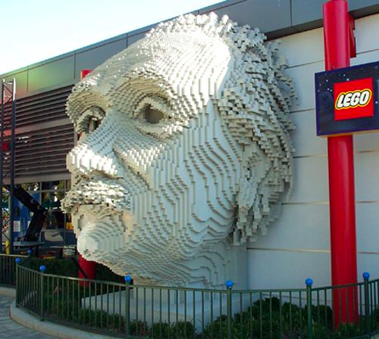

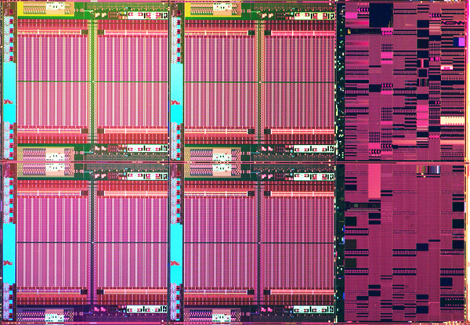

Key Concept: Abstraction
Create building blocks that are tightly specified. Abstract way their details to a simple interface. And then use them to build more complex things.
Then optimize the building blocks like crazy…

Slide 4
Outline
Chapter 9
Repeated code: TRAPs and Subroutines
Key concepts
Lookup table: for starting address of subroutines/TRAPS (vector table)
Preserving register and PC values
Instructions
TRAP
RET
JSR, JSRR

Slide 5
Observation 1
start
Get input R3 ← MEM[x4000]
R4 ← X²
Multiply
Example problem: Compute y=3x³-6x²+7x for any input x > 0
Programs have lots of repetitive code fragments
R5 ← X³
Multiply
R5 ← 3X³
Multiply
R4 ← 6X²
Multiply
R3 ← 7X
Multiply
R6 ← 3X³ - 6X²
Add
; multiply R0 ←R1 * R2
MULT AND R0, R0, #0 ; R0 = 0
LOOP ADD R0, R0, R2 ; R0 = R0 + R2
ADD R1, R1, #-1 ; decrease counter
BRp LOOP
R6 ← (3X³ - 6X²) + 7x
Add
Store output
stop

Slide 6
Implementation Option 1
start
Issues ?
Get input R3 ← MEM[x4000]
;; LC-3 Assembly Program
.ORIG x3000
LDI R3, Xaddr; R3 ← x
ADD R1, R3, #0;
; Multiply R4 ← R1 * R3 x²
...
...
; Multiply R5 ← R4 * R3 x³
...
; Multiply R5 ← R5 * 3 (3x³)
...
; Multiply R4 ← 6 * R4
R4 ← X²
Multiply
R5 ← X³
Multiply
R5 ← 3X³
Multiply
R4 ← 6X²
Multiply
R3 ← 7X
Multiply
R6 ← 3X³ - 6X²
Add
R6 ← (3X³ - 6X²) + 7x
Add
Store output
stop
*Sometimes programs are compiled to look like this for better performance: inline functions

Slide 7
Another example: Code (from last lecture) for reading characters from keyboard
Very common… would be replicated often
Too many specific details for most programmers
know address of KBDR (xFE02) and KBSR (xFE00)
use the registers correctly (polling, data format)
Improper usage could breach security of the system!
START LDI R1, KBSR_ADDR
BRzp START
LDI R0, KBDR_ADDR
BRnzp NEXT_TASK
...
KBSR_ADDR .FILL xFE00
KBDR_ADDR .FILL xFE02

Slide 8
Idea
Package these pieces of code as part of the (operating) system
In general, provide “pieces of code” or subroutines, functions, methods, procedures, or service routine that do some specific subtasks
User invokes or calls subroutine
Subroutine code performs operation / task
Returns control to user program with no other unexpected changes
input
My program
Piece of code / Subroutine / Trap service routine
output

Slide 9
How to make this idea work?
User program invokes or calls subroutine; OS code performs operation; Returns control to user program
The actual code of the service routine
Mechanism for invocation
TRAP Instruction, e.g., TRAP x23
TRAP vector (8 bits)
How to find address service routine?

Slide 10
TRAP Vector Table for LC3
vector | address | symbol | routine
…
x20 | x…. | GETC | read a single character (no echo)
x21 | x…. | OUT | output a character to the monitor
x22 | x…. | PUTS | write a string to the console
x23 | x…. | IN | print prompt to console, read and echo character from keyboard
X23 | x…. | PUTSP | write a string to the console; two chars per memory location
x25 | x…. | HALT | halt the program
…
Look-up table decouples names of subroutines (GETC) from the location of its implementation in memory

Slide 11
What do we need to make this work?
User program invokes or calls subroutine; OS code performs operation; Returns control to user program
Address | Contents | Comments
x0000 |  | ;system space;
X0023 | x0463 | ; Trap vector table
x00FF |  | ; End of trap vector table
x0463 |  | ; code for GETC
….
x04… |  | ; code for OUT
…
x3000 |  | ; user program
…
 | TRAP x23 | ; call to
xFE00 |  | ; Device registers
The actual code of the service routine
Mechanism for invocation
TRAP Instruction, e.g., TRAP x23
TRAP vector
MAR ←ZEXT[trapvector]
MDR ←MEM[MAR]
PC←MDR
How to return to user program after execution of OUT completes?

Slide 12
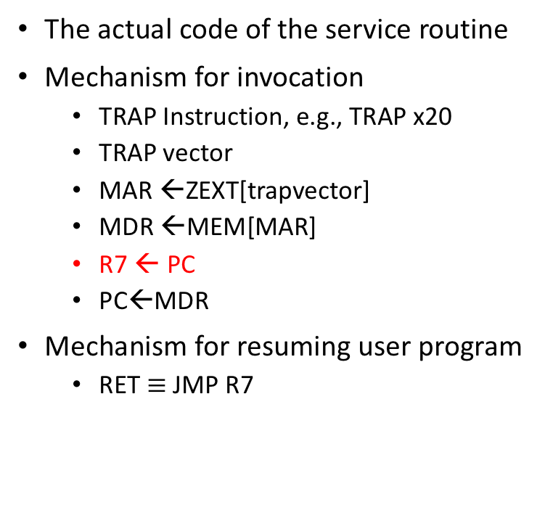
What do we need to make this work?
User program invokes or calls subroutine; OS code performs operation; Returns control to user program
Address | Contents | Comments
x0000 |  | ;system space;
x0023 | x0463 | ; Trap vector table
x00FF |  | ; End of trap vector table
x0463 |  | ; code for GETC
…. | RET
x04.. |  | ; code for OUT
…
x3000 |  | ; user program
…
 | TRAP x23 | ; call to
xFE00 |  | ; Device registers
The actual code of the service routine
Mechanism for invocation
TRAP Instruction, e.g., TRAP x20
TRAP vector
MAR ←ZEXT[trapvector]
MDR ←MEM[MAR]
R7 ← PC
PC←MDR
Mechanism for resuming user program
RET $≡$ JMP R7

Slide 13
Putting it all together: 4 Things make TRAPs work
TRAP instruction
used by program to transfer control to OS subroutines
8-bit trap vector names one of the 256 subroutines
Trap vector table: stores starting addresses of OS subroutines
stored at x0000 through x00FF in memory
A set of OS subroutines
part of operating system -- routines start at arbitrary addresses (convention is that system code is below x3000) up to 256 routines
A linkage back to the user program (RET)
want execution of the user program to resume immediately after the TRAP instruction

Slide 14
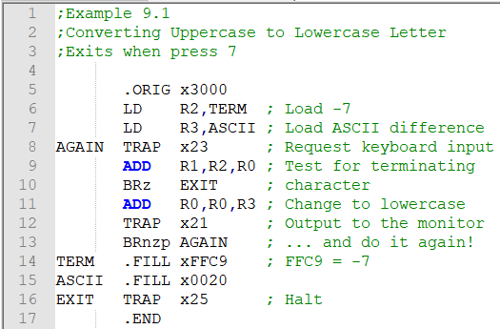
Example 9.1

Slide 15
What do we need to make this work?
User program invokes or calls subroutine; OS code performs operation; Returns control to user program
Address | Contents | Comments
x0000 |  | ;system space;
x0023 | x0463 | ; Trap vector table
x00FF |  | ; End of trap vector table
x0463 |  | ; code for GETC
…. | RET
X04.. |  | ; code for OUT
…
x3000 |  | ; user program
…
 | TRAP x23 | ; call to
xFE00 |  | ; Device registers
The actual code of the service routine
Mechanism for invocation
TRAP Instruction, e.g., TRAP x20
TRAP vector
MAR ←ZEXT[trapvector]
MDR ←MEM[MAR]
R7 ← PC
PC←MDR
Mechanism for resuming user program
RET $≡$ JMP R7

Slide 16
TRAP Example (Needs special attention)
.ORIG x3000
AND R0, R0, #0
ADD R0, R0, #5 ;init R0 and set it to 5
LD R7, COUNT ;Initialize to 10
IN ;same as ‘TRAP x23’
ADD R0, R0, #1 ;increment R0
ADD R7, R7, #-1 ;decrement COUNT
HALT
.END
COUNT .FILL #10
Question: What could go wrong?
What are the values in R0 and R7 before and after IN statement?
6

Slide 17
Suggested approach:
Caller of service routine can save (and restore): Caller-save
Called service routine saves (and restore): Callee-save
Saving and restoring values of registers is an example of a task computers need to perform in context switching
; Caller-save user program
…
ST R0, SaveR0 ; store R0 in memory
ST R7, SaveR7 ; store R7 in memory
IN ; call TRAP which ; destroys R0 and R7
LD R7, SaveR7 ; restore R7
… ; consume input in R0
LD R0, SaveR0 ; restore R0
…
HALT
SaveR0 .BLKW 1
SaveR7 .BLKW 1
Notes:
Caller knows what is important
Callee knows what damage will be done

Slide 18
Subroutines
Service routines (TRAP) provide 3 main functions
Shield programmers from system-specific details
Write frequently-used code just once
Protect system recourses from malicious/clumsy programmers
Subroutines provide the same functions for non-system (user) code
What are some of the reasons to use subroutines?
8

Slide 19
Subroutines
A sequence of instructions that performs a specific task (and nothing else---no side effects). This unit can then be used in programs wherever that particular task should be performed.
Hide details of code and package them with an interface
Abstract away details
Needs only Arguments and return values
Why is this a good idea in programming?
Reuse; shorter programs
Simplify; code comprehension
Teamwork; allows multiple developers to work on different pieces; libraries
TRAPs are examples of OS subroutines

Slide 20
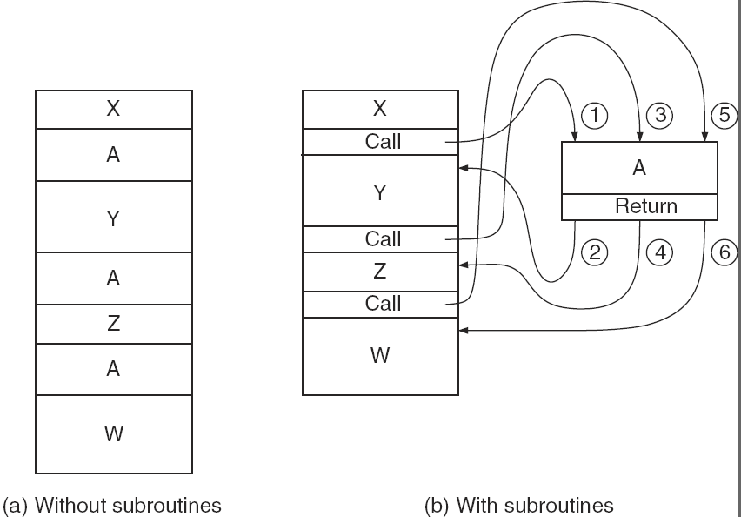
Figure 9.7

Slide 21
JSR and JSRR and RET
JSR:
R7 <- PC;
PC <- PC + SEXT(PCOffset11);
JSRR:
R7 <- PC;
PC <- BaseR;
RET:
PC <- R7;

Slide 22
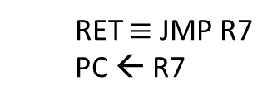
JSR and JSRR
R7←PC
If (IR[11] == 0) PC←BaseR
Else PC←PC+SEXT(IR[10:0])
RET $≡$ JMP R7
PC ← R7

Slide 23
Compare Example 9.4 and 9.8 (observe using subroutine)

Slide 24
Subroutine Examples
Can you find the bugs in the following piece of code?
; SUBTR subroutine computes difference of two 2’s complement numbers
; IN: R1, R2
; JSR SUBTR
OUT: R0 <- R1-R2
SUBTR NOT R2, R2
ADD R7, R2, #1
ADD R0, R1, R7
RET
How should we compute 2x² – 3x + 1?
12

Slide 27
Summary of Lecture 3
Need: reuse code (MULT, OUT), hide details from user (xFE02), protect system critical resources (e.g., access to KBDR)
Idea: package repeated code into subroutines or system routines
Implementation
Invocation: TRAP x21 (R7 ← PC, PC ← x0430)
System routine code for OUT at x0430 (in OS space) executes
RET (PC ← R7); resume execution of user program
Side effect: May lose useful information in registers (R7, R1)
Caller save or callee save the relevant registers

Slide 28
Examples: a Subtraction subroutine
; SUBTR
Notes:
Input/output interface; what does the abstraction not capture; how to use it

Slide 29
A Multiplication subroutine
; IN
; OUT
;

Slide 30
Subroutine abstraction
Interface specifies
Input: type (ASCII, int) and location (Registers)
Output: type and location
Optionally used resources (Registers)
Does not specify?

Slide 31
Libraries and compilation

Slide 32
Exercise
start
Get input R3 ← MEM[x4000]
R4 ← X²
Multiply
Compute y=ax³-bx²+cx for any input x > 0
R5 ← X³
Multiply
R5 ← aX³
Multiply
R4 ← bX²
Multiply
R3 ← cX
Multiply
R6 ← aX³ - bX²
Add
R6 ← (aX³ - bX²) + cx
Add
Store output
stop

Slide 33
Exercises
Write an LC-3 assembly language program to calculate: y = ax² + bx + c;
Lab exercise: encode a given string by shifting each character by an offset
Count the number of occurrences of the word “code” in a given string of text.

Slide 34
Nested Subroutines
Can a subroutine call itself?

Slide 35
Summary and tradeoffs
Idea: package repeated code into subroutines: easier to program, debug, maintain, share
TRAP subroutines addressed by their trapvector using the trapvector table
Jump and return accomplished by setting PC values
Side effect: May lose useful information in registers
Caller-save or callee-save register values
But, context switch (saving and restoring registers) incurs additional cost---cycles, memory accesses
Inline functions
Next: stack data structure

