Slide 1

ECE 220 Computer Systems & Programming
Lecture 16 – File I/O
Notes:
ECE Main Slide

Slide 2
Input / Output Streams
scanf(“%d”, &x)
Input Device
ASCII Stream
I/O Device operates using
I/O protocol (such as memory mapped I/O)
In C, we abstract away the I/O
details to an I/O function call
2

Slide 3
Stream Abstraction for I/O
All character-based I/O in C is performed on text streams.
A stream is a sequence of ASCII characters, such as:
the sequence of ASCII characters printed to the monitor by a single program
the sequence of ASCII characters entered by the user during a single program
the sequence of ASCII characters in a single file
Characters are processed in the order in which they were added to the stream.
e.g., a program sees input characters in the same order as the user typed them.
Standard Streams:
Input (keyboard) is called stdin.
Output (monitor) is called stdout.
Error (monitor) is called stderr.
3

Slide 4
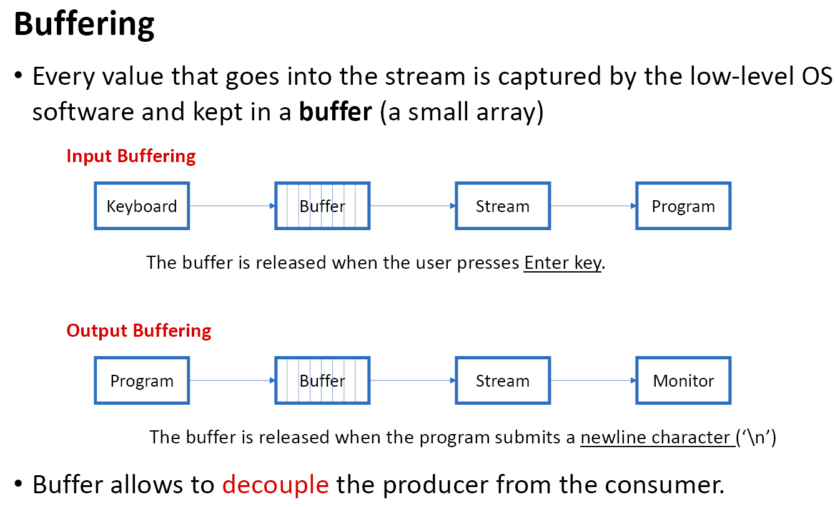

Slide 5
Simple Buffer
Head
Producer adds data at Tail
Consumer removes data from Head
Buffer Full?
Buffer Empty?
Concept of circular buffer
Also called First in, First Out (FIFO) or Queue
Tail
Buffer Size
5

Slide 6
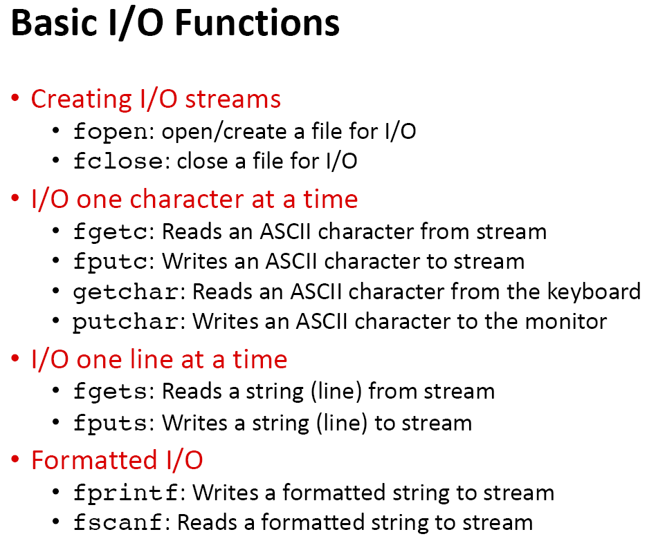

Slide 7
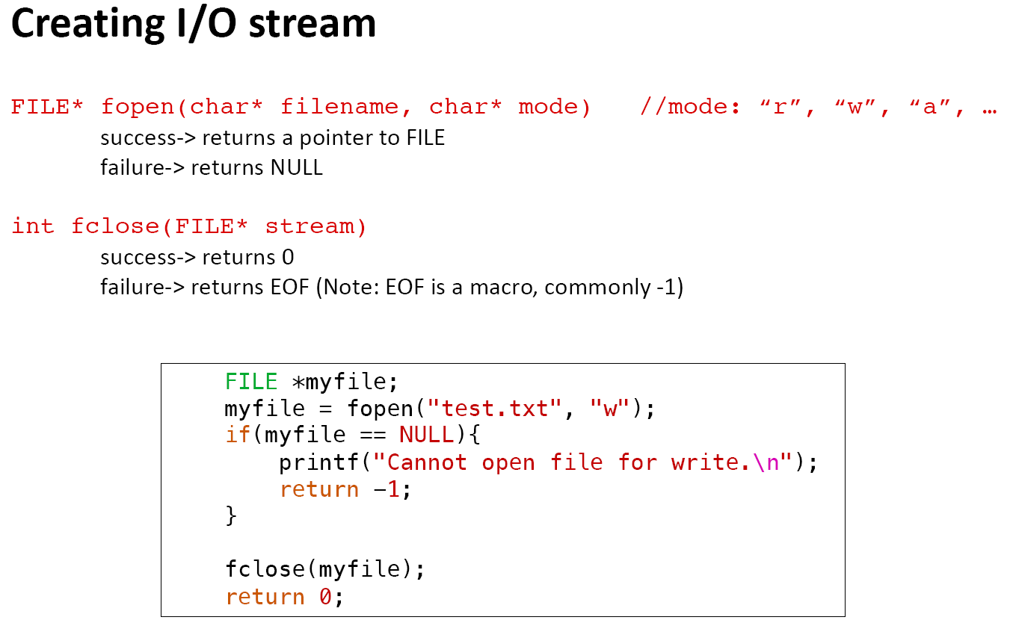

Slide 8
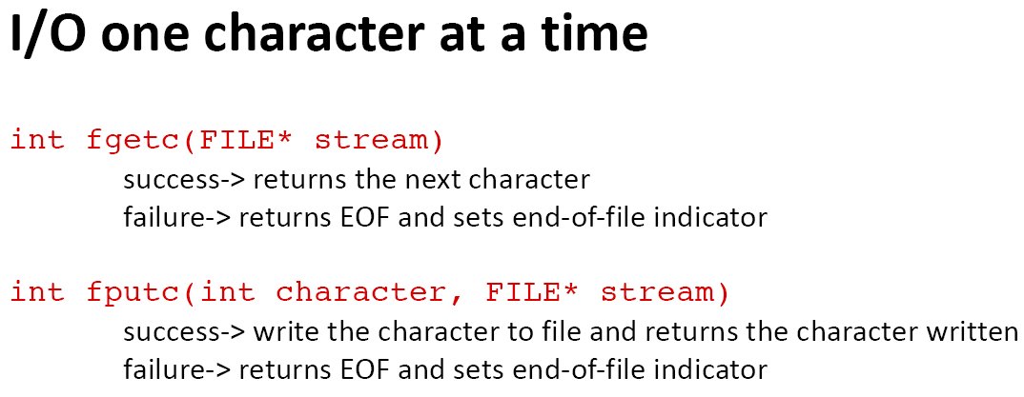
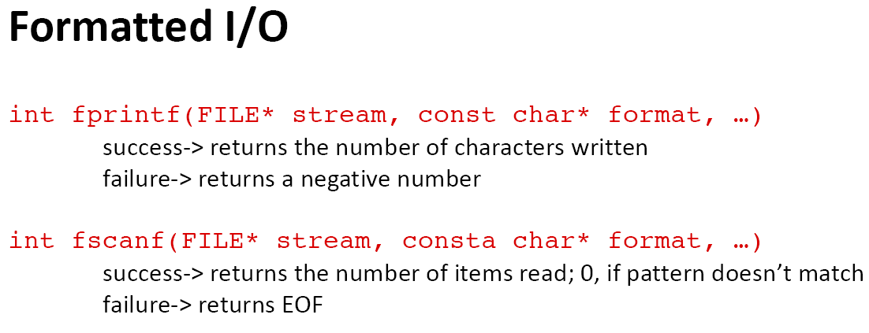

Slide 9
/* File I/O Example */
#include <stdio.h>
int main(){
FILE *file;
char buffer[100];
//open a file to write to
file = fopen("intro.txt", "w");
//use fgets to get input from user
printf("Write a self introduction with less than 100 characters: ");
fgets(buffer, 100, stdin);
//use fputs to save user input from buffer to file
fputs("Your self introduction: ", file);
fputs(buffer, file);
fclose(file);
//use fputs to display string in buffer
fputs(buffer, stdout);
return 0;
}
9

Slide 10
Exercise: Read an mxn matrix from file in_matrix.txt and write its transpose to file out_matrix.txt. The first row of the file specifies the size of the matrix.
Hint: use fscanf to read from a file and use fprintf to write to a file.
in_matrix.txt
#include <stdio.h>
int main(){
FILE *in_file;
FILE *out_file;
//
in_file = fopen("in_matrix.txt", "r");
if(in_file == NULL)
return -1;
//
int m, n;
fscanf(in_file, "%d %d", &m, &n);
int matrix[m][n];
2 3
1 2 3
4 5 6
out_matrix.txt
3 2
1 4
2 5
3 6
10

Slide 11
//
out_file = fopen("out_matrix.txt", "w");
if(out_file == NULL)
return -1;
//
fprintf(out_file, "%d %d\n", n, m);
return 0;
}
11

