Slide 1

ECE 220 Computer Systems & Programming
Course Review: C to LC3 for Linked List, Virtual Function, Template
Notes:
ECE Main Slide

Slide 2
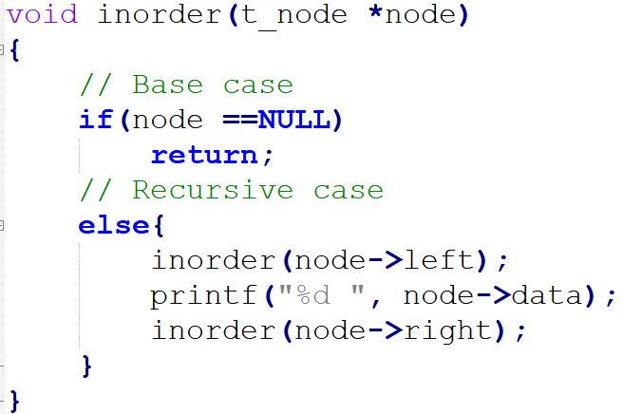
inOrder LC3 (please see, inOrder.asm in github)

Slide 3
Left return: (inOrder.asm)
x6FF4 |  | R5(new)
Restore R5 = x6FF8 | R5(old) = x6FF8 | R6
 | R.A (left Return)
 | R.V | <-R6 (when DONE is executed 1st)
x6FF8 | x0 | R5(new)
After 1st RET R5 is updated - | R5(old) = x6FFC | R6 <- R6 after 1st RET
with x6FF8 | R.A (left return) | R2=[R1+1]=[6004]=x0
R1=[R5+4]=[6FFC]=x6003 | R.V | R0 = [R1]=[6003]= 2 (printed)
x6FFC | x6003 | R5(new)
 | R5(old) | R6
 | R.A=HALT (R7) | R2=[R1+1]=[6001]=x6003
 | R.V
x7000 | x6000 | R6, R5
 |  | main

Slide 4
Right Return (inOrder.asm)
x6FF4 |  | R5(new)
After 2nd DONE R5 is updated - | R5 (old) =x6FF8 | R6 ; R5=x6FF8 (after 2nd DONE)
with x6FF8 | R.A (right return) R7
(after 2nd DONE, before RET)->R6 | R.V | R3= [R1+2]=[6005]= 0 (NULL)
x6FF8 | x0 | R5(new) <-R6
After 2nd RET R5 is updated - | R5(old) = x6FFC | R6 <- R6 after 2nd RET
with x6FFC | R.A (left return) | R2=[R1+1]=[6004]=x0 (NULL)
After 2nd return R7 is left return | R.V | R6 (before 2nd RET)
After 2nd RET R5 = x6FFC | x6003 | R5(new)
R1 = [R5+4] = [x7000] = x6000 | R5(old) | R6
R0=[R1]=[x6000]=x38 (print 8) | R.A=HALT (R7) | R2=[R1+1]=[6001]=x6003
 | R.V
x7000 | x6000 | R6
 |  | main

Slide 5
Virtual Table
stores pointers to all virtual functions
created for each class that uses virtual functions
lookup during the function call
class Shape{
protected:
int width, height;
public:
Shape(int a, int b) { width = a; height = b; }
virtual int area() { cout << “Base class area.” << endl; return 0; }
};
class Rectangle : public Shape{
public:
Rectangle(int a, int b) : Shape(a,b){}
int area() {
cout << “Rectangle class area.” << endl;
return width*height; }
};
3

Slide 6
Abstract Base Class & Pure Virtual Functions
class Shape{
protected:
int width, height;
public:
Shape(int a, int b) { width = a; height = b; }
virtual int area()=0; //pure virtual function – it has no body
};
int main(){
Shape shape1(2,4); // this will cause compiler error!
Shape *p_shape1; // this is allowed
}
derived class must define a body for this virtual function, or it will also be considered an abstract base class
4
Notes:
Abstract base class - a class that has one or more pure virtual functions. It cannot be used to instantiate objects.

Slide 7
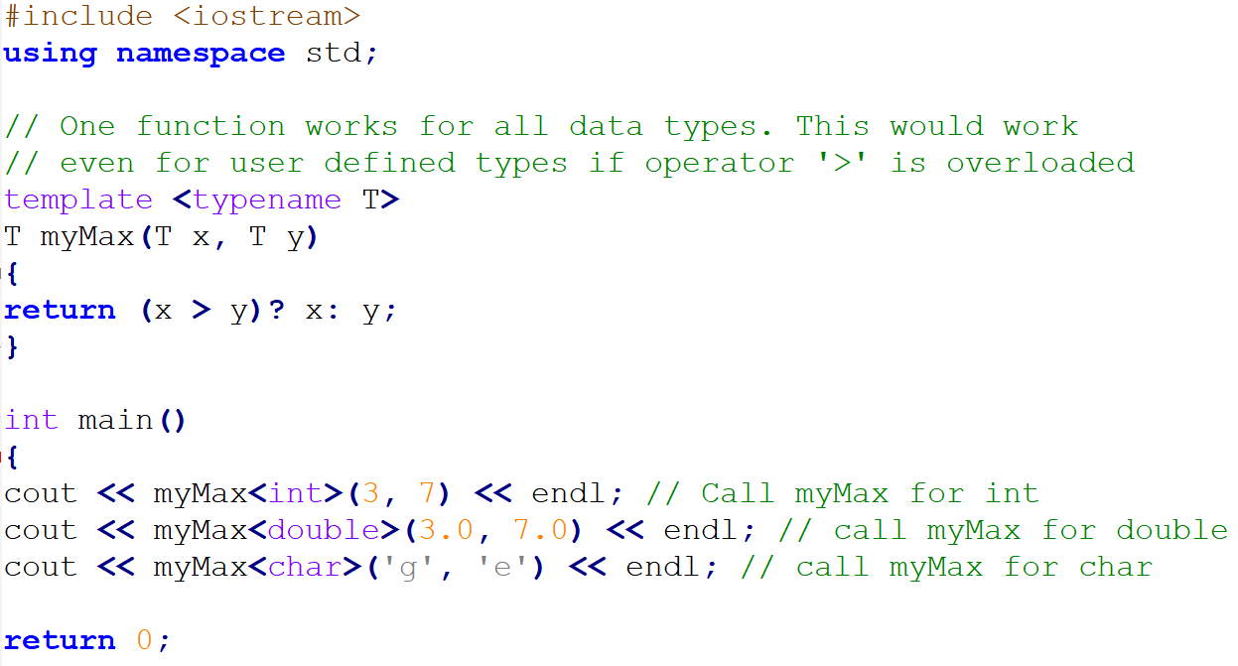
Function Template
5
Notes:
When a function template is first called for each type, the compiler creates an instantiation. Each instantiation is a version of the templated function specialized for the type. This instantiation will be called every time the function is used for the type.

Slide 8
Class Template
template <class T>
class mypair {
T a, b;
public:
mypair (T first, T second)
{a=first; b=second;}
T getmax ();
};
template <class T>
T mypair<T>::getmax () {
T retval;
retval = a>b? a : b;
return retval;
}
int main () {
mypair <int> myobject (100, 75);
cout << myobject.getmax();
return 0;
}
6
Notes:
Templates are a way of making your classes more abstract by letting you define the behavior of the class without actually knowing what data type will be handled by the operations of the class. In essence, this is what is known as generic programming.
Unlike function template instantiation, where arguments of function itself helps the compiler to deduce template type arguments, with class templates you must explicitly pass template type (in angle brackets).

Slide 9
Vector
Sequence container that encapsulates dynamic size arrays (container - an object that holds the same type of data)
Can expand or shrink during run-time
Similar to array, elements are stored in contiguous memory locations
#include <iostream>
#include <vector>
int main() {
// Create a vector containing integers
std::vector<int> v = {17, 5, 16, 8};
// Add two more integers to vector
v.push_back(15);
v.push_back(3);
// Iterate and print values of vector
for(int i = 0; i < v.size(); i++) { std::out << v[i] << '\n'; }
}
11
Notes:
Modifiers:
assign() – It assigns new value to the vector elements by replacing old ones
push_back() – It push the elements into a vector from the back
pop_back() – It is used to pop or remove elements from a vector from the back.
insert() – It inserts new elements before the element at the specified position
erase() – It is used to remove elements from a container from the specified position or range.
swap() – It is used to swap the contents of one vector with another vector of same type and size.
clear() – It is used to remove all the elements of the vector container
emplace() – It extends the container by inserting new element at position
emplace_back() – It is used to insert a new element into the vector container, the new element is added to the end of the vector

