Slide 1

ECE 220 Computer Systems & Programming
Lecture 16 – File I/O
Notes:
ECE Main Slide

Slide 2
Input / Output Streams
scanf(“%d”, &x)
Input Device
ASCII Stream
I/O Device operates using
I/O protocol (such as memory mapped I/O)
In C, we abstract away the I/O
details to an I/O function call
2

Slide 3
Stream Abstraction for I/O
All character-based I/O in C is performed on text streams.
A stream is a sequence of ASCII characters, such as:
the sequence of ASCII characters printed to the monitor by a single program
the sequence of ASCII characters entered by the user during a single program
the sequence of ASCII characters in a single file
Characters are processed in the order in which they were added to the stream.
e.g., a program sees input characters in the same order as the user typed them.
Standard Streams:
Input (keyboard) is called stdin.
Output (monitor) is called stdout.
Error (monitor) is called stderr.
3

Slide 4
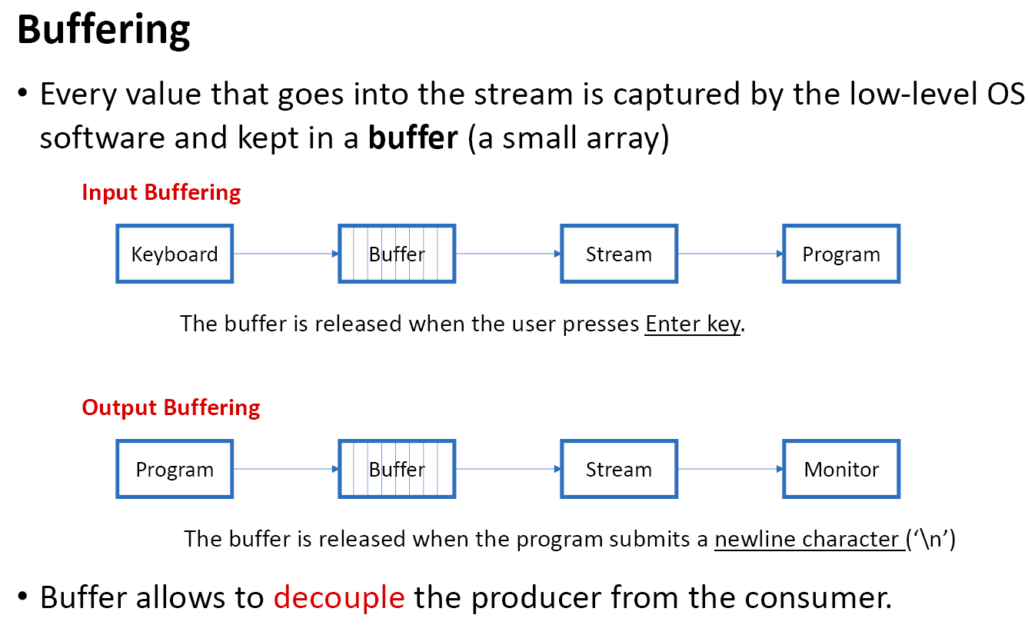

Slide 5
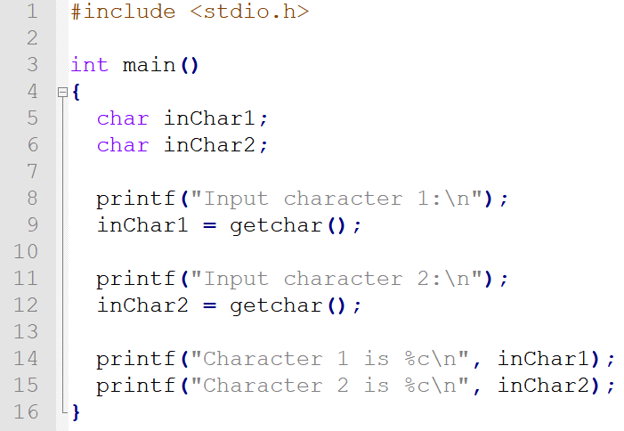
Buffered Input

Slide 6
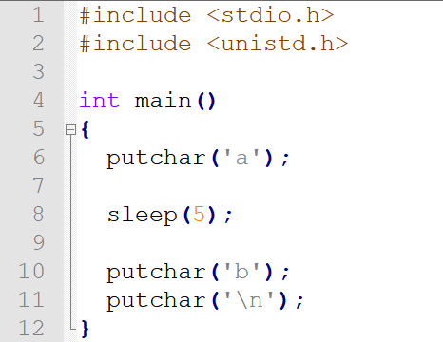
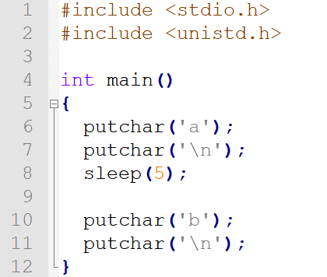
Buffered output

Slide 7
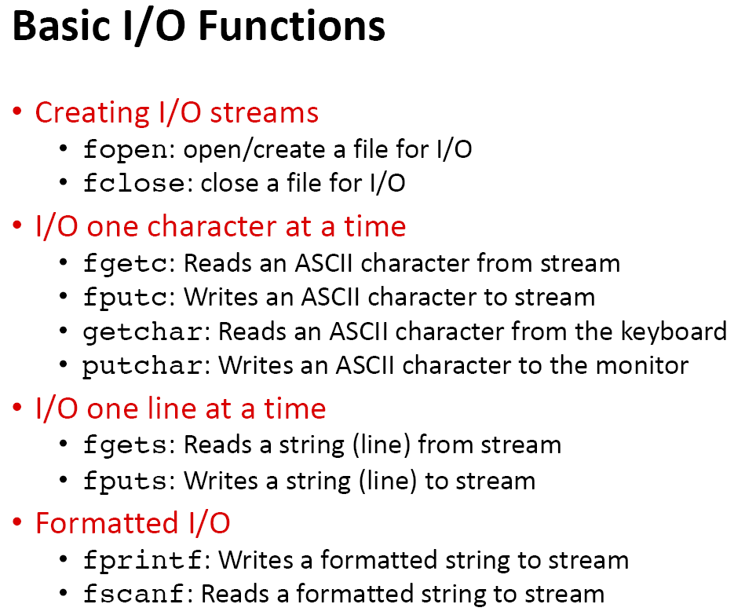

Slide 8
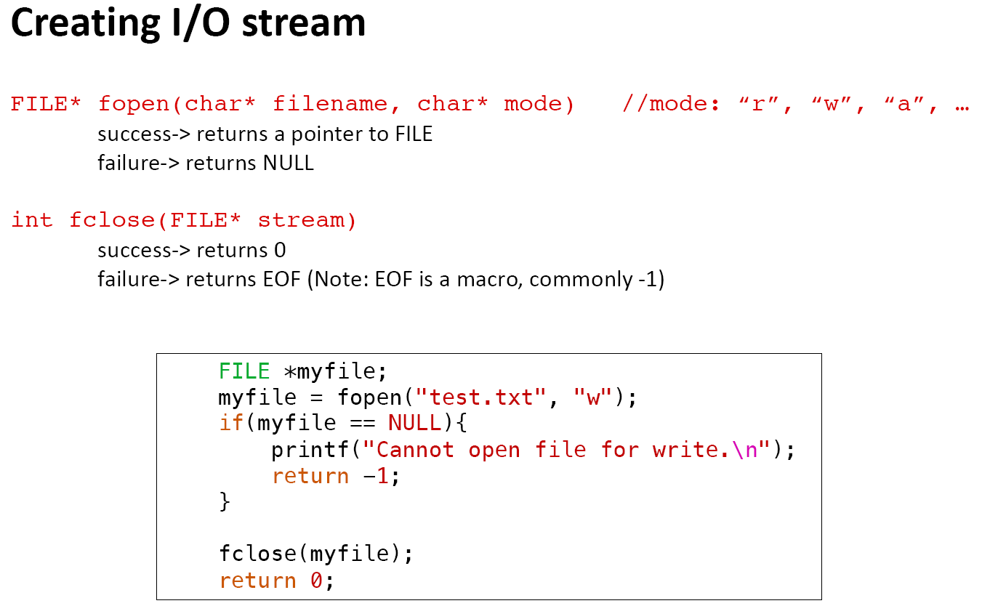

Slide 9
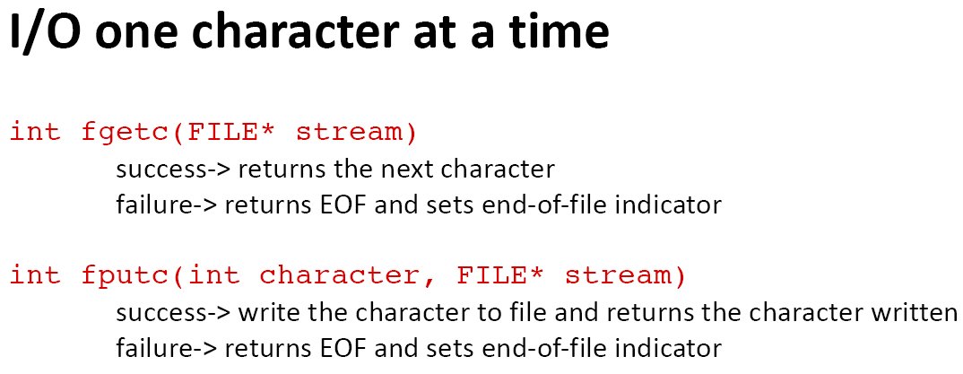

Slide 10
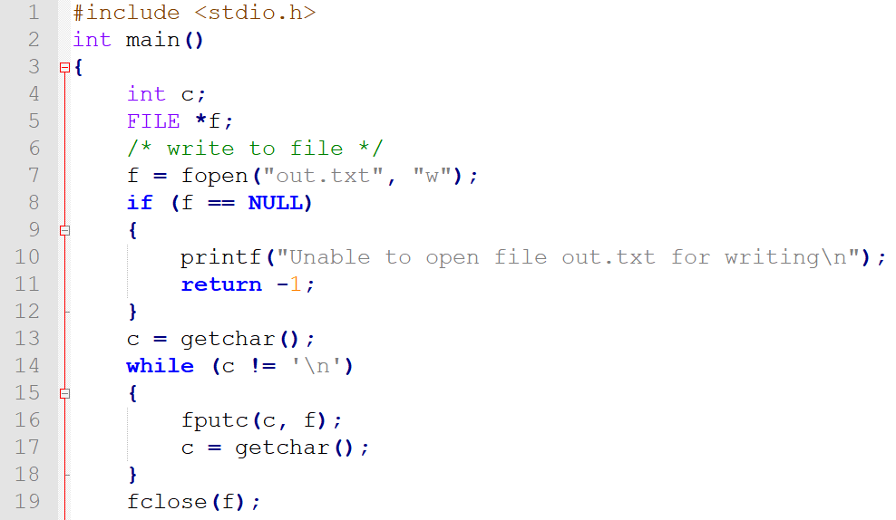
Write to a file using fputc()

Slide 11
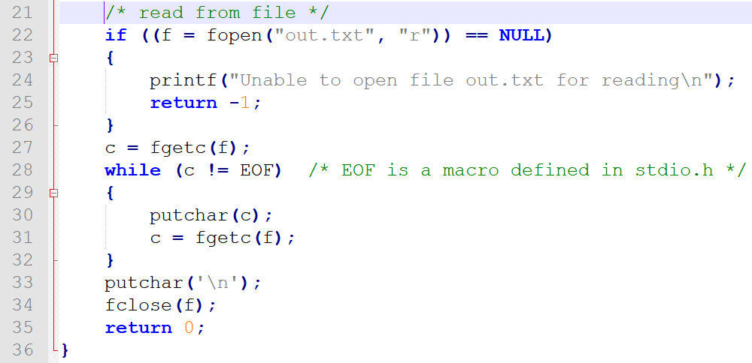
Read from a file using fgetc()

Slide 12
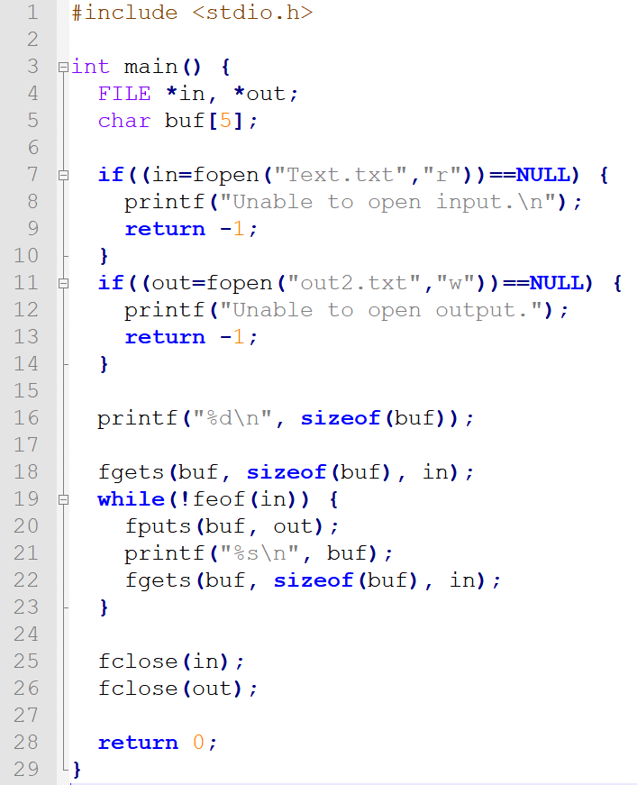
I/O one line at a time:
fgets, fputs

Slide 13
/* File I/O Example */
#include <stdio.h>
int main(){
FILE *file;
char buffer[100];
//open a file to write to
file = fopen("intro.txt", "w");
//use fgets to get input from user
printf("Write a self introduction with less than 100 characters: ");
fgets(buffer, 100, stdin);
//use fputs to save user input from buffer to file
fputs("Your self introduction: ", file);
fputs(buffer, file);
fclose(file);
//use fputs to display string in buffer
fputs(buffer, stdout);
return 0;
}
9

Slide 14
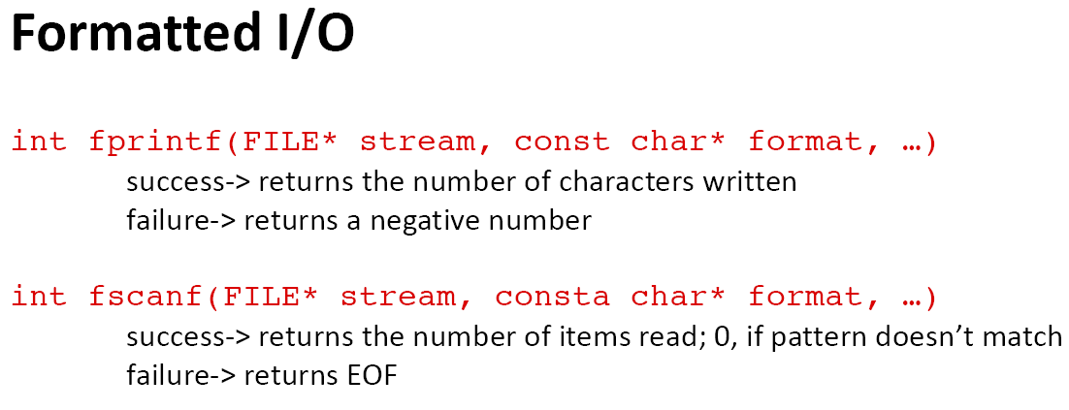
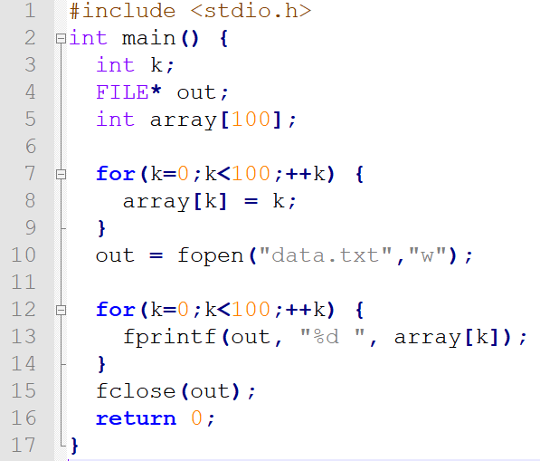

Slide 15
Exercise: Read an mxn matrix from file in_matrix.txt and write its transpose to file out_matrix.txt. The first row of the file specifies the size of the matrix.
Hint: use fscanf to read from a file and use fprintf to write to a file.
in_matrix.txt
#include <stdio.h>
int main(){
FILE *in;
FILE *out;
//
in_file = fopen("in_matrix.txt", "r");
if(in == NULL)
return -1;
//
int m, n;
fscanf(in, "%d %d", &m, &n);
int matrix[m][n];
2 3
1 2 3
4 5 6
out_matrix.txt
3 2
1 4
2 5
3 6
10

Slide 16
//
out_file = fopen("out_matrix.txt", "w");
if(out == NULL)
return -1;
//
fprintf(out, "%d %d\n", n, m);
return 0;
}
11

