Slide 1

ECE 220 Computer Systems & Programming
Lecture 12 – Strings and Multi-dimensional Arrays
Notes:
ECE Main Slide

Slide 2
Outline
Chapter 16.3-16.4
Key concepts
Array as Function Parameters
Strings
Multi-dimensional arrays

Slide 3
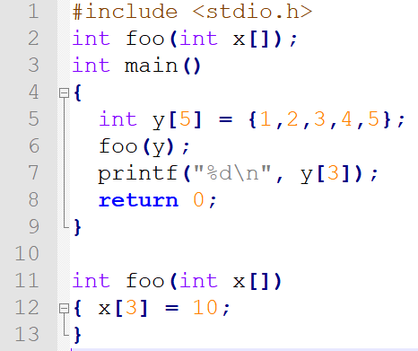
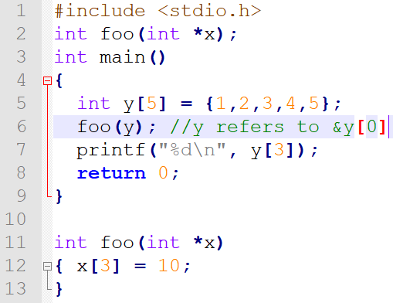
Arrays as Function parameters:
How do we pass array to a function?
C passes arrays by reference
the address of the array (i.e., address of the first element) is written to the function's activation record
[]indicate to the compiler that the corresponding parameter will be the base address of an array of the specified type.

Slide 4
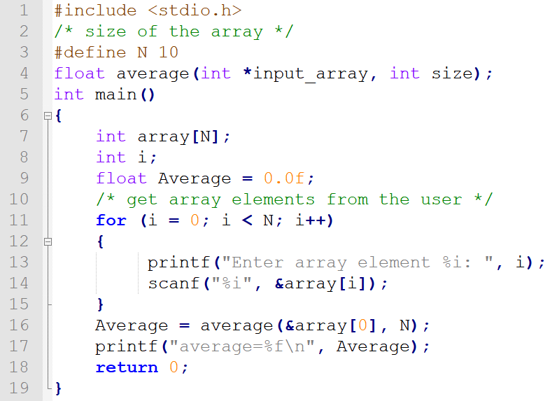
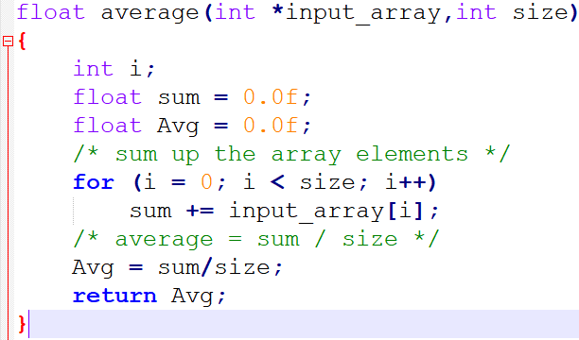
Review of arrays and pointers
Write a program that takes as input N integers from the user, passes them in an array to a function to compute their average. N is a positive number.

Slide 5
Pointer Array Duality
char word[10];
char *cptr;
cptr = word; //assign cptr to point to word
cptr word &word[0]
(cptr + n) word + n &word[n]
*cptr *word word[0]
*(cptr + n) *(word + n) word[n]
4

Slide 6
Example: Dice Roll Matching Game
Problem Statement:
# Roll a dice three times to generate three random numbers.
# Use the generated random numbers as indices to pick three random characters from an array of characters.
# guess the three random characters and check how many characters you guessed right. Also, check if it was a perfect match. You are allowed to use three trials.
We will three functions:
roll_a_dice
pick_characters
comp_characters
Note: *function prototype are declared in functions.h
*functions are defined in dice_roll.c

Slide 7
Strings
Allocate space for a string just like any other array:
char outputString[16];
Space for string must contain room for terminating zero. [see the simple_string.c code on github]
Special syntax for initializing a string:
char outputString[16] = "Result = ";
…which is the same as:
outputString[0] = 'R'; outputString[1] = 'e'; outputString[2] = 's'; ...
Null terminating strings – ‘\0’ special sequence that corresponds to the null character.

Slide 8
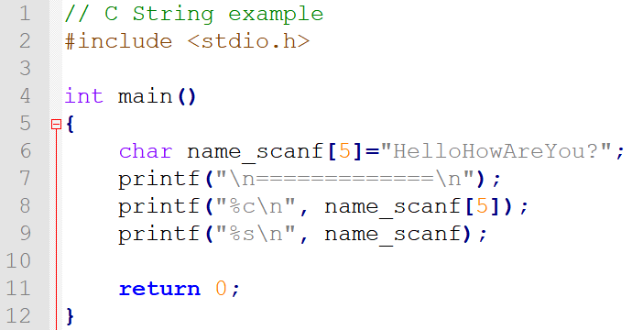
Simple_string.c
Space for string must contain room for terminating zero. [see the simple_string.c code on github]
//printf (“%s”) -- print characters up to terminating zero
// printf("%s\n", name_scanf);

Slide 9
I/O with Strings
printf and scanf use "%s" format character for string
printf -- print characters up to terminating zero
printf("%s", outputString);
scanf -- read characters until whitespace, store result in string, and terminate with zero
scanf("%s", inputString);
gets,fgets – reads line into string; stops when newline character is read
gets(str);
fgets(str,10,stdin);

Slide 10
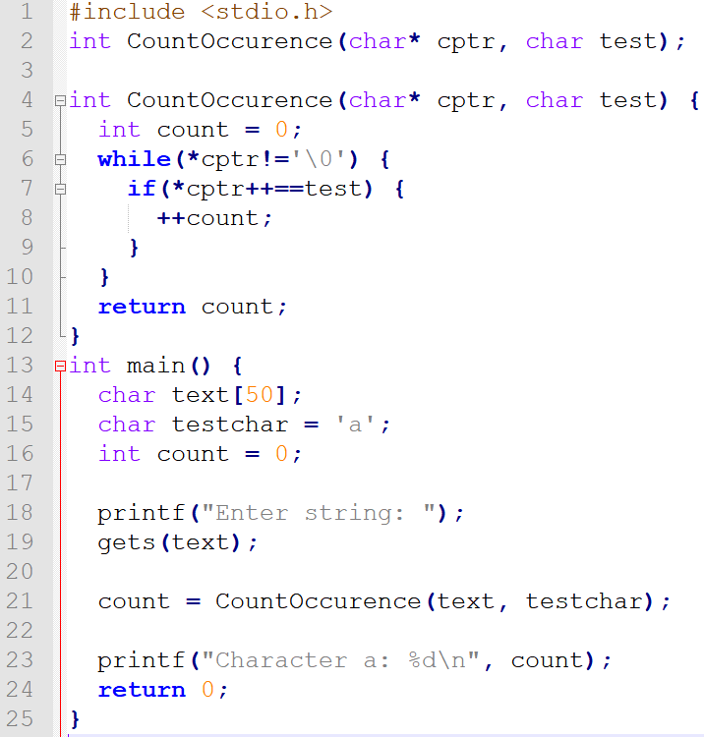
Example: gets

Slide 11
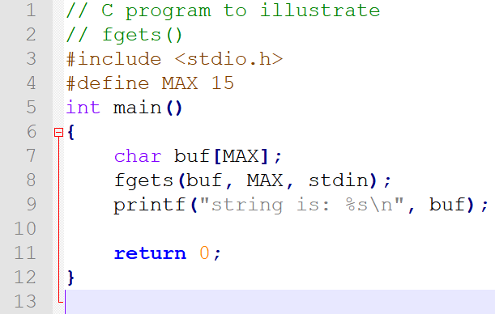
fgets:

Slide 12
Multi-dimensional Arrays
 | Column 1 | Column 2 | Column 3
Row 1 | a[0][0] | a[0][1] | a[0][2]
Row 2 | a[1][0] | a[1][1] | a[1][2]
int a [2][3];
In memory
2D arrays
<type> <name> [<dim1>][<dim2>];
e.g., int a[2][3];
*multi-dimensional array is stored in row-major order
Flat index = row x (width of row) + col
(i.e. a[1][1] = 1*3+1 = 4)
* multi-dimensional array is stored in row-major order
a[0][0]
a[0][1]
a[0][2]
a[1][0]
a[1][1]
a[1][2]

Slide 13
Initialize Multi-dimensional Array
int a[2][3] = {{1, 2, 3}, {4, 5, 6}};
or
int a[][3] = {{1, 2, 3}, {4, 5, 6}};
or
int a[2][3] = {1, 2, 3, 4, 5, 6};
Some expressions:
a[0][2] ⬄ *(a[0] +2)
a[0] ⬄ *a

Slide 14
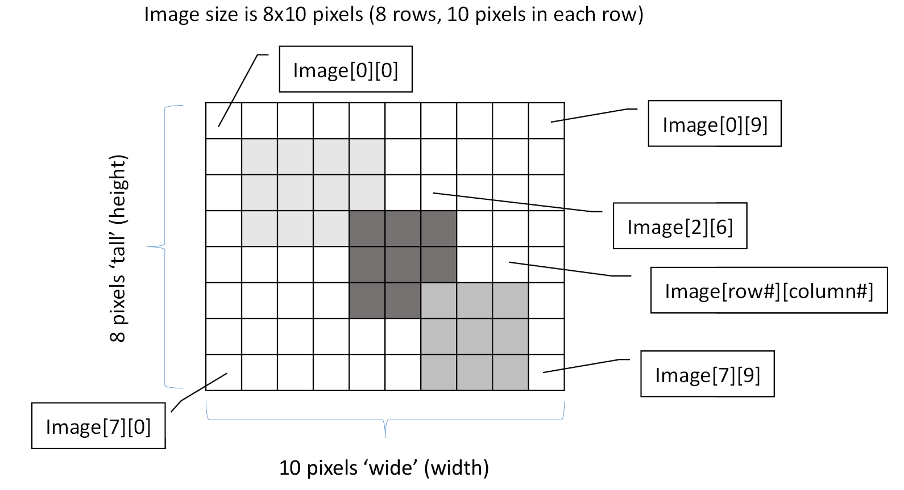
Example: Image Storage

Slide 15
Image Analysis Example Problem:
Problem statement:
Count the number of 2x2 pixel blocks in an image of size 5x5 pixels that match the reference block. Here both Image and Block are passed as reference to the function Match.

Slide 16
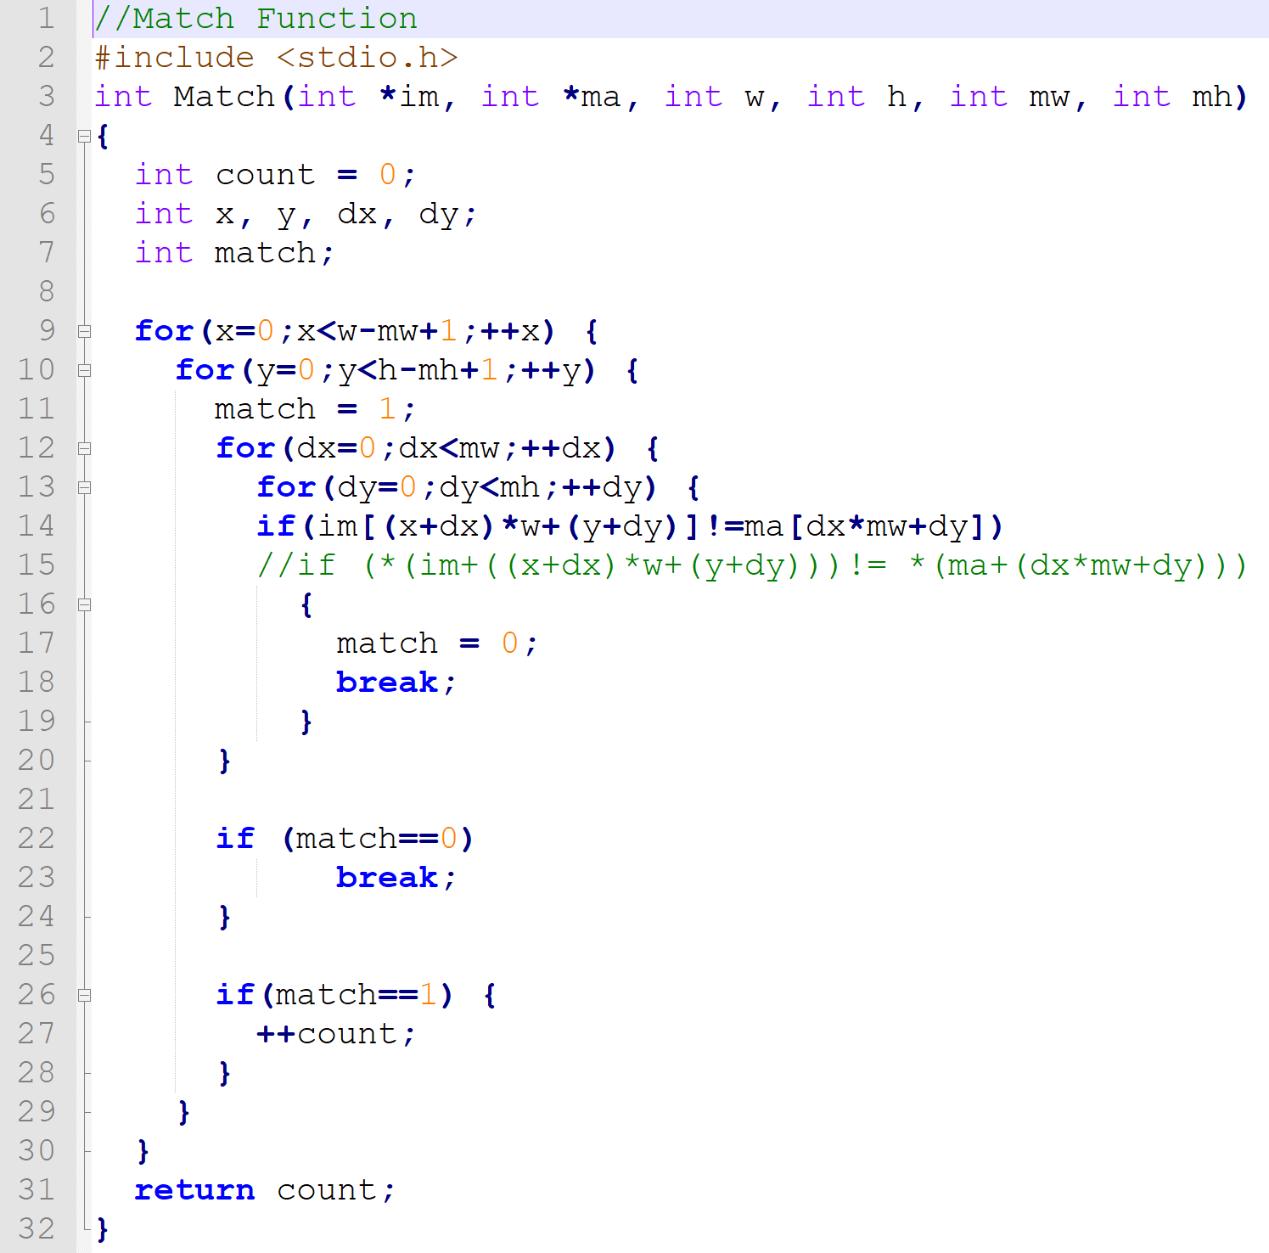

Slide 17
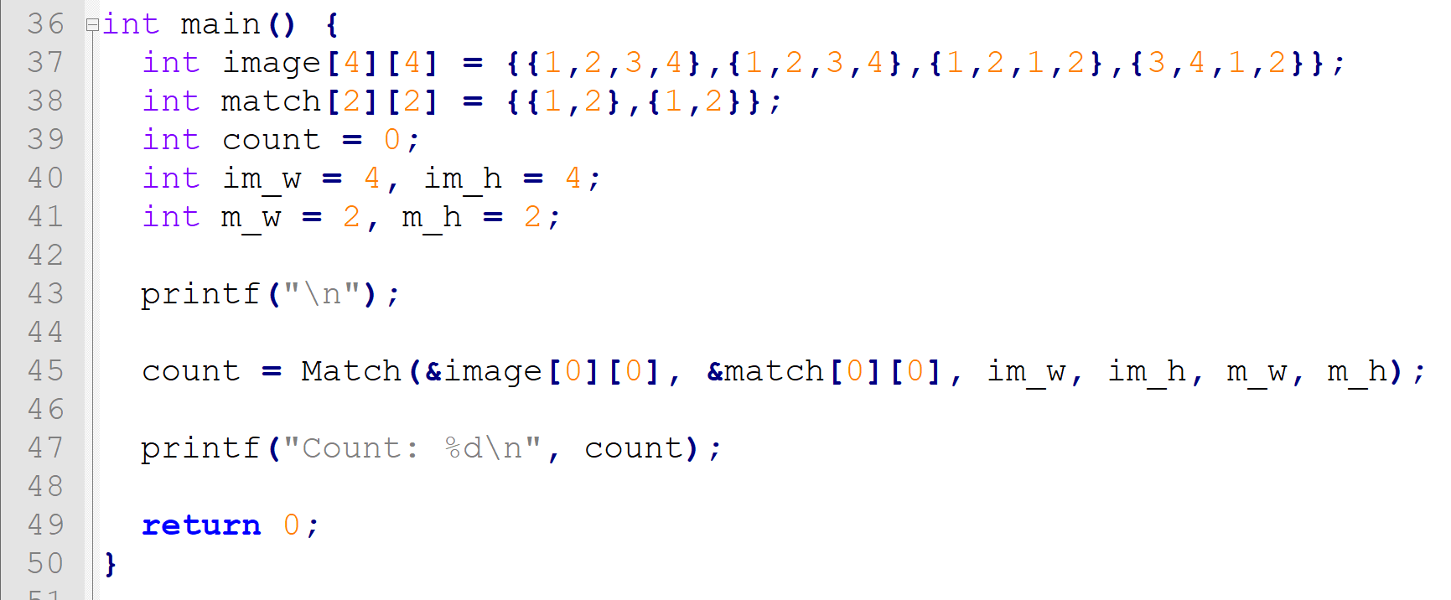
Main Function:

Slide 18
Exercise: implement a function that interchanges two rows of a 5x5 matrix. The functions takes three arguments: pointer to the matrix, row number x and row number y.
#define SIZE 5
void row_interchange(int *matrix, int x, int y){
}
10

