Slide 1

ECE 220 Computer Systems & Programming
Lecture 17 – Data Structures
Notes:
ECE Main Slide

Slide 2
2

Slide 3
Data Type
Three fundamental data types:
integer
float/double
char
We also discussed:
Array
Pointer

Slide 4
Structures
allow user to define a new type consists of a combination of fundamental data types (aggregate data type)
Example: a repository of students and their grades in this class
Name, can be captured as an array of chars (string): char name[100];
Student ID, can be stored as an int: int ID;
Grade for the class, can be stored as a float: float GPA;
There may be many other characteristics that we would want to capture..
How do we capture them?
4

Slide 5
Structure – why we need it?
If we only have one student, we can declare one variable per property:
char name[100];
int ID;
float GPA;
If we have many (N) students, we can allocate arrays:
char name[N][100];
int ID[N];
float GPA[N];
to access information about a particular student, we would need to access data in all three arrays: name[i], ID[i], GPA[i]
if there are only a few properties that we care about, this solution (using separate arrays) may be acceptable
but if we have many properties, the solution with arrays becomes cumbersome
think about passing a large number of arguments to a function
a better solution is to aggregate all the properties into a single object

Slide 6
Structures
struct construct allows to create a new data type consisting of several member elements (aggregate data type)
Example: student record
struct StudentStruct
{
char Name[20];
int UIN;
float GPA;
}; //In this example, we have created a new data type and gave it the tag StudentStruct;
To declare a variable of this type, we can use the new data type’s name:
struct StudentStruct student;
strncpy(student.Name, “John Doe”, sizeof(student.Name));
student.UIN = 123456789;
student.GPA = 3.89;
//student.name =“John Doe”; //Compiler Error
//or we can just use one line
struct StudentStruct student = {“John Doe”, 123456789, 3.89};
4

Slide 7
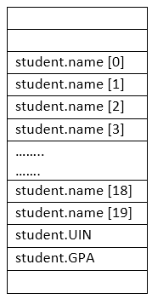
Structures (run-time stack)
struct construct allows to create a new data type consisting of several member elements (aggregate data type)
Example: student record
struct StudentStruct
{
char Name[20];
int UIN;
float GPA;
};
struct StudentStruct student;
student.UIN = 123456789;
student.GPA = 3.89;
strncpy(student.Name, “John Doe”, sizeof(student.Name));
4

Slide 8
Structures (run-time stack)
y
struct StudentStruct
{
char Name[20];
int UIN;
float GPA;
};
int main()
{
int x;
struct StudentStruct student;
int y;
student.UIN=0;
}
R5
x
LC3 code of student.UIN=0;
AND R1, R1, #0; zero out R1
AND R0,R5, #-22; R0 contains the base address of student
STR R1, R0, #20 ; student.UIN=0
4

Slide 9
Using typedef
C allows to give names to user-defined data types using typedef keyword. Thus, we can give an alternative (shorter) name to “struct tag“:
typedef struct tag myType; myType <varName>;
here old name “struct tag” will be given a new name myType.
struct StudentStruct
{
char Name[100];
int UIN;
float GPA;
}student;
typedef struct StudentStruct student;
student s1, s2;
5
Notes:
Simple example: typedef int color;
color pixel[30];

Slide 10
Using typedef (both approaches are same)
struct StudentStruct
{
char Name[100];
int UIN;
float GPA;
};
typedef struct StudentStruct student;
student s1, s2;
/***********************************/
typedef struct StudentStruct
{
char Name[100];
int UIN;
float GPA;
}student;
student s1, s2;
5

Slide 11
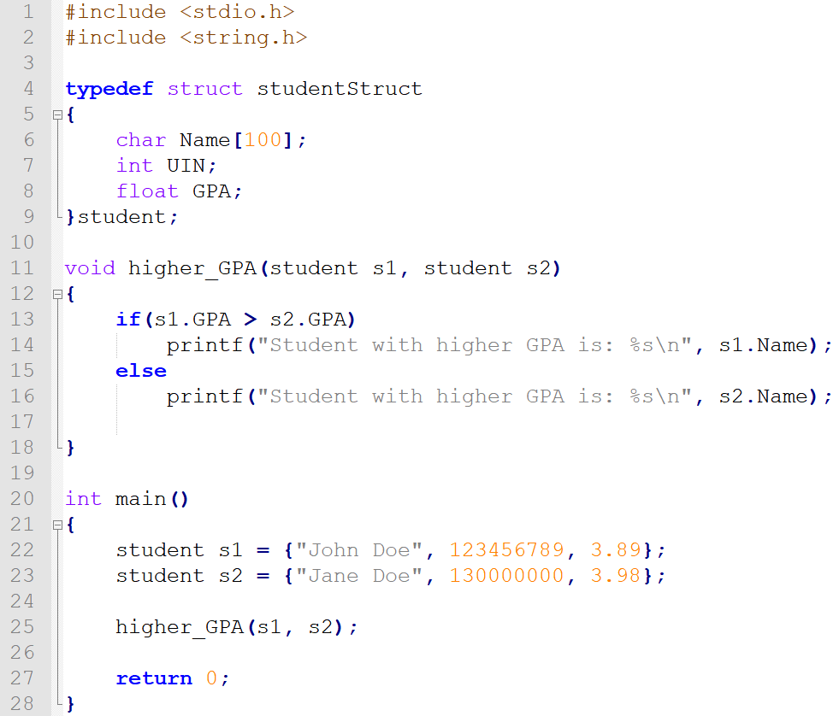

Slide 12
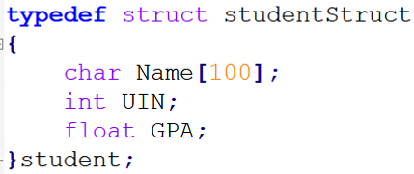
Arrays of Structs
//create an array of student struct
student ece220[200];
//access each element of the array
ece220[0]
ece220[1]
//access individual fields in each element
ece220[0].Name[0] = ‘J’;
ece220[0].Name[1] = ‘o’;
ece220[0].Name[2] = ‘h’;
ece220[0].Name[3] = ‘n’;
ece220[0].UIN = 123456789;
ece220[0].GPA = 3.89;
7

Slide 13
Pointer to Struct
student ece220[200];
student *ptr;
ptr = ece220; //pointer to a struct array
//ptr = &ece220[5];
ptr++; //where is ptr pointing to now?
strncpy(ptr->Name, “John Doe”, sizeof(s1.Name));
ptr->UIN = 123456789; //(*ptr).UIN
ptr->GPA = 3.89; //(*ptr).GPA
//which student record has been changed?
8

Slide 14
Struct within a Struct
typedef struct StudentName
{
char First[30];
char Middle[30];
char Last[40];
}name;
student ece220[200];
student *ptr;
ptr = ece220;
//How can we set the ‘First’ name in the first student record?
strncpy( , “John”, );
typedef struct StudentStruct
{
name Name;
int UIN;
float GPA;
}student;
9

Slide 15
First[0]
…
First[29]
Middle[0]
…
Middle[29]
Last[0]
…
Last[39]
UIN
GPA
First[0]
…
First[29]
Middle[0]
…
Middle[29]
…
name
ece220[0]
ece220[1]
10

Slide 16
Enumeration Constants:
Enumerated data type:
An enumeration, introduced by the keyword enum, is a set of integer constants represented by identifiers.
Values in an enum start with 0, unless specified otherwise, and are incremented by 1.
Syntax: enum [tag] { enumerator-list }
Example:
enum Months {JAN, FEB, MAR, APR, MAY, JUN, JUL, AUG, SEP, OCT, NOV, DEC};
enum Months cur_month;
cur_month = MAR; //Here JAN equals 0, FEB equals 1, and so on..
//what is the value of cur_month?
//what if we define it this way?
enum Months {JAN=1, FEB, MAR, APR, MAY, JUN, JUL, AUG, SEP, OCT, NOV, DEC};
3

Slide 17
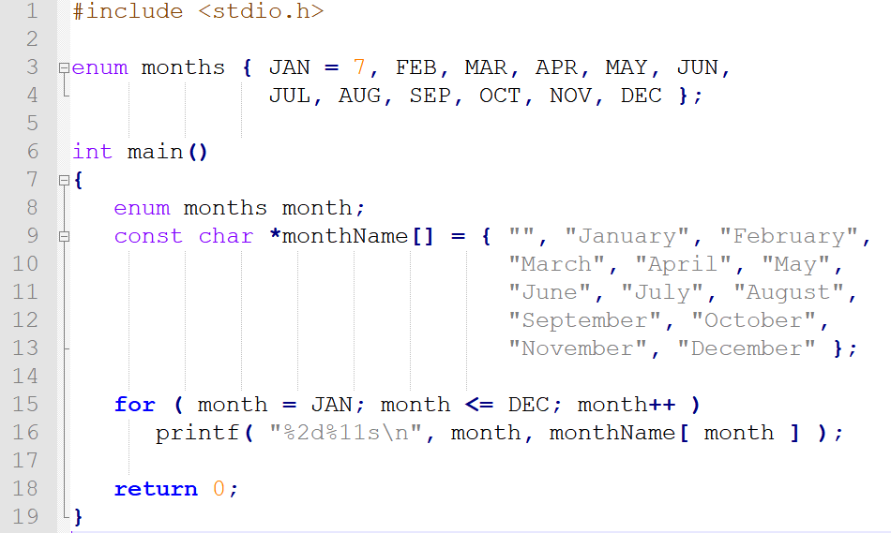
Another Example (enum):

Slide 18
Unions
a union data type is similar to a struct, however, it defines a single location in memory that can be given many different names
Example:
union valueUnion { long int i_value; float f_value; } union valueUnion v; v.i_value = 5; /* holds integer */ v.f_value = 5.25f; /* now holds float */ /* but not both! */
6

