Slide 1

ECE 220 Computer Systems & Programming
Lecture 11: Pointers and Arrays
October 1, 2019
Notes:
ECE Main Slide

Slide 2
Outline
Chapter 16
Key concepts
Passing by reference with pointers
Arrays basics

Slide 3
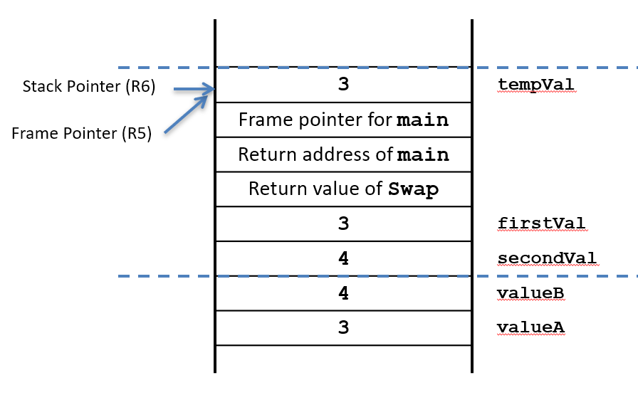
Function Swap
#include<stdio.h>
void Swap(int firstVal, int secondVal);
int main()
{
int valueA = 3;
int valueB = 4;
1. printf("%d %d\n”, valueA, valueB);
2. Swap(valueA, valueB);
3. printf("%d %d\n", valueA, valueB);
4. return 0;
}
void Swap(int firstVal, int secondVal)
{
int tempVal;
5. tempVal = firstVal;
6. firstVal = secondVal;
7. secondVal = tempVal;
}

Slide 4
Function NewSwap
#include<stdio.h>
void NewSwap(int *firstVal, int *secondVal);
int main()
{
int valueA = 3;
int valueB = 4;
1. printf("%d %d\n”, valueA, valueB);
2. NewSwap(&valueA, &valueB);
3. printf("%d %d\n", valueA, valueB);
4. return 0;
}
void NewSwap(int *firstVal, int *secondVal)
{
int tempVal;
5. tempVal = *firstVal;
6. *firstVal = *secondVal;
7. *secondVal = tempVal;
}

Slide 5
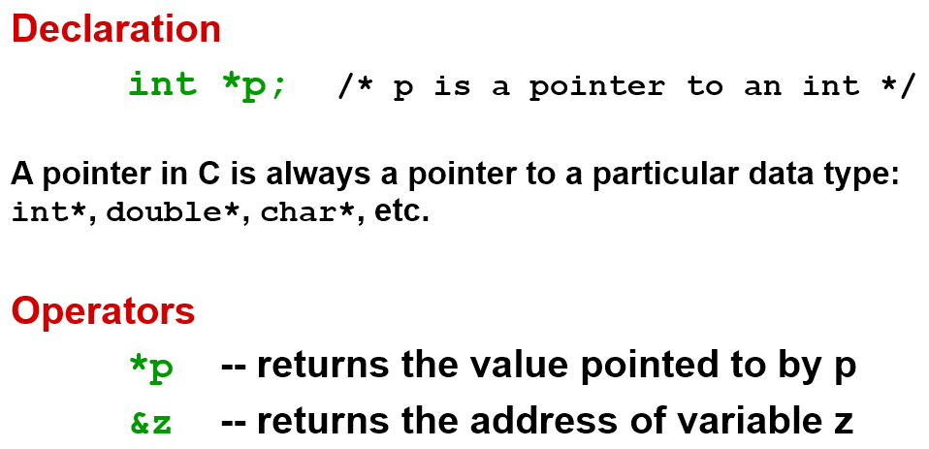
Pointers

Slide 6
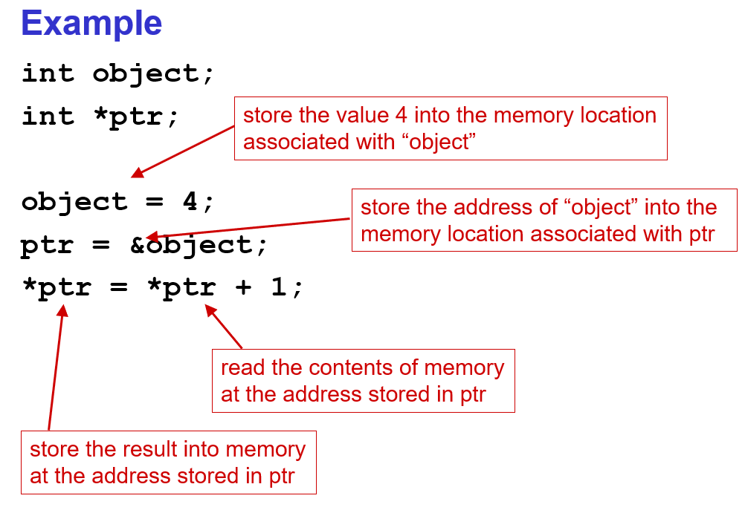

Slide 7
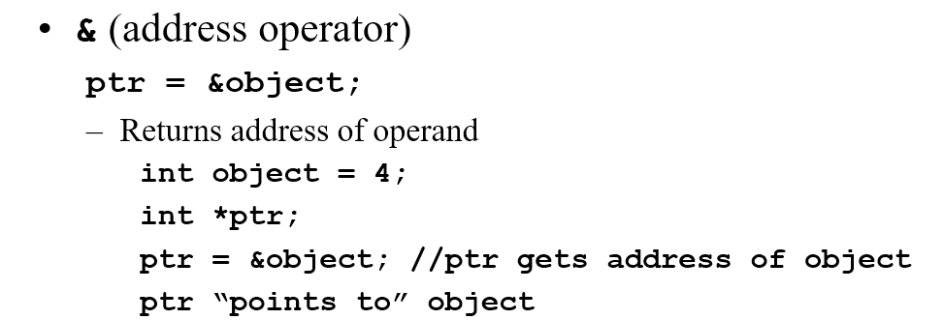
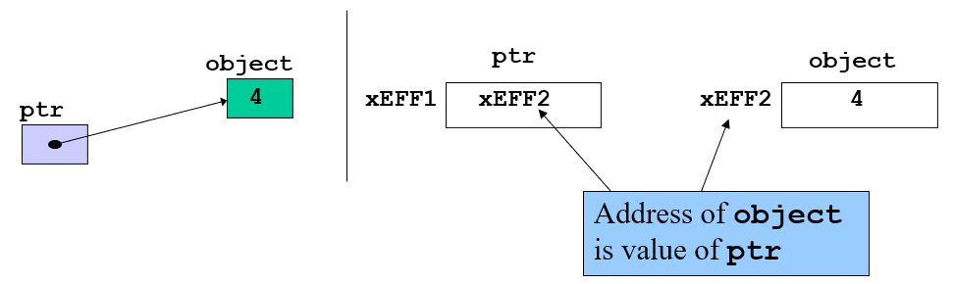


Slide 8
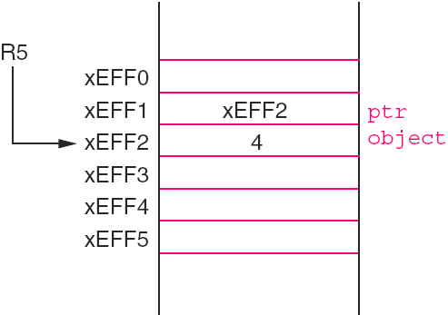
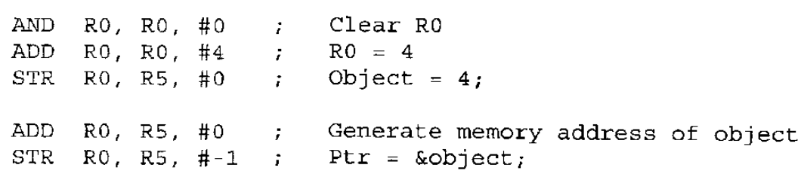
Pointers in LC3
The indirection operator ‘*’
int object = 4;
int *ptr;
ptr = &object;

Slide 9
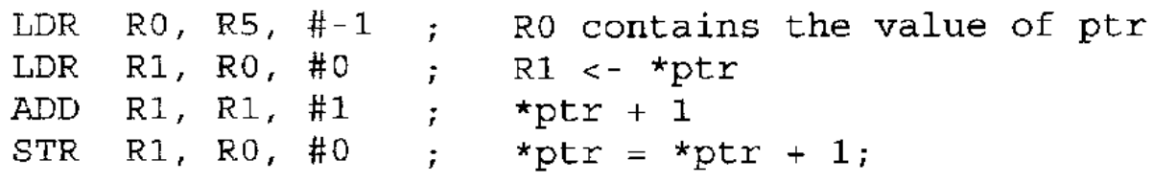
Pointers in LC3

Slide 10
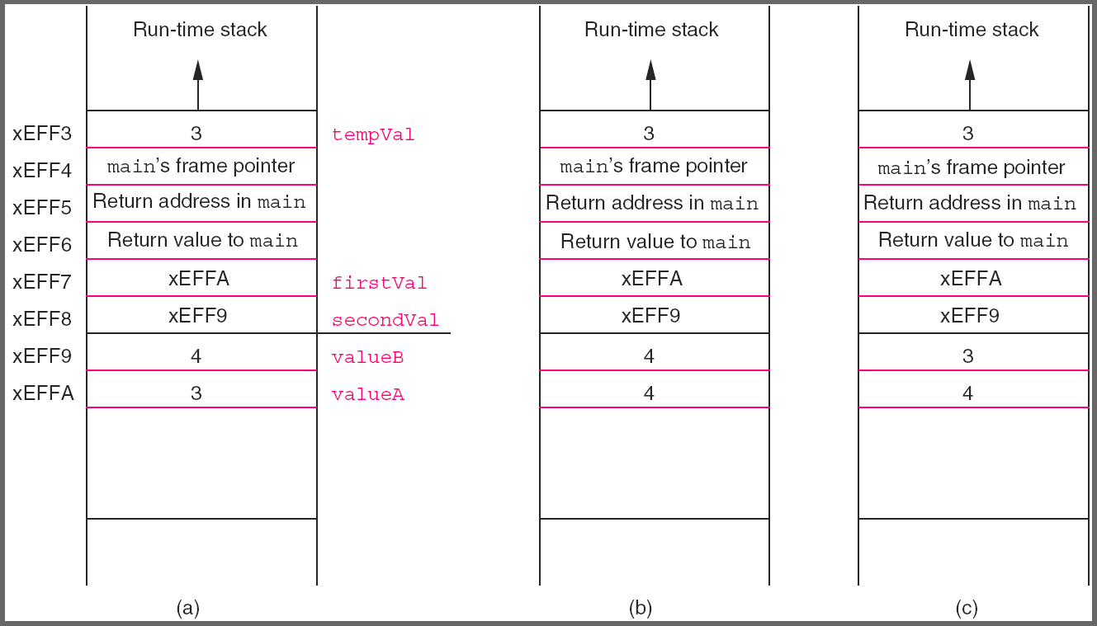
Function NewSwap
#include<stdio.h>
void NewSwap(int *firstVal, int *secondVal);
int main()
{
int valueA = 3;
int valueB = 4;
1. printf("%d %d\n”, valueA, valueB);
2. NewSwap(&valueA, &valueB);
3. printf("%d %d\n", valueA, valueB);
4. return 0;
}
void NewSwap(int *firstVal, int *secondVal)
{
int tempVal;
5. tempVal = *firstVal;
6. *firstVal = *secondVal;
7. *secondVal = tempVal;
}
More Examples on Github: CallByValue, CalByReference

Slide 11
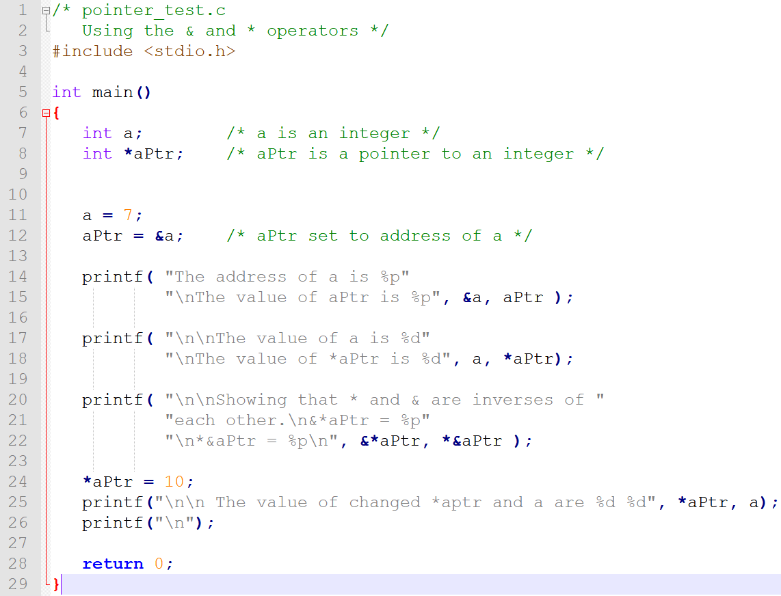
Exercise:

Slide 12
Arrays: Basic Concept
Initial Location
Sequentially arranged data of same type
Offset

Slide 13
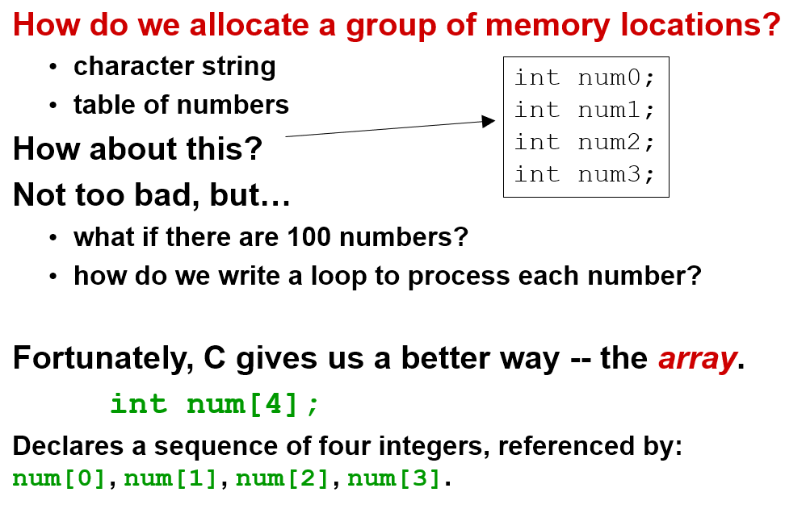
Arrays: Basic Concept

Slide 14
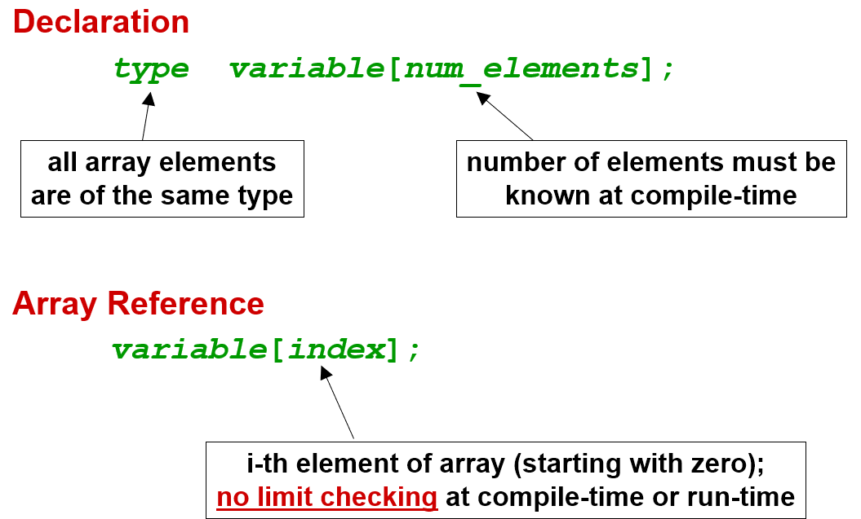
Arrays: Syntax

Slide 15
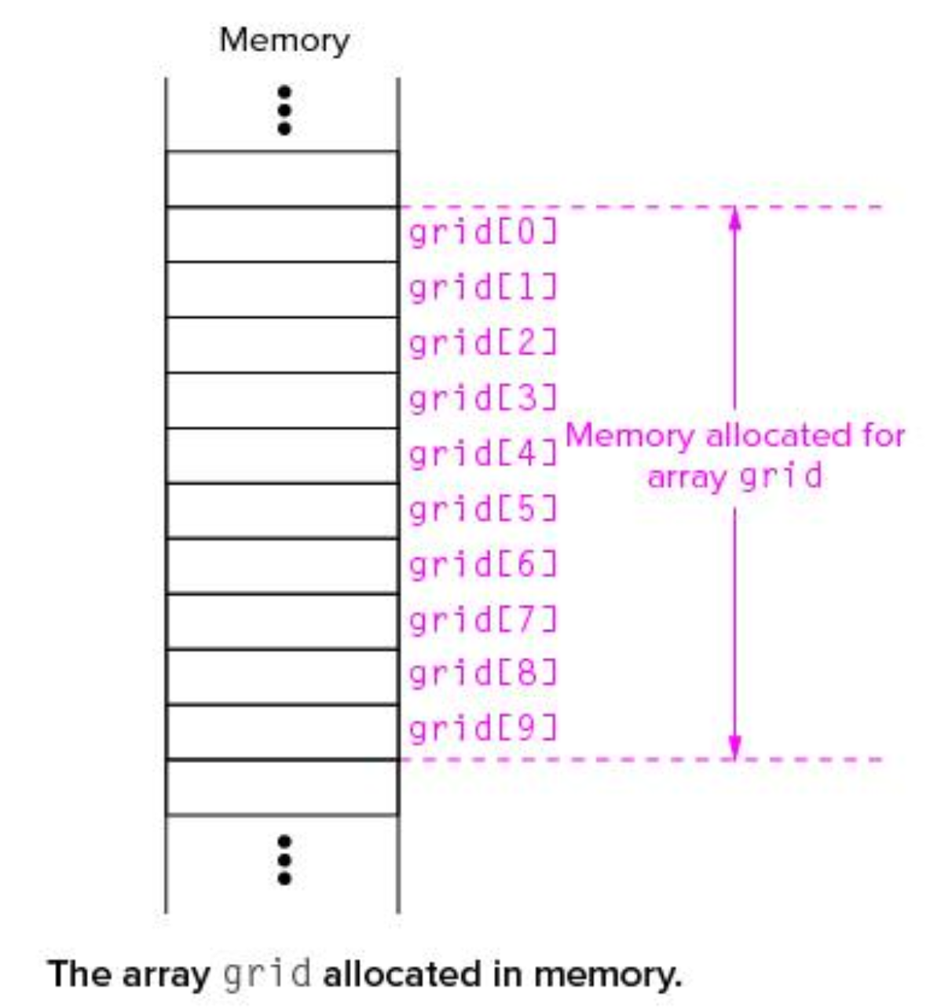
Memory allocation of Int grid [10]
grid[0] is allocated at the lowest memory address

Slide 16
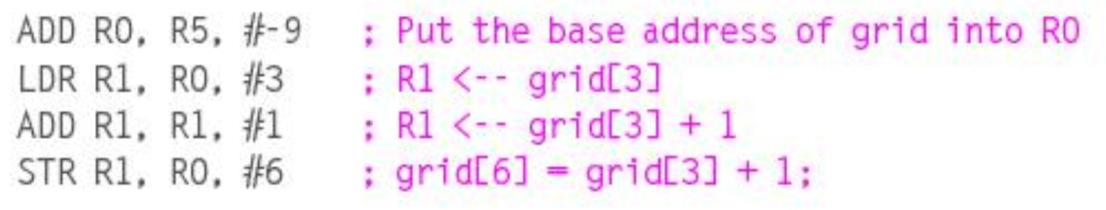
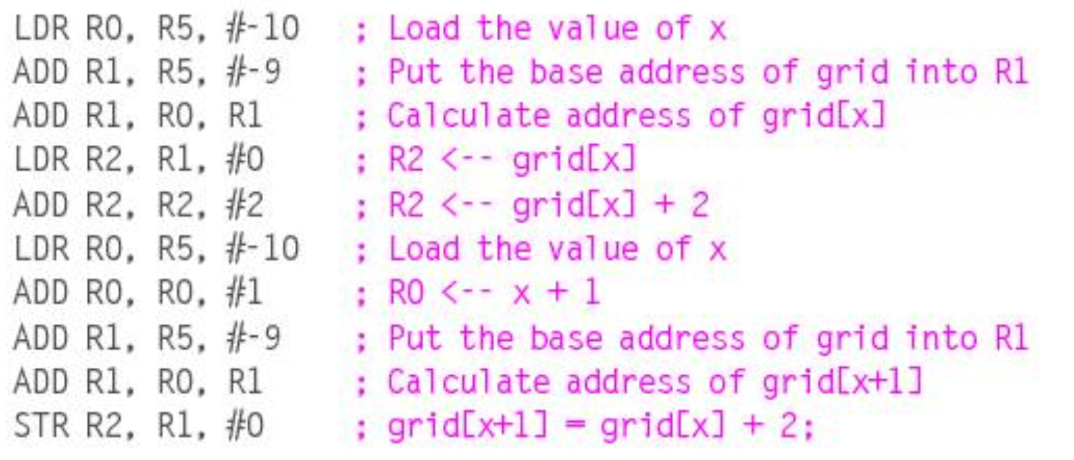
Assume grid is local variable. grid[6] = grid[3]+1;
Assume, x is allocated on top of the grid.
grid[x+1] = grid[x]+2

Slide 17
Arrays Example
Declaring and using Arrays
Int grid[10]= {5,7,8,9,10,11,12,2,3,1};
int grid1[10] = {0,1,2,3,4,5,6,7,8,9};
grid1[6] = grid1[3] + 1;
int i;
for(i=0;i<10;i++)
{
grid[i] = grid[i]+grid1[i];
}
8

Slide 18
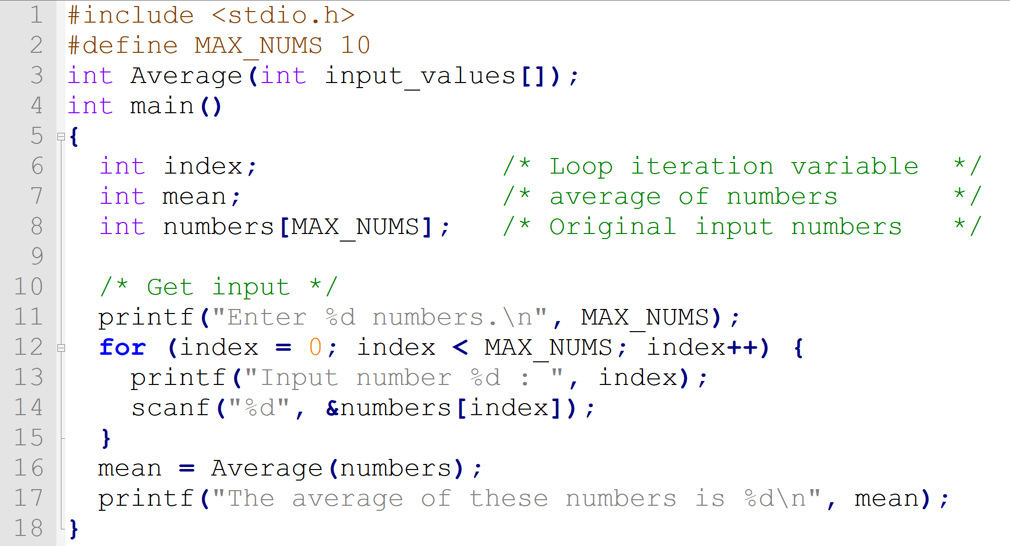
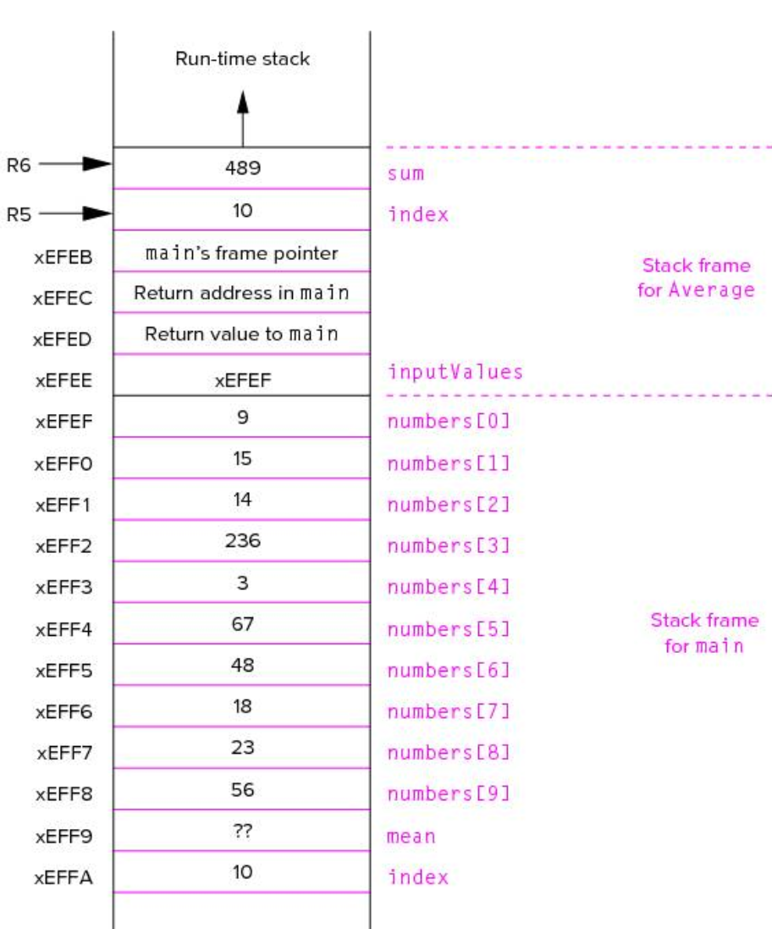
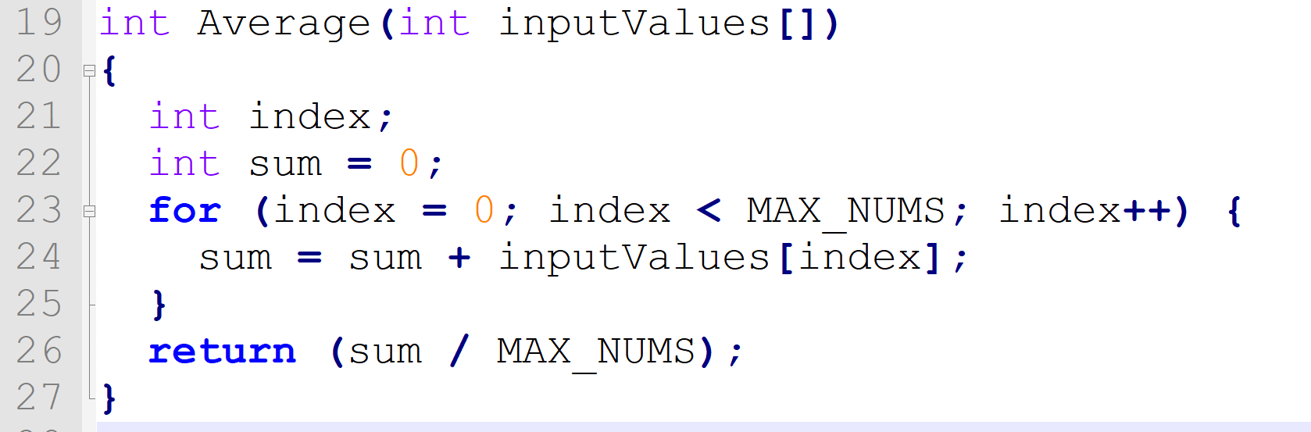
Passing Array as Arguments
9

