Slide 1

ECE 220 Computer Systems & Programming
Lecture 14 – Recursion
October 15, 2019
Notes:
ECE Main Slide

Slide 2
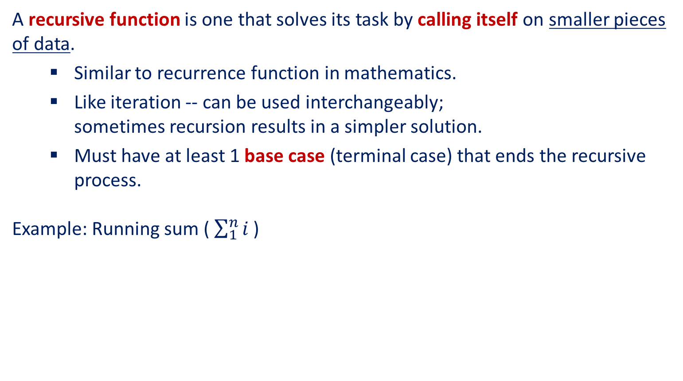
Recursion
A recursive function is one that solves its task by calling itself on smaller pieces of data.
Similar to recurrence function in mathematics.
Like iteration -- can be used interchangeably; sometimes recursion results in a simpler solution.
Must have at least 1 base case (terminal case) that ends the recursive process.
Example: Running sum ($\sum_{1}^{n}{i}$ )
Mathematical Definition:
RunningSum(1) = 1 RunningSum(n) = n + RunningSum(n-1)
Recursive Function:
int RunningSum(int n) { if (n == 1) return 1; else return n + RunningSum(n-1); }
4

Slide 3
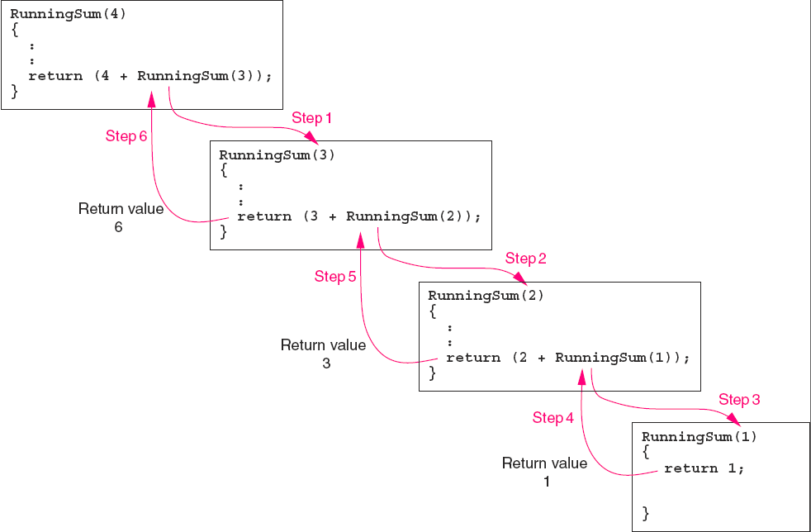
Running sum Recursion

Slide 4
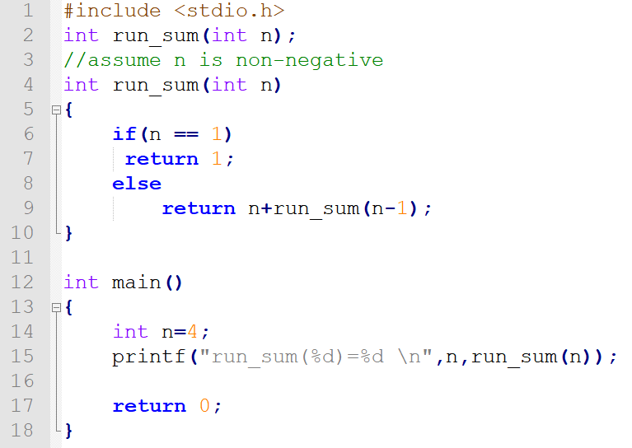
Running sum (code)

Slide 5
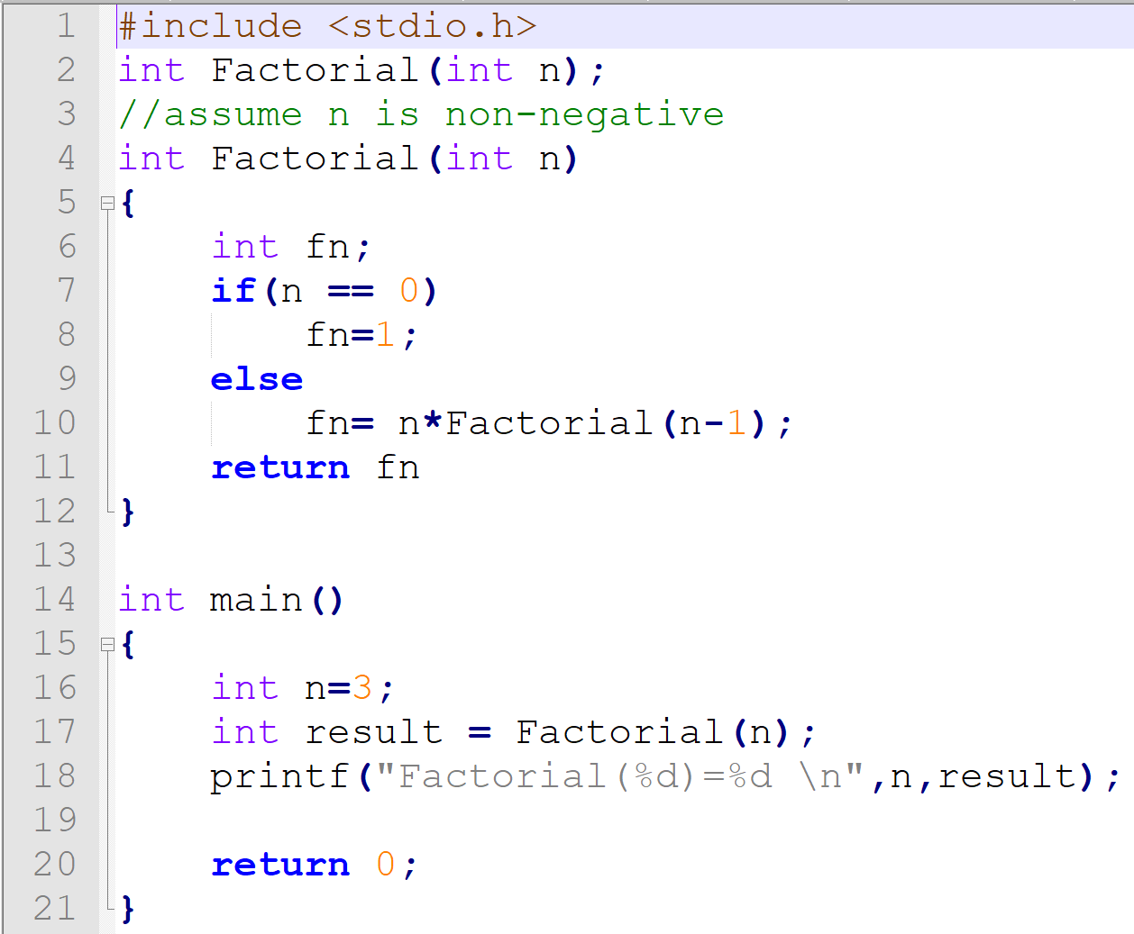
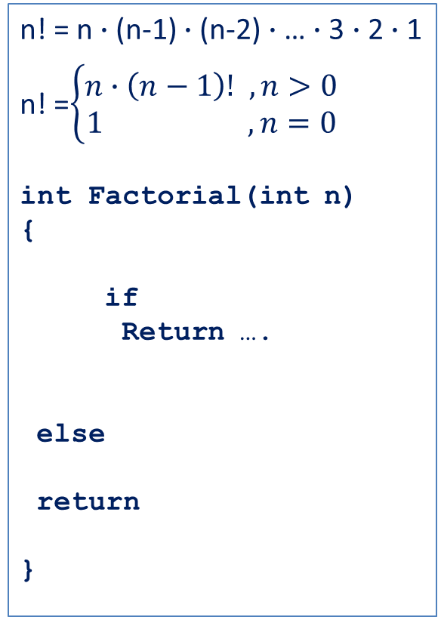
Factorial
n! = n$∙$(n-1) $∙$(n-2) $∙$… $∙$3 $∙$2 $∙$1
n! =$\left\{\begin{aligned}n∙\left(n−1\right)! ,n>0 \\ 1 ,n=0\end{aligned}\right.$
int Factorial(int n)
{
if
Return ….
else
return
}
10

Slide 6
Executing Factorial
Observation:
Each invocation solves a smaller version of the problem;
2) Once the base case is reached,
recursive process stops.
Factorial(3);
return value = 6
Factorial(3)
return 3 * Factorial(2);
return value = 2
Factorial(2)
return 2 * Factorial(1);
return value = 1
Factorial(1)
return 1 * Factorial(0);
return value = 1
Factorial(0)
return 1;
11

Slide 7
Run-Time Stack During Execution of Factorial
main calls Factorial(3)
Factorial(3) calls Factorial(2)
Factorial(2) calls Factorial(1)
Factorial(1) calls Factorial(0)
R6
Fact(0)
R6
Fact(1)
Fact(1)
R6
Fact(2)
Fact(2)
Fact(2)
R6
Fact(3)
Fact(3)
Fact(3)
Fact(3)
main
main
main
main
12

Slide 8
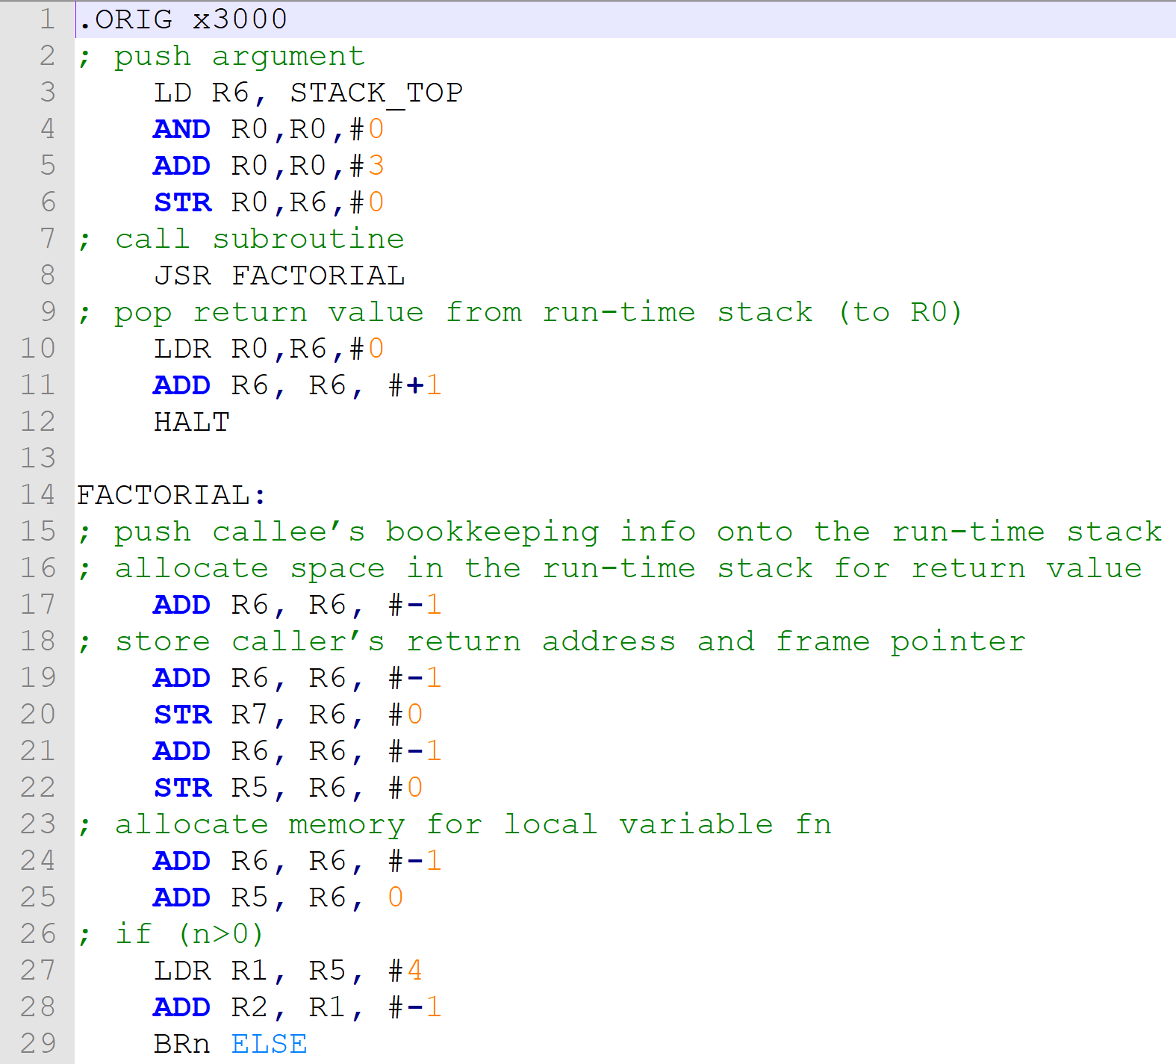
Recursion- C code to LC3
(See the code factorial.asm)

Slide 9
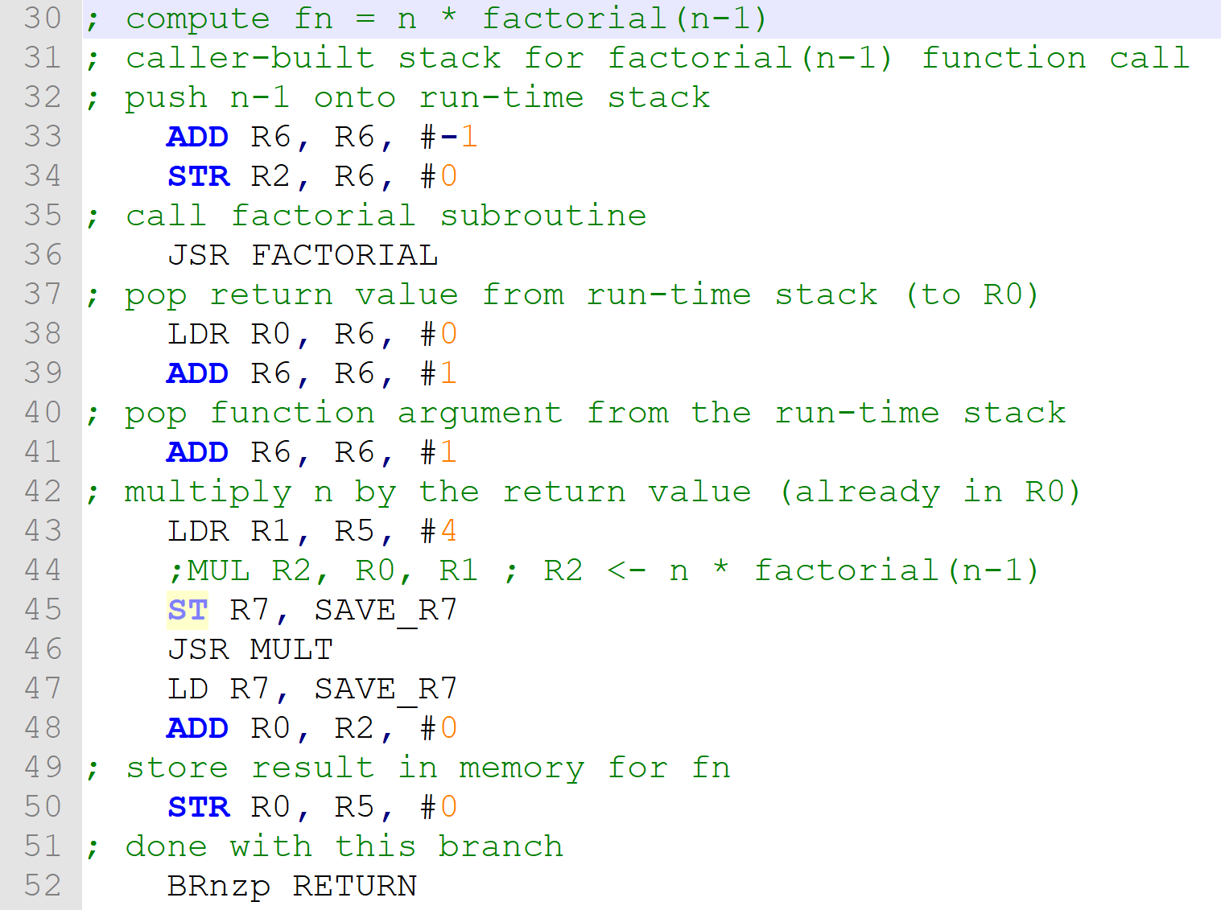
Recursion- C code to LC3 (cont.)
(See the code factorial.asm)

Slide 10
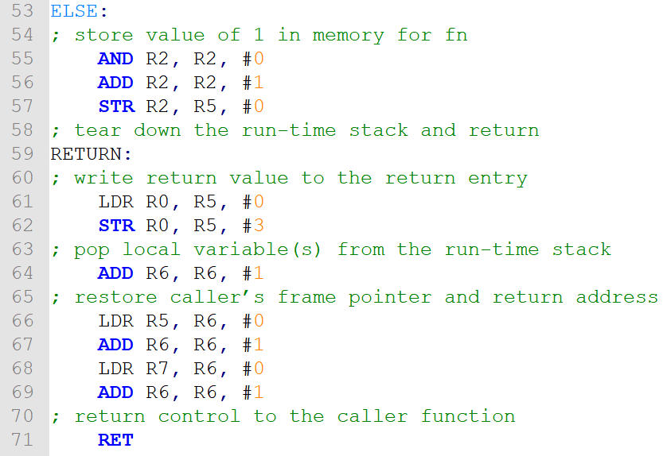
Recursion- C code to LC3 (cont.)

Slide 11
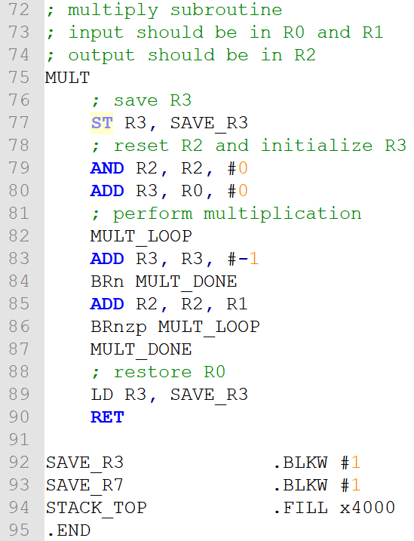
Recursion- C code to LC3 (cont.)
(See the code factorial.asm)

Slide 12
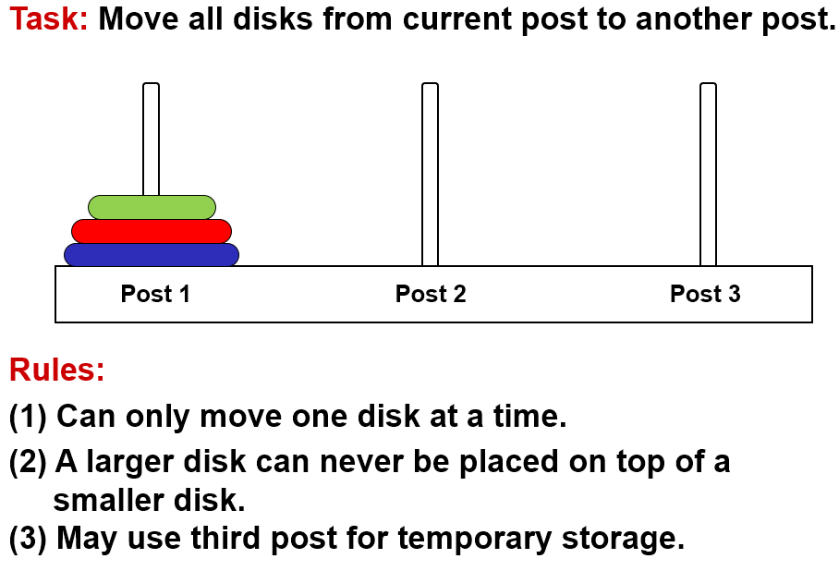
Towers of Hanoi Problem

Slide 13
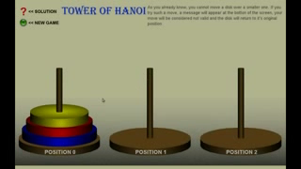
Tower of Hanoi (Animation)

Slide 14
Task Decomposition
Suppose disks start on Post 1, and target is Post 3.
1. Move top n-1 disks to Post 2.
2. Move largest disk to Post 3.
3. Move n-1 disks from Post 2 to Post 3.
1
2
3
1
2
3
1
2
3

Slide 15
Task Decomposition (cont.)
Task 1 is really the same problem, with fewer disks and a different target post.
"Move n-1 disks from Post 1 to Post 2."
And Task 3 is also the same problem, with fewer disks and different starting and target posts.
"Move n-1 disks from Post 2 to Post 3."
So this is a recursive algorithm.
The terminal case is moving the smallest disk -- can move directly without using third post.
Number disks from 1 (smallest) to n (largest).

Slide 16
Towers of Hanoi: Pseudocode
MoveDisk(diskNumber, startPost, endPost, midPost) { if (diskNumber > 1) { /* Move top n-1 disks to mid post */ MoveDisk(diskNumber-1, startPost, midPost, endPost); printf("Move disk number %d from %d to %d.\n", diskNumber, startPost, endPost); /* Move n-1 disks from mid post to end post */ MoveDisk(diskNumber-1, midPost, endPost, startPost); } else printf("Move disk number 1 from %d to %d.\n", startPost, endPost); }

Slide 17
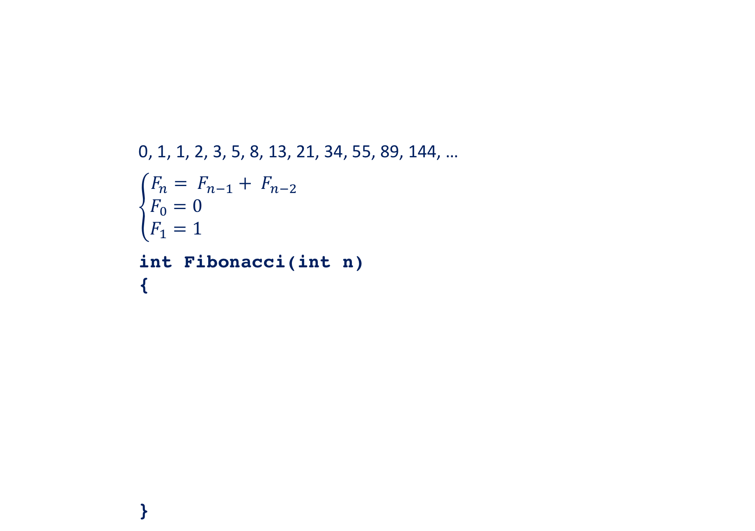
Fibonacci Number
0, 1, 1, 2, 3, 5, 8, 13, 21, 34, 55, 89, 144, …
$$\left\{\begin{aligned}F_{n}= F_{n−1}+ F_{n−2} \\ F_{0}=0 \\ F_{1}=1 \end{aligned}\right.$$
int Fibonacci(int n)
{
}
5

Slide 18
Fibonacci with Look-up Table
int table[100];
/* each element will be initialized to -1 in main */
int fibonacci(int n){
/*if fibonacci(n) has been calculated, return it*/
/*otherwise, perform the calculation, save it to table
and then return it*/
}
6

Slide 19
Binary Search
/*This function takes four arguments: pointer to a sorted array, the search item, the start index and the end index of the array. If the search item is found, the function returns its index in the array. Otherwise, it returns -1.*/
int binary(int array[], int item, int start, int end)
{
}
7

Slide 20
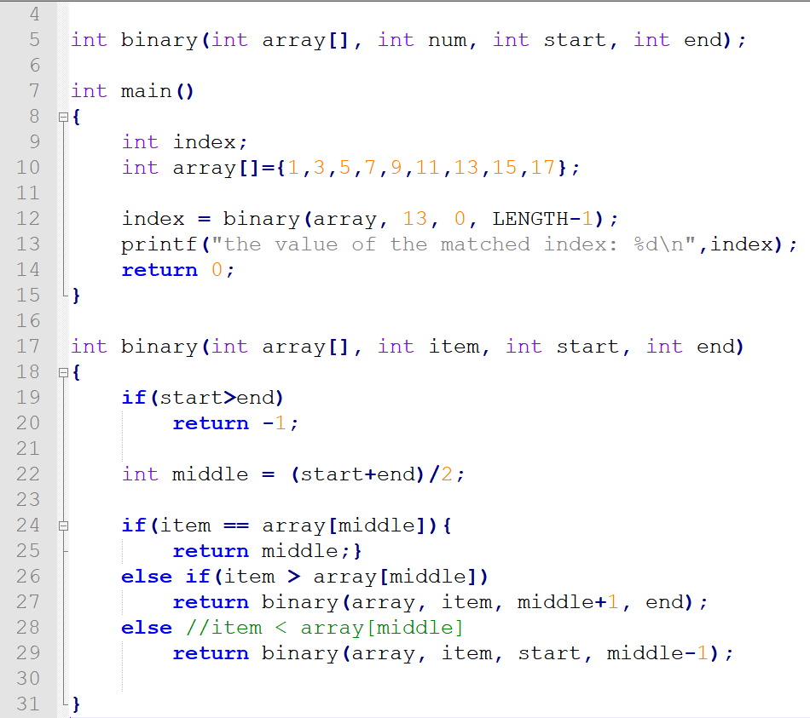

Slide 21
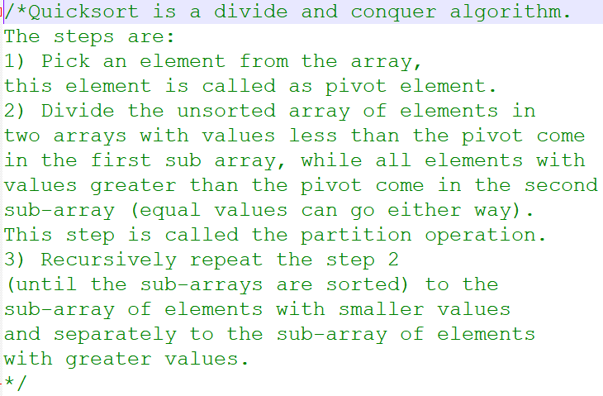
Quick Sort: also called divide-and-conquer
1) pick a pivot and partition array into 2 subarrays;
2) then sort subarrays using the same method.
8

Slide 22
Quick Sort: also called divide-and-conquer
1) pick a pivot and partition array into 2 subarrays;
2) then sort subarrays using the same method.
Pivot Element p
3 | 5 | 2 | 1 | 4
<p
>p
2 | 1 | 3 | 5 | 4
1 | 2
4 | 5
1
4
Sorted Array
1 | 2 | 3 | 4 | 5
8

Slide 23
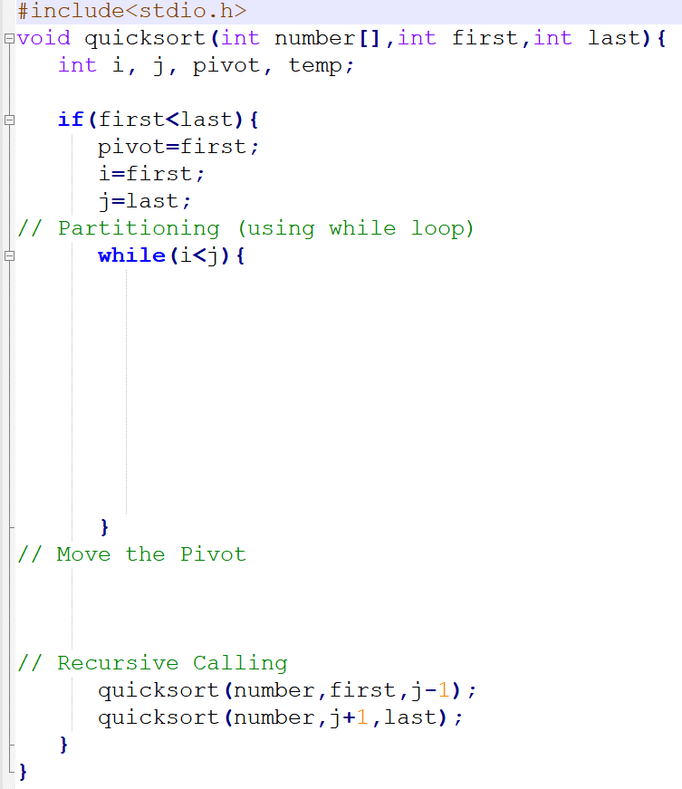
Quick Sort
9

