Slide 1

ECE 220 Computer Systems & Programming
Lecture 10 – Implementing Function in C and Run-Time Stack
September 26, 2019
Notes:
ECE Main Slide

Slide 2
Memory Allocation for Variables
When a C compiler compiles a program, it keeps track of variables in a program using a symbol table. Whenever it finds a new variable declaration, it creates a new entry in its symbol table corresponding to the variable being declared.
Symbol table contains enough information for the compiler to allocate storage in memory for the variable and for the generation of the proper sequence of machine code to access the value of that variable when it is used in the program.
Each entry in the symbol table has 4 items:
Name of the variable
Its type
Place in memory the variable has been allocated storage
Identifier for the block in which the variable is declared
Example: Next slide

Slide 3
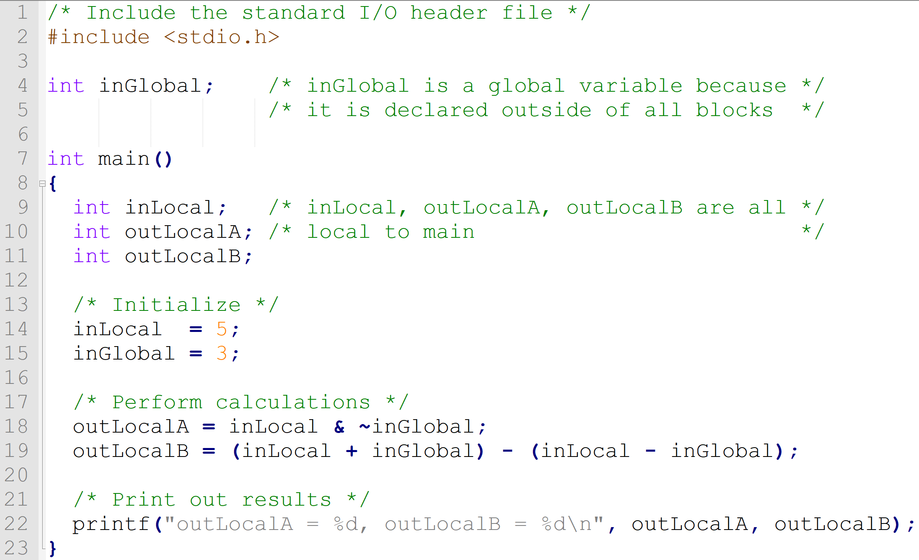
Example Code with Global and Local Variables:

Slide 4
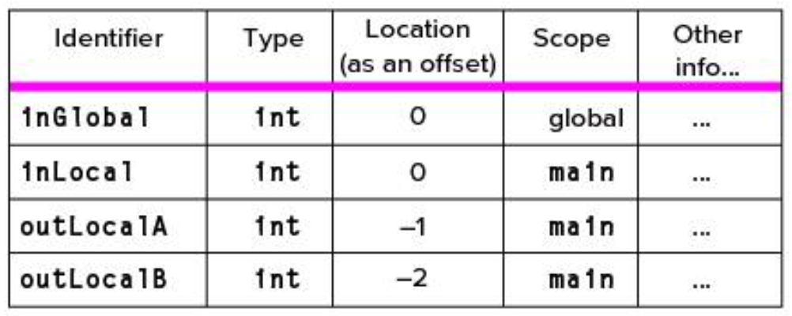
Memory Allocation, Symbol Table

Slide 5
LC-3 Memory:
There are two regions of memory in which C variables are allocated storage space:
Global data section
Where all global variables are stored
Or more generally where variables of the static storage class are allocated
Run-time stack
Where local variables (of the default automatic storage class) are allocated
We will talk about it in the next lecture

Slide 6
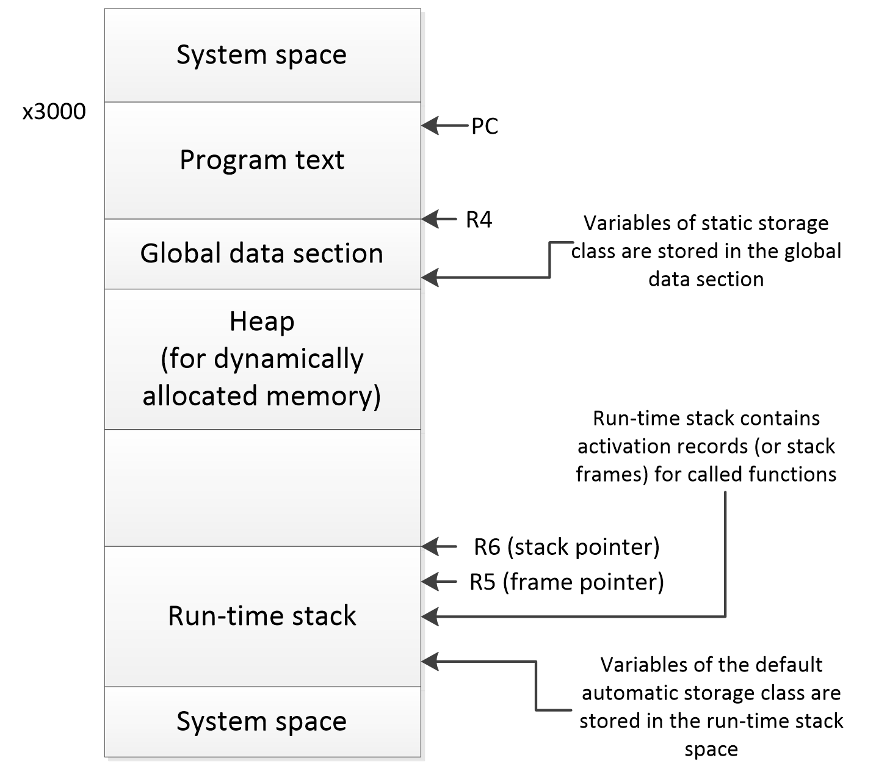
LC-3 Memory Organization:

Slide 7
Registers R4, R5 and R6 :
Note the use of registers R4, R5, and R6
R4 points to the first address of memory allocated for global variables
R5 contains frame pointer – memory region inside the function’s activation record where local variables are stored
R6 contains address of the top of the run-time stack

Slide 8
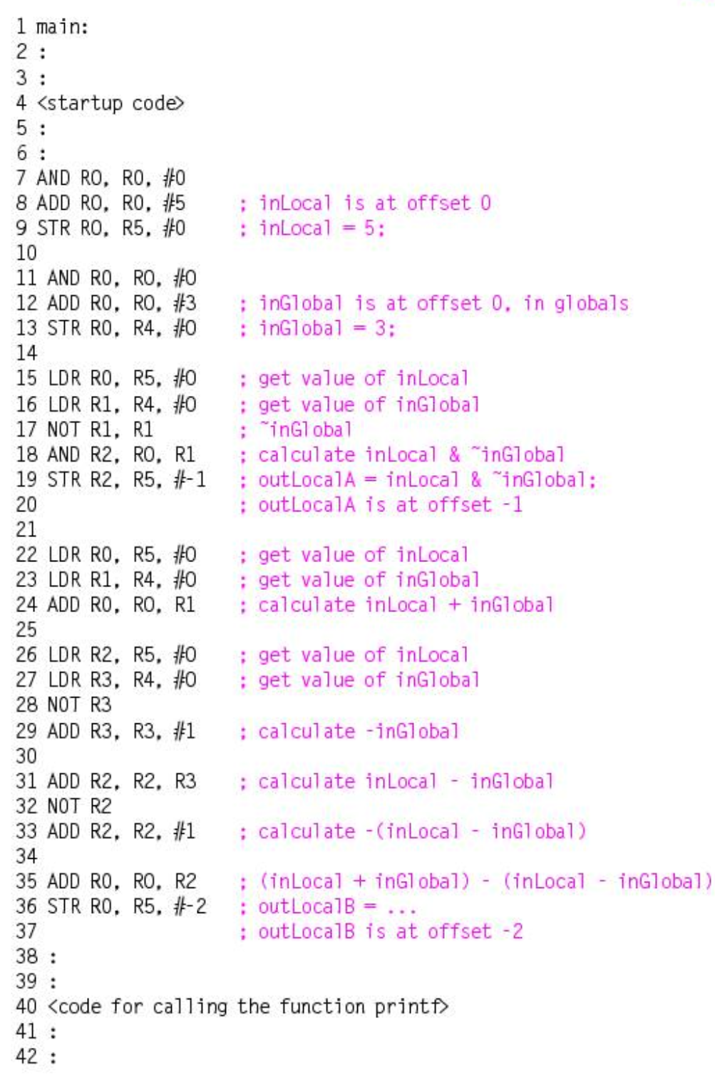
Symbol Table and LC-3 Code

Slide 9
Activation Records:
When we call a function in C, its activation record is pushed onto the run-time stack
Whenever a function completes, its activation record is popped off the run-time stack
Function’s activation record contains all the data local to the function involved in the function invocation, execution, and transfer of the results back to the calling function

Slide 10
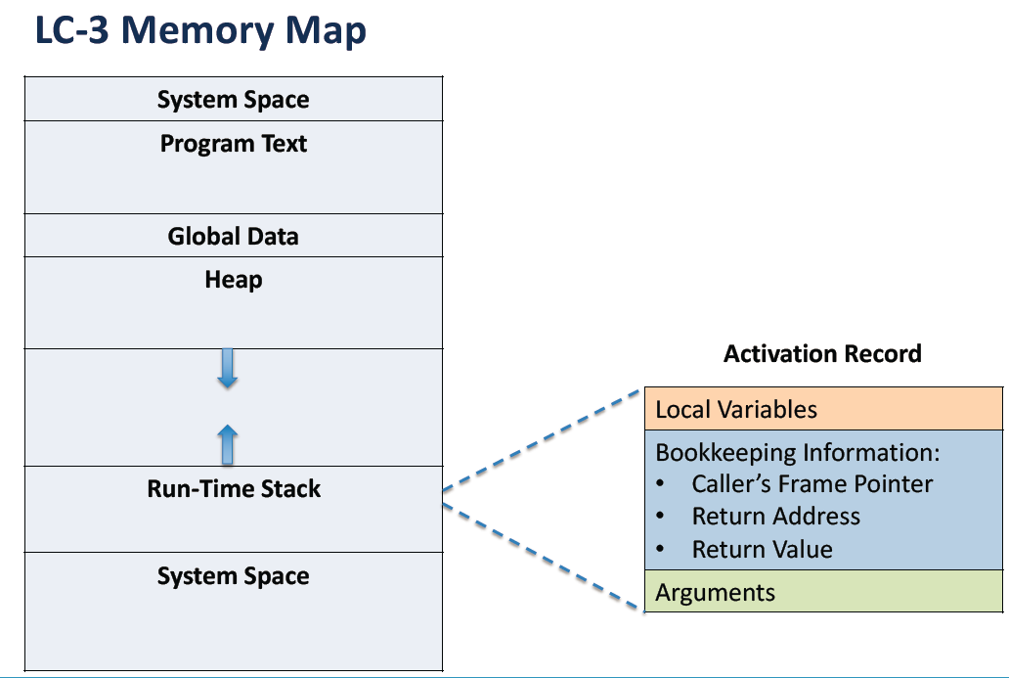

Slide 11
Activation Record
R6
y
x
w
caller’s frame pointer
return address
return value
a
b
int func(int a, int b) { int w, x, y; . . . return y; }
locals
R5
bookkeeping
args
8

Slide 12
Run-Time Stack
Recall that local variables are stored on the run-time stack in an activation record
Frame pointer (R5) points to the beginning of a region of activation record that stores local variables for the current function
When a new function is called, its activation record is pushed on the stack; when it returns, its activation record is popped off of the stack.

Slide 13
Run-Time Stack
Memory
Memory
Memory
R6
Watt
R5
R6
R6
R5
main
R5
main
main
Before call
During call
After call

Slide 14
Stack Built-up and Tear-down during Function Call and Return
1. caller setup: push callee’s arguments onto stack
2. pass control to callee (invoke function)
3. callee setup: (push bookkeeping info and local variables onto stack)
4. execute function
5. callee teardown: (pop local variables, caller’s frame pointer, and return address from stack)
6. return to caller
7. caller teardown: (pop callee’s return value and arguments from stack)
Caller function
Callee function
Caller function
9

Slide 15
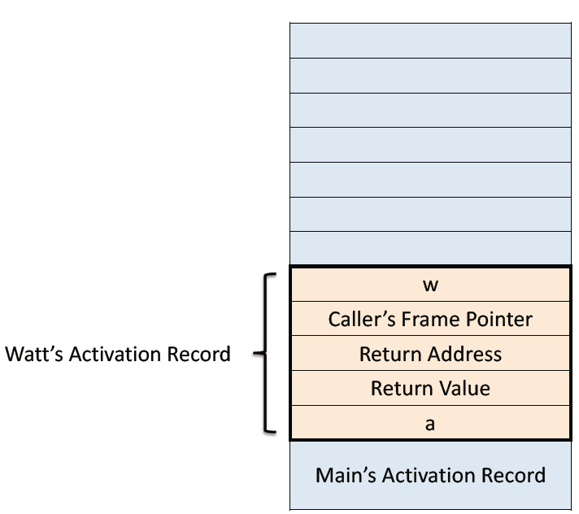
Example Function Call
int Volta(int q, int r) { int k; int m; ... return k; } int Watt(int a) { int w; ... w = Volta(w,10); ... return w; }

Slide 16
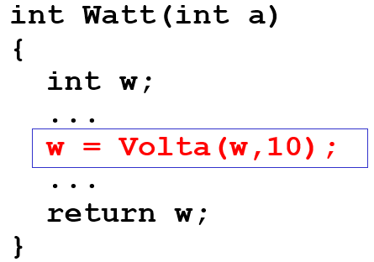
Calling the Function
25
10
25
q
r
w
dyn link
ret addr
ret val
a
w = Volta(w, 10);
; push second arg AND R0, R0, #0 ADD R0, R0, #10 ADD R6, R6, #-1 STR R0, R6, #0 ; push first argument LDR R0, R5, #0 ADD R6, R6, #-1 STR R0, R6, #0 ; call subroutine JSR Volta
new R6
R6
R5
xFD00
Note: Caller needs to know number and type of arguments, doesn't know about local variables.

Slide 17
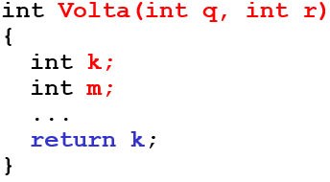
Starting the Callee Function
xFCFB
x3100
25
10
25
m
k
dyn link
ret addr
ret val
q
r
w
dyn link
ret addr
ret val
a
; leave space for return value ADD R6, R6, #-1 ; push return address ADD R6, R6, #-1 STR R7, R6, #0 ; push dyn link (caller’s frame ptr) ADD R6, R6, #-1 STR R5, R6, #0 ; set new frame pointer ADD R5, R6, #-1 ; allocate space for locals ADD R6, R6, #-2
new R6
new R5
R6
R5
xFD00

Slide 18
Ending the Callee Function
-43
217
xFCFB
x3100
217
25
10
25
m
k
dyn link
ret addr
ret val
q
r
w
dyn link
ret addr
ret val
a
return k;
; copy k into return value LDR R0, R5, #0 STR R0, R5, #3 ; pop local variables ADD R6, R5, #1 ; pop dynamic link (into R5) LDR R5, R6, #0 ADD R6, R6, #1 ; pop return addr (into R7) LDR R7, R6, #0 ADD R6, R6, #1 ; return control to caller RET
R6
R5
new R6
new R5
xFD00

Slide 19
Resuming the Caller Function
217
25
10
217
ret val
q
r
w
dyn link
ret addr
ret val
a
w = Volta(w,10);
JSR Volta ; load return value (top of stack) LDR R0, R6, #0 ; perform assignment STR R0, R5, #0
; pop return value; W=Volta(W,10) ADD R6, R6, #1
; pop arguments ADD R6, R6, #2
R6
new R6
R5
xFD00

Slide 20
Summary of LC-3 Function Call Implementation
Caller pushes arguments (last to first).
Caller invokes subroutine (JSR).
Callee allocates return value, pushes R7 and R5.
Callee allocates space for local variables.
Callee executes function code.
Callee stores result into return value slot.
Callee pops local vars, pops R5, pops R7.
Callee returns (JMP R7).
Caller loads return value and pops arguments.
Caller resumes computation…

Slide 21
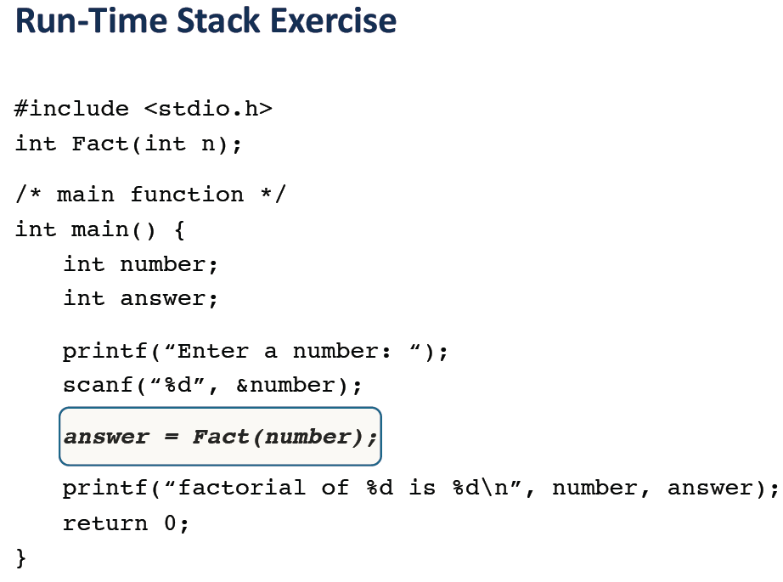
Adopted from Prof. Yuting’s lecture notes

Slide 22
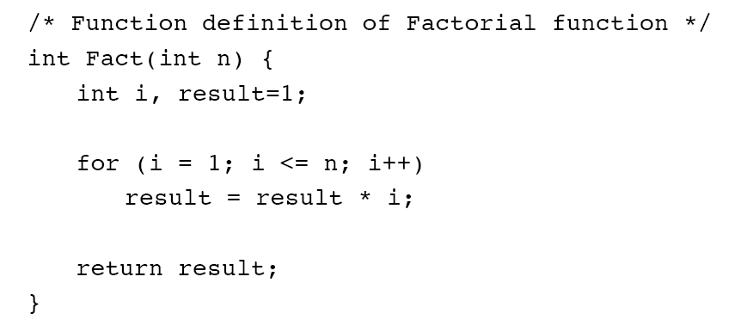

Slide 23
