Slide 1

ECE 220 Computer Systems & Programming
Lecture 8 – Control Structures
September 19, 2019
Notes:
ECE Main Slide

Slide 2
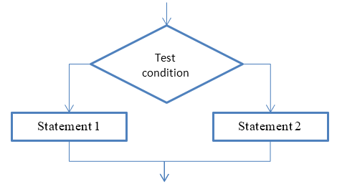
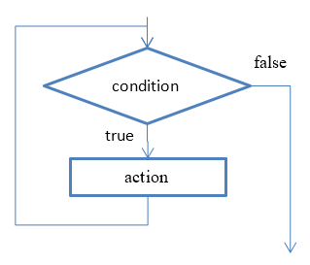
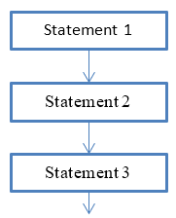
Control Structure
• There are three basic programing constructs: sequential, conditional, iterative
• Sequential construct means that C program instructions (statements) are executed sequentially, one after another
• Conditional construct means that one or another statement will be executed, but not both, depending on some condition.
• Iterative construct means that some statements will be executed multiple times until some condition is met

Slide 3
Control Structures
Conditional Constructs
if
if - else
switch
Iteration Constructs (loops)
while
do - while
for
3

Slide 4
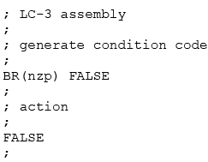
The if Statement (similar to BR in LC-3)
int x;
… //assign some value to x
if (x < 0)
x = -x; //invert x only if x < 0
int y = 0;
if ((x > 5) && (x < 25))
{
y = x * x + 5;
printf(“y = %d\n”, y);
}
* What would happen if {} is omitted?
condition
F
T
action
If (x=2) if (x==2)
y=5; y = 5
4

Slide 5
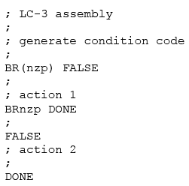
The if - else Statement
T
condition
F
/*x and y are of type int*/
if (x < 0)
x = -x;
else
x = x * 2;
if ((x > 5) && (x < 25))
{
y = x * x +5;
printf(“y = %d\n”, y);
}
else
printf(“x = %d\n”, x);
action_if
action_else
5

Slide 6
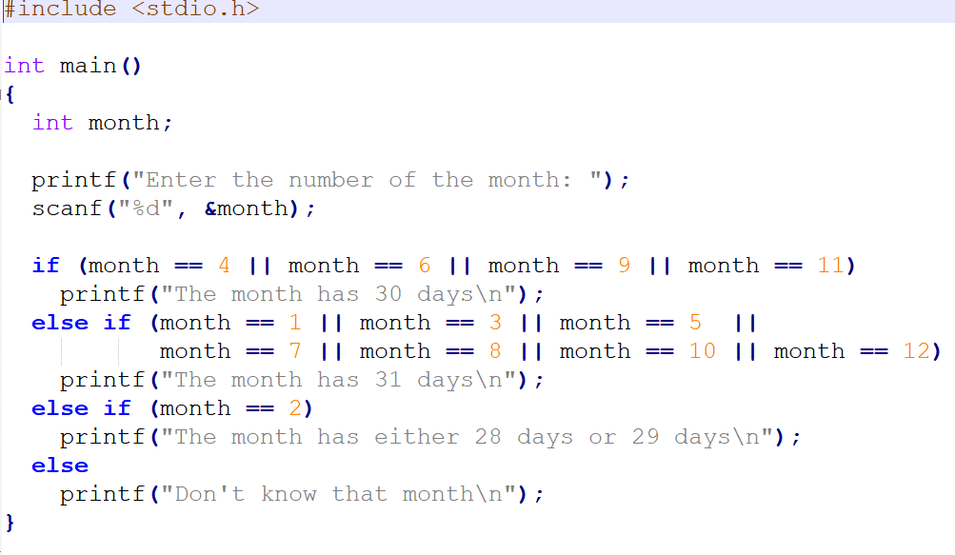
If, else-if, else statements:

Slide 7
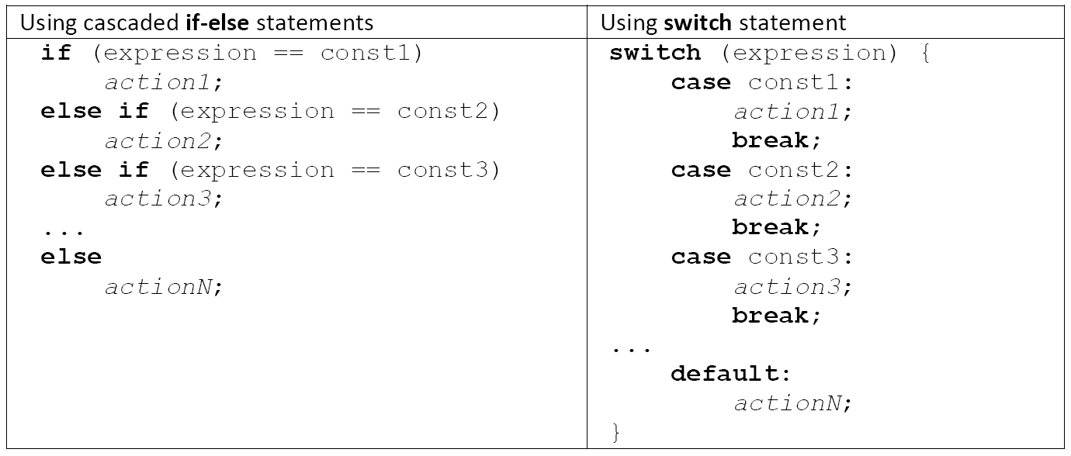
Switch statement:
gives compiler an opportunity to better optimize the code by bypassing some testing.
e.g. expression is a keypress data [see the example code (switch.c) on github]

Slide 8
The switch Statement
if
else if
else if
…
else
switch (expression)
{
case const1:
action 1;
break;
case const2:
action 2;
break;
...
default:
default action;
break;
}
// notice the use of ‘break’
*See the github example code
6

Slide 9
The while / do - while Statement
while: loop body may or may not
be executed even once
do – while: loop body will be
executed at least once
int x = 0;
while (x < 10) {
printf(“x=%d\n”, x);
x = x + 1;
}
/* let, x=10 */
int x = 0;
do {
printf(“x=%d\n”, x);
x = x + 1;
} while (x < 10);
7
Notes:
See the code on github

Slide 10
int x = 0;
while (x < 10) {
printf(“x=%d\n”, x);
x = x + 1;
}
The for Statement
int x;
for (x = 0; x < 10; x++)
{
printf(“x=%d\n”, x);
}
What would cause while loop or for loop to become infinite loops?
for (x = 0; x < 10; x++){
if (x == 5)
break;
printf(“x=%d\n”, x);
} /* what would be the print out? What if ‘break’ is replaced with ‘continue’? */
Example: on github break_continue.c
8

Slide 11
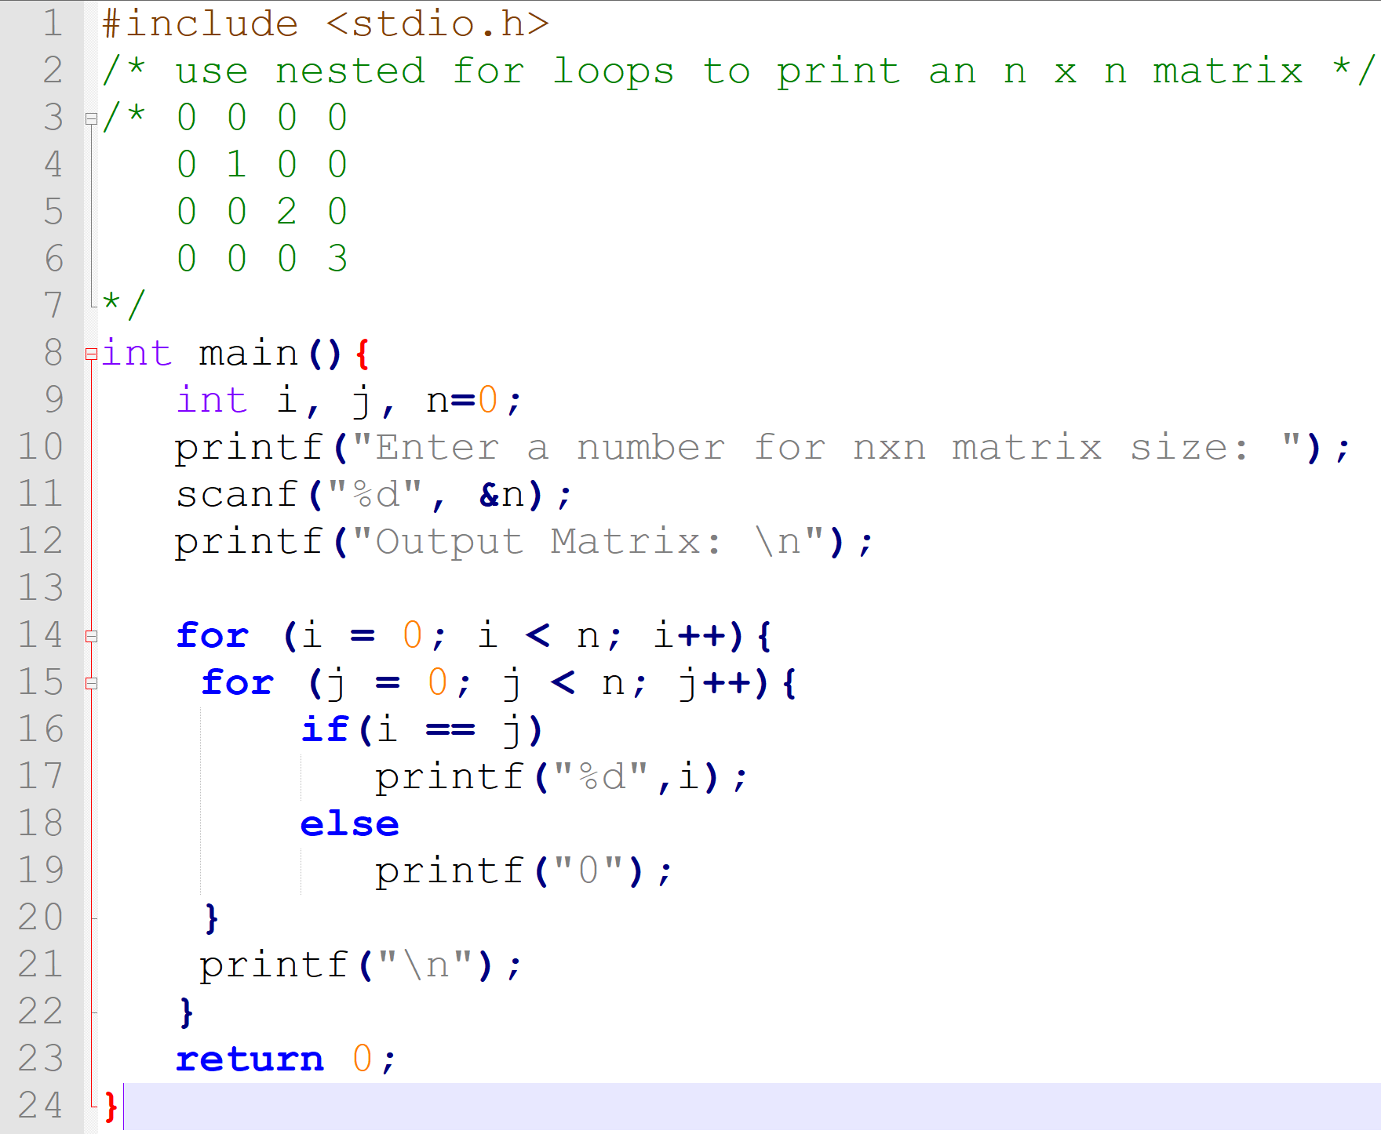
Nested Loops
9

Slide 12
Follow-up Questions
How to take user input for the value of n, for which n has to be >0 and <10?
(If user input is invalid, print the message “Number entered is invalid” and prompt the user to enter a number again. )
What are some ways to stop after printing the second diagonal element, such as the example below?
0 0 0 0
0 1 0 0
0 0 2
11

Slide 13
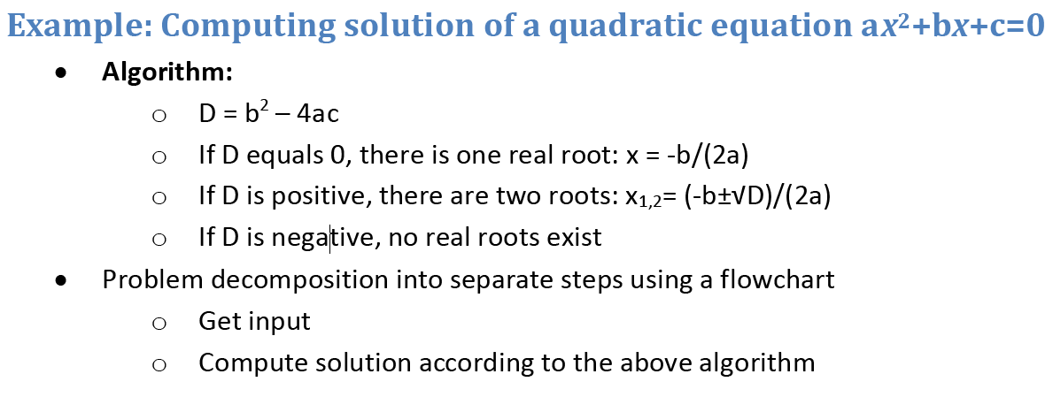

Slide 14
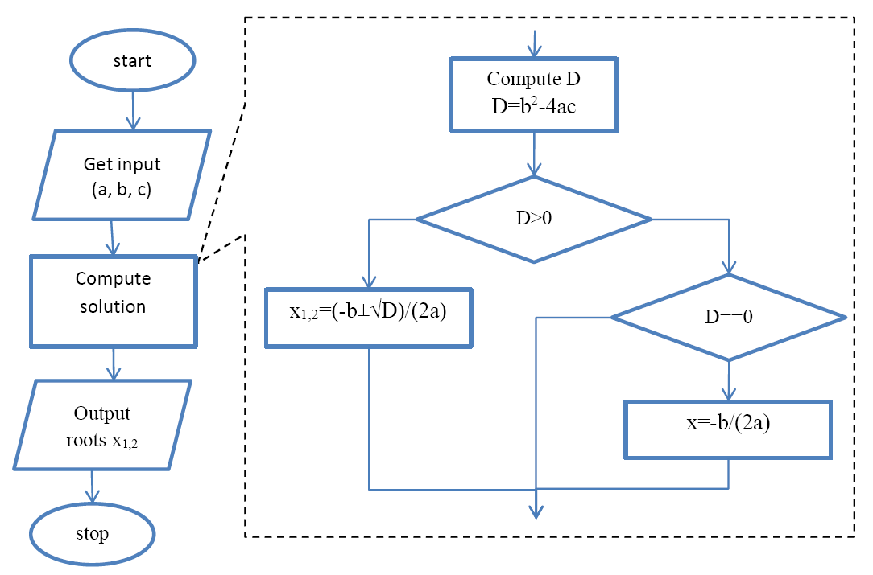

Slide 15
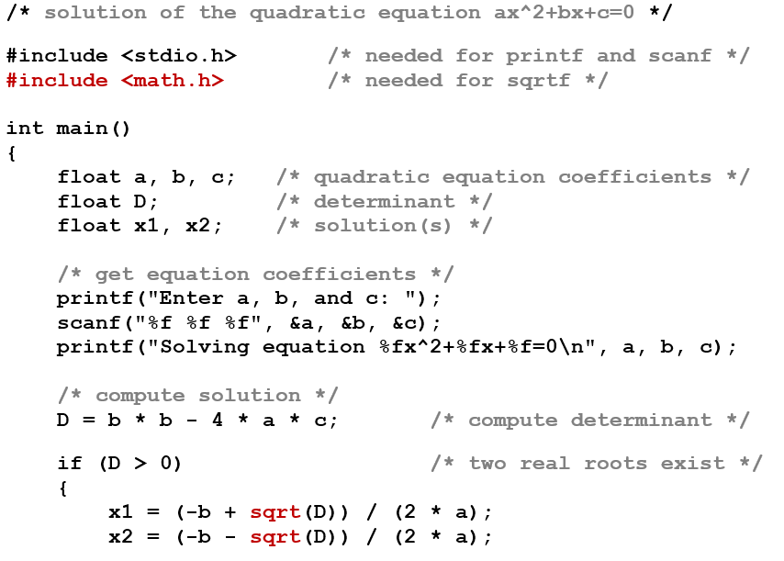
Solution of the quadratic equation:

Slide 16
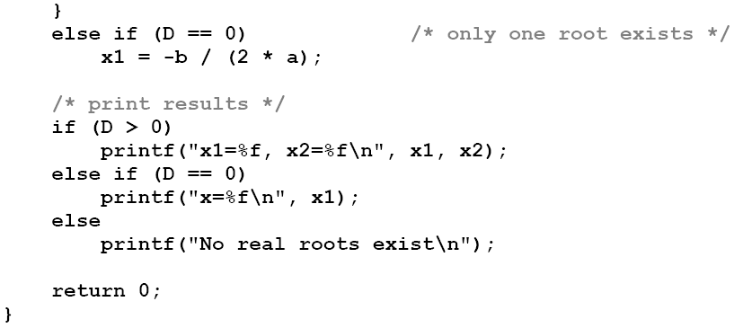
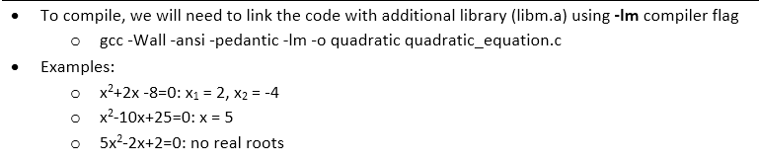
(continue)

Slide 17
Exercise
# Write a program that finds all the prime numbers between 2 and n; where, n is an int value within the range of your data type.
#MP3 discussion:
10

