Slide 1

ECE 220 Computer Systems & Programming
Lecture 22 – C to LC-3 with Linked Data Structure
Notes:
ECE Main Slide

Slide 2
C to LC-3 – Assembly Translation with linked data structure
Recursive tree traversal
Problem statement: Convert the following function from C to LC-3. This function recursively traverses a binary tree.
void TraverseTree(t_node *nd)
{
if (nd != NULL)
{
TraverseTree(nd->left);
TraverseTree(nd->right);
}
}
5
Notes:
Remember that structures merely consist of simple data types where one element always comes after another in memory.
Also, we assume each basic data type takes only one memory position.
That is if nd points to an address of x6000, the data data is contained within x6000, the left pointer address is contained within x6001, and the right pointer address is at x6002.

Slide 3
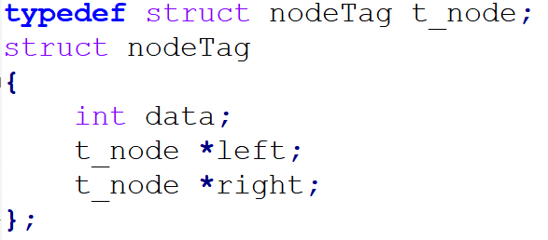
C to LC-3 – Assembly Translation with linked data structure
Recursive tree traversal
Problem statement: Convert the following function from C to LC-3. This function recursively traverses a binary tree.
void TraverseTree(t_node *nd)
{
if (nd != NULL)
{
TraverseTree(nd->left);
TraverseTree(nd->right);
}
}
5
Notes:
Remember that structures merely consist of simple data types where one element always comes after another in memory.
Also, we assume each basic data type takes only one memory position.
That is if nd points to an address of x6000, the data data is contained within x6000, the left pointer address is contained within x6001, and the right pointer address is at x6002.

Slide 4
Activation Record
6

Slide 5
Step#1
TRAVERSE_TREE
; Allocate space for return value
ADD R6, R6, #-1
; Push return address to stack
ADD R6, R6, #-1
STR R7, R6, #0
; Store callee's frame pointer
ADD R6, R6, #-1
STR R5, R6, #0
; Set up new frame pointer
ADD R5, R6, #-1

Slide 6
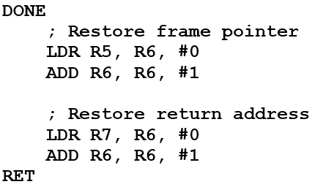
Step#2: Implement Logic Function
; if (nd == NULL), skip to the end
LDR R0, R5, #4;
BRz DONE
; TraverseTree(nd->left);
LDR R1, R0, #1 ; load nd->left to R1
; push nd->left to stack
ADD R6, R6, #-1
STR R1, R6, #0
; call subroutine
JSR TRAVERSE_TREE

Slide 7
Step#2: Implement Logic Function
; tear-down the rest of the stack
ADD R6, R6, #2
; TraverseTree(nd->right);
LDR R0, R5,#4
LDR R2, R0, #2 ; load nd->right to R2
; push nd->right to stack
ADD R6, R6, #-1;
STR R2, R6, #0;
; call subroutine
JSR TRAVERSE_TREE
; tear-down the rest of the stack
ADD R6, R6, #2
Teardown the activation record, return:
; if (nd == NULL), skip to the end
LDR R0, R5, #4;
BRz DONE
; TraverseTree(nd->left);
LDR R1, R0, #1 ; load nd->left to R1
; push nd->left to stack
ADD R6, R6, #-1
STR R1, R6, #0
; call subroutine
JSR TRAVERSE_TREE

Slide 8
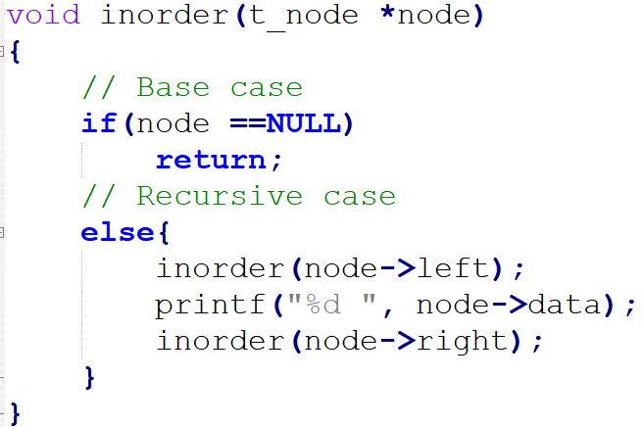
inOrder LC3 (please see, inOrder.asm in github)

Slide 9
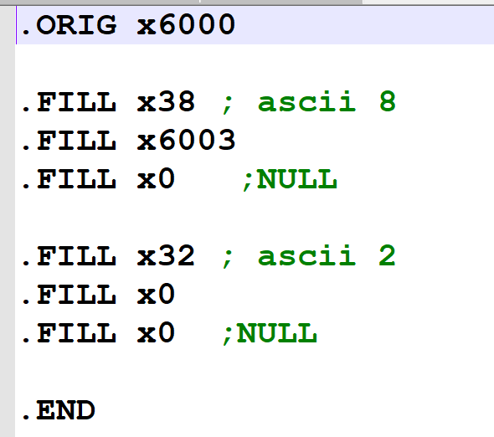
Data_inOrder.asm
8
2

Slide 10
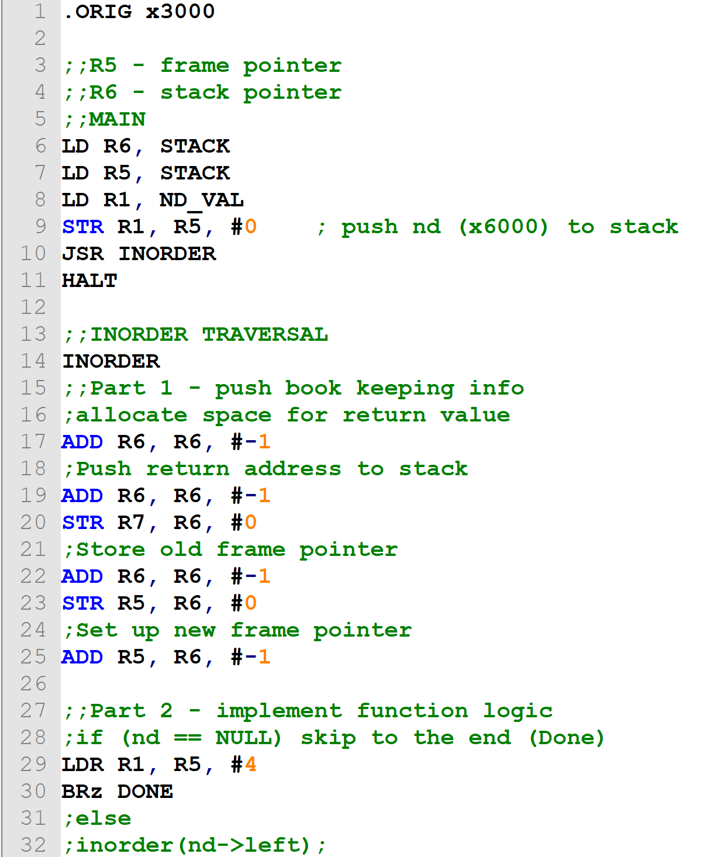
inOrder.asm

Slide 11
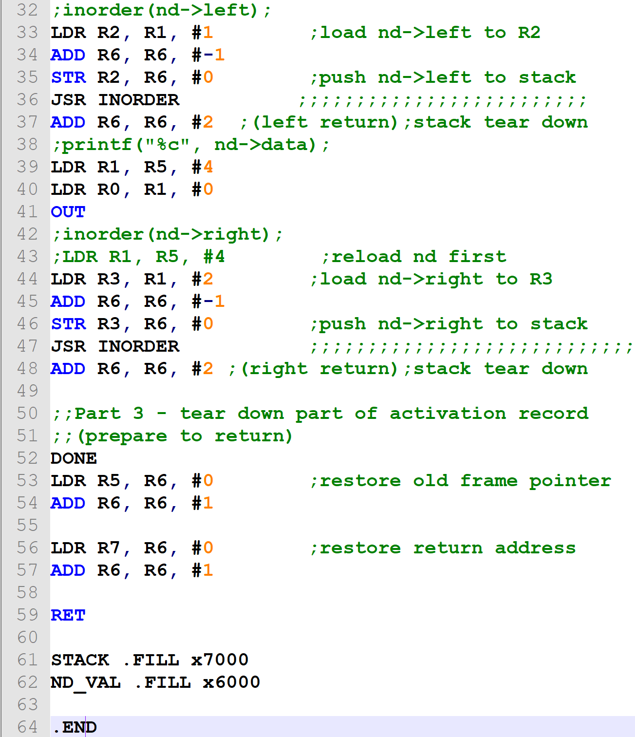
inOrder.asm(cont)

Slide 12
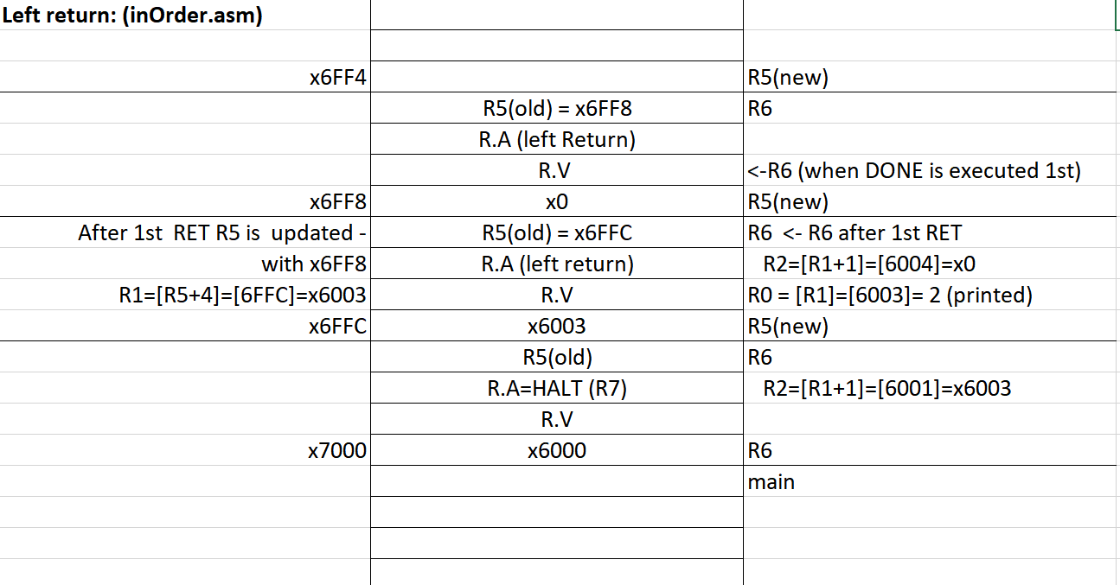

Slide 13
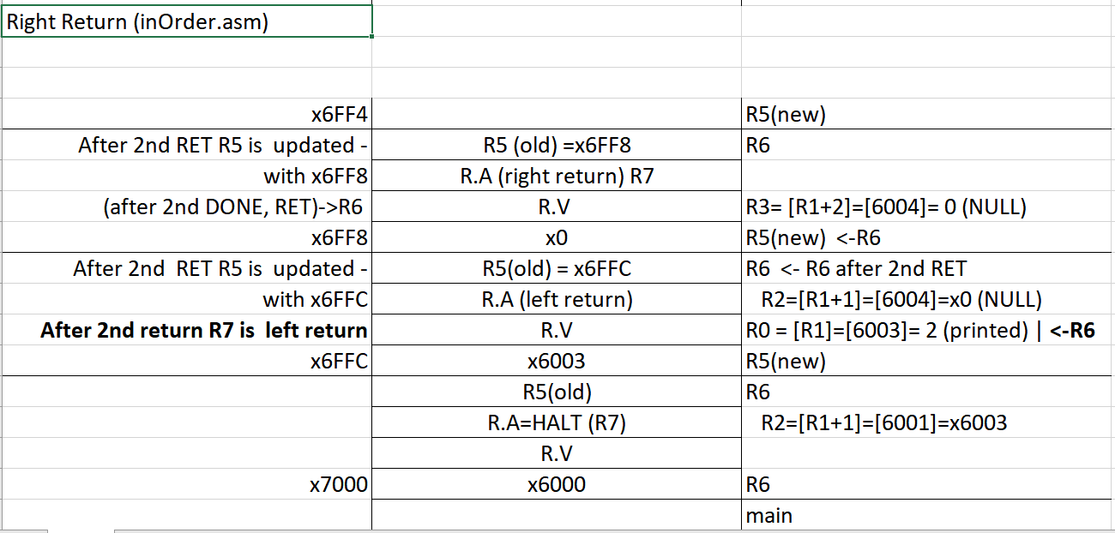

Slide 14
Left return: (inOrder.asm)
x6FF4 |  | R5(new)
Restore R5 = x6FF8 | R5(old) = x6FF8 | R6
 | R.A (left Return)
 | R.V | <-R6 (when DONE is executed 1st)
x6FF8 | x0 | R5(new)
After 1st RET R5 is updated - | R5(old) = x6FFC | R6 <- R6 after 1st RET
with x6FF8 | R.A (left return) | R2=[R1+1]=[6004]=x0
R1=[R5+4]=[6FFC]=x6003 | R.V | R0 = [R1]=[6003]= 2 (printed)
x6FFC | x6003 | R5(new)
 | R5(old) | R6
 | R.A=HALT (R7) | R2=[R1+1]=[6001]=x6003
 | R.V
x7000 | x6000 | R6, R5
 |  | main

Slide 15
Left return: (inOrder.asm)
x6FF4 |  | R5(new)
Restore R5 = x6FF8 | R5(old) = x6FF8 | R6
 | R.A (left Return)
 | R.V | <-R6 (when DONE is executed 1st)
x6FF8 | x0 | R5(new)
After 1st RET R5 is updated - | R5(old) = x6FFC | R6 <- R6 after 1st RET
with x6FF8 | R.A (left return) | R2=[R1+1]=[6004]=x0
R1=[R5+4]=[6FFC]=x6003 | R.V | R0 = [R1]=[6003]= 2 (printed)
x6FFC | x6003 | R5(new)
 | R5(old) | R6
 | R.A=HALT (R7) | R2=[R1+1]=[6001]=x6003
 | R.V
x7000 | x6000 | R6, R5
 |  | main

Slide 16
Left return: (inOrder.asm)
x6FF4 |  | R5(new)
Restore R5 = x6FF8 | R5(old) = x6FF8 | R6
 | R.A (left Return)
 | R.V | <-R6 (when DONE is executed 1st)
x6FF8 | x0 | R5(new)
After 1st RET R5 is updated - | R5(old) = x6FFC | R6 <- R6 after 1st RET
with x6FF8 | R.A (left return) | R2=[R1+1]=[6004]=x0
R1=[R5+4]=[6FFC]=x6003 | R.V | R0 = [R1]=[6003]= 2 (printed)
x6FFC | x6003 | R5(new)
 | R5(old) | R6
 | R.A=HALT (R7) | R2=[R1+1]=[6001]=x6003
 | R.V
x7000 | x6000 | R6, R5
 |  | main

Slide 17
Left return: (inOrder.asm)
x6FF4 |  | R5(new)
Restore R5 = x6FF8 | R5(old) = x6FF8 | R6
 | R.A (left Return)
 | R.V | <-R6 (when DONE is executed 1st)
x6FF8 | x0 | R5(new)
After 1st RET R5 is updated - | R5(old) = x6FFC | R6 <- R6 after 1st RET
with x6FF8 | R.A (left return) | R2=[R1+1]=[6004]=x0
R1=[R5+4]=[6FFC]=x6003 | R.V | R0 = [R1]=[6003]= 2 (printed)
x6FFC | x6003 | R5(new)
 | R5(old) | R6
 | R.A=HALT (R7) | R2=[R1+1]=[6001]=x6003
 | R.V
x7000 | x6000 | R6, R5
 |  | main

Slide 18
Left return: (inOrder.asm)
x6FF4 |  | R5(new)
Restore R5 = x6FF8 | R5(old) = x6FF8 | R6
 | R.A (left Return)
 | R.V | <-R6 (when DONE is executed 1st)
x6FF8 | x0 | R5(new)
After 1st RET R5 is updated - | R5(old) = x6FFC | R6 <- R6 after 1st RET
with x6FF8 | R.A (left return) | R2=[R1+1]=[6004]=x0
R1=[R5+4]=[6FFC]=x6003 | R.V | R0 = [R1]=[6003]= 2 (printed)
x6FFC | x6003 | R5(new)
 | R5(old) | R6
 | R.A=HALT (R7) | R2=[R1+1]=[6001]=x6003
 | R.V
x7000 | x6000 | R6, R5
 |  | main

Slide 19
Left return: (inOrder.asm)
x6FF4 |  | R5(new)
Restore R5 = x6FF8 | R5(old) = x6FF8 | R6
 | R.A (left Return)
 | R.V | <-R6 (when DONE is executed 1st)
x6FF8 | x0 | R5(new)
After 1st RET R5 is updated - | R5(old) = x6FFC | R6 <- R6 after 1st RET
with x6FF8 | R.A (left return) | R2=[R1+1]=[6004]=x0
R1=[R5+4]=[6FFC]=x6003 | R.V | R0 = [R1]=[6003]= 2 (printed)
x6FFC | x6003 | R5(new)
 | R5(old) | R6
 | R.A=HALT (R7) | R2=[R1+1]=[6001]=x6003
 | R.V
x7000 | x6000 | R6, R5
 |  | main

Slide 20
Left return: (inOrder.asm)
x6FF4 |  | R5(new)
Restore R5 = x6FF8 | R5(old) = x6FF8 | R6
 | R.A (left Return)
 | R.V | <-R6 (when DONE is executed 1st)
x6FF8 | x0 | R5(new)
After 1st RET R5 is updated - | R5(old) = x6FFC | R6 <- R6 after 1st RET
with x6FF8 | R.A (left return) | R2=[R1+1]=[6004]=x0
R1=[R5+4]=[6FFC]=x6003 | R.V | R0 = [R1]=[6003]= 2 (printed)
x6FFC | x6003 | R5(new)
 | R5(old) | R6
 | R.A=HALT (R7) | R2=[R1+1]=[6001]=x6003
 | R.V
x7000 | x6000 | R6, R5
 |  | main

Slide 21
Left return: (inOrder.asm)
x6FF4 |  | R5(new)
Restore R5 = x6FF8 | R5(old) = x6FF8 | R6
 | R.A (left Return)
 | R.V | <-R6 (when DONE is executed 1st)
x6FF8 | x0 | R5(new)
After 1st RET R5 is updated - | R5(old) = x6FFC | R6 <- R6 after 1st RET
with x6FF8 | R.A (left return) | R2=[R1+1]=[6004]=x0
R1=[R5+4]=[6FFC]=x6003 | R.V | R0 = [R1]=[6003]= 2 (printed)
x6FFC | x6003 | R5(new)
 | R5(old) | R6
 | R.A=HALT (R7) | R2=[R1+1]=[6001]=x6003
 | R.V
x7000 | x6000 | R6, R5
 |  | main

Slide 22
Left return: (inOrder.asm)
x6FF4 |  | R5(new)
Restore R5 = x6FF8 | R5(old) = x6FF8 | R6
 | R.A (left Return)
 | R.V | <-R6 (when DONE is executed 1st)
x6FF8 | x0 | R5(new)
After 1st RET R5 is updated - | R5(old) = x6FFC | R6 <- R6 after 1st RET
with x6FF8 | R.A (left return) | R2=[R1+1]=[6004]=x0
R1=[R5+4]=[6FFC]=x6003 | R.V | R0 = [R1]=[6003]= 2 (printed)
x6FFC | x6003 | R5(new)
 | R5(old) | R6
 | R.A=HALT (R7) | R2=[R1+1]=[6001]=x6003
 | R.V
x7000 | x6000 | R6, R5
 |  | main

Slide 23
Left return: (inOrder.asm)
x6FF4 |  | R5(new)
Restore R5 = x6FF8 | R5(old) = x6FF8 | R6
 | R.A (left Return)
 | R.V | <-R6 (when DONE is executed 1st)
x6FF8 | x0 | R5(new)
After 1st RET R5 is updated - | R5(old) = x6FFC | R6 <- R6 after 1st RET
with x6FF8 | R.A (left return) | R2=[R1+1]=[6004]=x0
R1=[R5+4]=[6FFC]=x6003 | R.V | R0 = [R1]=[6003]= 2 (printed)
x6FFC | x6003 | R5(new)
 | R5(old) | R6
 | R.A=HALT (R7) | R2=[R1+1]=[6001]=x6003
 | R.V
x7000 | x6000 | R6, R5
 |  | main

Slide 24
Left return: (inOrder.asm)
x6FF4 |  | R5(new)
Restore R5 = x6FF8 | R5(old) = x6FF8 | R6
 | R.A (left Return)
 | R.V | <-R6 (when DONE is executed 1st)
x6FF8 | x0 | R5(new)
After 1st RET R5 is updated - | R5(old) = x6FFC | R6 <- R6 after 1st RET
with x6FF8 | R.A (left return) | R2=[R1+1]=[6004]=x0
R1=[R5+4]=[6FFC]=x6003 | R.V | R0 = [R1]=[6003]= 2 (printed)
x6FFC | x6003 | R5(new)
 | R5(old) | R6
 | R.A=HALT (R7) | R2=[R1+1]=[6001]=x6003
 | R.V
x7000 | x6000 | R6, R5
 |  | main

Slide 25
Left return: (inOrder.asm)
x6FF4 |  | R5(new)
Restore R5 = x6FF8 | R5(old) = x6FF8 | R6
 | R.A (left Return)
 | R.V | <-R6 (when DONE is executed 1st)
x6FF8 | x0 | R5(new)
After 1st RET R5 is updated - | R5(old) = x6FFC | R6 <- R6 after 1st RET
with x6FF8 | R.A (left return) | R2=[R1+1]=[6004]=x0
R1=[R5+4]=[6FFC]=x6003 | R.V | R0 = [R1]=[6003]= 2 (printed)
x6FFC | x6003 | R5(new)
 | R5(old) | R6
 | R.A=HALT (R7) | R2=[R1+1]=[6001]=x6003
 | R.V
x7000 | x6000 | R6, R5
 |  | main

Slide 26
Left return: (inOrder.asm)
x6FF4 |  | R5(new)
Restore R5 = x6FF8 | R5(old) = x6FF8 | R6
 | R.A (left Return)
 | R.V | <-R6 (when DONE is executed 1st)
x6FF8 | x0 | R5(new)
After 1st RET R5 is updated - | R5(old) = x6FFC | R6 <- R6 after 1st RET
with x6FF8 | R.A (left return) | R2=[R1+1]=[6004]=x0
R1=[R5+4]=[6FFC]=x6003 | R.V | R0 = [R1]=[6003]= 2 (printed)
x6FFC | x6003 | R5(new)
 | R5(old) | R6
 | R.A=HALT (R7) | R2=[R1+1]=[6001]=x6003
 | R.V
x7000 | x6000 | R6, R5
 |  | main

Slide 27
Left return: (inOrder.asm)
x6FF4 |  | R5(new)
Restore R5 = x6FF8 | R5(old) = x6FF8 | R6
 | R.A (left Return)
 | R.V | <-R6 (when DONE is executed 1st)
x6FF8 | x0 | R5(new)
After 1st RET R5 is updated - | R5(old) = x6FFC | R6 <- R6 after 1st RET
with x6FF8 | R.A (left return) | R2=[R1+1]=[6004]=x0
R1=[R5+4]=[6FFC]=x6003 | R.V | R0 = [R1]=[6003]= 2 (printed)
x6FFC | x6003 | R5(new)
 | R5(old) | R6
 | R.A=HALT (R7) | R2=[R1+1]=[6001]=x6003
 | R.V
x7000 | x6000 | R6, R5
 |  | main

Slide 28
Left return: (inOrder.asm)
x6FF4 |  | R5(new)
Restore R5 = x6FF8 | R5(old) = x6FF8 | R6
 | R.A (left Return)
 | R.V | <-R6 (when DONE is executed 1st)
x6FF8 | x0 | R5(new)
After 1st RET R5 is updated - | R5(old) = x6FFC | R6 <- R6 after 1st RET
with x6FF8 | R.A (left return) | R2=[R1+1]=[6004]=x0
R1=[R5+4]=[6FFC]=x6003 | R.V | R0 = [R1]=[6003]= 2 (printed)
x6FFC | x6003 | R5(new)
 | R5(old) | R6
 | R.A=HALT (R7) | R2=[R1+1]=[6001]=x6003
 | R.V
x7000 | x6000 | R6, R5
 |  | main

Slide 29
Left return: (inOrder.asm)
x6FF4 |  | R5(new)
Restore R5 = x6FF8 | R5(old) = x6FF8 | R6
 | R.A (left Return)
 | R.V | <-R6 (when DONE is executed 1st)
x6FF8 | x0 | R5(new)
After 1st RET R5 is updated - | R5(old) = x6FFC | R6 <- R6 after 1st RET
with x6FF8 | R.A (left return) | R2=[R1+1]=[6004]=x0
R1=[R5+4]=[6FFC]=x6003 | R.V | R0 = [R1]=[6003]= 2 (printed)
x6FFC | x6003 | R5(new)
 | R5(old) | R6
 | R.A=HALT (R7) | R2=[R1+1]=[6001]=x6003
 | R.V
x7000 | x6000 | R6, R5
 |  | main

Slide 30
Left return: (inOrder.asm)
x6FF4 |  | R5(new)
Restore R5 = x6FF8 | R5(old) = x6FF8 | R6
 | R.A (left Return)
 | R.V | <-R6 (when DONE is executed 1st)
x6FF8 | x0 | R5(new)
After 1st RET R5 is updated - | R5(old) = x6FFC | R6 <- R6 after 1st RET
with x6FF8 | R.A (left return) | R2=[R1+1]=[6004]=x0
R1=[R5+4]=[6FFC]=x6003 | R.V | R0 = [R1]=[6003]= 2 (printed)
x6FFC | x6003 | R5(new)
 | R5(old) | R6
 | R.A=HALT (R7) | R2=[R1+1]=[6001]=x6003
 | R.V
x7000 | x6000 | R6, R5
 |  | main

Slide 31
Left return: (inOrder.asm)
x6FF4 |  | R5(new)
Restore R5 = x6FF8 | R5(old) = x6FF8 | R6
 | R.A (left Return)
 | R.V | <-R6 (when DONE is executed 1st)
x6FF8 | x0 | R5(new)
After 1st RET R5 is updated - | R5(old) = x6FFC | R6 <- R6 after 1st RET
with x6FF8 | R.A (left return) | R2=[R1+1]=[6004]=x0
R1=[R5+4]=[6FFC]=x6003 | R.V | R0 = [R1]=[6003]= 2 (printed)
x6FFC | x6003 | R5(new)
 | R5(old) | R6
 | R.A=HALT (R7) | R2=[R1+1]=[6001]=x6003
 | R.V
x7000 | x6000 | R6, R5
 |  | main

Slide 32
Left return: (inOrder.asm)
x6FF4 |  | R5(new)
Restore R5 = x6FF8 | R5(old) = x6FF8 | R6
 | R.A (left Return)
 | R.V | <-R6 (when DONE is executed 1st)
x6FF8 | x0 | R5(new)
After 1st RET R5 is updated - | R5(old) = x6FFC | R6 <- R6 after 1st RET
with x6FF8 | R.A (left return) | R2=[R1+1]=[6004]=x0
R1=[R5+4]=[6FFC]=x6003 | R.V | R0 = [R1]=[6003]= 2 (printed)
x6FFC | x6003 | R5(new)
 | R5(old) | R6
 | R.A=HALT (R7) | R2=[R1+1]=[6001]=x6003
 | R.V
x7000 | x6000 | R6, R5
 |  | main

Slide 33
Left return: (inOrder.asm)
x6FF4 |  | R5(new)
Restore R5 = x6FF8 | R5(old) = x6FF8 | R6
 | R.A (left Return)
 | R.V | <-R6 (when DONE is executed 1st)
x6FF8 | x0 | R5(new)
After 1st RET R5 is updated - | R5(old) = x6FFC | R6 <- R6 after 1st RET
with x6FF8 | R.A (left return) | R2=[R1+1]=[6004]=x0
R1=[R5+4]=[6FFC]=x6003 | R.V | R0 = [R1]=[6003]= 2 (printed)
x6FFC | x6003 | R5(new)
 | R5(old) | R6
 | R.A=HALT (R7) | R2=[R1+1]=[6001]=x6003
 | R.V
x7000 | x6000 | R6, R5
 |  | main

Slide 34
Left return: (inOrder.asm)
x6FF4 |  | R5(new)
Restore R5 = x6FF8 | R5(old) = x6FF8 | R6
 | R.A (left Return)
 | R.V | <-R6 (when DONE is executed 1st)
x6FF8 | x0 | R5(new)
After 1st RET R5 is updated - | R5(old) = x6FFC | R6 <- R6 after 1st RET
with x6FF8 | R.A (left return) | R2=[R1+1]=[6004]=x0
R1=[R5+4]=[6FFC]=x6003 | R.V | R0 = [R1]=[6003]= 2 (printed)
x6FFC | x6003 | R5(new)
 | R5(old) | R6
 | R.A=HALT (R7) | R2=[R1+1]=[6001]=x6003
 | R.V
x7000 | x6000 | R6, R5
 |  | main

Slide 35
Left return: (inOrder.asm)
x6FF4 |  | R5(new)
Restore R5 = x6FF8 | R5(old) = x6FF8 | R6
 | R.A (left Return)
 | R.V | <-R6 (when DONE is executed 1st)
x6FF8 | x0 | R5(new)
After 1st RET R5 is updated - | R5(old) = x6FFC | R6 <- R6 after 1st RET
with x6FF8 | R.A (left return) | R2=[R1+1]=[6004]=x0
R1=[R5+4]=[6FFC]=x6003 | R.V | R0 = [R1]=[6003]= 2 (printed)
x6FFC | x6003 | R5(new)
 | R5(old) | R6
 | R.A=HALT (R7) | R2=[R1+1]=[6001]=x6003
 | R.V
x7000 | x6000 | R6, R5
 |  | main

Slide 36
Left return: (inOrder.asm)
x6FF4 |  | R5(new)
Restore R5 = x6FF8 | R5(old) = x6FF8 | R6
 | R.A (left Return)
 | R.V | <-R6 (when DONE is executed 1st)
x6FF8 | x0 | R5(new)
After 1st RET R5 is updated - | R5(old) = x6FFC | R6 <- R6 after 1st RET
with x6FF8 | R.A (left return) | R2=[R1+1]=[6004]=x0
R1=[R5+4]=[6FFC]=x6003 | R.V | R0 = [R1]=[6003]= 2 (printed)
x6FFC | x6003 | R5(new)
 | R5(old) | R6
 | R.A=HALT (R7) | R2=[R1+1]=[6001]=x6003
 | R.V
x7000 | x6000 | R6, R5
 |  | main

Slide 37
Left return: (inOrder.asm)
x6FF4 |  | R5(new)
Restore R5 = x6FF8 | R5(old) = x6FF8 | R6
 | R.A (left Return)
 | R.V | <-R6 (when DONE is executed 1st)
x6FF8 | x0 | R5(new)
After 1st RET R5 is updated - | R5(old) = x6FFC | R6 <- R6 after 1st RET
with x6FF8 | R.A (left return) | R2=[R1+1]=[6004]=x0
R1=[R5+4]=[6FFC]=x6003 | R.V | R0 = [R1]=[6003]= 2 (printed)
x6FFC | x6003 | R5(new)
 | R5(old) | R6
 | R.A=HALT (R7) | R2=[R1+1]=[6001]=x6003
 | R.V
x7000 | x6000 | R6, R5
 |  | main

Slide 38
Left return: (inOrder.asm)
x6FF4 |  | R5(new)
Restore R5 = x6FF8 | R5(old) = x6FF8 | R6
 | R.A (left Return)
 | R.V | <-R6 (when DONE is executed 1st)
x6FF8 | x0 | R5(new)
After 1st RET R5 is updated - | R5(old) = x6FFC | R6 <- R6 after 1st RET
with x6FF8 | R.A (left return) | R2=[R1+1]=[6004]=x0
R1=[R5+4]=[6FFC]=x6003 | R.V | R0 = [R1]=[6003]= 2 (printed)
x6FFC | x6003 | R5(new)
 | R5(old) | R6
 | R.A=HALT (R7) | R2=[R1+1]=[6001]=x6003
 | R.V
x7000 | x6000 | R6, R5
 |  | main

Slide 39
Left return: (inOrder.asm)
x6FF4 |  | R5(new)
Restore R5 = x6FF8 | R5(old) = x6FF8 | R6
 | R.A (left Return)
 | R.V | <-R6 (when DONE is executed 1st)
x6FF8 | x0 | R5(new)
After 1st RET R5 is updated - | R5(old) = x6FFC | R6 <- R6 after 1st RET
with x6FF8 | R.A (left return) | R2=[R1+1]=[6004]=x0
R1=[R5+4]=[6FFC]=x6003 | R.V | R0 = [R1]=[6003]= 2 (printed)
x6FFC | x6003 | R5(new)
 | R5(old) | R6
 | R.A=HALT (R7) | R2=[R1+1]=[6001]=x6003
 | R.V
x7000 | x6000 | R6, R5
 |  | main

Slide 40
Left return: (inOrder.asm)
x6FF4 |  | R5(new)
Restore R5 = x6FF8 | R5(old) = x6FF8 | R6
 | R.A (left Return)
 | R.V | <-R6 (when DONE is executed 1st)
x6FF8 | x0 | R5(new)
After 1st RET R5 is updated - | R5(old) = x6FFC | R6 <- R6 after 1st RET
with x6FF8 | R.A (left return) | R2=[R1+1]=[6004]=x0
R1=[R5+4]=[6FFC]=x6003 | R.V | R0 = [R1]=[6003]= 2 (printed)
x6FFC | x6003 | R5(new)
 | R5(old) | R6
 | R.A=HALT (R7) | R2=[R1+1]=[6001]=x6003
 | R.V
x7000 | x6000 | R6, R5
 |  | main

Slide 41
Left return: (inOrder.asm)
x6FF4 |  | R5(new)
Restore R5 = x6FF8 | R5(old) = x6FF8 | R6
 | R.A (left Return)
 | R.V | <-R6 (when DONE is executed 1st)
x6FF8 | x0 | R5(new)
After 1st RET R5 is updated - | R5(old) = x6FFC | R6 <- R6 after 1st RET
with x6FF8 | R.A (left return) | R2=[R1+1]=[6004]=x0
R1=[R5+4]=[6FFC]=x6003 | R.V | R0 = [R1]=[6003]= 2 (printed)
x6FFC | x6003 | R5(new)
 | R5(old) | R6
 | R.A=HALT (R7) | R2=[R1+1]=[6001]=x6003
 | R.V
x7000 | x6000 | R6, R5
 |  | main

Slide 42
Right Return (inOrder.asm)
x6FF4 |  | R5(new)
After 2nd DONE R5 is updated - | R5 (old) =x6FF8 | R6 ; R5=x6FF8 (after 2nd DONE)
with x6FF8 | R.A (right return) R7
(after 2nd DONE, before RET)->R6 | R.V | R3= [R1+2]=[6005]= 0 (NULL)
x6FF8 | x0 | R5(new) <-R6
After 2nd RET R5 is updated - | R5(old) = x6FFC | R6 <- R6 after 2nd RET
with x6FFC | R.A (left return) | R2=[R1+1]=[6004]=x0 (NULL)
After 2nd return R7 is left return | R.V | R6 (before 2nd RET)
After 2nd RET R5 = x6FFC | x6003 | R5(new)
R1 = [R5+4] = [x7000] = x6000 | R5(old) | R6
R0=[R1]=[x6000]=x38 (print 8) | R.A=HALT (R7) | R2=[R1+1]=[6001]=x6003
 | R.V
x7000 | x6000 | R6
 |  | main

Slide 43
Right Return (inOrder.asm)
x6FF4 |  | R5(new)
After 2nd DONE R5 is updated - | R5 (old) =x6FF8 | R6 ; R5=x6FF8 (after 2nd DONE)
with x6FF8 | R.A (right return) R7
(after 2nd DONE, before RET)->R6 | R.V | R3= [R1+2]=[6005]= 0 (NULL)
x6FF8 | x0 | R5(new) <-R6
After 2nd RET R5 is updated - | R5(old) = x6FFC | R6 <- R6 after 2nd RET
with x6FFC | R.A (left return) | R2=[R1+1]=[6004]=x0 (NULL)
After 2nd return R7 is left return | R.V | R6 (before 2nd RET)
After 2nd RET R5 = x6FFC | x6003 | R5(new)
R1 = [R5+4] = [x7000] = x6000 | R5(old) | R6
R0=[R1]=[x6000]=x38 (print 8) | R.A=HALT (R7) | R2=[R1+1]=[6001]=x6003
 | R.V
x7000 | x6000 | R6
 |  | main

Slide 44
Right Return (inOrder.asm)
x6FF4 |  | R5(new)
After 2nd DONE R5 is updated - | R5 (old) =x6FF8 | R6 ; R5=x6FF8 (after 2nd DONE)
with x6FF8 | R.A (right return) R7
(after 2nd DONE, before RET)->R6 | R.V | R3= [R1+2]=[6005]= 0 (NULL)
x6FF8 | x0 | R5(new) <-R6
After 2nd RET R5 is updated - | R5(old) = x6FFC | R6 <- R6 after 2nd RET
with x6FFC | R.A (left return) | R2=[R1+1]=[6004]=x0 (NULL)
After 2nd return R7 is left return | R.V | R6 (before 2nd RET)
After 2nd RET R5 = x6FFC | x6003 | R5(new)
R1 = [R5+4] = [x7000] = x6000 | R5(old) | R6
R0=[R1]=[x6000]=x38 (print 8) | R.A=HALT (R7) | R2=[R1+1]=[6001]=x6003
 | R.V
x7000 | x6000 | R6
 |  | main

Slide 45
Right Return (inOrder.asm)
x6FF4 |  | R5(new)
After 2nd DONE R5 is updated - | R5 (old) =x6FF8 | R6 ; R5=x6FF8 (after 2nd DONE)
with x6FF8 | R.A (right return) R7
(after 2nd DONE, before RET)->R6 | R.V | R3= [R1+2]=[6005]= 0 (NULL)
x6FF8 | x0 | R5(new) <-R6
After 2nd RET R5 is updated - | R5(old) = x6FFC | R6 <- R6 after 2nd RET
with x6FFC | R.A (left return) | R2=[R1+1]=[6004]=x0 (NULL)
After 2nd return R7 is left return | R.V | R6 (before 2nd RET)
After 2nd RET R5 = x6FFC | x6003 | R5(new)
R1 = [R5+4] = [x7000] = x6000 | R5(old) | R6
R0=[R1]=[x6000]=x38 (print 8) | R.A=HALT (R7) | R2=[R1+1]=[6001]=x6003
 | R.V
x7000 | x6000 | R6
 |  | main

Slide 46
Right Return (inOrder.asm)
x6FF4 |  | R5(new)
After 2nd DONE R5 is updated - | R5 (old) =x6FF8 | R6 ; R5=x6FF8 (after 2nd DONE)
with x6FF8 | R.A (right return) R7
(after 2nd DONE, before RET)->R6 | R.V | R3= [R1+2]=[6005]= 0 (NULL)
x6FF8 | x0 | R5(new) <-R6
After 2nd RET R5 is updated - | R5(old) = x6FFC | R6 <- R6 after 2nd RET
with x6FFC | R.A (left return) | R2=[R1+1]=[6004]=x0 (NULL)
After 2nd return R7 is left return | R.V | R6 (before 2nd RET)
After 2nd RET R5 = x6FFC | x6003 | R5(new)
R1 = [R5+4] = [x7000] = x6000 | R5(old) | R6
R0=[R1]=[x6000]=x38 (print 8) | R.A=HALT (R7) | R2=[R1+1]=[6001]=x6003
 | R.V
x7000 | x6000 | R6
 |  | main

Slide 47
Right Return (inOrder.asm)
x6FF4 |  | R5(new)
After 2nd DONE R5 is updated - | R5 (old) =x6FF8 | R6 ; R5=x6FF8 (after 2nd DONE)
with x6FF8 | R.A (right return) R7
(after 2nd DONE, before RET)->R6 | R.V | R3= [R1+2]=[6005]= 0 (NULL)
x6FF8 | x0 | R5(new) <-R6
After 2nd RET R5 is updated - | R5(old) = x6FFC | R6 <- R6 after 2nd RET
with x6FFC | R.A (left return) | R2=[R1+1]=[6004]=x0 (NULL)
After 2nd return R7 is left return | R.V | R6 (before 2nd RET)
After 2nd RET R5 = x6FFC | x6003 | R5(new)
R1 = [R5+4] = [x7000] = x6000 | R5(old) | R6
R0=[R1]=[x6000]=x38 (print 8) | R.A=HALT (R7) | R2=[R1+1]=[6001]=x6003
 | R.V
x7000 | x6000 | R6
 |  | main

Slide 48
Right Return (inOrder.asm)
x6FF4 |  | R5(new)
After 2nd DONE R5 is updated - | R5 (old) =x6FF8 | R6 ; R5=x6FF8 (after 2nd DONE)
with x6FF8 | R.A (right return) R7
(after 2nd DONE, before RET)->R6 | R.V | R3= [R1+2]=[6005]= 0 (NULL)
x6FF8 | x0 | R5(new) <-R6
After 2nd RET R5 is updated - | R5(old) = x6FFC | R6 <- R6 after 2nd RET
with x6FFC | R.A (left return) | R2=[R1+1]=[6004]=x0 (NULL)
After 2nd return R7 is left return | R.V | R6 (before 2nd RET)
After 2nd RET R5 = x6FFC | x6003 | R5(new)
R1 = [R5+4] = [x7000] = x6000 | R5(old) | R6
R0=[R1]=[x6000]=x38 (print 8) | R.A=HALT (R7) | R2=[R1+1]=[6001]=x6003
 | R.V
x7000 | x6000 | R6
 |  | main

Slide 49
Right Return (inOrder.asm)
x6FF4 |  | R5(new)
After 2nd DONE R5 is updated - | R5 (old) =x6FF8 | R6 ; R5=x6FF8 (after 2nd DONE)
with x6FF8 | R.A (right return) R7
(after 2nd DONE, before RET)->R6 | R.V | R3= [R1+2]=[6005]= 0 (NULL)
x6FF8 | x0 | R5(new) <-R6
After 2nd RET R5 is updated - | R5(old) = x6FFC | R6 <- R6 after 2nd RET
with x6FFC | R.A (left return) | R2=[R1+1]=[6004]=x0 (NULL)
After 2nd return R7 is left return | R.V | R6 (before 2nd RET)
After 2nd RET R5 = x6FFC | x6003 | R5(new)
R1 = [R5+4] = [x7000] = x6000 | R5(old) | R6
R0=[R1]=[x6000]=x38 (print 8) | R.A=HALT (R7) | R2=[R1+1]=[6001]=x6003
 | R.V
x7000 | x6000 | R6
 |  | main

Slide 50
Right Return (inOrder.asm)
x6FF4 |  | R5(new)
After 2nd DONE R5 is updated - | R5 (old) =x6FF8 | R6 ; R5=x6FF8 (after 2nd DONE)
with x6FF8 | R.A (right return) R7
(after 2nd DONE, before RET)->R6 | R.V | R3= [R1+2]=[6005]= 0 (NULL)
x6FF8 | x0 | R5(new) <-R6
After 2nd RET R5 is updated - | R5(old) = x6FFC | R6 <- R6 after 2nd RET
with x6FFC | R.A (left return) | R2=[R1+1]=[6004]=x0 (NULL)
After 2nd return R7 is left return | R.V | R6 (before 2nd RET)
After 2nd RET R5 = x6FFC | x6003 | R5(new)
R1 = [R5+4] = [x7000] = x6000 | R5(old) | R6
R0=[R1]=[x6000]=x38 (print 8) | R.A=HALT (R7) | R2=[R1+1]=[6001]=x6003
 | R.V
x7000 | x6000 | R6
 |  | main

Slide 51
Right Return (inOrder.asm)
x6FF4 |  | R5(new)
After 2nd DONE R5 is updated - | R5 (old) =x6FF8 | R6 ; R5=x6FF8 (after 2nd DONE)
with x6FF8 | R.A (right return) R7
(after 2nd DONE, before RET)->R6 | R.V | R3= [R1+2]=[6005]= 0 (NULL)
x6FF8 | x0 | R5(new) <-R6
After 2nd RET R5 is updated - | R5(old) = x6FFC | R6 <- R6 after 2nd RET
with x6FFC | R.A (left return) | R2=[R1+1]=[6004]=x0 (NULL)
After 2nd return R7 is left return | R.V | R6 (before 2nd RET)
After 2nd RET R5 = x6FFC | x6003 | R5(new)
R1 = [R5+4] = [x7000] = x6000 | R5(old) | R6
R0=[R1]=[x6000]=x38 (print 8) | R.A=HALT (R7) | R2=[R1+1]=[6001]=x6003
 | R.V
x7000 | x6000 | R6
 |  | main

Slide 52
Right Return (inOrder.asm)
x6FF4 |  | R5(new)
After 2nd DONE R5 is updated - | R5 (old) =x6FF8 | R6 ; R5=x6FF8 (after 2nd DONE)
with x6FF8 | R.A (right return) R7
(after 2nd DONE, before RET)->R6 | R.V | R3= [R1+2]=[6005]= 0 (NULL)
x6FF8 | x0 | R5(new) <-R6
After 2nd RET R5 is updated - | R5(old) = x6FFC | R6 <- R6 after 2nd RET
with x6FFC | R.A (left return) | R2=[R1+1]=[6004]=x0 (NULL)
After 2nd return R7 is left return | R.V | R6 (before 2nd RET)
After 2nd RET R5 = x6FFC | x6003 | R5(new)
R1 = [R5+4] = [x7000] = x6000 | R5(old) | R6
R0=[R1]=[x6000]=x38 (print 8) | R.A=HALT (R7) | R2=[R1+1]=[6001]=x6003
 | R.V
x7000 | x6000 | R6
 |  | main

Slide 53
Right Return (inOrder.asm)
x6FF4 |  | R5(new)
After 2nd DONE R5 is updated - | R5 (old) =x6FF8 | R6 ; R5=x6FF8 (after 2nd DONE)
with x6FF8 | R.A (right return) R7
(after 2nd DONE, before RET)->R6 | R.V | R3= [R1+2]=[6005]= 0 (NULL)
x6FF8 | x0 | R5(new) <-R6
After 2nd RET R5 is updated - | R5(old) = x6FFC | R6 <- R6 after 2nd RET
with x6FFC | R.A (left return) | R2=[R1+1]=[6004]=x0 (NULL)
After 2nd return R7 is left return | R.V | R6 (before 2nd RET)
After 2nd RET R5 = x6FFC | x6003 | R5(new)
R1 = [R5+4] = [x7000] = x6000 | R5(old) | R6
R0=[R1]=[x6000]=x38 (print 8) | R.A=HALT (R7) | R2=[R1+1]=[6001]=x6003
 | R.V
x7000 | x6000 | R6
 |  | main

Slide 54
Right Return (inOrder.asm)
x6FF4 |  | R5(new)
After 2nd DONE R5 is updated - | R5 (old) =x6FF8 | R6 ; R5=x6FF8 (after 2nd DONE)
with x6FF8 | R.A (right return) R7
(after 2nd DONE, before RET)->R6 | R.V | R3= [R1+2]=[6005]= 0 (NULL)
x6FF8 | x0 | R5(new) <-R6
After 2nd RET R5 is updated - | R5(old) = x6FFC | R6 <- R6 after 2nd RET
with x6FFC | R.A (left return) | R2=[R1+1]=[6004]=x0 (NULL)
After 2nd return R7 is left return | R.V | R6 (before 2nd RET)
After 2nd RET R5 = x6FFC | x6003 | R5(new)
R1 = [R5+4] = [x7000] = x6000 | R5(old) | R6
R0=[R1]=[x6000]=x38 (print 8) | R.A=HALT (R7) | R2=[R1+1]=[6001]=x6003
 | R.V
x7000 | x6000 | R6
 |  | main

Slide 55
Right Return (inOrder.asm)
x6FF4 |  | R5(new)
After 2nd DONE R5 is updated - | R5 (old) =x6FF8 | R6 ; R5=x6FF8 (after 2nd DONE)
with x6FF8 | R.A (right return) R7
(after 2nd DONE, before RET)->R6 | R.V | R3= [R1+2]=[6005]= 0 (NULL)
x6FF8 | x0 | R5(new) <-R6
After 2nd RET R5 is updated - | R5(old) = x6FFC | R6 <- R6 after 2nd RET
with x6FFC | R.A (left return) | R2=[R1+1]=[6004]=x0 (NULL)
After 2nd return R7 is left return | R.V | R6 (before 2nd RET)
After 2nd RET R5 = x6FFC | x6003 | R5(new)
R1 = [R5+4] = [x7000] = x6000 | R5(old) | R6
R0=[R1]=[x6000]=x38 (print 8) | R.A=HALT (R7) | R2=[R1+1]=[6001]=x6003
 | R.V
x7000 | x6000 | R6
 |  | main

Slide 56
Right Return (inOrder.asm)
x6FF4 |  | R5(new)
After 2nd DONE R5 is updated - | R5 (old) =x6FF8 | R6 ; R5=x6FF8 (after 2nd DONE)
with x6FF8 | R.A (right return) R7
(after 2nd DONE, before RET)->R6 | R.V | R3= [R1+2]=[6005]= 0 (NULL)
x6FF8 | x0 | R5(new) <-R6
After 2nd RET R5 is updated - | R5(old) = x6FFC | R6 <- R6 after 2nd RET
with x6FFC | R.A (left return) | R2=[R1+1]=[6004]=x0 (NULL)
After 2nd return R7 is left return | R.V | R6 (before 2nd RET)
After 2nd RET R5 = x6FFC | x6003 | R5(new)
R1 = [R5+4] = [x7000] = x6000 | R5(old) | R6
R0=[R1]=[x6000]=x38 (print 8) | R.A=HALT (R7) | R2=[R1+1]=[6001]=x6003
 | R.V
x7000 | x6000 | R6
 |  | main

Slide 57
Right Return (inOrder.asm)
x6FF4 |  | R5(new)
After 2nd DONE R5 is updated - | R5 (old) =x6FF8 | R6 ; R5=x6FF8 (after 2nd DONE)
with x6FF8 | R.A (right return) R7
(after 2nd DONE, before RET)->R6 | R.V | R3= [R1+2]=[6005]= 0 (NULL)
x6FF8 | x0 | R5(new) <-R6
After 2nd RET R5 is updated - | R5(old) = x6FFC | R6 <- R6 after 2nd RET
with x6FFC | R.A (left return) | R2=[R1+1]=[6004]=x0 (NULL)
After 2nd return R7 is left return | R.V | R6 (before 2nd RET)
After 2nd RET R5 = x6FFC | x6003 | R5(new)
R1 = [R5+4] = [x7000] = x6000 | R5(old) | R6
R0=[R1]=[x6000]=x38 (print 8) | R.A=HALT (R7) | R2=[R1+1]=[6001]=x6003
 | R.V
x7000 | x6000 | R6
 |  | main

Slide 58
Right Return (inOrder.asm)
x6FF4 |  | R5(new)
After 2nd DONE R5 is updated - | R5 (old) =x6FF8 | R6 ; R5=x6FF8 (after 2nd DONE)
with x6FF8 | R.A (right return) R7
(after 2nd DONE, before RET)->R6 | R.V | R3= [R1+2]=[6005]= 0 (NULL)
x6FF8 | x0 | R5(new) <-R6
After 2nd RET R5 is updated - | R5(old) = x6FFC | R6 <- R6 after 2nd RET
with x6FFC | R.A (left return) | R2=[R1+1]=[6004]=x0 (NULL)
After 2nd return R7 is left return | R.V | R6 (before 2nd RET)
After 2nd RET R5 = x6FFC | x6003 | R5(new)
R1 = [R5+4] = [x7000] = x6000 | R5(old) | R6
R0=[R1]=[x6000]=x38 (print 8) | R.A=HALT (R7) | R2=[R1+1]=[6001]=x6003
 | R.V
x7000 | x6000 | R6
 |  | main

Slide 59
Right Return (inOrder.asm)
x6FF4 |  | R5(new)
After 2nd DONE R5 is updated - | R5 (old) =x6FF8 | R6 ; R5=x6FF8 (after 2nd DONE)
with x6FF8 | R.A (right return) R7
(after 2nd DONE, before RET)->R6 | R.V | R3= [R1+2]=[6005]= 0 (NULL)
x6FF8 | x0 | R5(new) <-R6
After 2nd RET R5 is updated - | R5(old) = x6FFC | R6 <- R6 after 2nd RET
with x6FFC | R.A (left return) | R2=[R1+1]=[6004]=x0 (NULL)
After 2nd return R7 is left return | R.V | R6 (before 2nd RET)
After 2nd RET R5 = x6FFC | x6003 | R5(new)
R1 = [R5+4] = [x7000] = x6000 | R5(old) | R6
R0=[R1]=[x6000]=x38 (print 8) | R.A=HALT (R7) | R2=[R1+1]=[6001]=x6003
 | R.V
x7000 | x6000 | R6
 |  | main

Slide 60
Right Return (inOrder.asm)
x6FF4 |  | R5(new)
After 2nd DONE R5 is updated - | R5 (old) =x6FF8 | R6 ; R5=x6FF8 (after 2nd DONE)
with x6FF8 | R.A (right return) R7
(after 2nd DONE, before RET)->R6 | R.V | R3= [R1+2]=[6005]= 0 (NULL)
x6FF8 | x0 | R5(new) <-R6
After 2nd RET R5 is updated - | R5(old) = x6FFC | R6 <- R6 after 2nd RET
with x6FFC | R.A (left return) | R2=[R1+1]=[6004]=x0 (NULL)
After 2nd return R7 is left return | R.V | R6 (before 2nd RET)
After 2nd RET R5 = x6FFC | x6003 | R5(new)
R1 = [R5+4] = [x7000] = x6000 | R5(old) | R6
R0=[R1]=[x6000]=x38 (print 8) | R.A=HALT (R7) | R2=[R1+1]=[6001]=x6003
 | R.V
x7000 | x6000 | R6
 |  | main

Slide 61
Right Return (inOrder.asm)
x6FF4 |  | R5(new)
After 2nd DONE R5 is updated - | R5 (old) =x6FF8 | R6 ; R5=x6FF8 (after 2nd DONE)
with x6FF8 | R.A (right return) R7
(after 2nd DONE, before RET)->R6 | R.V | R3= [R1+2]=[6005]= 0 (NULL)
x6FF8 | x0 | R5(new) <-R6
After 2nd RET R5 is updated - | R5(old) = x6FFC | R6 <- R6 after 2nd RET
with x6FFC | R.A (left return) | R2=[R1+1]=[6004]=x0 (NULL)
After 2nd return R7 is left return | R.V | R6 (before 2nd RET)
After 2nd RET R5 = x6FFC | x6003 | R5(new)
R1 = [R5+4] = [x7000] = x6000 | R5(old) | R6
R0=[R1]=[x6000]=x38 (print 8) | R.A=HALT (R7) | R2=[R1+1]=[6001]=x6003
 | R.V
x7000 | x6000 | R6
 |  | main

Slide 62
Right Return (inOrder.asm)
x6FF4 |  | R5(new)
After 2nd DONE R5 is updated - | R5 (old) =x6FF8 | R6 ; R5=x6FF8 (after 2nd DONE)
with x6FF8 | R.A (right return) R7
(after 2nd DONE, before RET)->R6 | R.V | R3= [R1+2]=[6005]= 0 (NULL)
x6FF8 | x0 | R5(new) <-R6
After 2nd RET R5 is updated - | R5(old) = x6FFC | R6 <- R6 after 2nd RET
with x6FFC | R.A (left return) | R2=[R1+1]=[6004]=x0 (NULL)
After 2nd return R7 is left return | R.V | R6 (before 2nd RET)
After 2nd RET R5 = x6FFC | x6003 | R5(new)
R1 = [R5+4] = [x7000] = x6000 | R5(old) | R6
R0=[R1]=[x6000]=x38 (print 8) | R.A=HALT (R7) | R2=[R1+1]=[6001]=x6003
 | R.V
x7000 | x6000 | R6
 |  | main

Slide 63
Right Return (inOrder.asm)
x6FF4 |  | R5(new)
After 2nd DONE R5 is updated - | R5 (old) =x6FF8 | R6 ; R5=x6FF8 (after 2nd DONE)
with x6FF8 | R.A (right return) R7
(after 2nd DONE, before RET)->R6 | R.V | R3= [R1+2]=[6005]= 0 (NULL)
x6FF8 | x0 | R5(new) <-R6
After 2nd RET R5 is updated - | R5(old) = x6FFC | R6 <- R6 after 2nd RET
with x6FFC | R.A (left return) | R2=[R1+1]=[6004]=x0 (NULL)
After 2nd return R7 is left return | R.V | R6 (before 2nd RET)
After 2nd RET R5 = x6FFC | x6003 | R5(new)
R1 = [R5+4] = [x7000] = x6000 | R5(old) | R6
R0=[R1]=[x6000]=x38 (print 8) | R.A=HALT (R7) | R2=[R1+1]=[6001]=x6003
 | R.V
x7000 | x6000 | R6
 |  | main

Slide 64
Recursive linked list traversal
Problem statement: Convert the following function from C to LC-3. This function recursively traverses a linked list and prints its content.
/* typedef struct tag {char data; struct tag *next;} node; */
int print_list(node *head)
{
if (!head) return 0;
printf("%c", head->data);
return print_list(head->next);
}

Slide 65
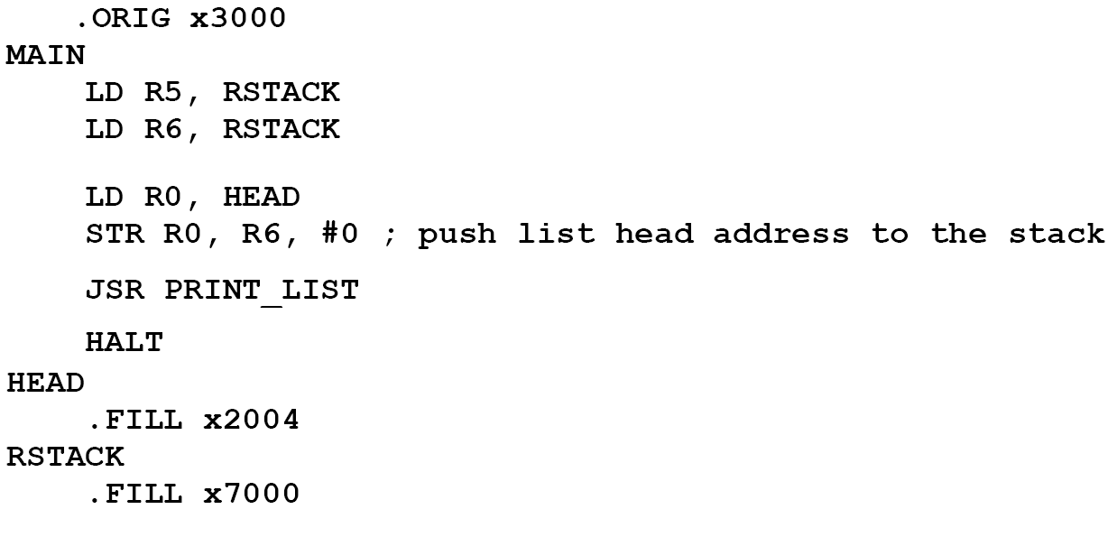
Main function: (print_list.asm)

Slide 66
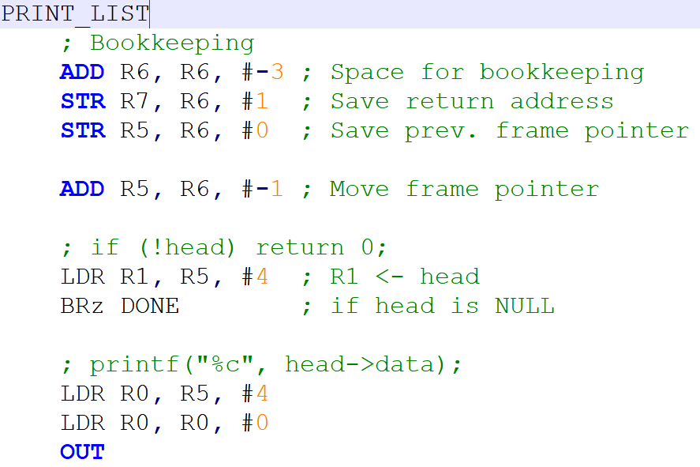

Slide 67
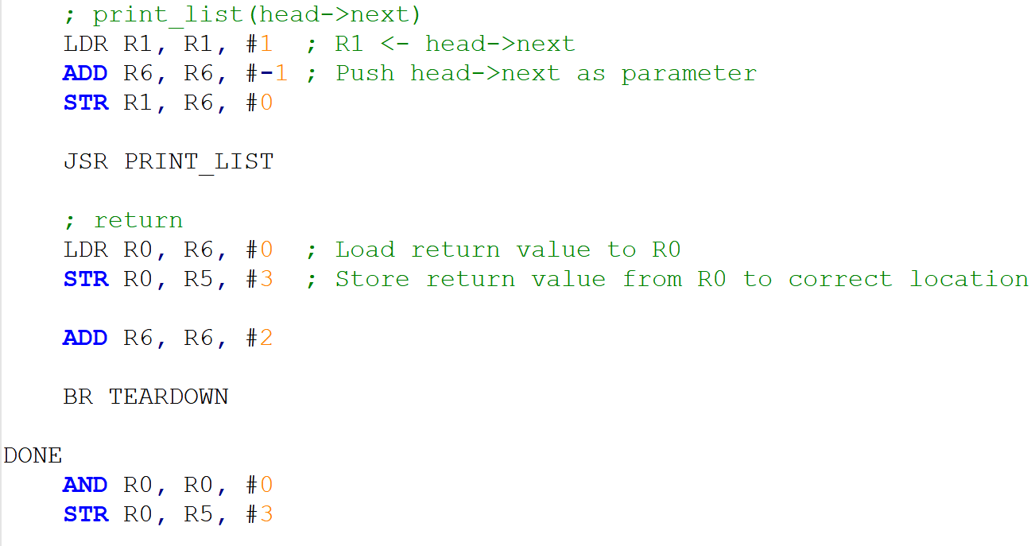
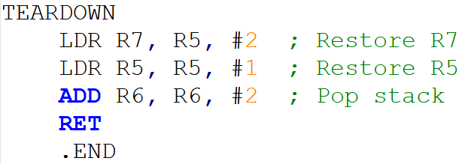

Slide 68
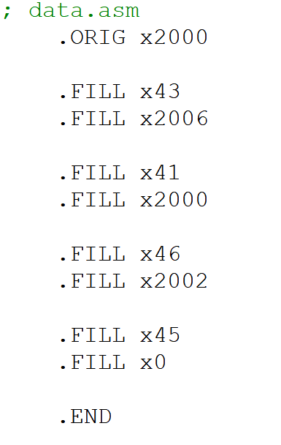
Data file: data.asm

