Slide 1

ECE 220 Computer Systems & Programming
Lecture 21 – Trees: traversal and search
Notes:
ECE Main Slide

Slide 2
Tree Data Structure
Array, linked list, stack, queue – linear data structures
Tree: A data structure that captures hierarchical nature of relations between data elements using a set of linked nodes. Nodes are connected by edges. It’s a nonlinear data structure.
Tree Terminology:
root, internal node, external node (leaf),
parent, child, sibling, height, depth
The depth of a node is the number of edges
from the node to the tree's root node. A root node will have a depth of 0.
The height of a node is the number of
edges on the longest path from the node to a leaf. A leaf node will have a height of 0.
2

Slide 3
Common Operations on Tree:
Locate an item
Add a new item at a particular place
Delete an item
Remove a section of a tree (pruning)
Add a new section to a tree (grafting)

Slide 4
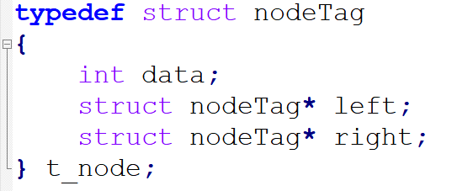
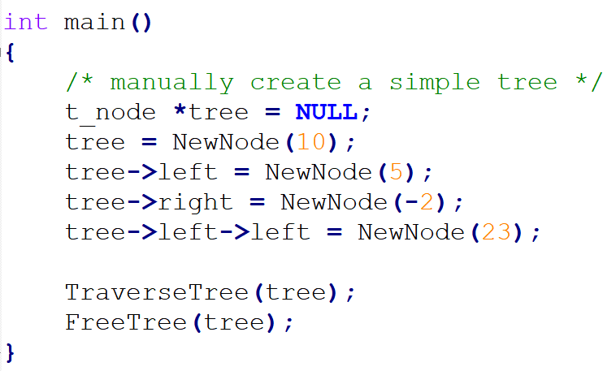
Manually Creating a simple tree:

Slide 5
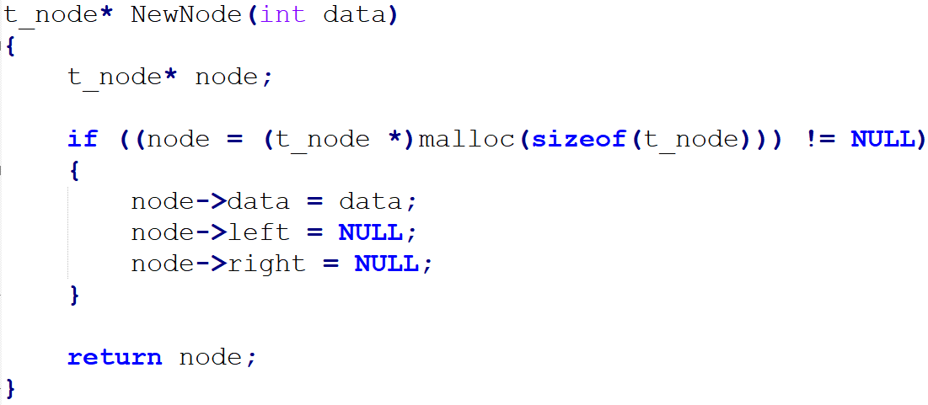
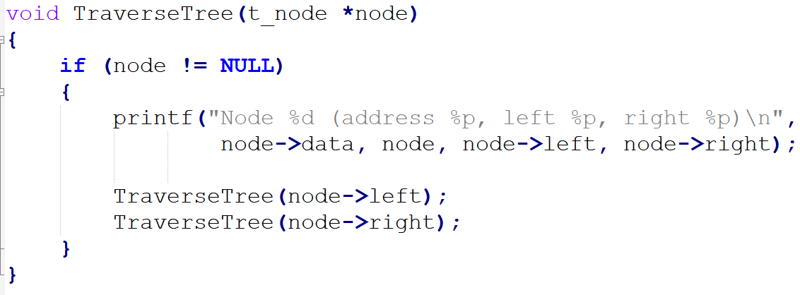

Slide 6
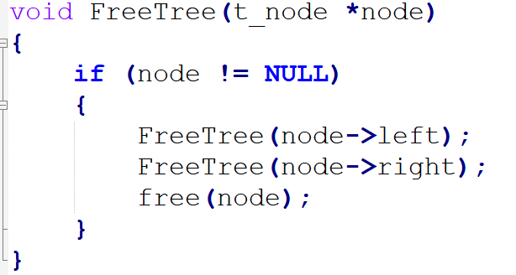
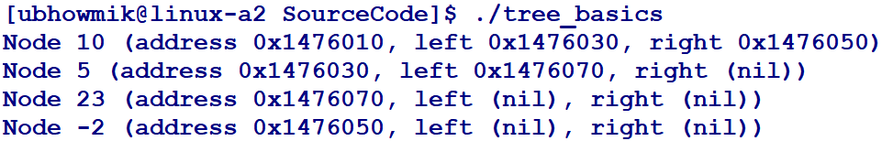

Slide 7
Binary Tree
Each node has at most 2 children – left child and right child
What is the height of the tree?
What is the depth of node E?
What is the height of node E?
Which nodes are leaves?
3

Slide 8
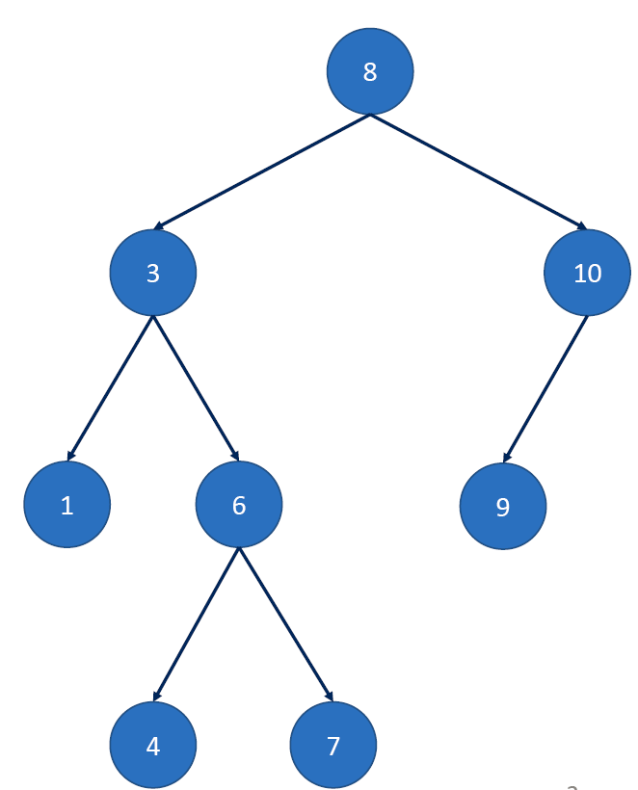
Binary Search Tree
Data of nodes on the left subtree is smaller than the data of parent node
Data of nodes on the right subtree is larger than the data of parent node
Both left and right subtrees must also be BST
Data in each node is unique
What is the sequence of access for
1. pre-order traversal?
2. in-order traversal?
3. post-order traversal?
http://visualgo.net/bst.html
5

Slide 9
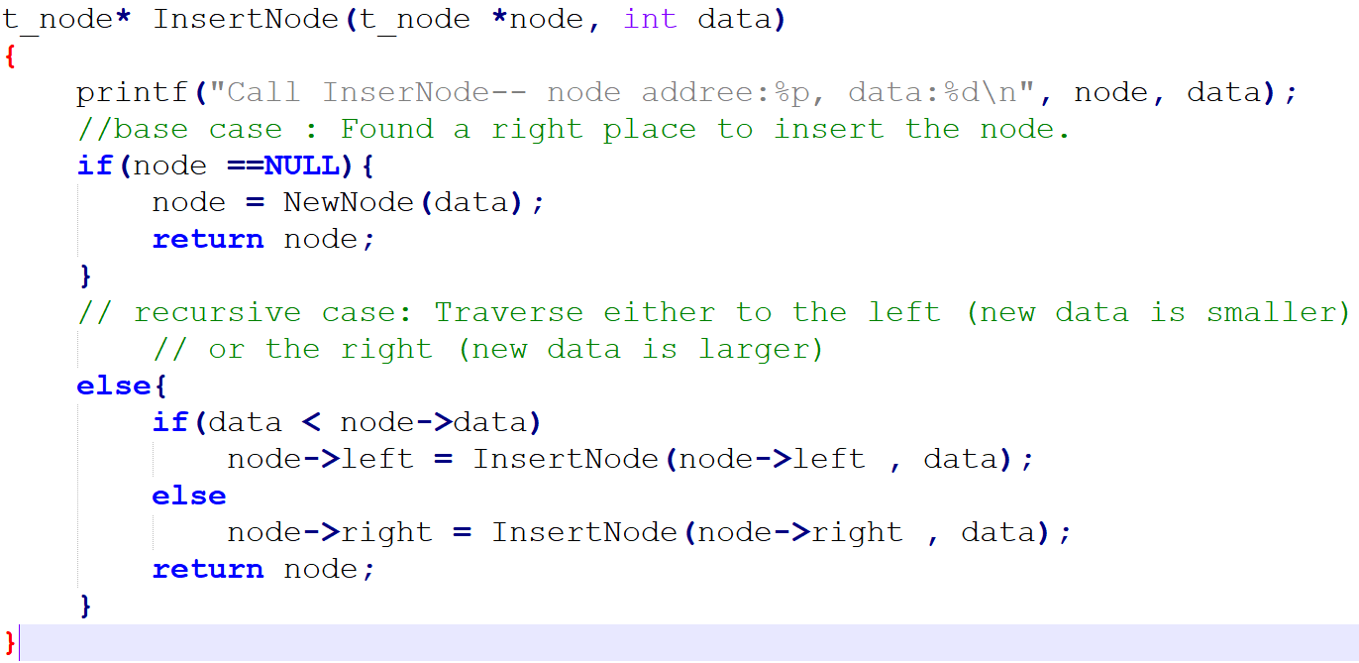
Insert a new node in the right place (BST)

Slide 10
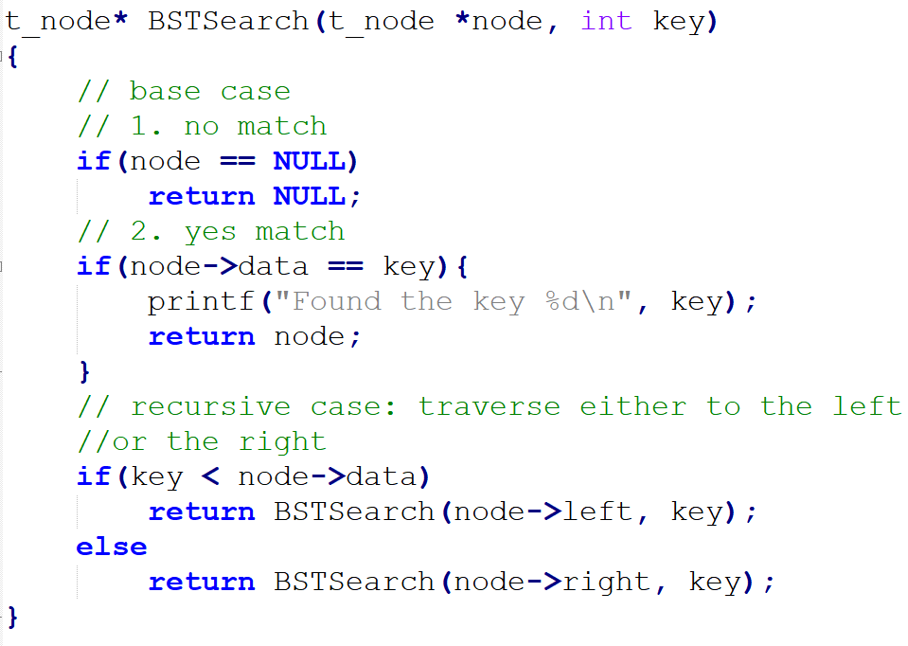
Search for a Node in BST
6

Slide 11
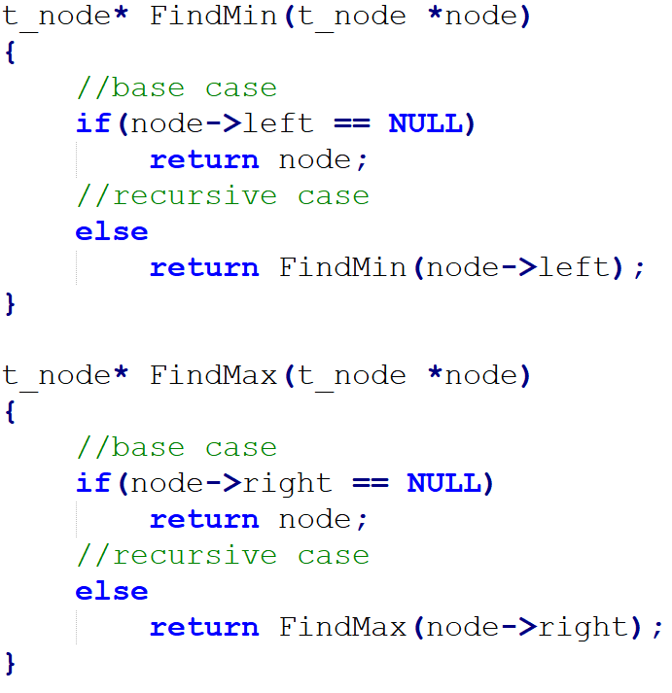
Finding Minimum and Maximum:

Slide 12
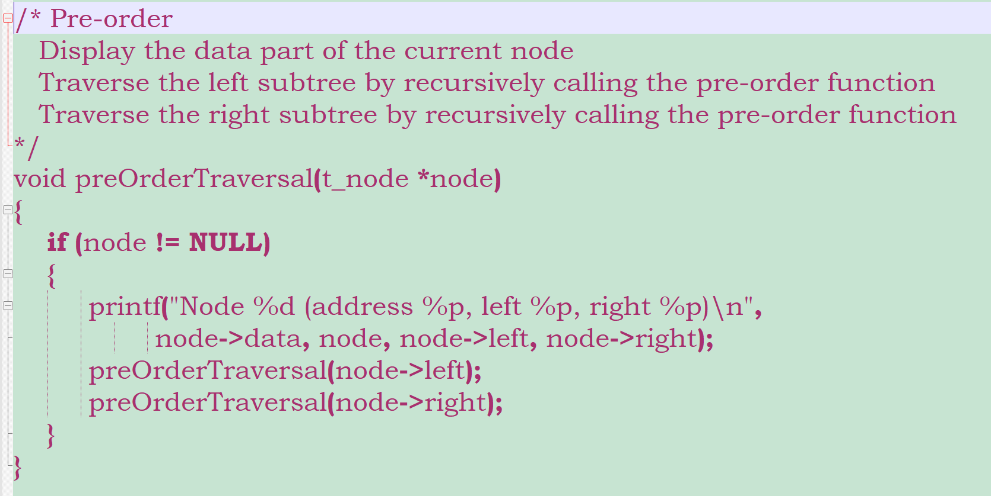
Traverse a BST (preOrder)
8

Slide 13
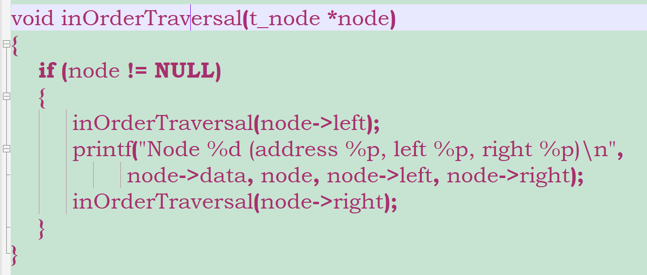
Traverse a BST (inOrder)

Slide 14
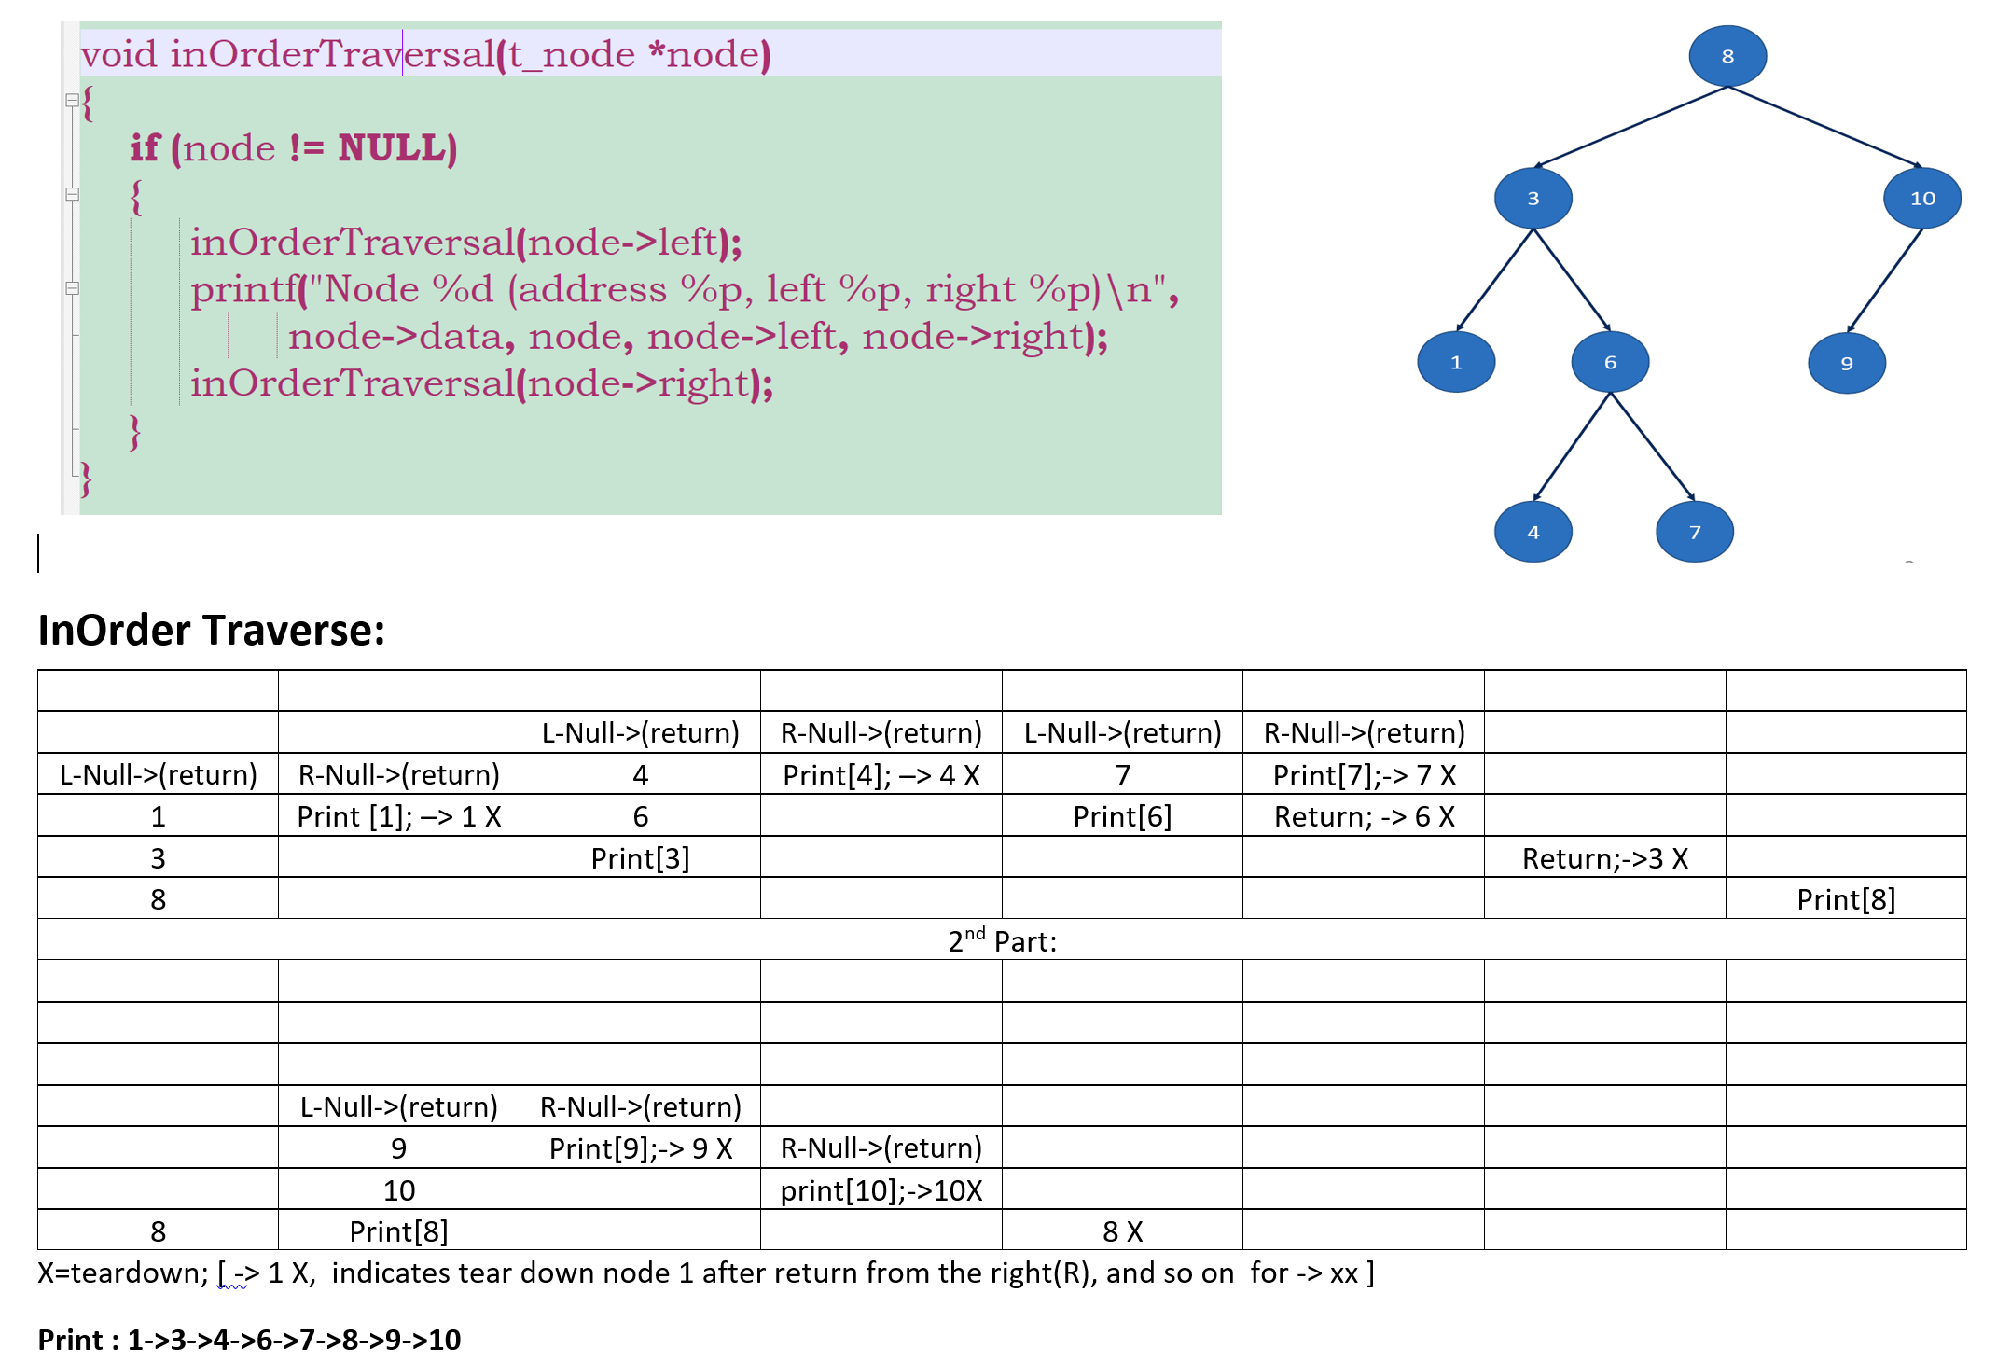

Slide 15
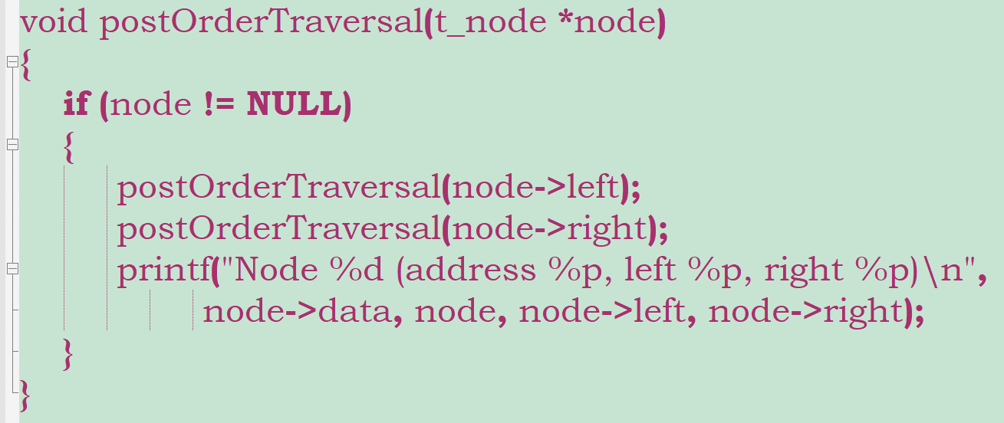
Traverse a BST (postorder)

Slide 16
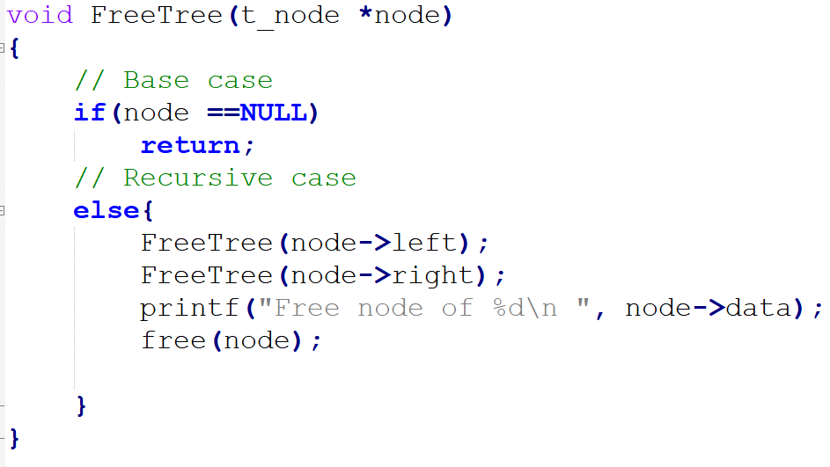
FreeTree:

Slide 17
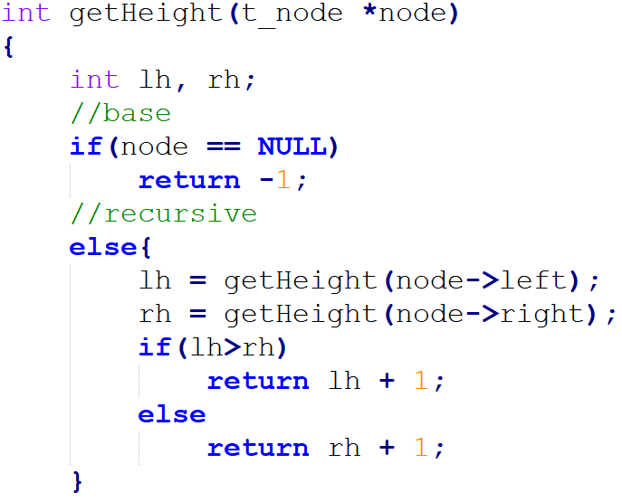
Height of BST

Slide 18
Breadth First Search (BFS)
Start at the root node and explores all neighboring nodes first. Then for each of these nearest nodes, it explores their unexplored neighbor nodes and so on. A queue data structure is used to carry out the search.
Suitable for finding shortest path in a graph - GPS application.
Steps:
1. Enqueue the root node.
2. Dequeue the node and check it -if the sought element is found, done.
Otherwise, enqueue any direct childs that have not been tested.
3. Repeat step#2.
Code on Github: BST_search_BFS_DFS.c

Slide 19
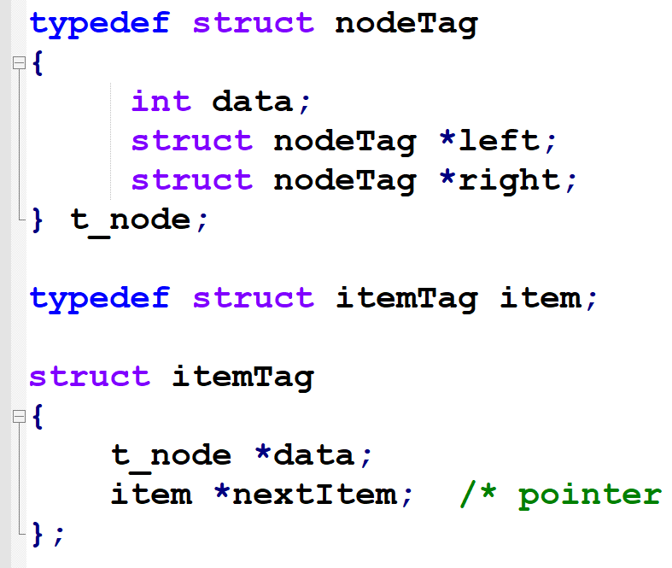
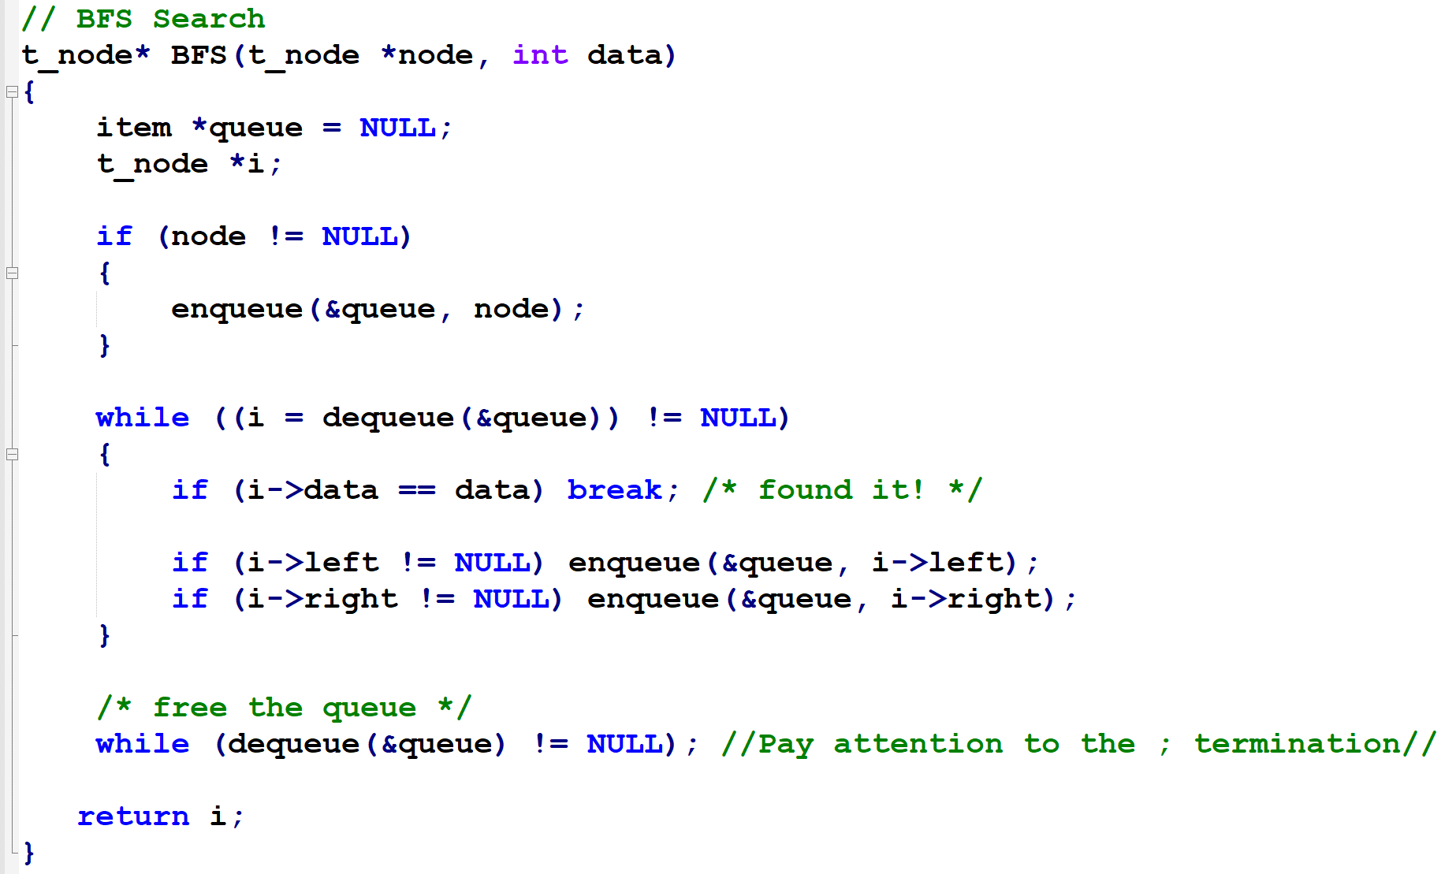

Slide 20
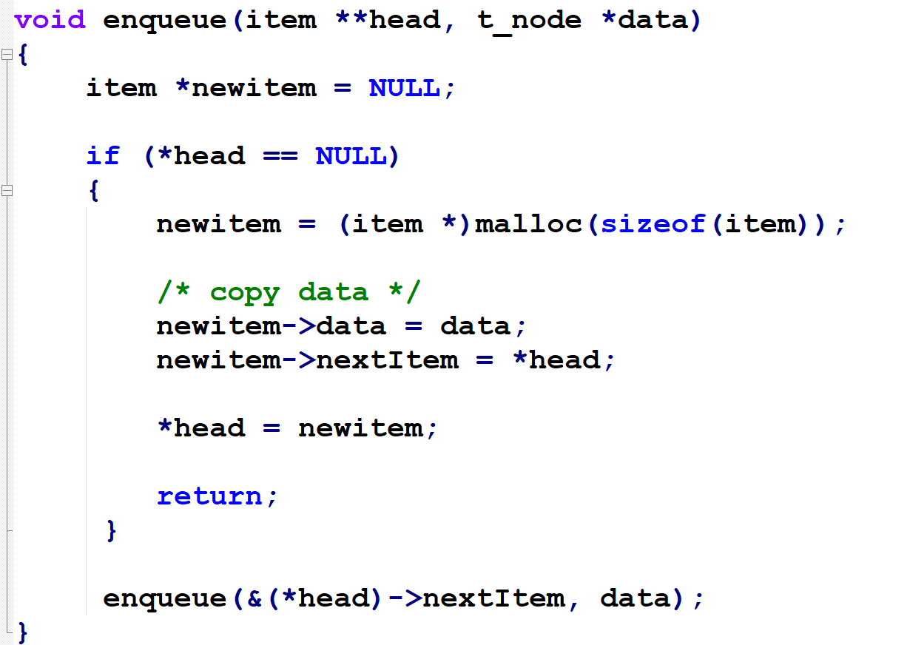
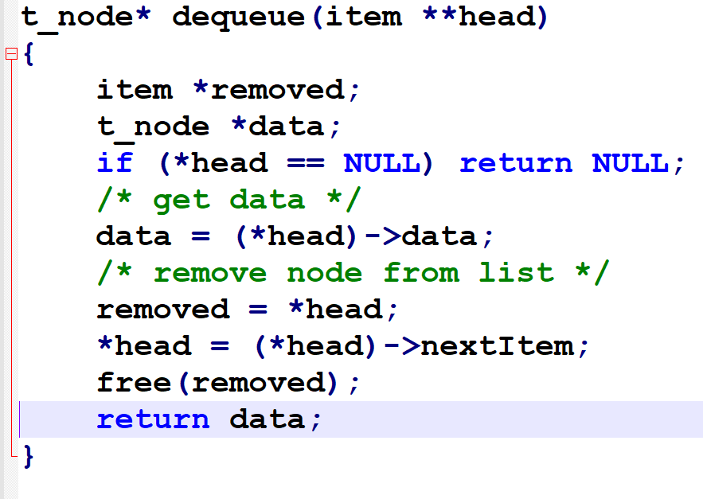

Slide 21
Depth First Search (DFS)
Start at the root node and explores as far as possible along each branch, going deeper and deeper in the tree.
When a leaf node is reached, the algorithm backtracks to the parent node and checks its children nodes.
Can be implemented as a recursive algorithm.
(The algorithm used in slide#6, “Search for a Node in BST,” is DFS)

