Slide 1

ECE 220 Computer Systems & Programming
Lecture 9 – Functions in C & Run-Time Stack
September 24, 2019
Notes:
ECE Main Slide

Slide 2
C Functions
Provides abstraction
hide low-level details
give high-level structure to program, easier to understand overall program flow
enable separable, independent development
reuse code
Structure of a function
zero or multiple arguments passed in
single result returned (optional)
return value is always a particular type
4

Slide 3
Making a Function Call in C
#include <stdio.h>
/* our Factorial function prototype goes here */
int Fact(int n);
/* main function */
int main() {
int number;
int answer;
printf(“Enter a number: “);
scanf(“%d”, &number);
answer = Fact(number); /* function call */
/* number – argument transferred from main to Factorial */
answer – return value from Factorial to main */
printf(“factorial of %d is %d\n”, number, answer);
return 0;
}
5

Slide 4
Function “Fact”:
/* implementation of Factorial function goes here */
int Fact(int n) {
int i, result=1; /* local variables in Factorial */
for (i = 1; i <= n; i++)
result = result * i;
return result; /* return value */
}
6

Slide 5
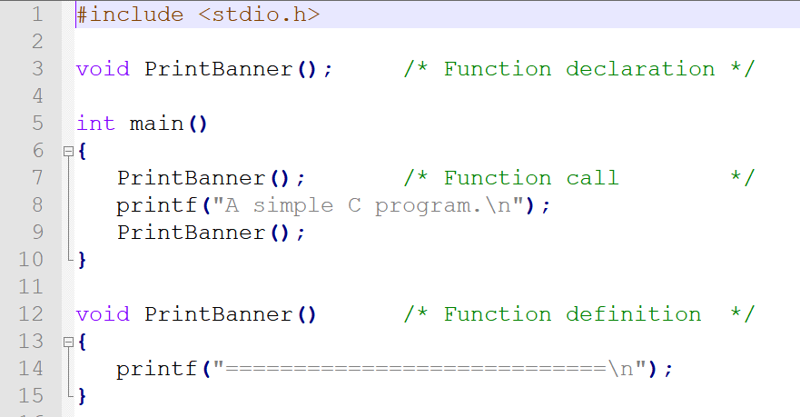
Function that does not return value:
*Note: Functions do not necessarily have to be in the same file
(see the github example)
print.h ---> declares the function prototype
main.c ---> call the “print” function
print.c ---> print function

Slide 6
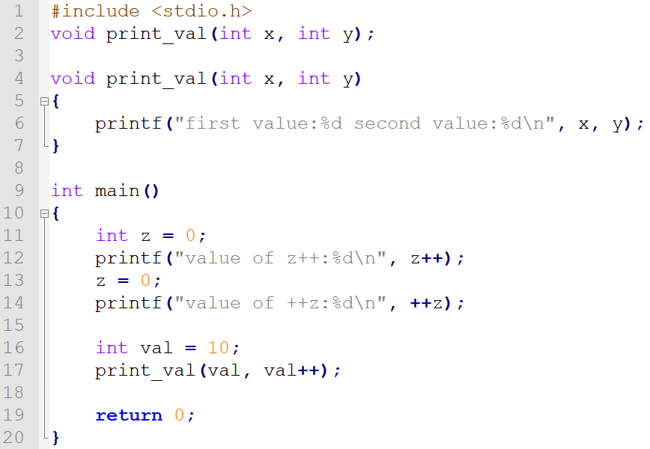
Example:

Slide 7
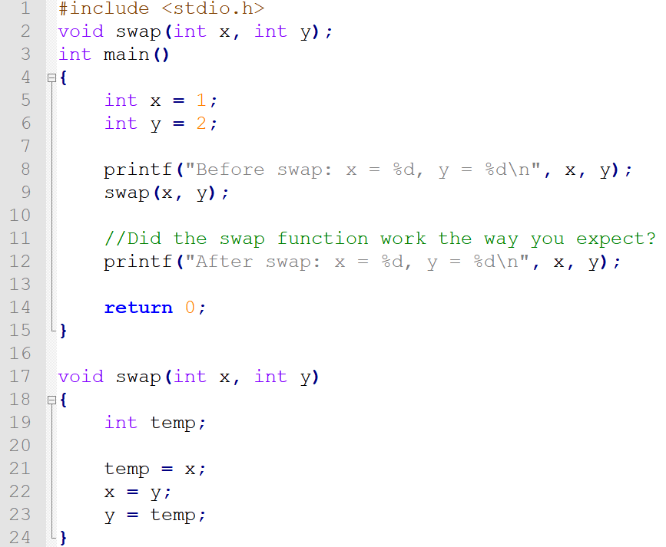
How about the following “swap” function?

Slide 8
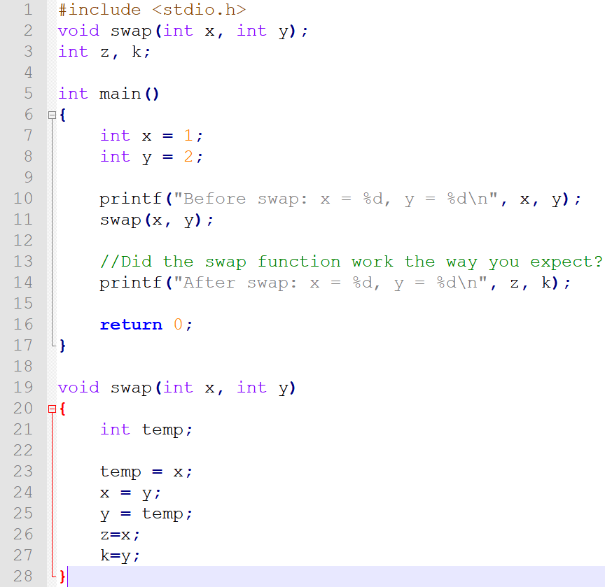
Possible Solution

Slide 9
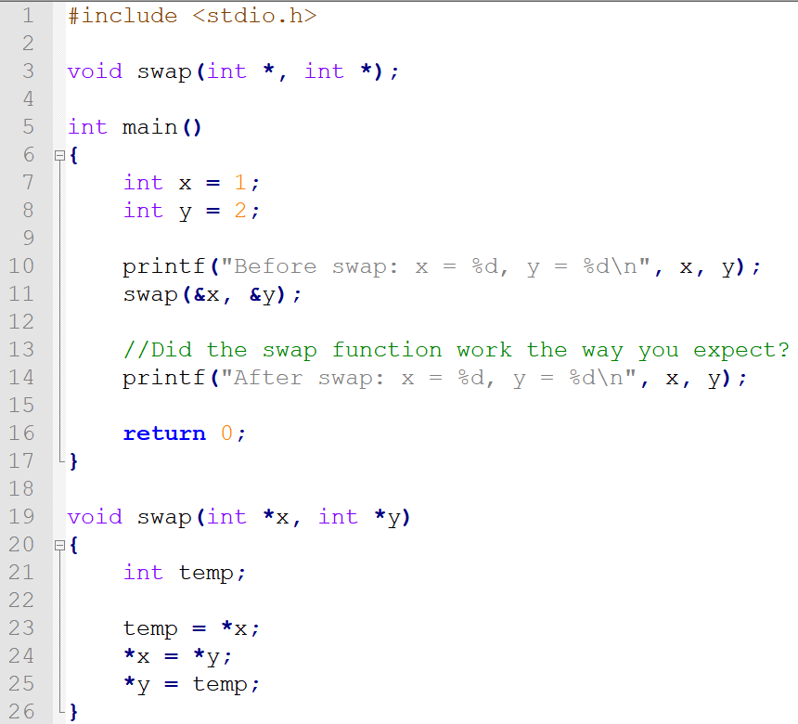
Possible Solution (advanced topics coming soon!)

Slide 10
Run-Time Stack
R5 – Frame Pointer. It points to the beginning of a region of activation record that stores local variables for the current function.
R6 – Stack Pointer. It points to the top most occupied location on the stack.
Arguments are pushed to the stack _______________________.
Local variables are pushed to the stack ___________________________.
R6
Fact
R5
R6
R6
main
R5
main
main
R5
Before call
During call
After call
7

Slide 11
Activation Record
R6
y
x
w
caller’s frame pointer
return address
return value
a
b
int func(int a, int b) { int w, x, y; . . . return y; }
locals
R5
bookkeeping
args
8

Slide 12
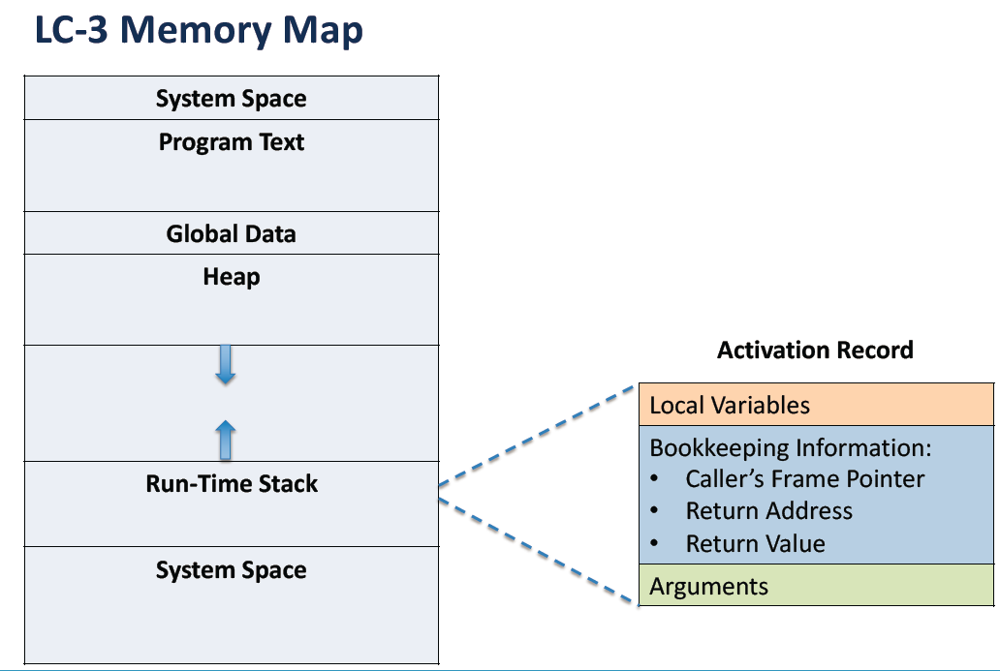

Slide 13
Stack Built-up and Tear-down
1. caller setup: push callee’s arguments onto stack
2. pass control to callee (invoke function)
3. callee setup: (push bookkeeping info and local variables onto stack)
4. execute function
5. callee teardown: (pop local variables, caller’s frame pointer, and return address from stack)
6. return to caller
7. caller teardown: (pop callee’s return value and arguments from stack)
Caller function
Callee function
Caller function
9

