Slide 1

ECE 220 Computer Systems & Programming
Lecture 19: Linked Lists
Notes:
ECE Main Slide

Slide 2
Outline
Linked List Data Structure
Chapter 19.5
Key concepts
Search/Add/Delete operations on a linked list
Linked Lists vs Arrays

Slide 3
The Linked List Data Structure
A linked list is an ordered collection of nodes, each of which contains some data, connected using pointers.
Each node points to the next node in the list.
The first node in the list is called the head
The last node in the list is called the tail
Head Pointer
Node 0
Node 1
Node 2
NULL

Slide 4
Array vs Linked List
Element 0
Element 1
Element 2
Head Pointer
Node 0
Node 1
Node 2
NULL
 | Array | Linked List
Memory Allocation | Static/Dynamic | Dynamic
Memory Structure | Contiguous | Not necessary consecutive
Order of Access | Random | Sequential
Insertion/Deletion | Create/delete space, then shift all successive elements | Change pointer address

Slide 5
Example: Linkedlist and its runtime stack
typedef struct person_node Person;
struct person_node
{
char name[20];
Person *next;
};
int main()
{
Person *theList = NULL;
AddPerson(&theList, “Bob");
AddPerson(&theList, "Bill");
}
/* add to the linked list */
int AddPerson(Person **ourList, char name[])
{
Person *newPerson = NULL;
newPerson = (Person *)malloc(sizeof(Person));
if (newPerson == NULL)
return 0;
strcpy(newPerson->name, name);
newPerson->next = *ourList;
*ourList = newPerson;
return 1;
}
1
2
3
1
2

Slide 6
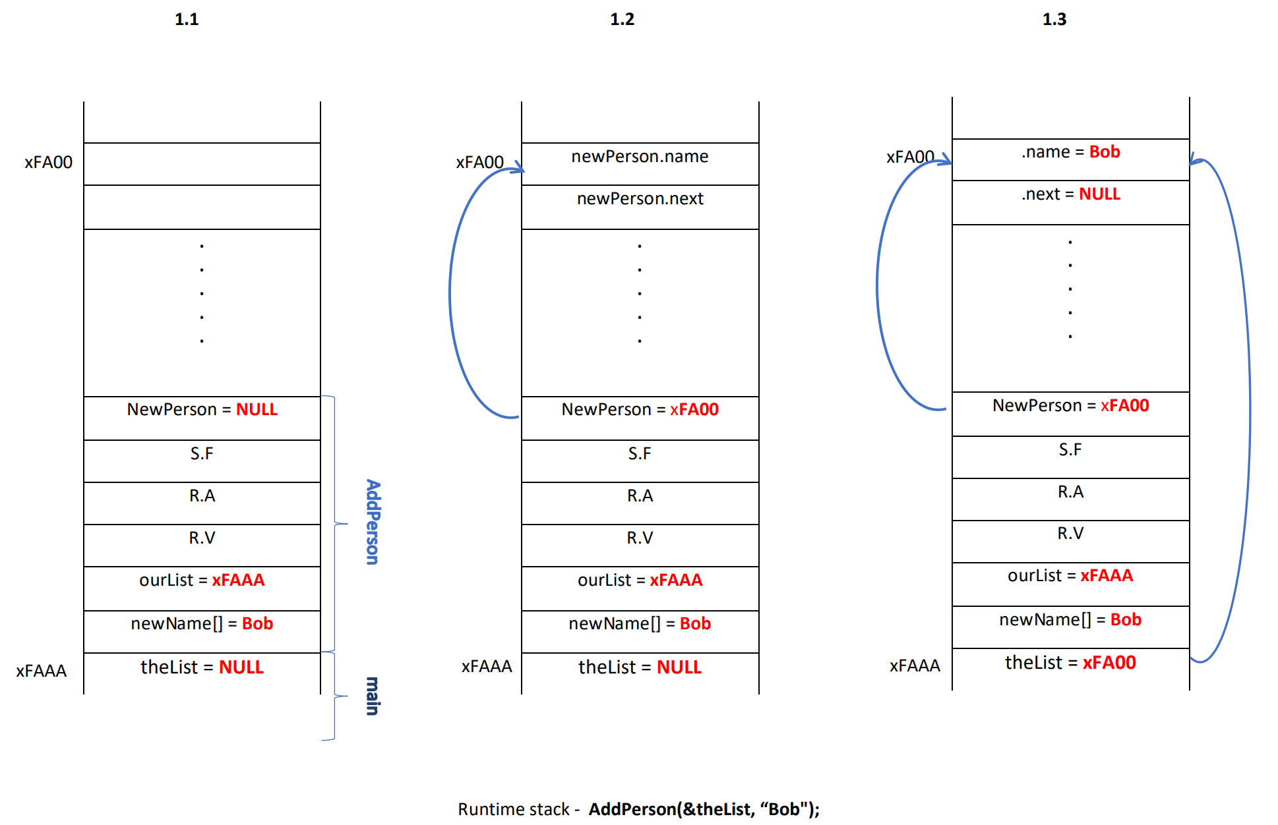

Slide 7
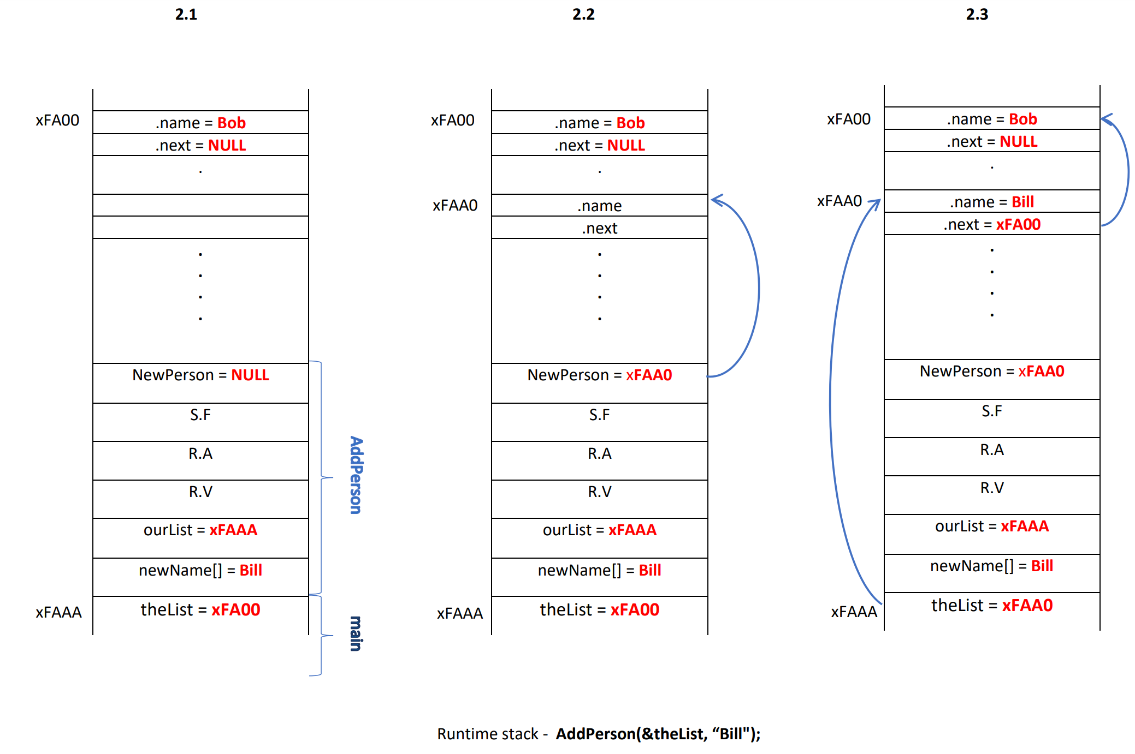

Slide 8
Exercise: Student Record
typedef struct studentStruct Record;
struct studentStruct
{
char Name[100];
int UIN;
float GPA;
Record *next;
};
We have a list of 200 student records sorted by UIN
Find a particular student record by UIN
Add a new student record to the list at the correct place
Delete a student record from the list
Head Pointer
Data|Next
Data|Next
NULL
5

Slide 9
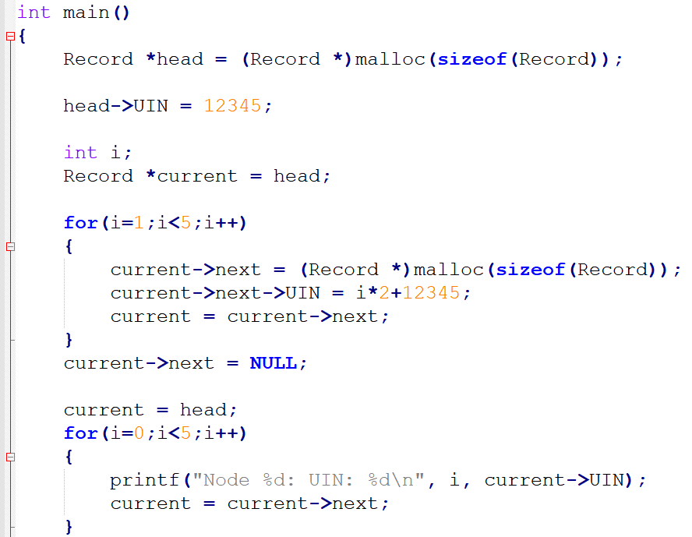
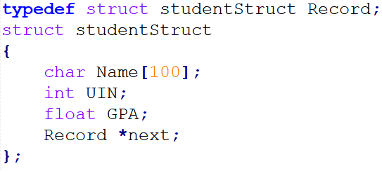
Create a Simple Linklist:

Slide 10
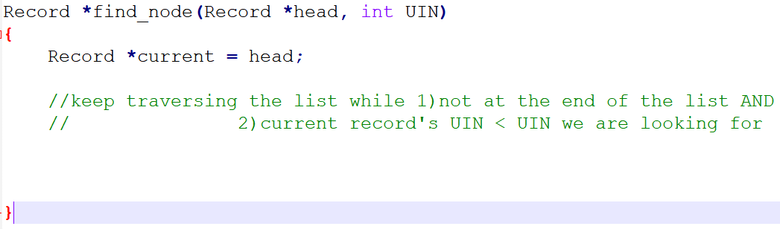
Find a Student Record by UIN
//print “Student Record Found” if UIN is found, return a pointer to this record
//otherwise print “Record Not Found”, return NULL

Slide 11
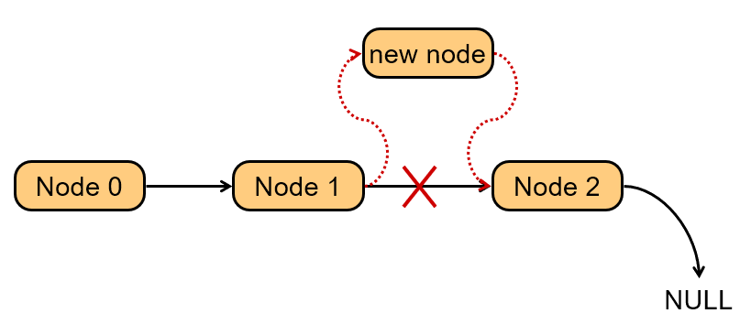
Adding a Node
Create a new node with the proper info. Find the node (if any) with a greater UIN. “Splice” the new node into the list:

Slide 12
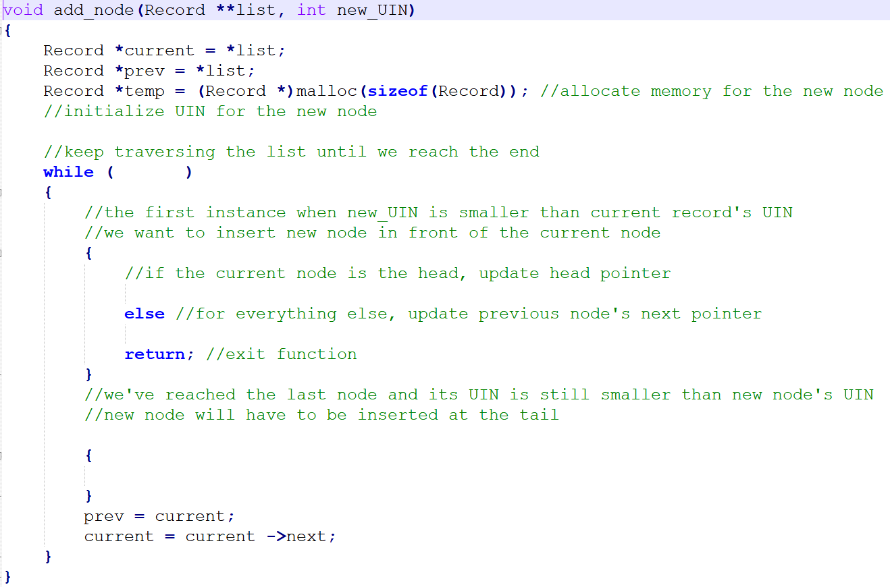

Slide 13
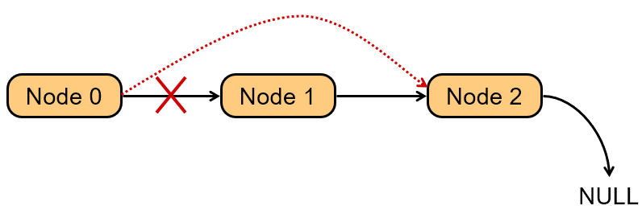
Deleting a Node
Find the node that points to the desired node. Redirect that node’s pointer to the next node (or NULL). Free the deleted node’s memory.

Slide 14
