Slide 1
University of Illinois at Urbana-Champaign Dept. of Electrical and Computer Engineering ECE 220: Computer Systems & Programming
Interrupts and exceptions

Slide 2
Memory-mapped I/O
In memory-mapped I/O, interaction with the I/O devices is controlled by our program
Our program polls ready bits of I/O registers to see if the I/O devices are ready for interaction
This leads to inefficiencies since our program effectively stalls until an I/O operation is complete

Slide 3
Interrupt-driven I/O
In interrupt-driven I/O, interaction with the I/O device is controlled by the I/O device itself
An I/O device generates an interrupt signal to indicate that I/O device is ready with new I/O operation
In response to this interrupt, the currently executed program stops its execution and the control is passed to some subroutine designed to handle the interrupt
Once the subroutine processes the interrupt, the control is passed back to the program that was previously executed

Slide 4
Several things must be true for an I/O device to actually interrupt the processor
The device must want to request service.
This is indicated by ready bit (KBSR[15] and DSR[15]). If these bits are set, there is a new I/O request ready to be served
15
14
0
undefined
KBSR
ready bit

Slide 5
The device must have the right to request service.
This is indicated by an interrupt enable bit (KBSR[14] and DSR[14]). If such bit is set by the processor, the processor wants to give the I/O device the right to request the interrupt service
15
14
0
undefined
KBSR
interrupt enable bit
ready bit

Slide 6
Interrupt Signal (INT)
Ready bit and interrupt enable bit together are used to generate an interrupt
15
14
0
undefined
KBSR
interrupt signal to processor

Slide 7
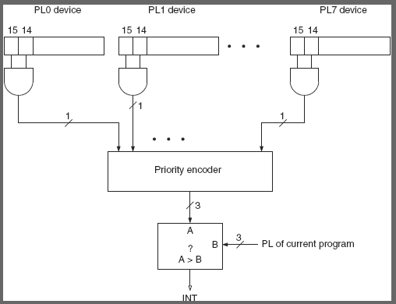
This request must be more urgent than the processor’s current task.
A program is executed with some specified priority level, LC-3 has 8 such priority levels PL0..PL7.

Slide 8
Polling vs Interrupt-driven I/O
15
14
0
15
14
0
undefined
KBSR
undefined
KBSR
ready bit
interrupt signal to processor
KBSR is negative?
IE = 0
I/O device will NOT be able to interrupt
Have to use polling
IE = 1
Interrupt-driven I/O enabled
Interrupt request generated as soon as Ready bit sets (e.g., a key is typed)
YES
NO
(nothing)
read KBDR

Slide 9
Flow of Interrupt-driven I/O
Stage 1: Initiate the interrupt
1.1 Stop the running program on any instruction
1.2 Save the state of the running program
1.3 Generate address of the interrupt servicing subroutine
Stage 2: Service the interrupt
2.1 Transfer control to the interrupt subroutine
2.2 Execute the interrupt subroutine
Stage 3: Return from the interrupt
3.1 Resume right where we left off

Slide 10
Stage 1: Initiating the Interrupt
An I/O device generates an interrupt signal (INT) to indicate that I/O device is ready with a new I/O operation (e.g., a new character has been entered on the keyboard)
I/O device presents an 8-bit interrupt vector (INTV) which is used construct a memory address that contains the location of the interrupt handler in a interrupt table

Slide 11
Interrupt Priority
For an interrupt to be served, the request must be more urgent than the processor’s current task
LC-3 priority levels are PL0-PL7
Higher is more urgent, e.g., keyboard is PL4
LC-3 maintains an interrupt priority in PSR[10:8]
Devices wanting to interrupt also have a 3-bit priority
The interrupt will be served only when program is running at priority < PL4

Slide 12
LC-3 Interrupt Table
Each device is associated with an 8-bit vector INTV to index an interrupt vector table
Interrupt vector table is in memory between x0100 and x01FF
Each record in the interrupt vector table contains beginning address of service routine for handling interrupt
Exception service routines (x0100-x017F)
Interrupt service routines (x0180-x01FF)

Slide 13
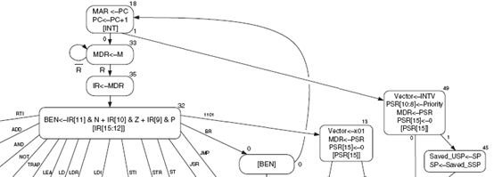
1.1 Stopping the Execution of the Program
State 18 in LC-3 FSM is the only state in which the processor checks for interrupts
If INT=0 (no interrupt) go to State 33
If INT=1 go to State 49 (110001)

Slide 14
1.2 Saving the State - What
PC so that we can return to execute the next instruction after the interrupt has been served
NZP condition codes in case they are needed by a BR instruction later on
Processor Status Register (PSR)
15
10 9 8
0
P
PL
N
Z
P
PSR
Privilege mode
Priority Level
Condition Codes

Slide 15
1.2 Saving the State - Where
Supervisor Stack - a special region of memory used as the stack for serving interrupts
Supervisor Stack Pointer (SSP)
Saved.SSP: Internal register to store SSP
User Stack - a stack accessed by user programs
User Stack Pointer (USP)
Saved.USP: Internal register to store USP
Access both stacks using R6 as the stack pointer.
When switching from User mode to Supervisor mode, save R6 to Saved.USP

Slide 16
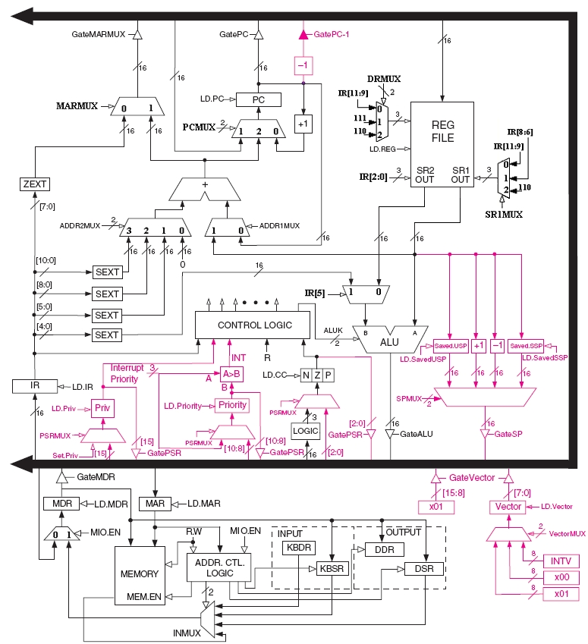
LC-3 Hardware to Support Interrupts

Slide 17
1.3 Generating ISR address
Set MAR to x01vv, where vv is 8-bit interrupt vector (INVT) from interrupting device
e.g., for keyboard INTV=x80, MAR ← x0180
Load from memory: MDR ← MEM[x01vv]
Set PC to MDR

Slide 18
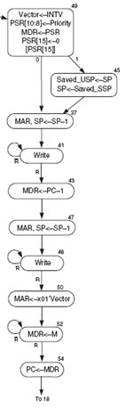
LC-3 FSM for Handling an Interrupt
Load PSR to MDR in preparation for pushing into Supervisory Stack
Record Priority Level and INTV provided by interrupting device
Test old PSR[15]
If old PSR[15] = 1 then system was in User mode and hence save USP (R6) in Saved.USP, load R6 with Saved.SSP, go to state 37
If old PSR[15] = 0 then system was in supervisory mode already
Save PSR, old PC to Supervisory Stack
Load PC with address of interrupt service routine

Slide 19
Stage 2: Service the interrupt
PC contains the starting address of the ISR
The ISR will execute, and the requirements of the I/O device will be served
For example, copy KBDR into some memory location
Callee-save for general purpose registers
Only Input from the keyboard interrupt is implemented on LC-3

Slide 20
Return from the Interrupt (RTI) Instruction
To return from ISR, we need special instruction, RTI
RTI is a privileged instruction
Can only be executed in Supervisor mode
If executed in User mode, causes an exception

Slide 21
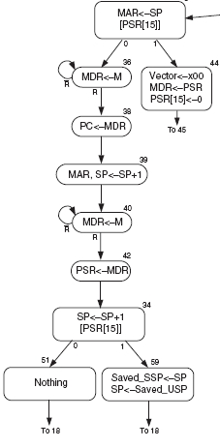
Stage 3: Return from the interrupt (RTI)
If PSR[15] = 0
Restore PC and PSR
Test old PSR[15]
If old PSR[15] = 1 then the system returns to User mode and hence restore USP (R6) and store SSP
If old PSR[15] = 0 then system continues to be in the Supervisory mode
If PSR[15] = 1 (Privilege Mode Exception)
Handle condition as an privileged mode violation
Load Interrupt Vector with starting address of Privilege mode violation
Go to State 45 to handle interrupt as if by INT

Slide 22
Exception Handling
Only exceptions from
Privilege mode violation
If processor encounter RTI when in User mode
Illegal opcode
If IR[15:12] = 1101 is true (unused opcode)
Exception handling is similar to interrupt handling

Slide 23
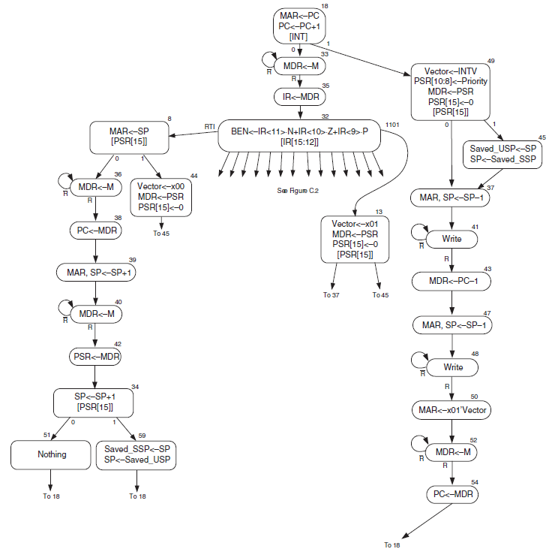
Extended LC-3 Datapath and FSM

Slide 24
Example
; run this with ;https://courses.grainger.illinois.edu/ece220/fa2019/lc3web/index.html (based on https://wchargin.github.io/lc3web)
.ORIG x3000
LEA R0,ISR_KB
STI R0,KBINTV ;load ISR address to INTV (M[x0180] <- ISR_KB)
LD R3,EN_IE
STI R3,KBSR ;enable IE bit of KBSR
AGAIN
LD R0,NUM2 ;infinite loop printing '2'
OUT ;Interrrupt during this OUT can cause re-entrant problem(lc3web)
;due to R7-save in OUT (which is not necessary, update needed).
BRnzp AGAIN

Slide 25
Example - continued
ISR_KB
ST R0,SaveR0 ;callee-save
ST R1,SaveR1 ;callee-save
LDI R0,KBDR ;read a charcter from keyboard and clear ready bit
DPOLL LDI R1, DSR ; Test Display Regster is ready
BRzp DPOLL
STI R0, DDR
LD R0,SaveR0
LD R1,SaveR1
HALT
RTI
EN_IE .FILL x4000 ;enable IE 0100_0000_0000_0000
NUM2 .FILL x0032 ;'2'
KBSR .FILL xFE00 ; Address of KBSR
KBDR .FILL xFE02 ; Address of KBDR
DSR .FILL xFE04 ; Address of DSR
DDR .FILL xFE06 ; Address of DDR
KBINTV .FILL x0180 ; INT vector table address for keyboard
SaveR0 .BLKW #1
SaveR1 .BLKW #1
.END

Slide 26
Nested Interrupts

Slide 27
