Slide 1

ECE 220 Computer Systems & Programming
Lecture 9 – Functions in C & Run-Time Stack
September 24, 2019
Notes:
ECE Main Slide

Slide 2
C Functions
Provides abstraction
hide low-level details
give high-level structure to program, easier to understand overall program flow
enable separable, independent development
reuse code
Structure of a function
zero or multiple arguments passed in
single result returned (optional)
return value is always a particular type
4

Slide 3
Making a Function Call in C
#include <stdio.h>
/* our Factorial function prototype goes here */
int Fact(int n);
/* main function */
int main() {
int number;
int answer;
printf(“Enter a number: “);
scanf(“%d”, &number);
answer = Fact(number); /* function call */
/* number – argument transferred from main to Factorial */
answer – return value from Factorial to main */
printf(“factorial of %d is %d\n”, number, answer);
return 0;
}
5

Slide 4
Function “Fact”:
/* implementation of Factorial function goes here */
int Fact(int n) {
int i, result=1; /* local variables in Factorial */
for (i = 1; i <= n; i++)
result = result * i;
return result; /* return value */
}
6

Slide 5
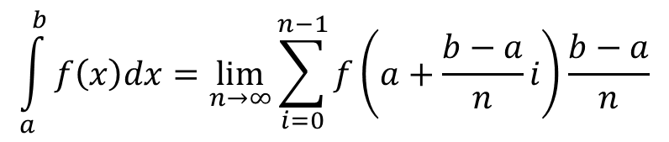
Riemann integral Adopted from Prof. Kindratenko’s notes
Problem statement: write a program to compute integral of a function f(x) on an interval [a,b].
Algorithm: use integral definition as an area under a function f(x) on an interval [a,b]
f(x)
n
dx
x
a
b
$$\int_{a}^{b}{f\left(x\right)dx}=\lim_{n→∞}{\sum_{i=0}^{n−1}{f\left(a+\frac{b−a}{n}i\right)\frac{b−a}{n}}}$$

Slide 6
#include <stdio.h>
float f(float x);
float Reimann(int n, float a, float b);
int main()
{
printf("%f\n", Reimann(100, -1.0f, 1.0f));
return 0;
}
/* f(x) = x*x+2x+3 */
float f(float x)
{
return (x * x + 2 * x + 3);
}
/* compute integral of f(x) = x*x+2x+3 on [a,b] */
float Reimann(int n, float a, float b)
{
float s = 0.0f; /* computed integral value */
int i; /* loop counter */
float x, y; /* x and y=f(x) */
float dx = (b - a) / n; /* width of rectangles */
for (i = 0; i < n; i++)
{
x = a + dx * i;
y = f(x);
s += y * dx;
}
return s;
}

Slide 7
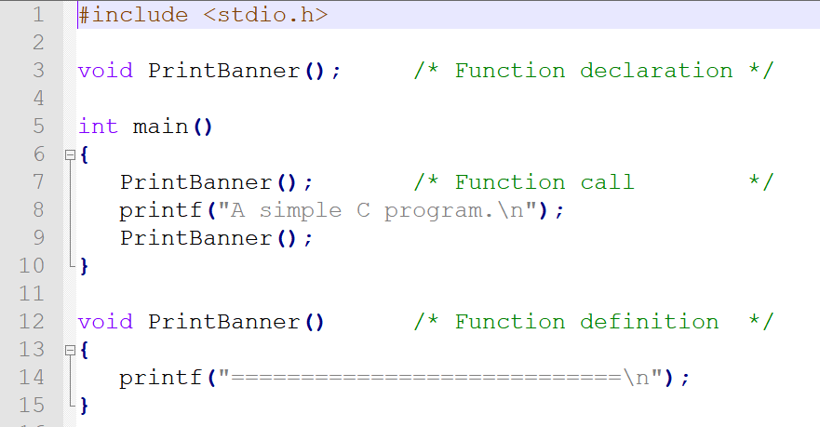
Function that does not return value:
*Note: Functions do not necessarily have to be in the same file
(see the github example)
print.h ---> declares the function prototype
main.c ---> call the “print” function
print.c ---> print function

Slide 8
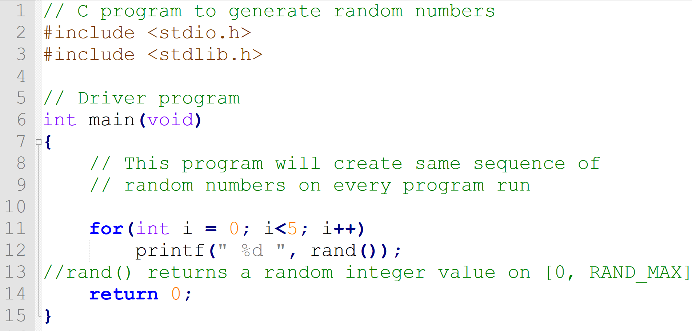
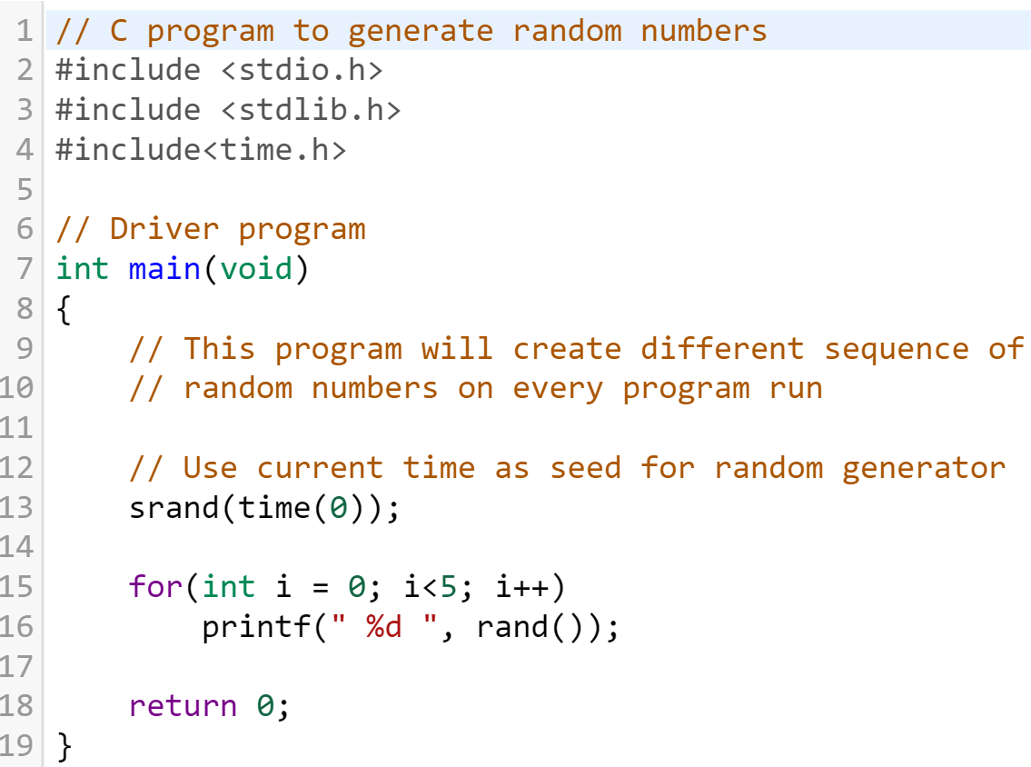
rand(), srand() functions and RAND_MAX macros (stdlib.h)
Ref:
https://www.geeksforgeeks.org/rand-and-srand-in-ccpp/

Slide 9
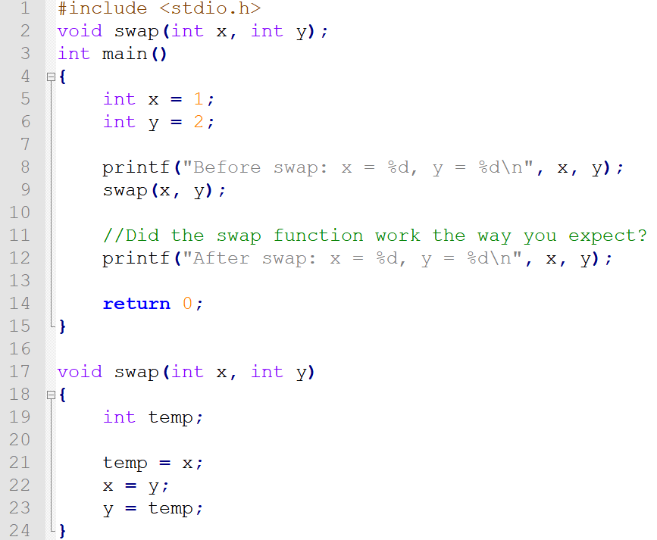
How about the following “swap” function?

Slide 10
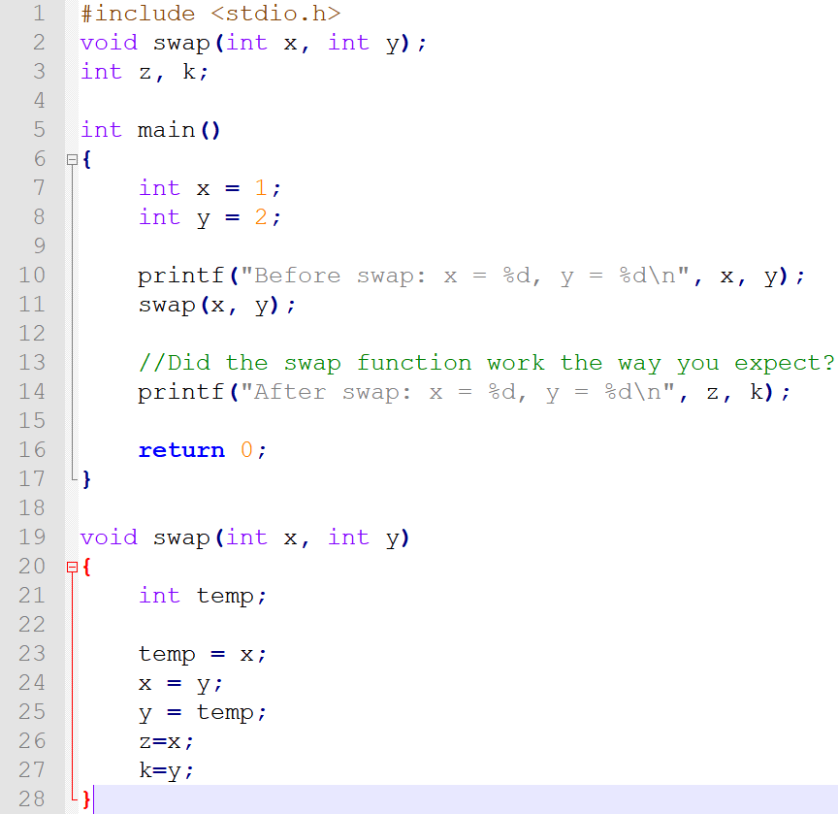
Possible Solution

Slide 11
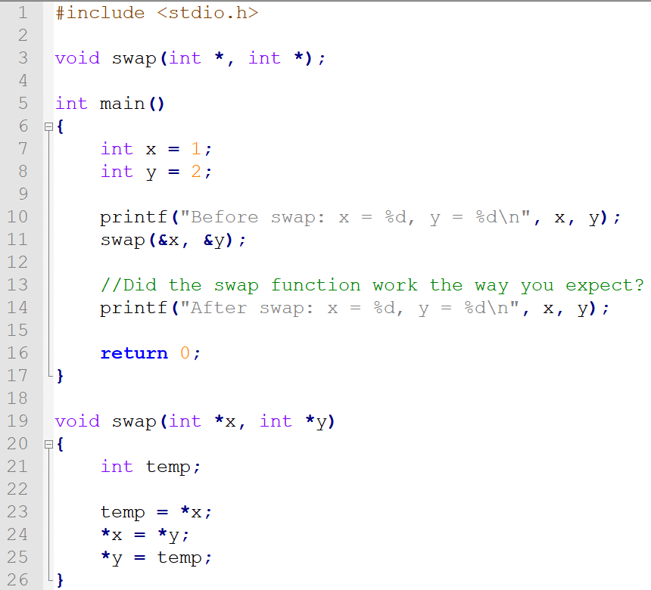
Possible Solution (advanced topics coming soon!)

