Slide 1
Aerivio Systems
Company Overview
Edge AI for distributed maritime autonomy
Volume 5 Supporting Document · Navy STTR Phase I · Topic N25B-T042

Slide 2
Who We Are
Small business building power-efficient, on-device AI for defense maritime autonomy
Founded by low-power ML and embedded-systems engineers
Core competency: compressing accurate acoustic classifiers to single-digit-watt edge modules
Mission: put reliable classification where connectivity fails — the contested edge
2

Slide 3
The Team
Dr. Mara Ellison — PI · 12 yrs low-power ML for sensing; author of core quantization IP
Tomas Reyes — Systems · 9 yrs embedded real-time; two fielded maritime autonomy stacks
Priya Nandakumar — ML · model compression & data augmentation
Advisory: acoustics SME + transition advisor (former program office)
Teamed with Cascadia State University for undersea acoustics research (STTR RI).
3

Slide 4
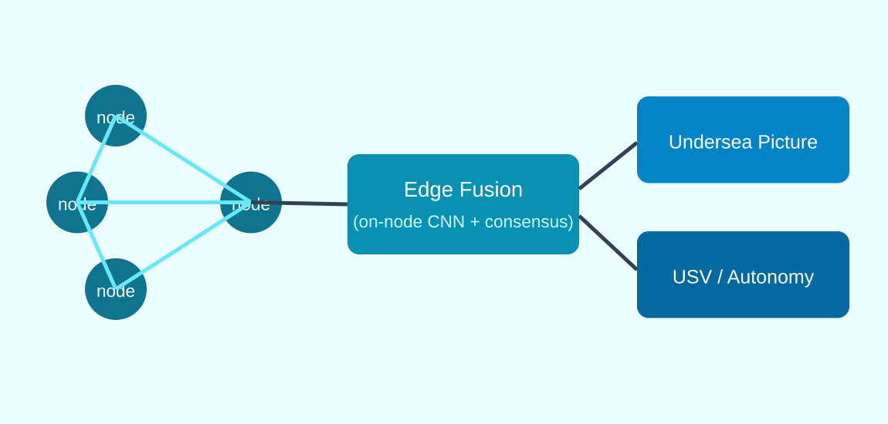
Core Technology & IP
Quantization-aware training to 4-bit weights with <1.5-point accuracy loss
Saliency-guided structured pruning — removes ~70% of parameters (patent pending)
Deterministic sub-watt runtime — guaranteed p99 latency at a fixed power budget
Result: an accurate maritime classifier in a 2-watt envelope
On-node inference + consensus fusion — classification at the distributed edge.
4

Slide 5
Past Performance
AFWERX SBIR Phase I (CSO) — single-vessel 4-bit acoustic classifier, 92%+ balanced accuracy at 2 W
Two prior fielded maritime autonomy stacks (systems team)
Peer-reviewed quantization and edge-scheduling publications
Reusable, meta-tagged content library carried pursuit-to-pursuit
This STTR builds directly on the AFWERX result — distribution and propagation are the new science.
5

Slide 6
The STTR Partnership
Aerivio (SBC, prime) — edge AI, quantization, on-node runtime, fusion implementation (56%)
Cascadia State (RI) — channel characterization, propagation models, corpus, range validation (35%)
Single PI at the SBC; RI Co-Investigator leads ocean-acoustics tasks
Allocation of Rights executed pre-award — transition path kept unencumbered
6

Slide 7
Facilities & Capabilities
Aerivio: acoustics bench, anechoic enclosure, 2-watt edge kits, GPU cluster, power-measurement bench
Cascadia State: calibrated test tank, hydrophone array, coastal test range, HPC for propagation modeling
Combined stack spans lab bench to at-sea range — no single party could replicate it
7

Slide 8
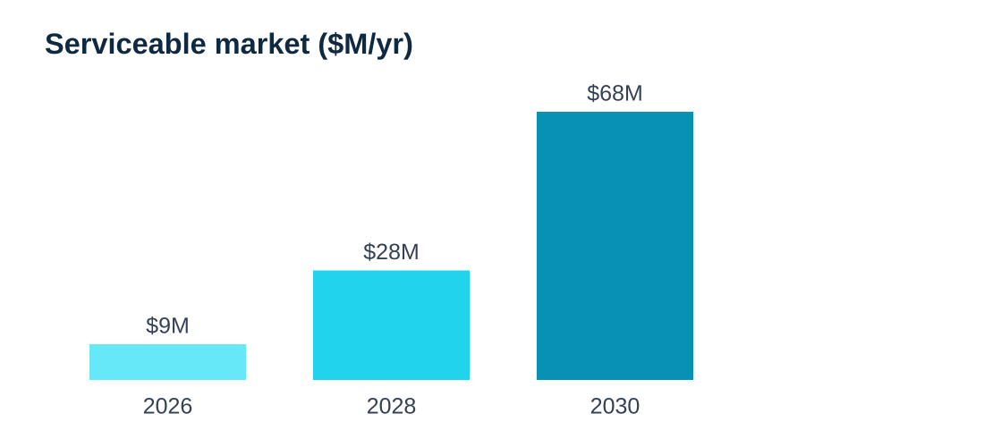
Why Aerivio
On-node inference where incumbents depend on backhaul that undersea denies
Validated 2-watt classifier — not a research prototype
Propagation-aware + consensus fusion — weak partial observations become confident classification
Software transition into existing node power budgets — no new hardware program
8

Slide 9
Transition & Commercialization
Phase I: feasibility in simulation + tank/range (now)
Phase II: hardened nodes + at-sea multi-node demo (~$1.6M / 24 mo)
Phase III: Navy undersea / USV program of record
Commercial: port & offshore-energy maritime domain awareness (dual-use)
9

Slide 10
Summary
Proven edge-AI small business + a leading ocean-acoustics research lab
A validated 2-watt classifier extended to distributed, propagation-aware, contested undersea sensing
Compliant STTR teaming, clear transition, dual-use market
Aerivio Systems · contact@aerivio.example · Proprietary
10

