Slide 1
Aerivio Systems
Commercialization Plan — SBIR Phase I
Edge-AI acoustic threat classification for unmanned surface vessels
Topic N251-042 · AFWERX SBIR Phase I (CSO) · $150,000 / 6 months

Slide 2
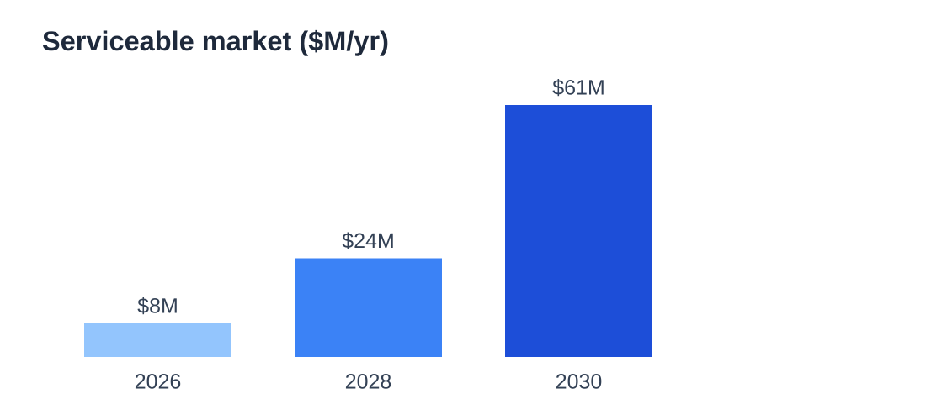
Market Opportunity
DoD USV fleet (Air Force & Navy) projected to exceed 300 hulls by 2030 — each needs edge acoustic sensing
Beachhead: DoD USV programs of record
Expansion: allied navies + commercial maritime security (ports, offshore energy)
Serviceable market growing ~$8M → $60M+ per year by 2030
2

Slide 3
Competition & Differentiation
Incumbents process acoustics shore-side → latency + comms dependence
Aerivio runs fully on-vessel at 2 watts, <100 ms
Defensible IP: saliency-guided quantization pipeline (patent pending)
Retrofits deployed hulls — no new hardware program required
Bottom line: we win where connectivity fails — exactly the contested environment that matters.
3

Slide 4
Go-to-Market & Milestones
Phase I (now): feasibility on the maritime corpus, months 1–6
Phase II: hardened module + at-sea demonstration (~$1.1M / 24 mo)
Phase III: transition to a DoD USV program of record
Commercial: port-security & offshore-energy monitoring (dual-use)
Transition is a software integration, not a hardware program — a low-barrier path to a funded home.
4

Slide 5
Financials & The Ask
Phase I budget: $150,000 over 6 months.
Team of 3 (PI + systems + ML engineer)
Deliverable: validated 4-bit edge classifier meeting all three gates
Phase II target: $1.1M for an at-sea demonstration
Commercial revenue path reduces single-program reliance
Ask: fund Phase I to de-risk the edge classifier and unlock the transition path.
5

