Slide 1
Group 4
Doors & First Riddle

Slide 2
Agenda
Doors
Materials
Mechanism
Sensors
First Puzzle
Detection of players

Slide 3

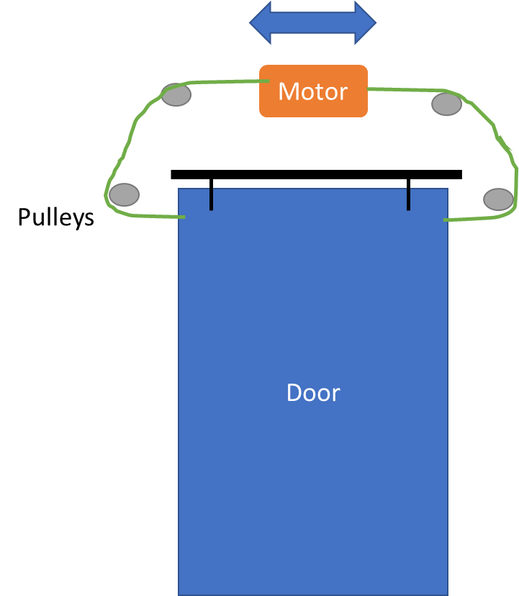
Doors
Material:
Wood
Mounting:
Sliding door
Mechanism:
Pull-rope

Slide 4
Doors
Detection of closed door
Pressure sensor
Feedback from motor?
Detection of objects in closing area
Infrared emitter and sensor

Slide 5
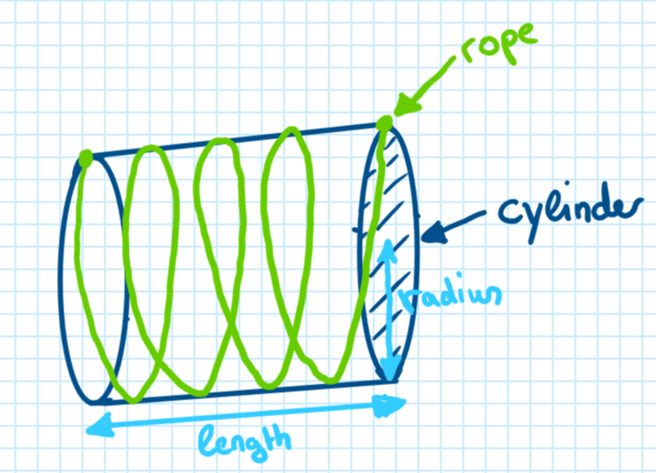
Puzzle
A wooden cylinder is physically given with a cord which is wound exactly four times around the cylinder. Thereby one end of the cord must touch one end of the cylinder so that the cord extends over the entire cylinder (see figure).
The task is to calculate the length of the cord. Given parameters are the radius and the length of the cylinder.
The result must then be entered into a keypad (binary or decimal system). If the result is correct the first door will open and the participants will get access for the lab room.

Slide 6
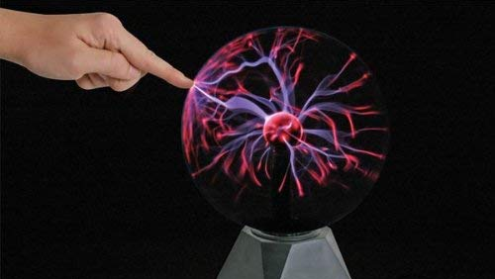
Detection of Players
Concept: Dead-man-switches spread across lab room have to be activated → 1st door closes and adventure continues
Hardware: Plasma globe / simple switch, current sensor (shunt resistor), uC/ relais, wiring
Current flow through plasma globe changes when touched by hands → measure current flow with shunt resistor and close door when each plasma globe is touched (make sure by positioning that no person can reach more than one plasma globe simultaneously)
Remark: Reliability of “plasma globe switch” has to be tested and in worst case exchanged by simple button switches

