Slide 1
Project „Escape Room“
Group 4 – Doors and first puzzle
David, Mario, Sarah

Slide 2
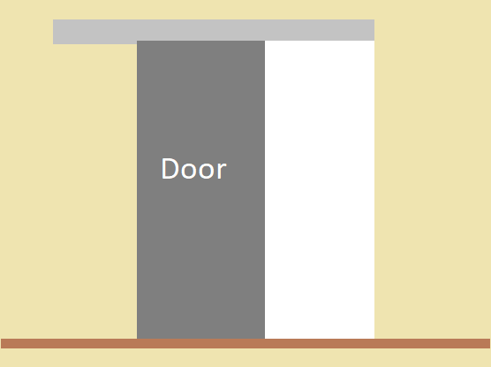
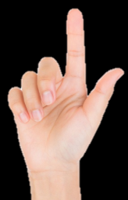
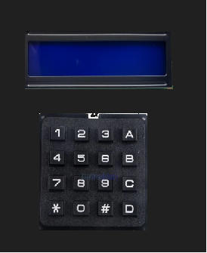
Interactions
RIGHT
open

Slide 3
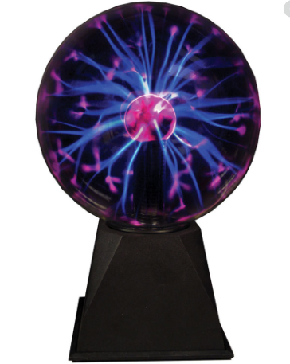
Interactions
close

Slide 4

How does this communciation work? -> MQTT
Activated/inactivated
open/close
solved
Puzzle
Door 1
open/close
Server
Activated/
inactivated
Touched/
not touched
open/close
Door 2
Globes

Slide 5
Puzzle
Components:
16x2 IC2 LCD Display
4x4 Matrix Keypad
3D printed housing
Microcontroller:
ESP32
Communication between microcontroller and components:
I2C Interface to LCD display
Analog Inputs to Keypad

Slide 6
Puzzle
no
Right password entered?
yes
Send via MQTT: Puzzle solved -> Door will open
Initialisation

Slide 7
Doors
Mechanical components:
Mounting
Gearbelts
Gearwheels
Floor guide rail
Endstops
Electrical compnents:
Motor and Driver
Endstops switches
Voltage supply
Microcontroller:
- ESP 32

Slide 8
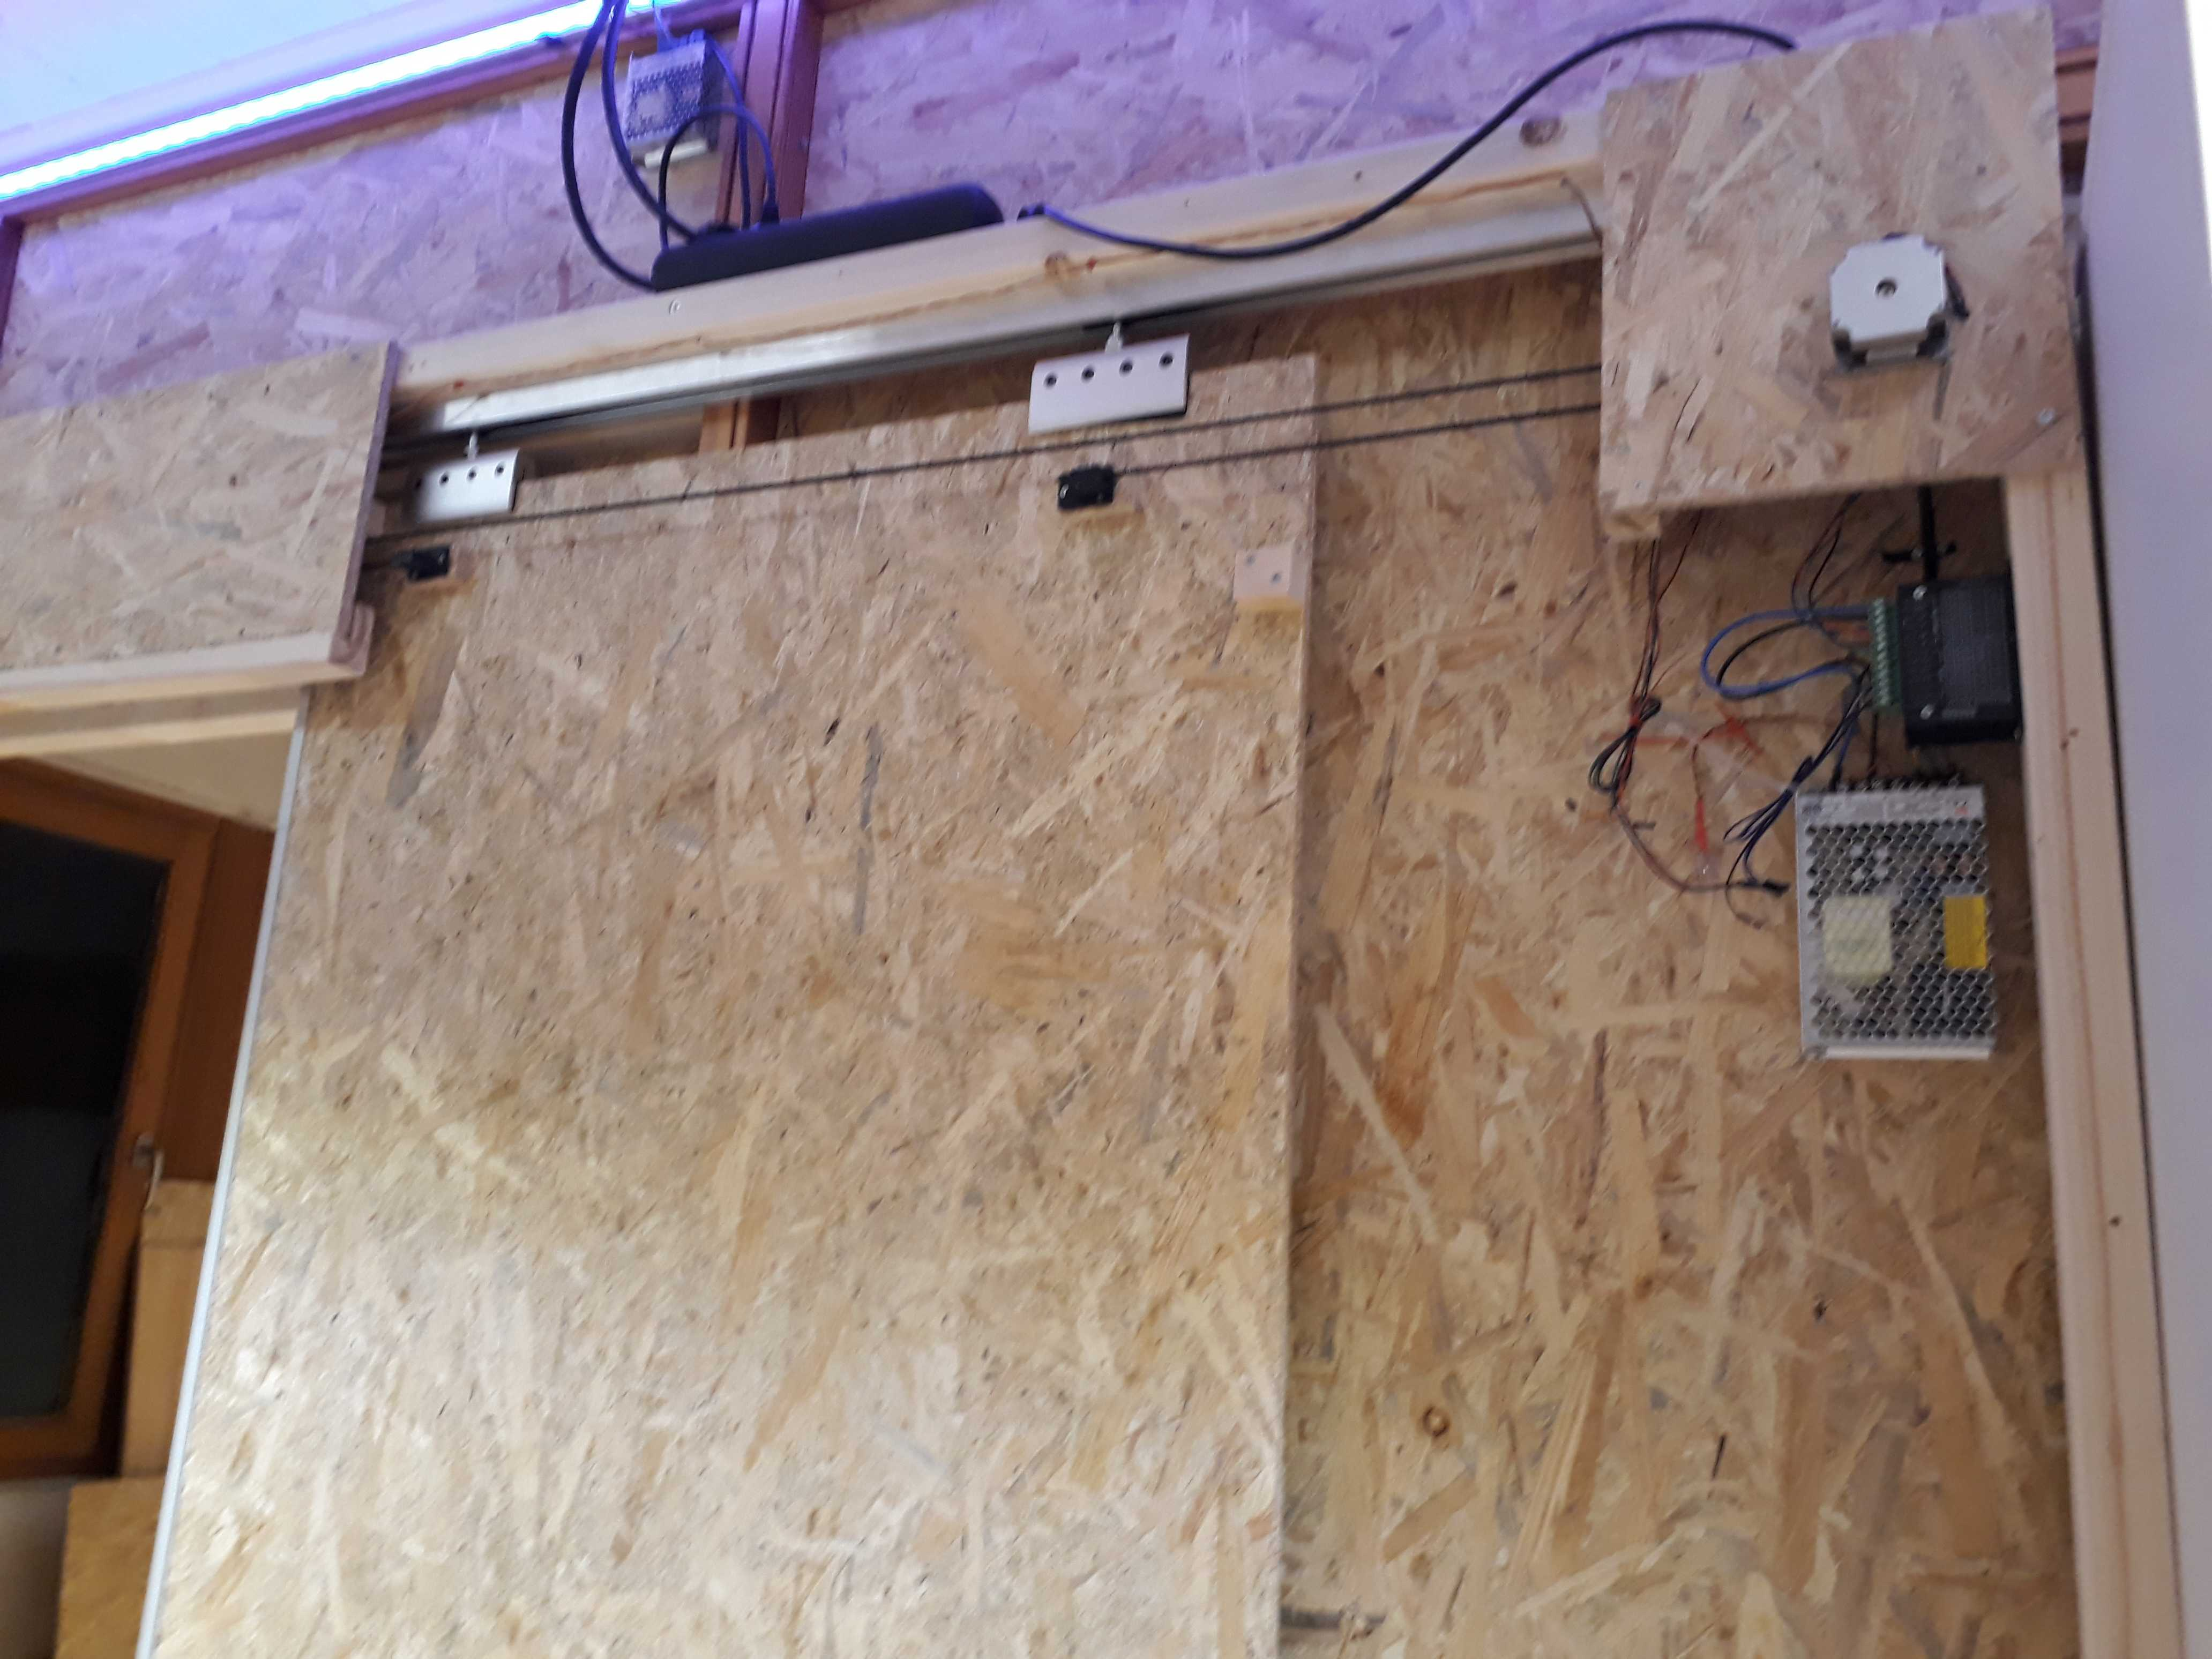
Doors
Mechanical components:
Mounting
Gearbelts
Gearwheels
Floor guide rail
Endstops
Electrical compnents:
Motor and Driver
Endstops switches
Voltage supply
Microcontroller:
- ESP 32

Slide 9
Doors – Functional principle
Endstop
touched?
Slowly move door in one direction
Repeat some for other side
Initialisation
yes
no
Save Endpositions
Move the door to the respective end stop
Get command: „open“
Send MQTT message: open
Move the door to the respective end stop
Get command: „close“
Send MQTT message: closed

Slide 10
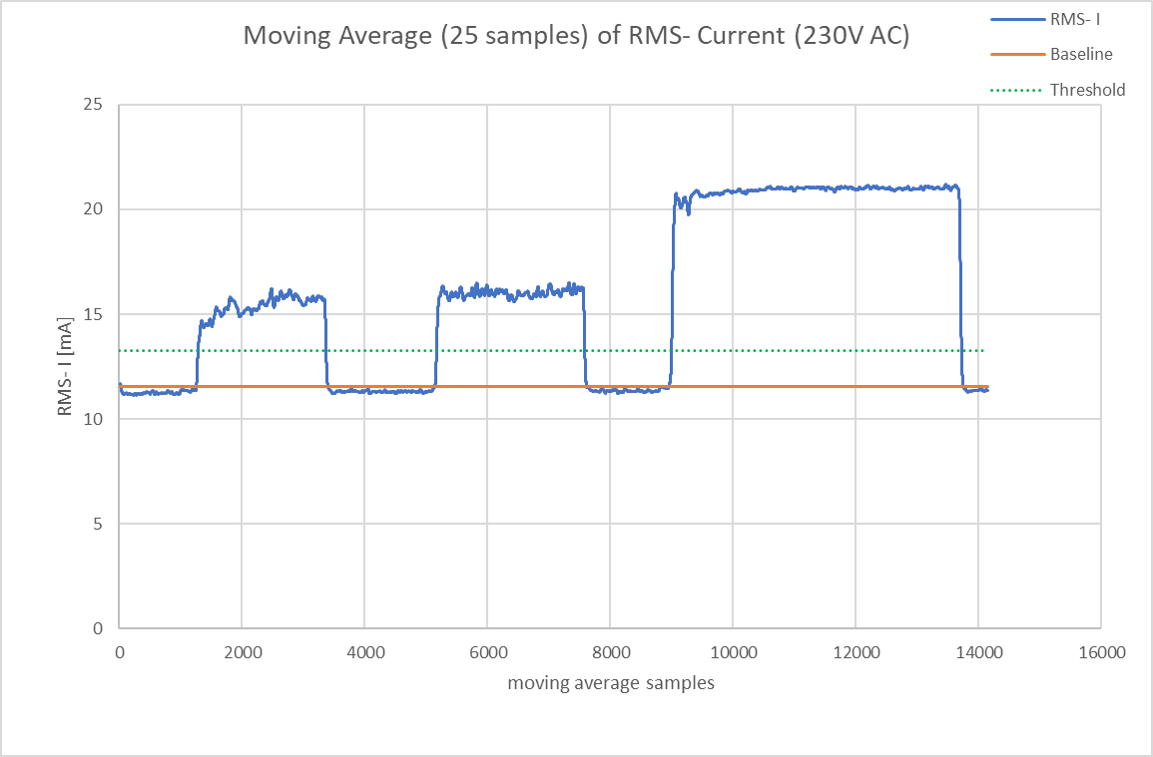
Plasma Globes – Sensing touch events
touched
touched
touched

Slide 11
Plasma Globes - Puzzle
open/close
close
open
touched/ not touched
closed!
master
touched/ not touched
touched/ not touched
slave
slave
slave

