Slide 1
Group 5: Safe
Frank Mutter, Markus Schwörer, Florian Bregler

Slide 2
Motivation
Main story goal:
Players have to steal the Prototypes
Safe:
  Open safe → Get Prototypes

Slide 3
Safe puzzle
Divided into two parts:
1. Safe activation:
  Voltage divider puzzle
  Switch puzzle
2. Safe opening:
  Code combination puzzle

Slide 4
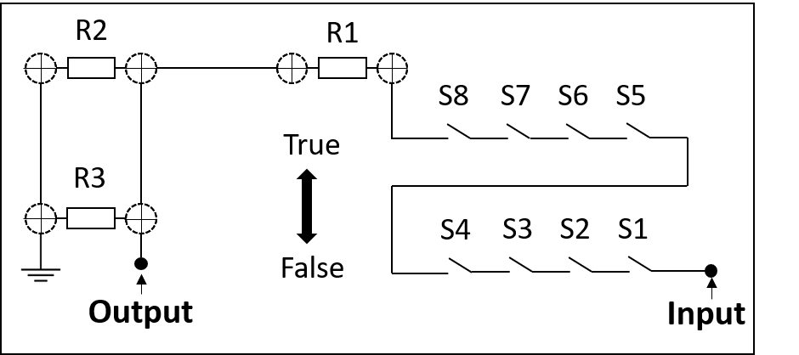
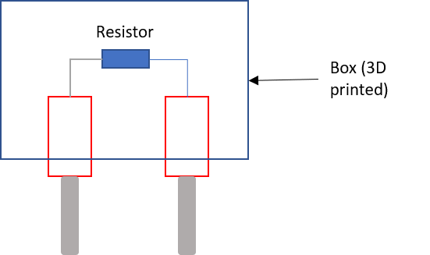
Safe activation
Set switch position according to data sheet
Divide input voltage using resistors

Slide 5
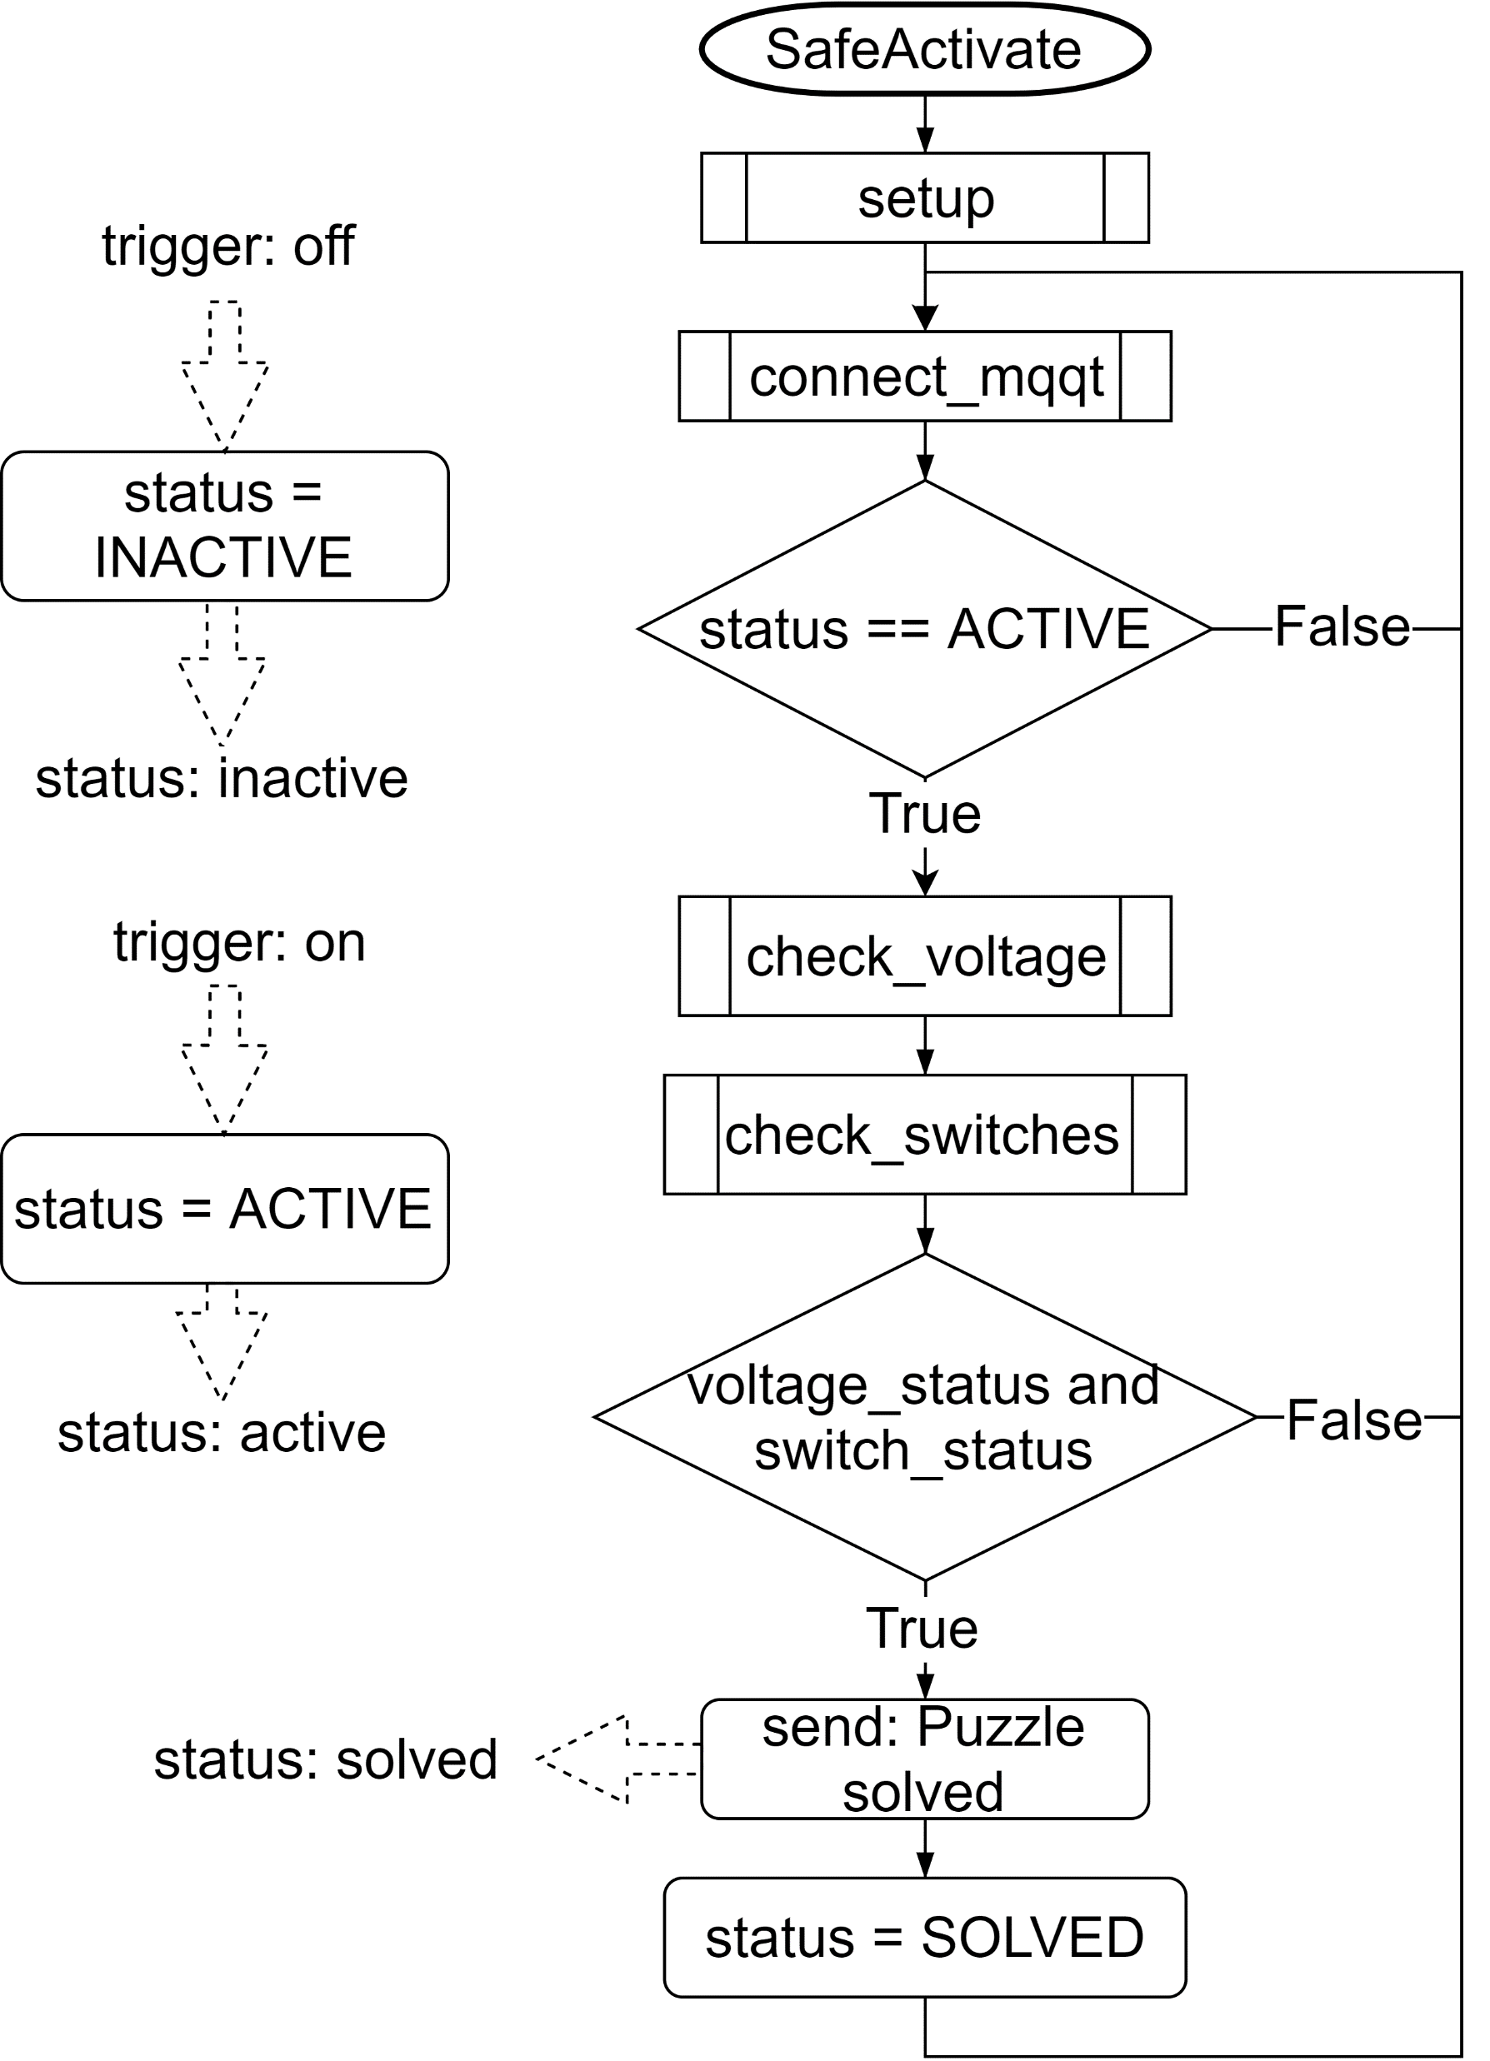
Safe activation

Slide 6
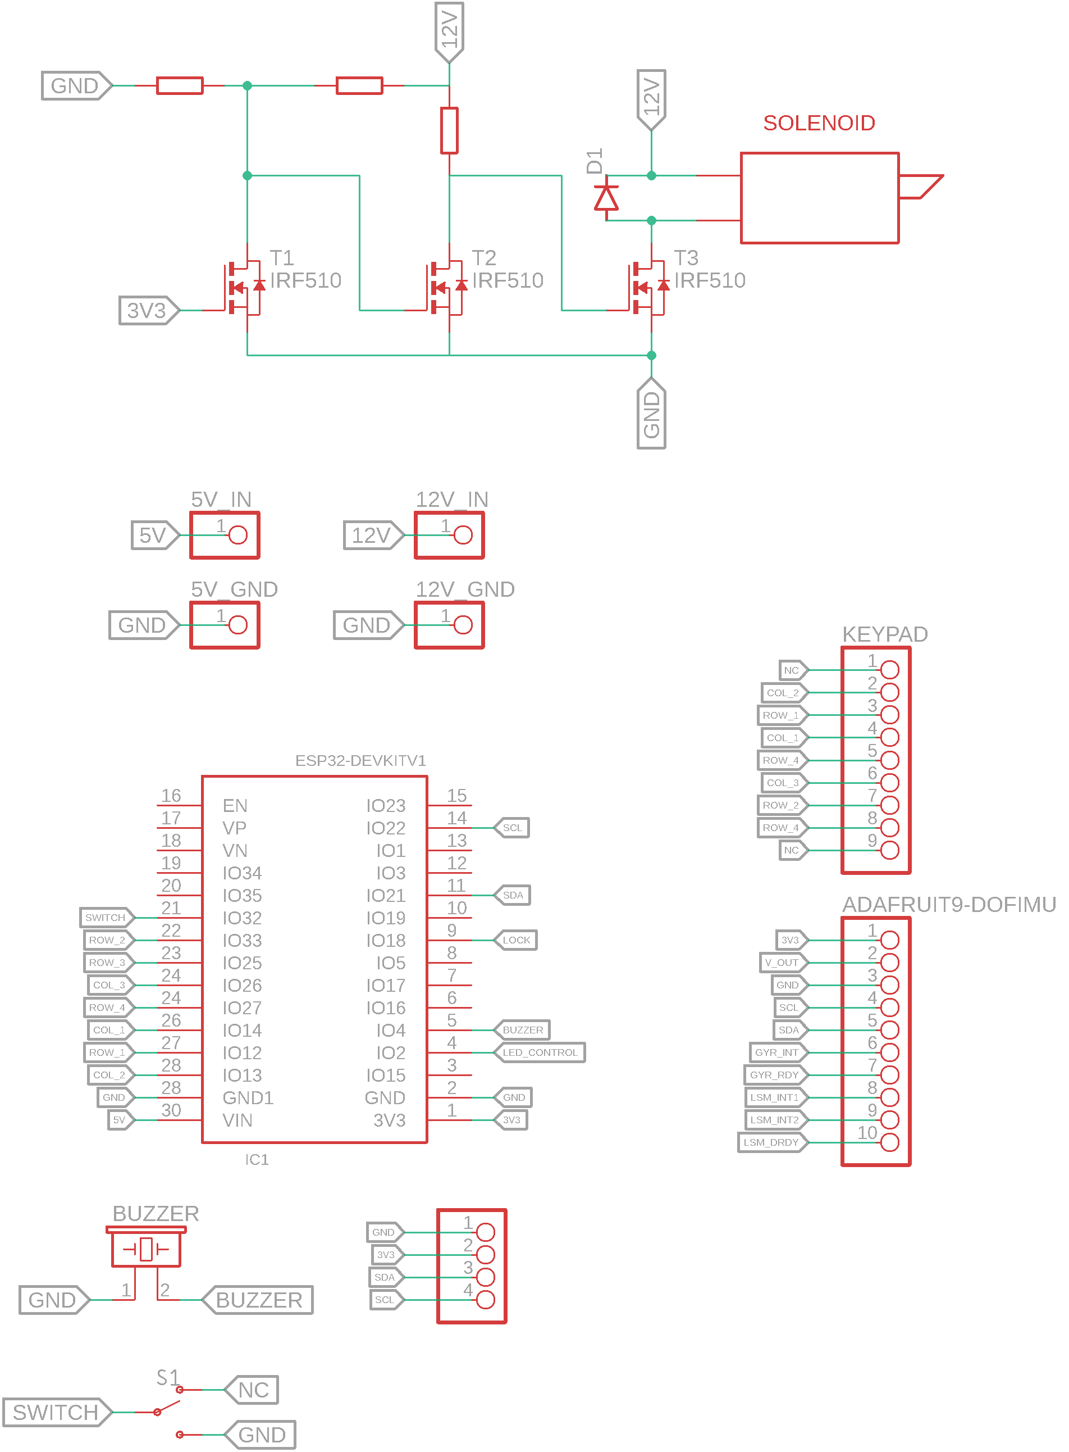
Safe control schematics
Acceleration sensor
Endstop switch
Piezo buzzer
LED stripe
Lock
Keypad
LCD

Slide 7
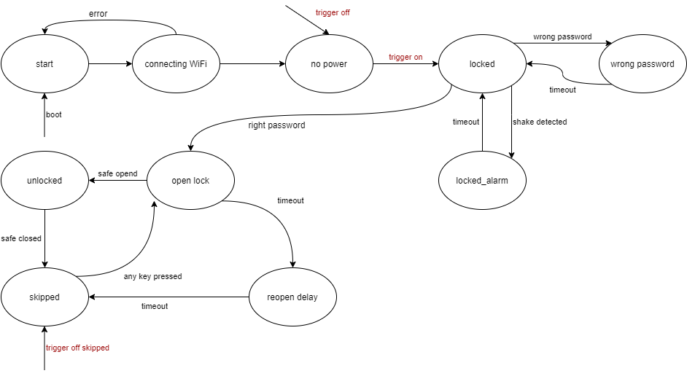
Safe control

Slide 8
Live demo
Blink
Game logic controls
mqqt on
Fade
mqtt off
Buzzer
mqtt skipped

