Slide 1
Group 5: Safe
Frank Mutter, Markus Schwörer, Florian Bregler

Slide 2
Motivation
Main story goal:
Players have to steal the Prototypes
Safe:
Open safe → Get Prototypes

Slide 3
Safe puzzle
Divided into two parts:
1. Safe activation:
Voltage divider puzzle
Switch puzzle
2. Safe opening:
Code combination puzzle

Slide 4
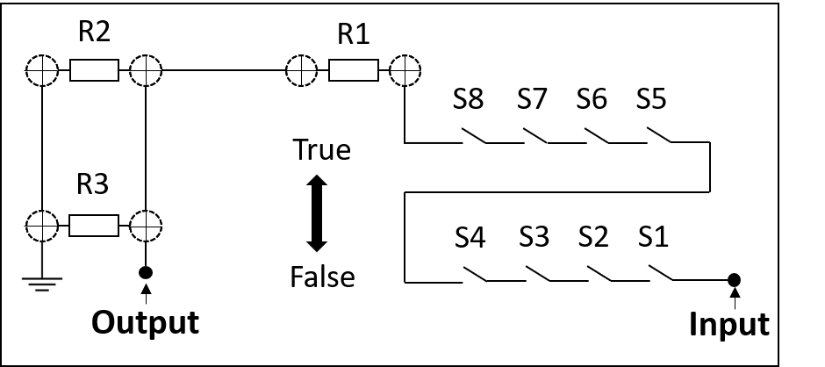
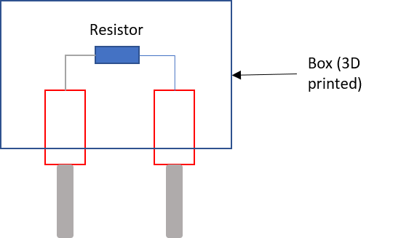
Safe activation
Set switch position according to data sheet
Divide input voltage using resistors

Slide 5
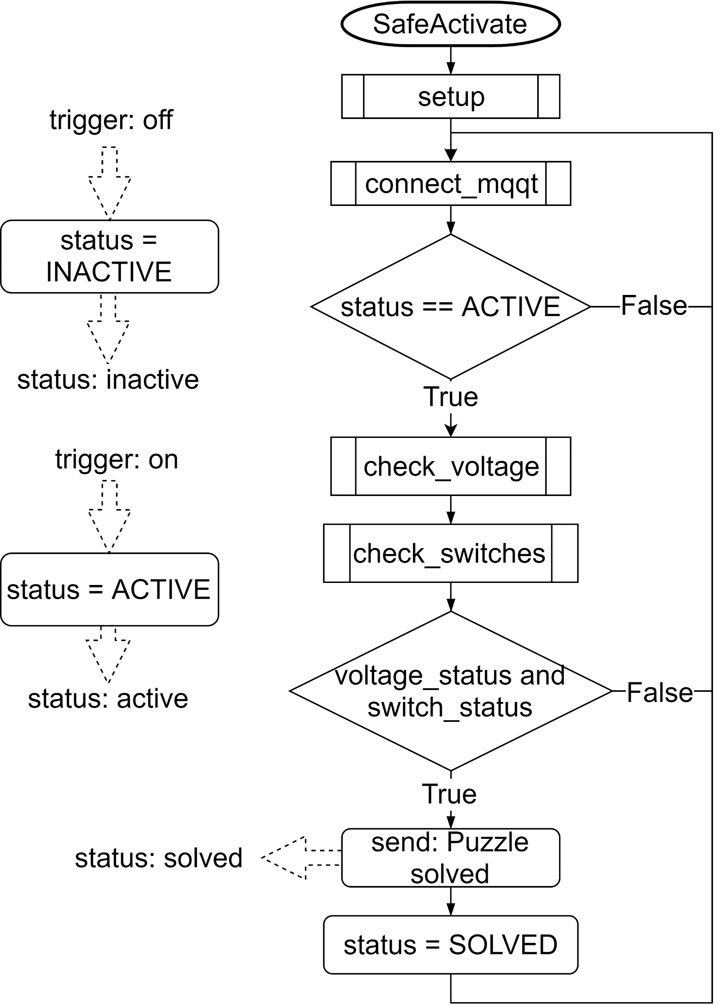
Safe activation

Slide 6
Safe opening

Slide 7
Live demo

