Slide 1
Group 5: Safe
Frank Mutter, Markus Schwörer, Florian Bregler

Slide 2
Motivation
Main Goal:
Players have to steal the Prototypes
Role of the safe:
Power the safe for activation
Open safe to get Prototypes

Slide 3
Safe puzzle
Divided into two Parts:
1. Safe activation:
Voltage Divider Puzzle
Switch Puzzle
2. Safe opening:
Code Combination Puzzle

Slide 4
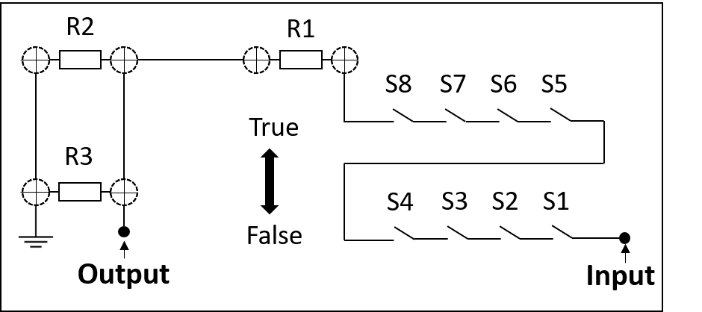
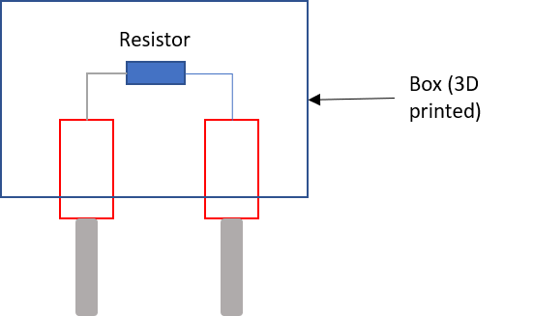
Safe activation
Set switch position according to data sheet
Divide input voltage using resistors

Slide 5
Safe opening

Slide 6
Life Demo

