Slide 1

KnowYourCity
The dashboard of Oulu
-Team Alpha-
Jilin Yang, University of Oulu, jilin.yang@student.oulu.fi
Haejong Dong, University of Oulu, haejong.dong@student.oulu.fi
Esa Viljamaa, VTT, esa.viljamaa@vtt.fi
UBISS 2015
6TH INTERNATIONAL UBI SUMMER SCHOOL 2015

Slide 2
Motivation
An improved access and visualization of city and district related open data is needed for:
Better awareness of citizens of the city status by easier access to services and information
Increased participation of citizens
Better decision-making support of city councellors
Novel business idea and application incubation for 3D virtual platforms

Slide 3
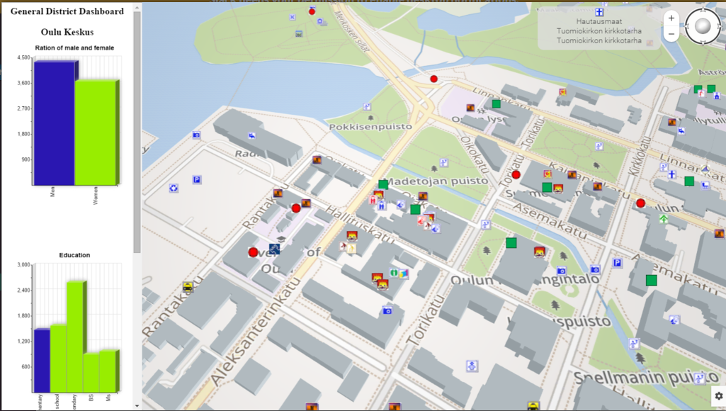
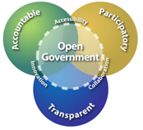


Realization
Web rocket
HTML5/WebGL
Web browser
realXtend
Meshmoon
Oulu services
data
Municipal open data
District data
Server
OPEN DATA

Slide 4
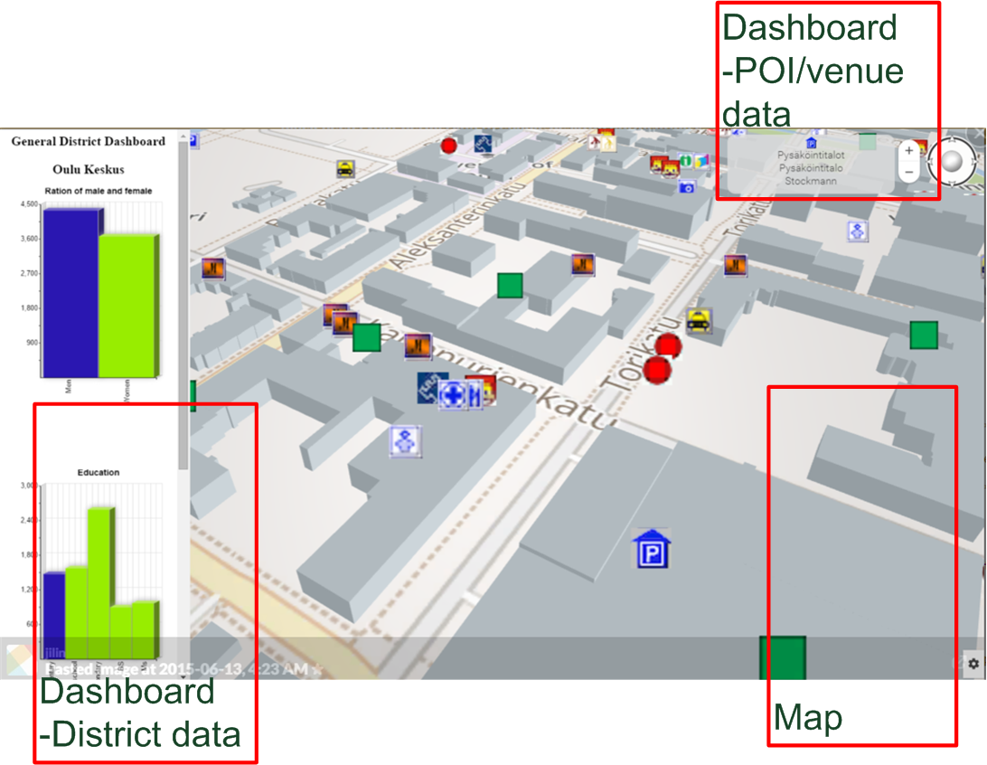
Usage
Moving around with arrows or mouse
Information of district or POI by mouse click on dashboards
3D map for visualization

Slide 5

Live presentation

Slide 6
Future work
Additional open data could be integrated, eg. real estate CAD and other information
Possibility to select from multiple sources for dashboard information and do district-wise comparisons for selected population attributes
Fancier visualizations

Slide 7
Thanks for your time!

