Slide 1
A Recommender System for Groceries Contractor
Applied Data Science Capstone
IBM Data Science Professional Certificate
Summer 2020

Slide 2

A Recommender System FOR SIMILAR HOUSES TO MINE
Image is from this site: https://www.geo-viz.com/blog/business-aspects-recommender-systems<

Slide 3
Synopsis
1.1 Scenario and Background
I am a data scientist currently residing in Downtown Singapore. I currently live within walking distance to Downtown "Telok Ayer MRT metro station" therefore I have access to good public transportation to work. Likewise, I enjoy many amenities in the neighborhood , such as international cuisine restaurants, cafes, food shops and entertainment. I have been offered a great opportunity to work in Manhattan, NY. Although, I am very excited about it, I am a bit stress toward the process to secure a comparable place to live in Manhattan. Therefore, I decided to apply the learned skills during the Coursera course to explore ways to make sure my decision is factual and rewarding. Of course, there are alternatives to achieve the answer using available Google and Social media tools, but it rewarding doing it myself with learned tools.
1.2 Problem to be resolved:
The challenge to resolve is being able to find a rental apartment unit in Manhattan NY that offers similar characteristics and benefits to my current situation. Therefore, in order to set a basis for comparison, I want to find a rental unit subject to the following conditions:
Apartment with min 2 bedrooms with monthly rent not to exceed US$7000/month
Unit located within walking distance (<=1.0 mile, 1.6 km) from a subway metro station in Manhattan
Area with amenities and venues similar to the ones described for current location

Slide 4
Synopsis
1.3 Interested Audience
I believe this is a relevant project for a person or entity considering moving to a major city in Europe, US or Asia, since the approach and methodologies used here are applicable in all cases. The use of Four-Square data API and mapping techniques combined with data analysis will help resolve the key questions arisen. Lastly, this project is a good practical case toward the development of Data Science skills.

Slide 5
Synopsis
2.1 Data of Current Situation
I Currently reside in the neighborhood of 'Mccallum Street' in Downtown Singapore. I use Foursquare to identify the venues around the area of residence which are then shown in the Singapore map shown in methodology and execution in section 3.0 . It serves as a reference for comparison with the desired future location in Manhattan NY
2.2 Data Required to resolve the problem
In order to make a good choice of a similar apartment in Manhattan NY, the following data is required: List/Information on neighborhoods form Manhattan with their Geodata ( latitude and longitude. List/Information about the subway metro stations in Manhattan with geodata. Listed apartments for rent in Manhattan area with descriptions ( how many beds, price, location, address) Venues and amenities in the Manhattan neighborhoods (e.g. top 10) 2.3 sources and manipulation The list of Manhattan neighborhoods is worked out during LAb exercise during the course. A csv file was created which will be read in order to create a data frame and its mapping. The csv file 'mh_neigh_data.csv' has the following below data structure. The file will be directly read to the Jupiter Notebook for convenience and space savings. The clustering of neighborhoods and mapping will be shown however. An algorithm was used to determine the geodata from Nominal. The actual algorithm coding may be shown in 'markdown' mode because it takes time to run.

Slide 6
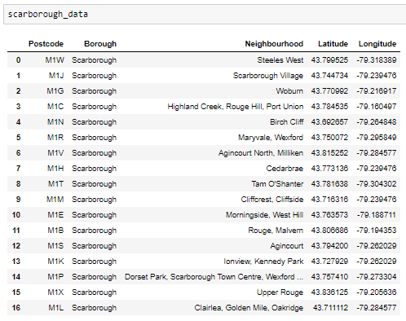
Main Article
Part 1: Identifying Postal Codes (and then Neighborhoods) in "Scarborough"

Slide 7
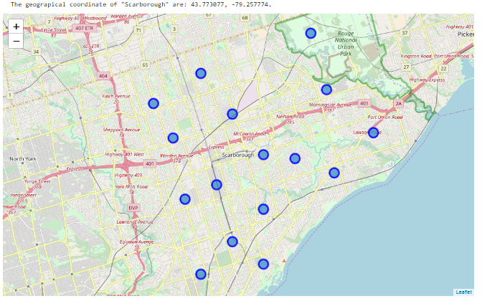
Main Article
Part 1: Identifying Postal Codes (and then Neighborhoods) in "Scarborough"

Slide 8
Main Article
Part 2: Connecting to Foursquare and Retrieving Locational Data for Each Venue in Every Neighborhood
After finding the list of neighborhoods, we then connect to the Foursquare API to gather information about venues inside each and every neighborhood. For each neighborhood, we have chosen the radius to be 1000 meter. It means that we have asked Foursquare to find venues that are at most 1000 meter far from the center of the neighborhood.

Slide 9
Main Article
Part 3: Processing the Retrieved Data and Creating a DataFrome for All the Venues inside the Scarborough
When the data is completely gathered, we will perform processing on that raw data to find our desirable features for each venue. Our main feature is the category of that venue. After this stage, the column "Venue's Category" wil be One-hot encoded and different venues will have different feature-columns. After On-hot encoding we will integrate all restaurant columns to one column "Total Restaurants" and all food joint columns to "Total Joints" column.

Slide 10
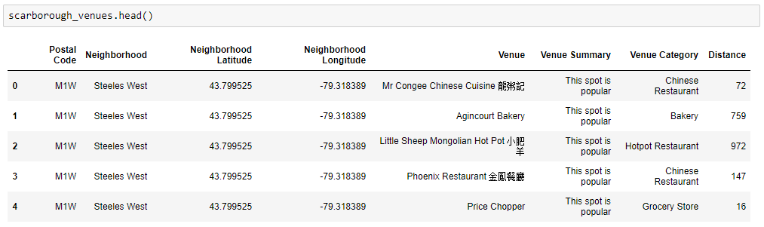
Main Article
Part 3: Processing the Retrieved Data and Creating a DataFrome for All the Venues inside the Scarborough

Slide 11
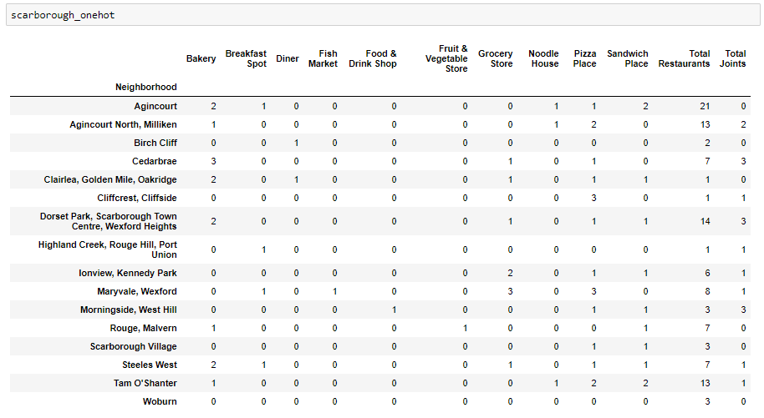
Now, the dataset is fully ready to be used for machine learning (and statistical analysis) purposes.

Slide 12
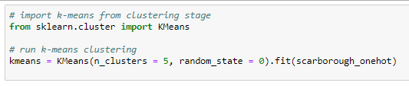
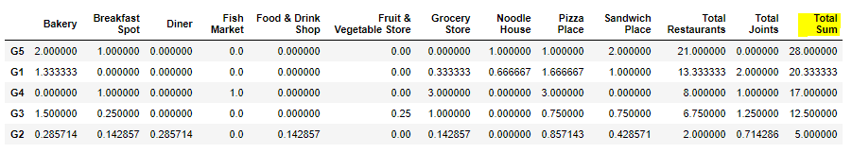
Main Article
Part 4: Applying one of Machine Learning Techniques (K-Means Clustering)

Slide 13
Decision Making and Reporting Results
Now, we focus on the centers of clusters and compare them for their "Total Restaurants" and their "Total Joints". The group which its center has the highest "Total Sum" will be our best recommendation to the contractor. {Note: Total Sum = Total Restaurants + Total Joints.} This algorithm although is pretty straightforward yet is strongly powerful.

Slide 14
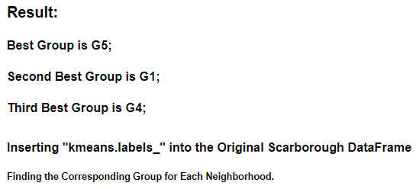
Decision Making and Reporting Results

Slide 15
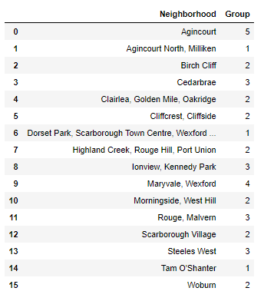
Decision Making and Reporting Results

Slide 16
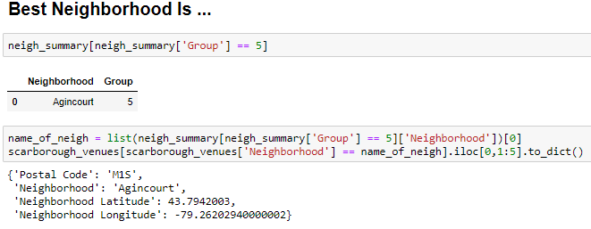
Decision Making and Reporting Results

Slide 17

Image is from: https://contenthub-static.grammarly.com/blog/wp-content/uploads/2017/10/thank-you-760x400.jpg

