Slide 1
Firewalls

Slide 2
Overview
What are firewalls?
Why do we need them?
Types of firewalls
Implementation
Best practices

Slide 3
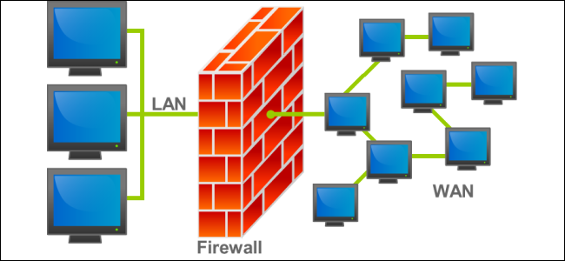
What is a Firewall?
… a network security system that monitors and controls incoming and outgoing network traffic based on predetermined security rules.

Slide 4
What Do They Do?
Essentially a network filter
First line of defense
Establishes a barrier between a trusted internal network and untrusted external network, such as (but not limited to) the Internet.

Slide 5



Slide 6

What Happens Without One?
Bad people get in where they’re not supposed to
Data goes places it’s not supposed to go
Fires start
People get very upset

Slide 7

Most Companies Today
“50% of administrators audit their firewalls once a year, and about 10% never do it.”
–Richard Broeke (sales manager at Securicom)

Slide 8
History of Firewalls
1980s - Firewalls emerge
1990s - First Security Firewall ( IP routers with filtering )
1992 - First Commercial Firewall - DEC SEAL
2009 - Next Gen Firewall defined

Slide 9
History of Firewalls
First Generation:
Packet Filters
Inspecting individual packets that come into the network
Second Gen
Stateful Filters
Keeps track of all open connections
Issues? Overhead.
Third Gen(Next Gen)
Application Layer
Understands Service Context
Protects Applications

Slide 10
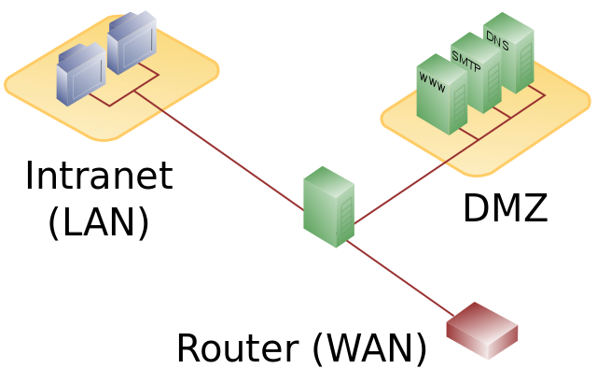

Slide 11
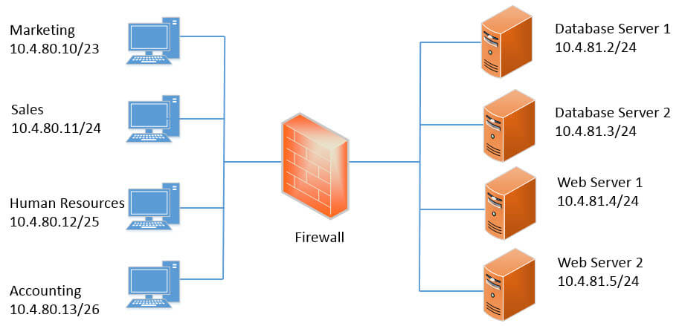

Slide 12
Types of Firewalls
Network Based vs Host Based
Stateful vs Stateless
Virtual Firewall
Packet Filters
Application Layer
Proxy Firewalls
Deep Packet Inspection

Slide 13
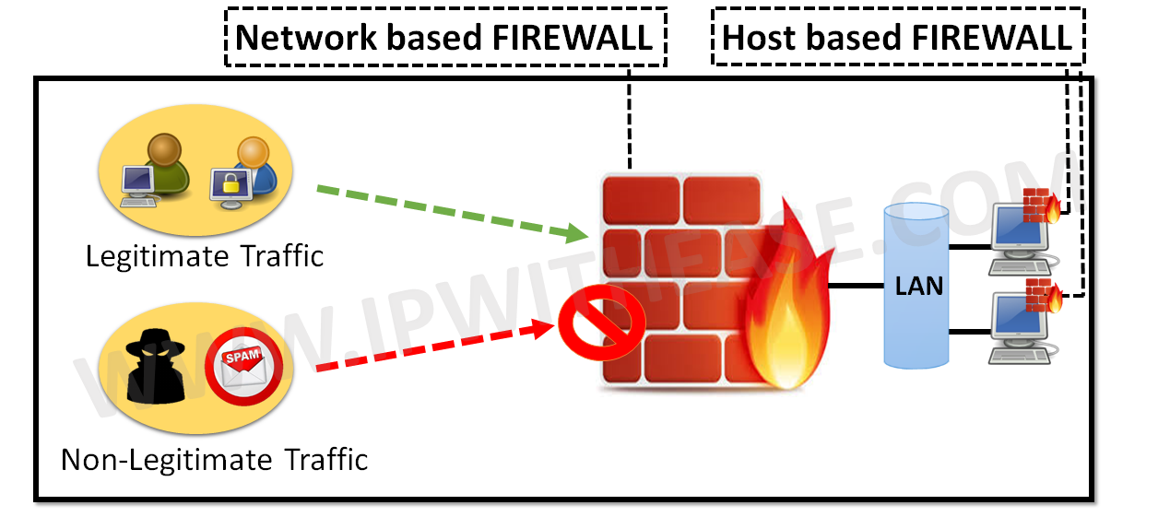
Network vs Host Based Firewall
Host Based Firewall
Installed on each machine
Example: Windows Firewall
Network Based Firewall
Built into the infrastructure
Example: pfSense

Slide 14
Stateful vs Stateless
Stateful
Keep track of connections
Monitors end to end
Can identify forged communications
Stateless
Used for packet filtering
Very fast
Works under heavy loads
Monitors based on data presented

Slide 15
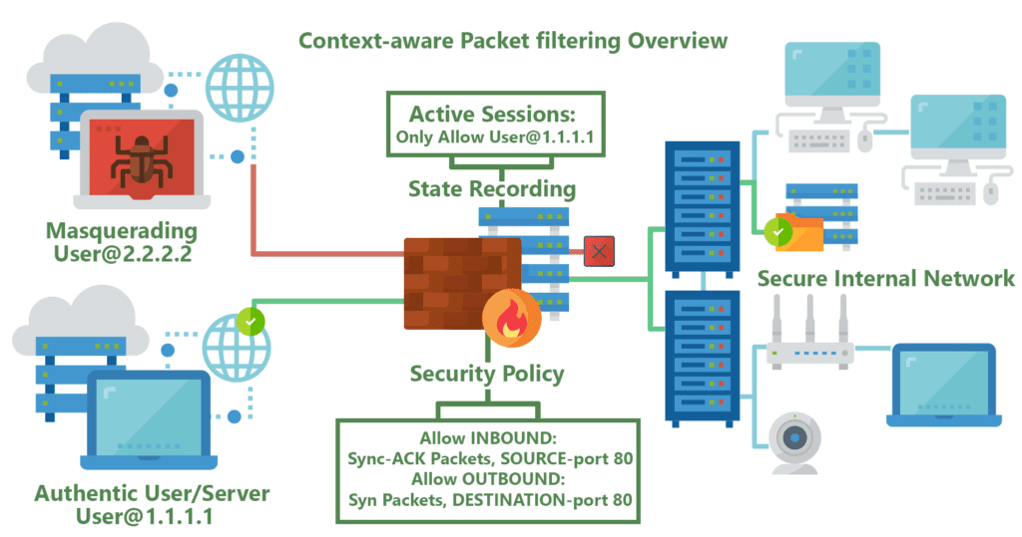
Stateful

Slide 16
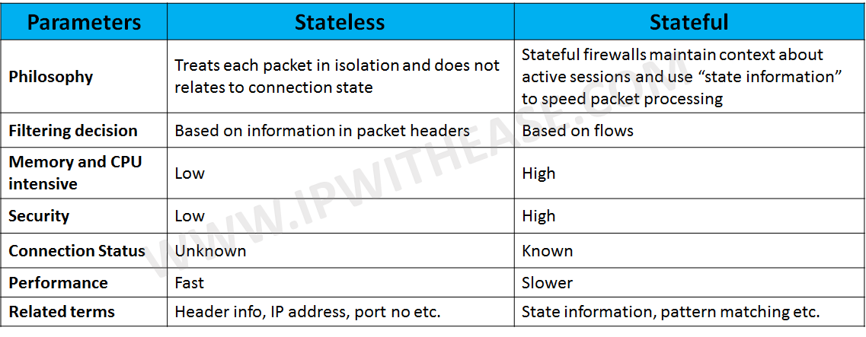

Slide 17
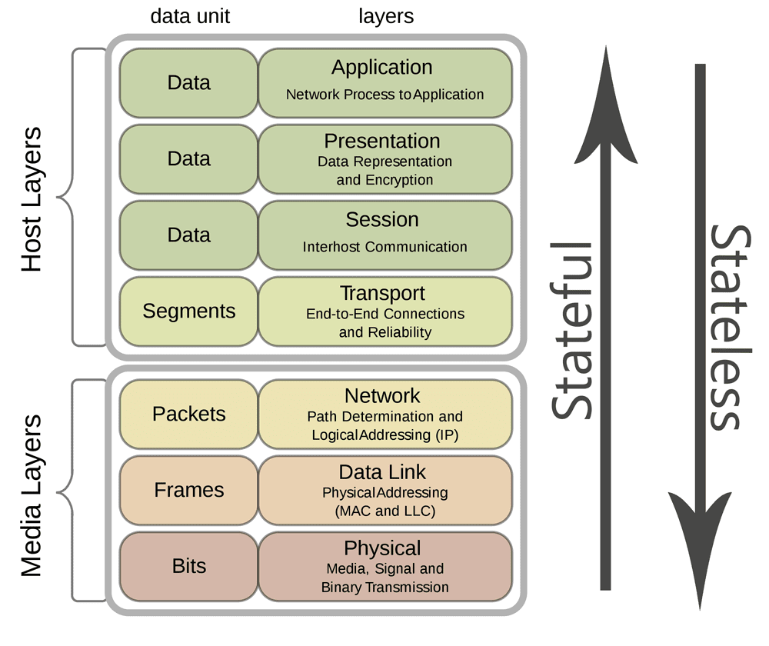
1000 × 840

Slide 18
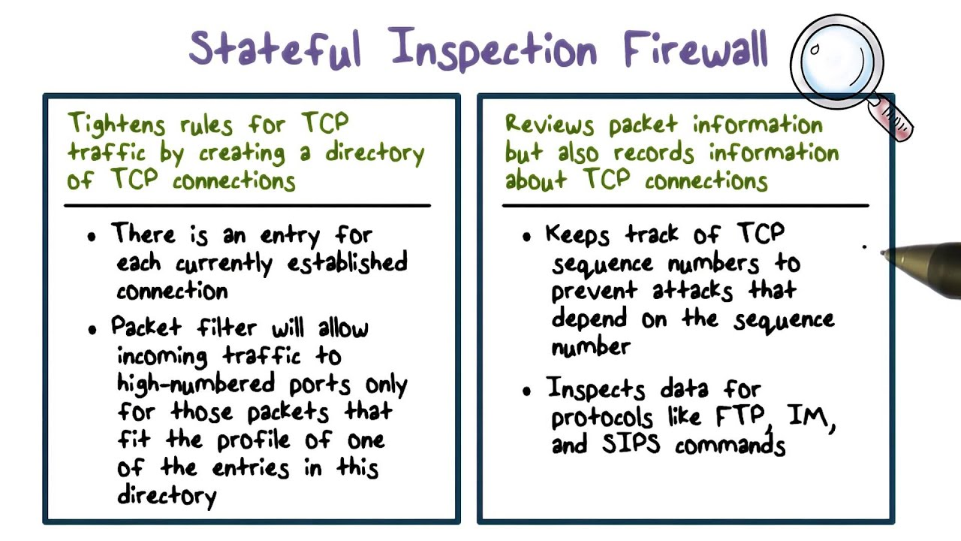

Slide 19
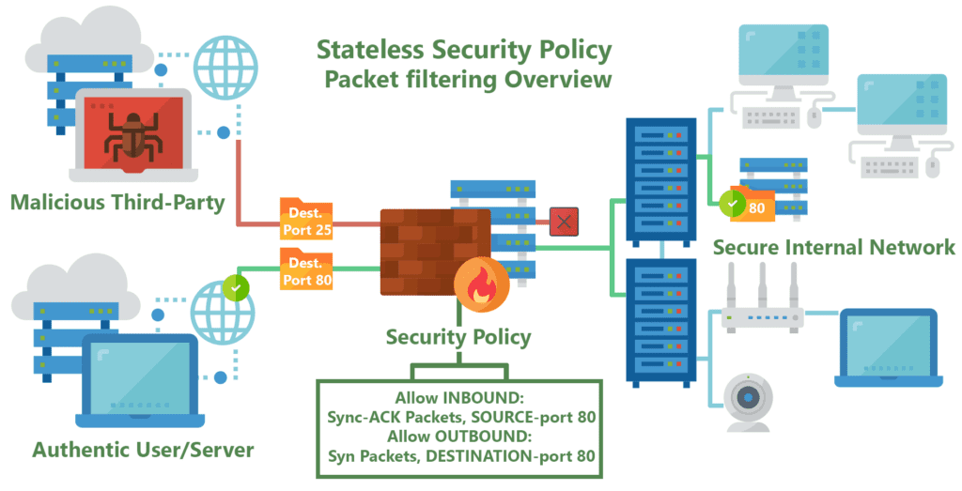
Stateless

Slide 20
Stateful vs Stateless
Which is better?

Slide 21
NAT + Firewall
Network Address Translation
Assigns private IP addresses to hosts behind the router
Those outside the internal network must connect through the single public IP
All hosts inside the private network have the same internet(external) IP address
Anyone ever port forward to host a minecraft server? Why is this necessary?

Slide 22
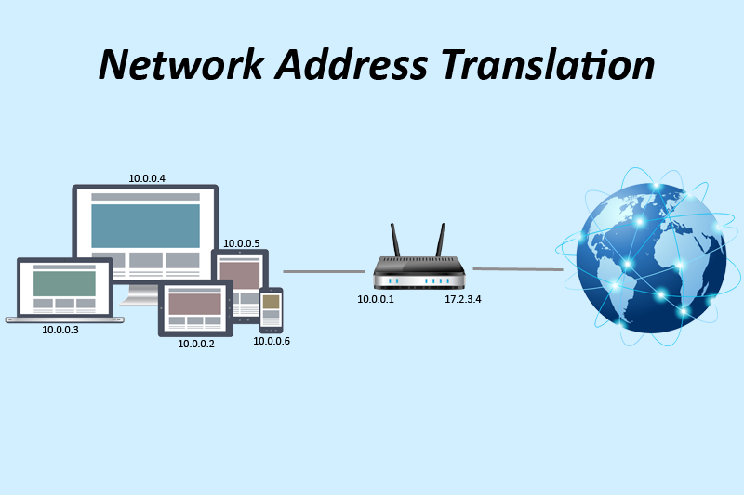

Slide 23
1:1 Nat
… maps one external IPv4 address to one internal IPv4 address.

Slide 24
Scenario: Linux
iptables - administration tool for IPv4 packet filtering and NAT.
… used to set up, maintain, and inspect the tables of IP packet filter rules in the Linux kernel.
Essentially, host based firewall for Linux. Filters, and does NAT.

Slide 25
Scenario: Linux
Block an incoming IP:
$ iptables –A INPUT –s 10.42.X.XXX –j DROP
Block outgoing IP:
$ iptables –A OUTPUT –d 10.42.X.XXX –j DROP
Block an incoming port:
$ iptables –A INPUT –s 10.42.X.XXX –p tcp –destination-port 80 –j drop

Slide 26
Persistence?
Debian
$ iptables-save >
/etc/iptables/rules.v4
/sbin/iptables-save
Redhat
$ Service iptables save
/etc/sysconfig/iptables

Slide 27
IPTables Flags
-A Append one or more rule
-D Delete a Rule
-I Insert a Rule
-R Replace
-F FLUSH chain, delete rule one by one
-j Jump
-s Source IP
-d Destination IP
-p Protocol(TCP/IP)
-L List all rules
-N Numerically List
-v Verbose (More information output)
Need more? $ man iptables

Slide 28
Too complicated ???

Slide 29
UFW (Uncomplicated Firewall)
Front-end for iptables
$ sudo ufw allow from 1.1.1.1 to any port 22
$ sudo ufw deny from 1.1.1.1/24
$ sudo ufw deny http(80)
$ sudo ufw status numbered
$ sudo ufw delete 2
$ sudo ufw default deny incoming

Slide 30
Activity
Team A
Linux Box 1
Block Team B with iptables
Team B
Linux Box 2
SSH into Team A
What happens when Team A blocks you? Can you get back in? Is there a backdoor?
Switch when done!

Slide 31
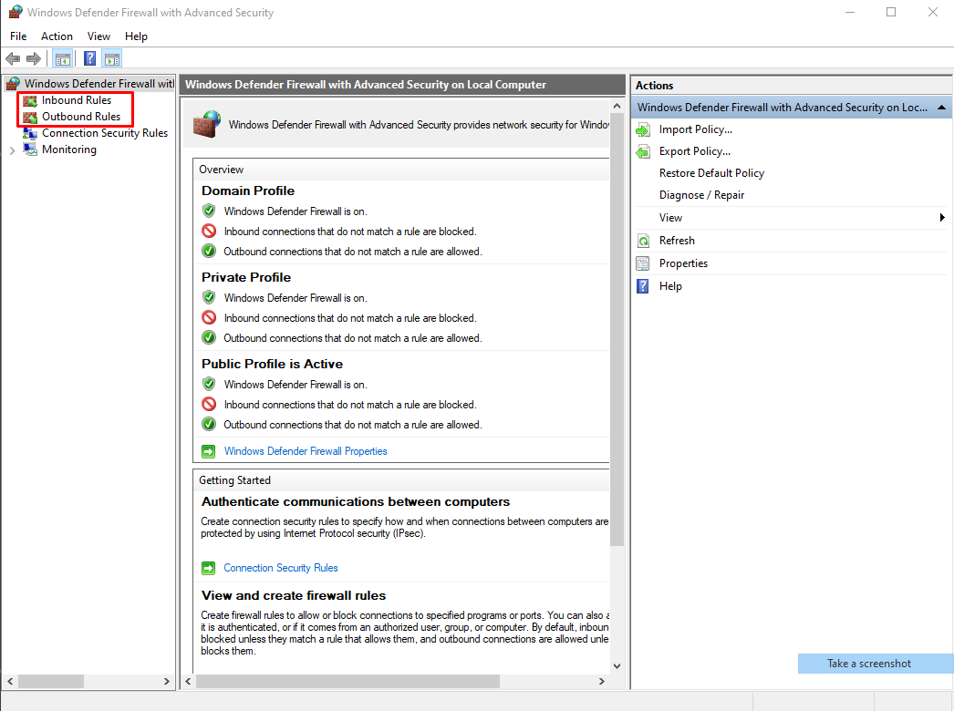
Scenario: Windows
Windows Firewall (GUI)
Host based

Slide 32
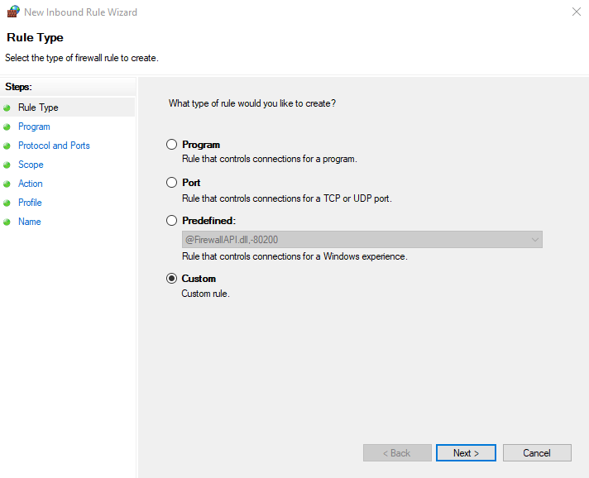

Slide 33
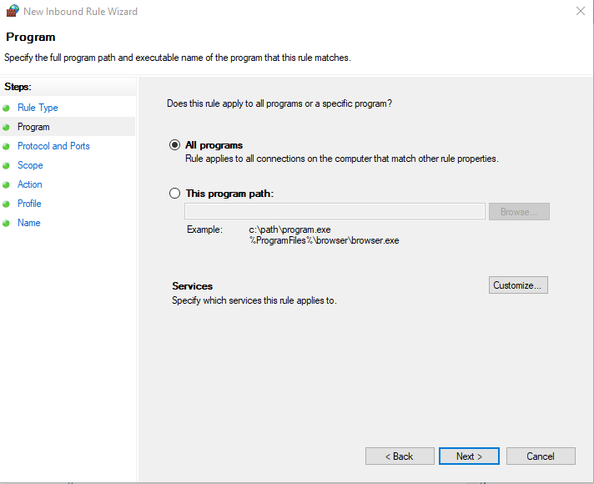

Slide 34
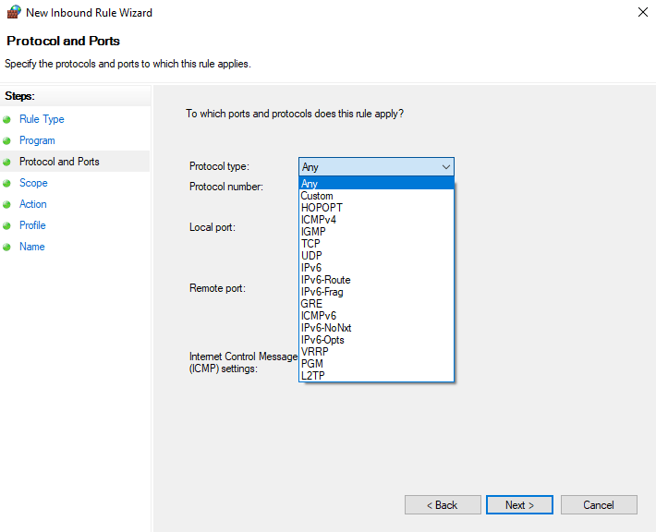

Slide 35
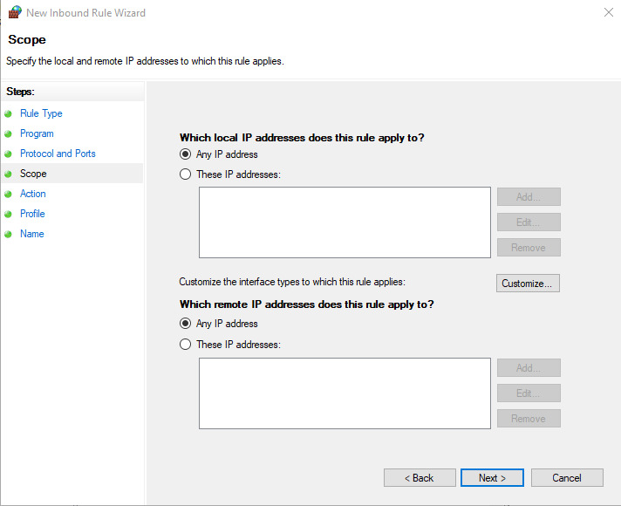

Slide 36
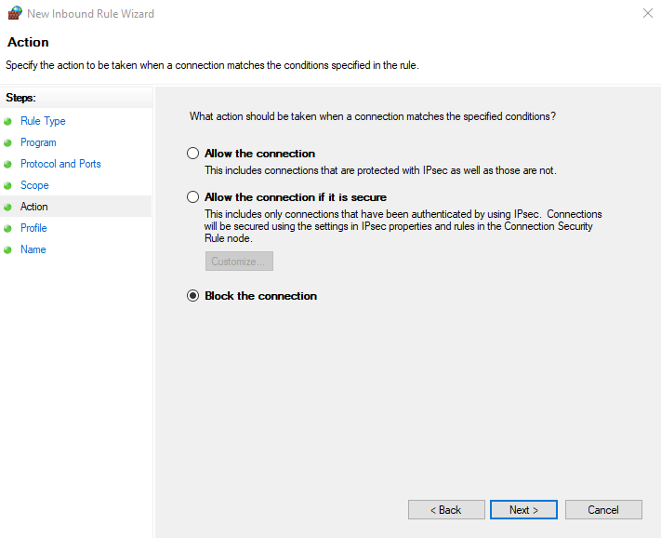

Slide 37
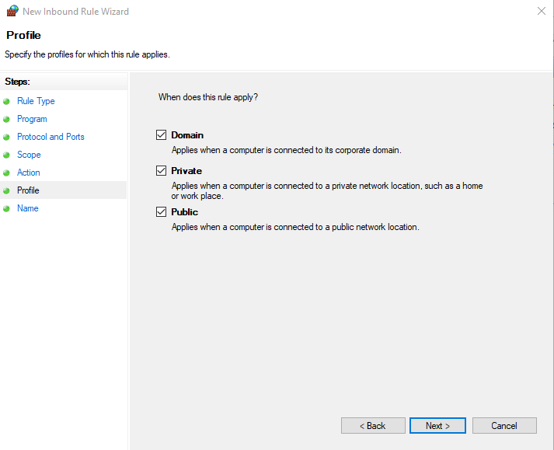

Slide 38
Windows (CMD)
Block an incoming IP
$ netsh advfirewall firewall add rule name=”NAME” dir=in action=block remoteip=198.168.1.1/24
Block an outgoing IP
$ netsh advfirewall firewall add rule name=”NAME” dir=out action=block remoteip=198.168.1.1/24
Block an incoming port
$ netsh advfirewall firewall add rule name=”NAME” dir=in action=block protocol=TCP localport=80

Slide 39
$ netsh advfirewall set *
$ netsh advfirewall set currentprofile firewallpolicy
$ netsh advfirewall set publicprofile state on/off
$ netsh advfirewall set privateprofile state on/off
Fix/review/test/improve etc this slide sucks

Slide 40
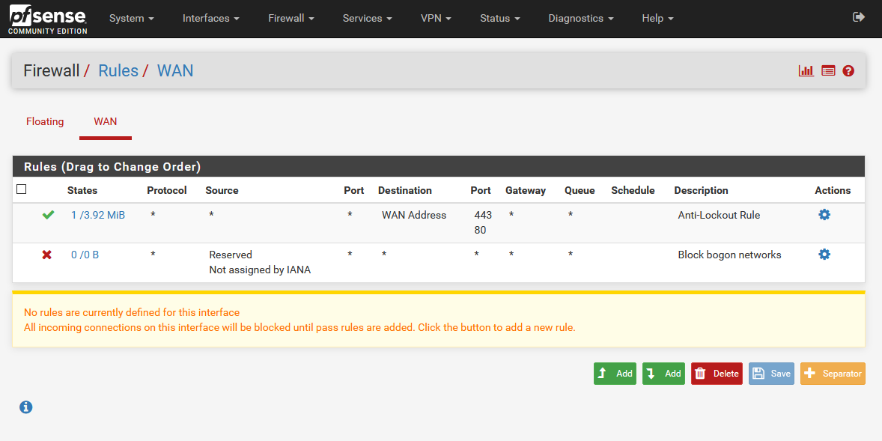
Scenario: pfSense

Slide 41
pfSense CLI
Blocking IP
$ easyrule block wan 10.42.x.xxx
Pass with Port
$ easyrule pass wan tcp 10.42.x.xxx 192.168.0.4 80
Pass without Port
$ easyrule pass wan icmp 10.42.x.xxx
Issues?: $ pfctl -d

Slide 42
Best Practices
Drop ALL connections
Implicit Deny
Block services not in use
Add back only what is NEEDED
Order matters
$ watch --interval=5 ‘iptables -nvL | grep -v “0 0”’
Monitor iptables
Read ps aux from top to bottom (processes)
Firewalls are not the last resort

Slide 43
Other Firewalls
Check Point
Symantec
Cisco
Juniper
Palo Alto

Slide 44
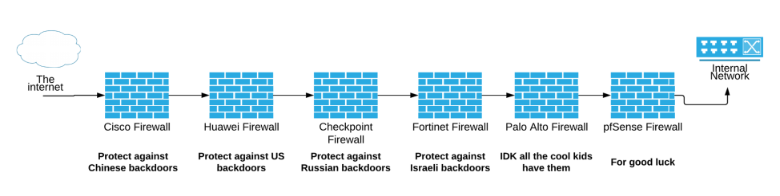

Slide 45
Where Do We Go From Here?
Zero Trust Architecture
“Never Trust, Always Verify”
Beyondcorp, Palo Alto, etc
Defense in Depth
Layer up!
Next Gen Firewalls (Palo Alto)
Galaxy Brain Firewall

Slide 46
Thinking Time
How can you improve your security?
How can you protect yourself?
Are firewalls omnipotent?
What can’t they do?
What else do you need?
Do we need firewalls?

Slide 47
Any Questions?

