Slide 1
DATA SCIENCE JOB SALARY ANALYSIS
2020 – 2024
Power BI Dashboard Summary for Management Review
Prepared by: Data Analytics Team
Dataset: 6,599 global data-role salary records • Built in Power BI Desktop

Slide 2
Executive Summary
What this dashboard covers and why it matters
This report summarizes a Power BI dashboard analyzing 6,599 global data-science job salary records from 2020 to 2024. It tracks how pay differs by experience, company size, work model, job title, and location — and how those patterns have shifted over time. The dashboard is filterable by employment type, experience level, company size, and work model to support ad-hoc management review.
$145.56K
39%
6,599
$1B
Average salary (USD)
Roles that are remote
Total salary records
Combined total salary (USD)
This deck walks through each dashboard page, highlights the key patterns found, and closes with recommended actions for hiring and compensation strategy.
Executive summary
Data Science Job Salary Analysis 2020–2024

Slide 3
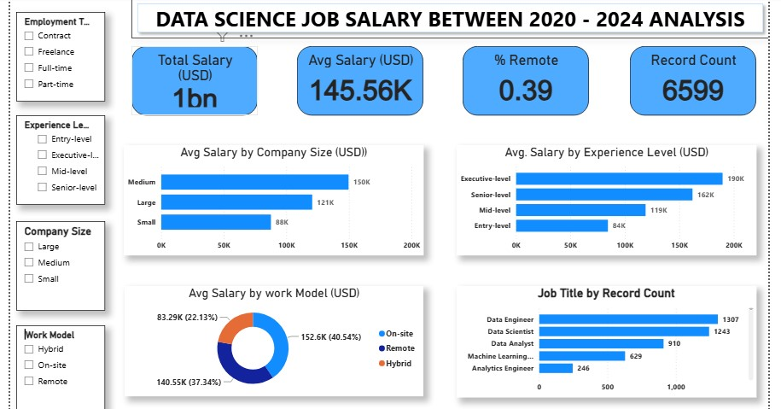
Dashboard Page 1: Overview & Filters
KPI cards, filter panel, and four supporting visuals
KEY OBSERVATIONS
The left-hand filter panel lets management slice by employment type, experience level, company size, and work model — no need to request a custom cut.
Average salary across all records is $145.56K; total combined salary is $1B; 39% of roles are remote.
Pay rises steadily with seniority: Entry $84K → Mid $119K → Senior $162K → Executive $190K.
Medium-sized companies pay the most on average ($150K), ahead of Large ($121K) and Small ($88K).
On-site roles average the highest pay (40.5% of records at $152.6K), narrowly ahead of Remote (37.3% at $140.6K); Hybrid trails at $83.3K.
Data Engineer (1,307) and Data Scientist (1,243) are the two most common job titles in the dataset.
Page 1 of 3
Data Science Job Salary Analysis 2020–2024

Slide 4
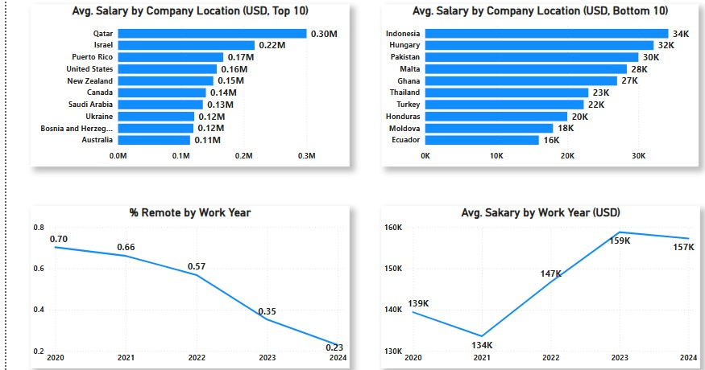
Dashboard Page 2: Geography & Trends
Top/bottom paying locations, remote-work share, and salary trend by year
KEY OBSERVATIONS
Qatar tops company-location pay at $0.30M average, followed by Israel ($0.22M) and Puerto Rico ($0.17M) — all likely small samples worth a record-count check.
United States sits mid-pack among top payers at $0.16M despite carrying the largest volume of records.
The lowest-paying locations (Indonesia, Hungary, Pakistan, Malta, Ghana) average $16K–$34K — a wide spread against the top 10.
Remote-work share has fallen sharply, from 70% in 2020 to 23% in 2024, with the steepest drop after 2022.
Average salary dipped in 2021 ($134K), then climbed to a peak of $159K in 2023 before easing slightly to $157K in 2024.
Page 2 of 3
Data Science Job Salary Analysis 2020–2024

Slide 5
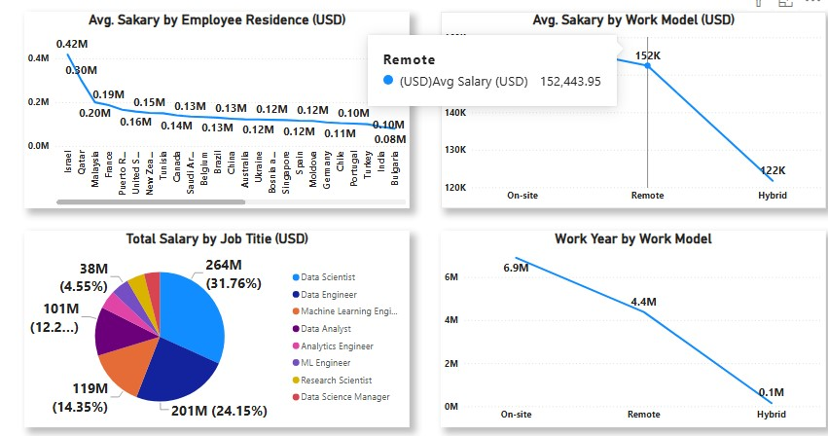
Dashboard Page 3: Residence, Work Model & Job Mix
Salary by employee residence, work model, and total salary contribution by role
KEY OBSERVATIONS
Employee residence mirrors company location: Israel ($0.42M) and Qatar ($0.30M) top the list, well above the general $0.10M–$0.20M band.
By work model, On-site ($152K) again leads, with Remote close behind ($152.4K per this cut) and Hybrid clearly lowest ($122K).
Data Scientist ($264M, 31.8%) and Data Engineer ($201M, 24.2%) together account for over half of total salary spend across the dataset.
Work-year volume is heavily concentrated in On-site (6.9M) and Remote (4.4M) roles, with Hybrid a small fraction (0.1M) — confirming hybrid arrangements are rare in this dataset, not just lower-paid.
Page 3 of 3
Data Science Job Salary Analysis 2020–2024

Slide 6
Key Insights Summary
Consolidated findings across all three dashboard pages
1
Experience is the clearest salary driver
2
Medium companies pay the most
Executive roles average $190K vs. $84K for Entry-level — a 2.3x gap.
Medium-sized firms out-pay both Large and Small companies on average.
3
Remote work is shrinking fast
4
Pay dipped, then recovered
Remote share fell from 70% (2020) to 23% (2024).
Average salary dropped in 2021 before climbing to a 2023 peak of $159K.
5
A few locations are extreme outliers
6
Two roles drive over half of total spend
Qatar and Israel post very high averages that likely reflect small sample sizes.
Data Scientist and Data Engineer together account for ~56% of total salary.
Key insights
Data Science Job Salary Analysis 2020–2024

Slide 7
Recommendations
Benchmark offers against experience level first — it's the strongest, most reliable salary predictor in this data.
Treat Qatar, Israel, and other top/bottom-10 outlier locations with caution until record counts are confirmed as statistically reliable.
Revisit remote-work policy expectations — pay is comparable between on-site and remote, but remote's share of the workforce is shrinking fast.
Prioritize compensation review for Data Scientist and Data Engineer roles first, since they represent the largest share of total salary spend.
Use this dashboard's filter panel for future ad-hoc management questions instead of requesting new one-off reports.
Thank you
Dashboard built in Power BI Desktop • Full report and files available in the project repository

