Slide 1
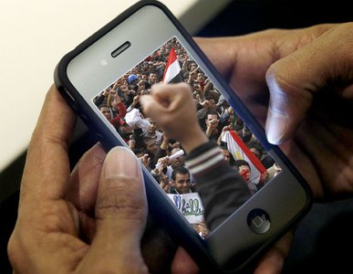
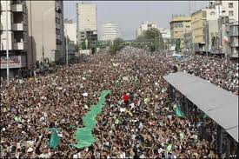
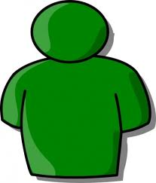
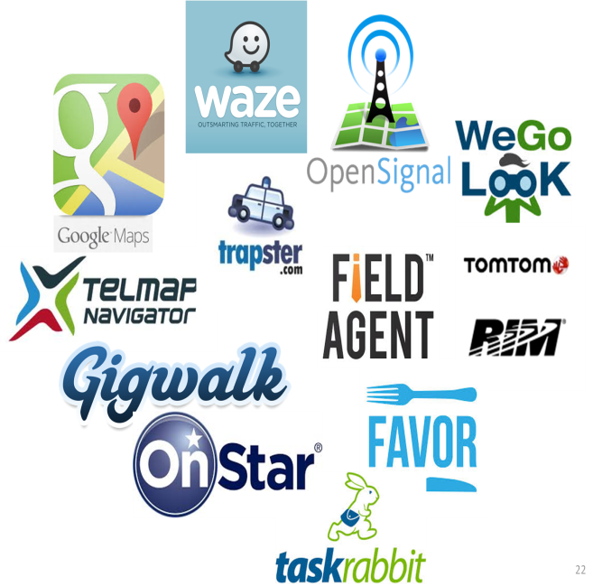
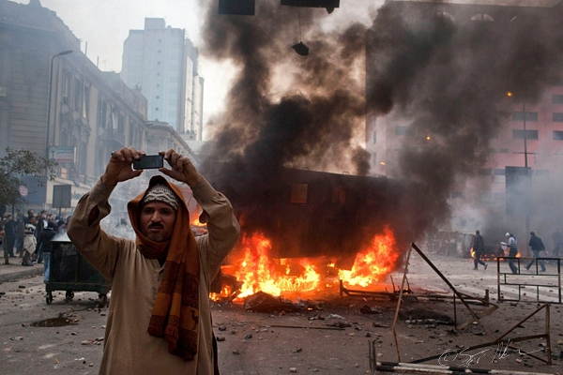
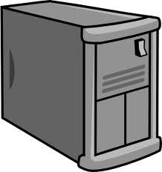
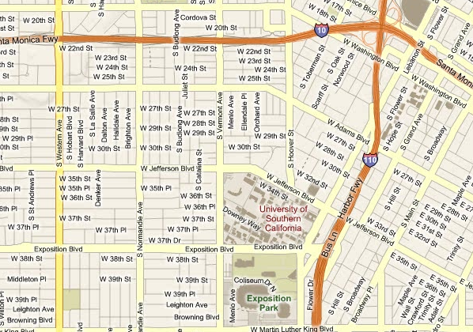

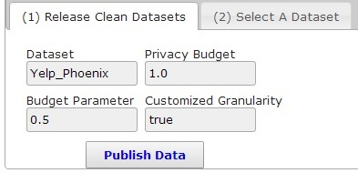
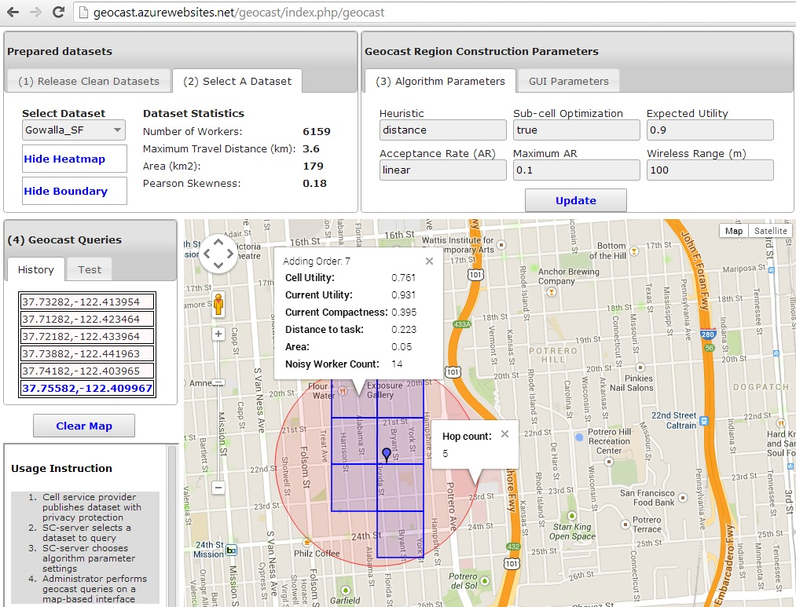
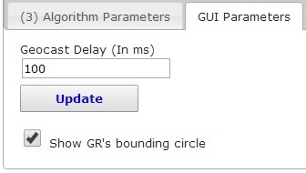
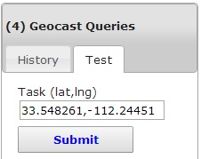
A Framework for Protecting Worker Location Privacy in Spatial Crowdsourcing
Ubiquity of mobile users
Requesters
Technology advances on mobiles
1
SC-server
Network bandwidth improvements
Workers
Spatial Crowdsourcing (SC)
Applications
2
A Scenario
3
Prototype System: PriGeoCrowd
Privacy Framework
Notes:
Hello everyone, my name Hien To, from Viterbi school of Engineering.
Today everyone has a smartphone, and you know your phone have so many sensors on it, for example GPS, wifi, camera. Also the network quality is getting better and better, like 4G LTE. Because of that now you can do amazing tasks with your phone, let me tell you how. Have you heard about crowdsourcing? CS is like AMT, you basically have a bundle of tasks that could be difficult for computer to solve, you give them to people. And they would do the tasks for you, let say one dollar per task. How about spatial crowdsourcing? the phones are real enabler of spatial crowdsourcing, where now people can move to the a location to do the task. The tasks could be taking a picture of Tommy Trojan, or it could be reporting weather or traffic condition. People can do so b/c they have the phone with them. So, SC is the same concept as CS except now the task requires the users to travel to the task location.
Spatial crowdsourcing has application in many fields such as journalism, tourism, intelligence, disaster response and urban planning. Let me illustrate with a disaster-response scenario, where Red Cross, here as the requester is interested in collecting pictures and videos of disaster areas from various locations of a city. The requester sends a task to a server. Then, the server crowdsources the task among the available workers in the nearby area of task. After the workers document their tasks with their phones, the results are sent back to the requester
However, current spatial crowdsourcing solution requires the workers to reveal their locations to untrustworthy server. And someone with access to this centralized server can manipulate your location to infer sensitive information, such as lifestyles or even your religious. For example, if someone know every Saturday you are at Church, so he know you are Christian. So your location is a sensitive information that we want to hide. But at the same time, the location is also important for spatial crowdsourcing application to efficiently assign tasks to people. We want to utilize location information without really revealing people’s location. Let me tell you how it could be possible. We introduce a technique that achieves effective SC services while offering privacy guarantees to workers. Basically, the data owner like ATT who already know your location will sanitize your location data. So no individual location is revealed, but there is enough aggregated information so that the service provider can do a good job in assigning tasks to workers. Because privacy guarantee often comes along with a cost. So, we also came up with analytical models and different task assignment strategies to make sure a task can be completed with high probability and at the same time reduce the travel distance of the workers. Our experimental results on real-world datasets verify this.
In addition, we also build a web app for monitoring the system.
The take away message is that our study enable cell phone companies like ATT to release data without really revealing individual location information, at the same time, the SC company can utilize the sanitized data to provide high quality crowdsourcing services.
Thank you very much!

