Slide 1

BMAN61102
GROUP PROJECT WORK
GROUP 3
Kiousi, Maria
Udoisang, Blessing Sunday
Paraskevas, Eleftherios
Wang, Shulin
Filippou, Chrysostomos Georgios
Sampigehalli Anand Murthy,Mahindra
Khan Rayis

Slide 2
CONTENTS
Introduction
Group Dynamics
Problem Formulation
Research and Modelling
Results and Analysis
Summary

Slide 3
INTRODUCTION
Where it all began…

Slide 4
INTRODUCTION The Case: TV & Internet Package
TASK
Decide as a group, on how to provide TV and internet in our house
BACKGROUND
A group of 7 students
Just moved in and staying for 18 months
No broadband or cable presently in the house
One modern TV available from one of us with capacity to receive Freeview & Freesat
Notes:
Scenario
We are to imagine that we share a house in “Fallowfield” (A place in Manchester, UK) and will do so for at least 18 months. Imagine too that it is the beginning of the academic year and that we have all just moved in. In all other respects we may take prices and availability of items and services as they are today.
Our task as a group is to decide upon how to provide TV and internet in our house. We might look at all in one packages build our own bundle of services from say terrestrial digital TV and TalkTalk Broadband. Currently there is no broadband, no cable (though it is available in the street that our house is on). There is a landline connection to the house, but no current contract. Each of us is to imagine that we have our personal computer as it is now – or that we do not have one, if indeed we don’t. One of us also has a modern TV able to receive Freeview and Freesat and that person is willing to put this in the communal lounge. Generally we are to play ourselves with our own tastes and preferences.
As a group we are to decide on how to provide TV and internet access at our house.
As a group we need to identify our objectives. Come up with 4 or 5 objectives at least. We should also identify some possible ways of providing TV and internet, cost them approximately, etc. Use the web or whatever to gather data and make these as reasonable as possible. Then conduct a decision analysis to help you choose which one you would organize.

Slide 5
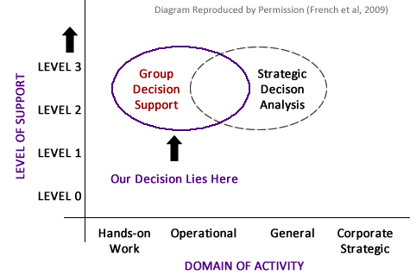
INTRODUCTION Domain of Decision Making

Slide 6
GROUP DYNAMICS
How we worked together, what we shared, which tools were used…

Slide 7
GROUP DYNAMICS Overview of Tasks
Shared Values
Group Processes
Tools Used

Slide 8
GROUP DYNAMICS Shared Values
Common Goal The task on ground – A good TV & Internet Package.
Effective Communication Everyone has a voice in the group
Responsibility & Commitment Commitment to assigned tasks; NO FREE RIDE!
Reporting and Documentation For consistency & to ensure nothing is overlooked
Devil’s Advocacy Identify weaknesses in decisions or processes
TIME Attend meetings on time; finish tasks on time.

Slide 9
GROUP DYNAMICS Group Processes
Meetings The task on ground – A good TV & Internet Package.
Effective Communication Everyone has a voice in the group
Responsibility & Commitment Commitment to assigned tasks; NO FREE RIDE!
Reporting and Documentation For consistency & to ensure nothing is overlooked
Devil’s Advocacy Identify weaknesses in decisions or processes
TIME Attend meetings on time; finish tasks on time.

Slide 10
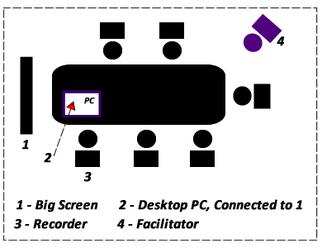
GROUP DYNAMICS Group Processes - Meetings
Our Meeting Rooms: Collab (in Kilburn) & Precinct Library Study Room
Notes:
GROUP DECISION SUPPORT ROOMS:
From the lectures, we understood the importance of seating arrangement in Group Decision Making, as such we endeavoured to hold our meetings in rooms that support the model according to the lectures. Our

Slide 11
PROBLEM FORMULATION
Understanding what is to be done and deciding the best approach

Slide 12
PROBLEM FORMULATION Overview of Tasks
The Decision Context
The Objectives
The Decision alternatives
Hierarchical Organisation of Objectives
The Attributes

Slide 13
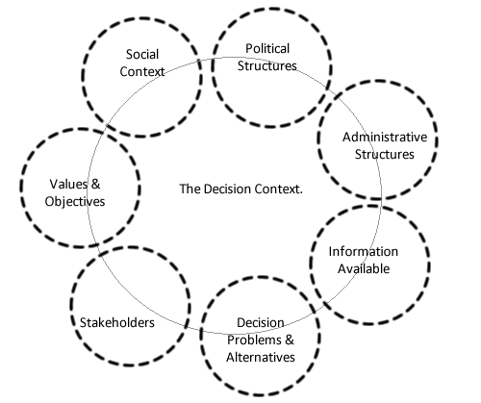
PROBLEM FORMULATION The Decision Context - 1
Notes:
The Decision context is the setting in which the decision occurs. It is framed by the administrative, political and social structures that surround the decision under consideration (HUT, MCDA Theory, 2002). It is obvious that the context of the task given would be greatly impacted by social factors than the other framing factors.
See Diagram: The factors are in dashed ellipses indicating that they may or may not impact the context. It also implies that they impact the context at varying degrees.

Slide 14
PROBLEM FORMULATION The Decision Context - 2
The Decision Problem To Provide TV & Internet in the House.
The Decision Makers The Group (Also responsible for the Consequences)
Decision Alternatives See note below and Table of Alternatives Attached.
Our Values Performance (high priority), Satisfaction, Entertainment, Prompt Attention

Slide 15
PROBLEM FORMULATION The Decision Context - 3
The Stakeholders Friends, Course mates, Neighbours, Family, Tax Authorities, Licensing Authorities.
The Social Context Differences in Opinions, Taste & Preferences; Differences in Demands
Information Sources The Internet, Sales Brochures, Interviews, Sales Agents & Friends
Timespan of Discretion Very Short, Almost Immediately

Slide 16
PROBLEM FORMULATION The Objectives - 1
MINIMIZE COST
MAXIMIZE PERFORMANCE
MAXIMIZE VALUE ADDED / EXTRAS
MAXIMIZE CUSTOMER SERVICE
MAXIMIZE ENTERTAINMENT
Notes:
By rotating the position of a facilitator amongst ourselves, we discussed about the decision problem, clarified the context and only then did we approach the subject of generating objectives. Collaboratively working together from different location via Google Documents (http://google.com/documents), each group member had the opportunity to individually provide a written list of objectives and then we moved on to a group discussion of the lists. Some of the concepts that helped us in generating objectives came from the Online MCDA course and also from the Course textbook. Among these are Use of alternatives, expert reviews, consequence modelling, online surveys, etc.
Below listed are the main objectives that guided our decision(s):
MINIMIZE COST
We plan to bla bla bla
MAXIMIZE PERFORMANCE
Due to the bla bla bla
MAXIMIZE VALUE ADDED / EXTRAS
To maximize bla bla bla
MAXIMIZE CUSTOMER SERVICE
Maximising bla bla bla bla
MAXIMIZE ENTERTAINMENT
Maximising bla bla bla bla

Slide 17
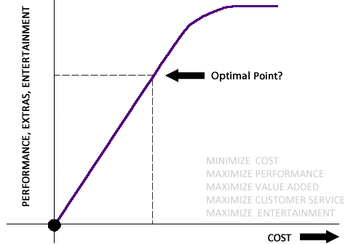
PROBLEM FORMULATION The Objectives – 2
The Conflict of Interest
Notes:
It became apparent after a little while that we cannot maximize all our objectives while at the same time minimizing cost. A balance had to be struck between them. The “Conflicting Criteria” had to be resolved on the basis of rationality and this is where Multi-Criteria Decision Analysis (MCDA) comes into the picture.

Slide 18
PROBLEM FORMULATION The Decision Alternatives
Package | PACkage Type | yyy | zzz
Package One | Single Provider | ---- | ---
Package Two | Combined | ---- | ----
Package Three | Combined | --- | ---
Package X | Single Provider | --- | ----

Slide 19
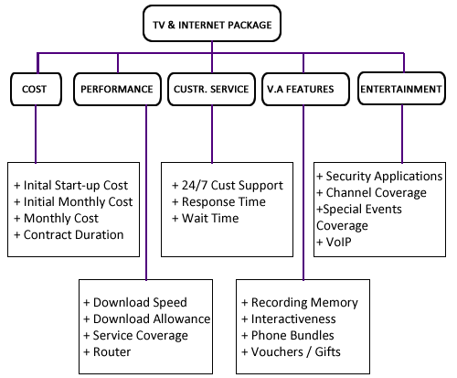
PROBLEM FORMULATION Hierarchical Organisation of Objectives
Notes:
This is the final structure, but we didn’t arrive at this at once, can someone give a discussion of how we arrived at this stating steps we took at each point and justifying them (how did we as a group justify the so taken steps?)

Slide 20
PROBLEM FORMULATION The Attributes - 1
attribute | description | type
MINIMIZE COST
Initial Start-up Cost | Connection fees - Equipment Free or Not? | GBP
Way of Payment | Instalment /Pay as You Go/ Upfront | Constructed
Monthly Cost | Description Please? | (GBP)
TV Licence | Description Please? | Constructed or Unit?
Contract Duration | Description Please? | Constructed or Unit?

Slide 21
PROBLEM FORMULATION The Attributes - 2
attribute | description | type
MAXIMIZE PERFORMANCE
Download Speed – Maximum Bandwidth | Connection fees - Equipment Free or Not? | Constructed or Unit?
Download Allowance | Unlimited – Limited | Constructed or Unit?
Service Coverage in our Area | Description Please? | Constructed or Unit?
Router | Does it have WiFi? Is it reliable for 7 people? | Constructed or Unit?
Working Time | Some broadband services only work during a range of a day, for example, AOL's service is only available from 8 to midnight | Constructed or Unit?

Slide 22
PROBLEM FORMULATION The Attributes - 3
attribute | description | type
MAXIMIZE VALUE ADDED / EXTRA SERVICES
Recording Memory | Description Please? | Constructed or Unit?
Interactiveness | Pause and Rewind TV, Shopping via TV | Constructed or Unit?
Phone Bundles | Description Please? | Constructed or Unit?

Slide 23
PROBLEM FORMULATION The Attributes - 4
attribute | description | type
MAXIMIZE CUSTOMER SERVICE
24/7 Customer Support | Description Please? | Constructed or Unit?
Response Time to Fix Problems | Description Please? | Constructed or Unit?
Wait time in Call centre | Description Please? | Constructed or Unit?

Slide 24
PROBLEM FORMULATION The Attributes - 5
attribute | description | type
MAXIMIZE ENTERTAINMENT
Channel Coverage | Description Please? | Constructed or Unit?
Special Events Coverage | Description Please? | Constructed or Unit?
VoIP | Description Please? | Constructed or Unit?
Security Applications | Description Please? | Constructed or Unit?

Slide 25
PROBLEM FORMULATION Constructed Attributes
Put table of Constructed Attributes here if any. See sample below
Sample Constructed Attribute (MCDA, HUT), Sample Purposes Only.

Slide 26
PROBLEM FORMULATION The Constraints
Constraint | description
Contract Rigidity | Most contracts are fixed at 12 or 18 months, this made it difficult bla bla bla....
More? | Description Please?
More? | Description Please?
More? | Description Please?

Slide 27
PROBLEM FORMULATION Alternatives & Consequences
attribute | Package 1 | package 2
MAXIMIZE ENTERTAINMENT
Channel Coverage | Score? | Score?
Special Events Coverage | Score? | Score?
VoIP | Score? | Score?
Security Applications | Score? | Score?
We can put a few of the scores here then refer to the table and report in
Microsoft word for more details, what do you think?

Slide 28
RESEARCH AND MODELLING
Bringing Rationality into the Chaos

Slide 29
RESEARCH AND MODELING Overview of Tasks
Preference Elicitation
Weight Elicitation
The Model

Slide 30
RESEARCH AND MODELING Preference Elicitation - 1
Measuring our preferences on each objective We need the model to discuss this.

Slide 31
RESEARCH AND MODELING P. E. – Attribute Ranges
Measuring our preferences on each objective Setting plausible ranges for each attributes especially the constructed ones
We need the model to discuss & update this.

Slide 32
RESEARCH AND MODELING P. E. – Weighting Methods
OBJECtive | Attribute | technique
MAXIMIZE ENTERTAINMENT
Channel Coverage | Constructed or Unit per period? | DR, AHP, SMART, Several?
Special Events Coverage | Constructed or Unit per period? | DR, AHP, SMART, Several?
VoIP | Constructed or Unit per period? | DR, AHP, SMART, Several?
Security Applications | Constructed or Unit per period? | DR, AHP, SMART, Several?
The above is only a sample, we need to discuss and update this as due

Slide 33
RESEARCH AND MODELING P. E. – Attribute Scores
Attributes scores per alternative We need the model to produce a table that should appear here. (Note to Blessing: See slide VII.B2, Also state clearly in the note that this table can be found in the Microsoft word document, Use ExcelMagic if possible).

Slide 34
RESEARCH AND MODELING Weight Elicitation - 1
Adjusting the weights of each objective to reflect our priorities We need the model to discuss this also.

Slide 35
RESEARCH AND MODELING Weight Elicitation - 2
Attributes and Objective Weights We need the model to discuss this of course (Note to Blessing: See slide VII.Hex, Also state clearly in the note that this table can be found in the Microsoft word document).

Slide 36
RESEARCH AND MODELING The Model - 1
At last, a chance to display the mega model *woof woof* We need the model to discuss this also. A picture of the model should appear here.

Slide 37
RESULTS AND ANALYSIS
The best alternative has been suggested but how sensitive is it to changes in our objectives? (and we’re humans, we change, don’t we?)

Slide 38
RESULTS AND ANALYSIS Overview of Tasks
Recommended Decision
Sensitivity Analysis
The Model

Slide 39
RESULTS AND ANALYSIS Recommended Decision - 1
Okay, here we show off our recommended decision to the French Nadian Lecturers :D A picture of the recommended decision alternative here.

Slide 40
RESULTS AND ANALYSIS Sensitivity Analysis - 1
Okay people, here we show our sensitivity analysis…. A picture speaks a thousand words in silence.

Slide 41
RESULTS AND ANALYSIS Sensitivity Analysis - 2
Okay people, here we show our sensitivity analysis…. 2 A picture speaks a thousand words in silence.

Slide 42
RESULTS AND ANALYSIS Sensitivity Analysis - 3
Okay people, here we show our sensitivity analysis…. Again? Yes, the more, the better A picture speaks a thousand words in silence. (Note to Blessing: Each Sensitivity Analysis shown should have a corresponding comprehensive description in the notes below)

Slide 43
SUMMARY
Okay, let’s go over it all, again please.

Slide 44
SUMMARY
Introduction
Problem Formulation
Research and Modelling
Results and Analysis

Slide 45
CONCLUSION
All is well that ends well.

Slide 46
REFERENCES
FRENCH, S., MAULE, J., & PAPAMICHAIL, N. (2009). Decision Behaviour, Analysis and Support. Cambridge, UK, Cambridge University Press.
Helsinki University of Technology. (2002). MCDA – Theory. Available at <http://www.mcda.hut.fi/value_tree/theory/> [Accessed, 01-04-2011]
FORSYTH, D. R. (2010). Group Dynamics (5th edition). Belmont, CA: Wadsworth/Cengage
More Refs …. ?

Slide 47
Thank you!
Questions?

Slide 48
FIND REMINDERS IN NOTES HERE
REMINDER SLIDE
Notes:
This Slide will be removed later, here now to remind me of @TODO Items.
Add References Slide
The Decision Context – 2: Put List of Alternatives in notes, attached word doc where posssible
Slide (Decision Alternatives) yet to be updated.
Reference course textbook in list of refs
Complete write up on Slide (Objectives 1)
Slide (Hierarchical Organisation of Objectives) – Write up needed
All Slides on Attributes require Description and Specifications for Type of Attributes (constructed, natural, proxy, unit of measure, etc)
Kindly cross compare attributes slides 1 – n to ensure comformity with slide (hierarchical organisation diagram)
I did not include virgin bundle as we have discussed in previous meetings because there is no coverage in fallowfield area for their TV
12GBP added across board as line rental for all packages because the price range was very close for all packages, so we took the average on all and decided as a group to set the figure fixed at 12GBP across board.
Since TV License is same in the UK, we agreed as a group to add it to the one off cost for all packages too. Also, we agreed that we use the colour tv license as none of us was in love with the "Black and White" option.
After discussing among ourselves we refined our customer service objective by eliminating Response Time and Wait Time in favour of Customer Ratings. This is because the former attributes were quite difficult to measure while the latter could be easily gotten from the internet and other sources
We initially agreed to rate a particular level of Service Coverage as excellent so if the package providers can meet that level, we rated them as excellent.However, on further discussion, we decided it was possible to construct a scale of measurement and research to fit this scale. We then constructed a scale as shown here: Excellent = ? ...etc.

