Slide 1

BMAN61102
GROUP PROJECT WORK
GROUP 3
Filippou, Chrysostomos Georgios
Khan, Rayis
Kiousi, Maria
Paraskevas, Eleftherios
Sampigehalli Anand Murthy, Mahindra
Udoisang, Blessing Sunday
Wang, Shulin
Notes:
List of Group Members – Group 3
Filippou, Chrysostomos Georgios
Khan, Rayis
Kiousi, Maria
Paraskevas, Eleftherios
Sampigehalli Anand Murthy, Mahindra
Udoisang, Blessing Sunday
Wang, Shulin

Slide 2
CONTENTS
Introduction
Group Dynamics
Problem Formulation
Research and Modelling
Results and Analysis
Summary
Notes:
Presentation Content
Introduction
Group Dynamics
Problem Formulation
Research and Modelling
Results and Analysis
Summary

Slide 3
INTRODUCTION
Where it all began…

Slide 4
INTRODUCTION The Case: TV & Internet Package
TASK
Decide as a group, on how to provide TV and internet in our house
BACKGROUND
A group of 7 students
Just moved in and staying for 18 months
No broadband or cable presently in the house
One modern TV available from one of us with capacity to receive Freeview & Freesat
Notes:
Scenario
We are to imagine that we share a house in “Fallowfield” (A place in Manchester, UK) and will do so for at least 18 months. Imagine too that it is the beginning of the academic year and that we have all just moved in. In all other respects we may take prices and availability of items and services as they are today.
Our task as a group is to decide upon how to provide TV and internet in our house. We might look at all in one packages build our own bundle of services from say terrestrial digital TV and TalkTalk Broadband. Currently there is no broadband, no cable (though it is available in the street that our house is on). There is a landline connection to the house, but no current contract. Each of us is to imagine that we have our personal computer as it is now – or that we do not have one, if indeed we don’t. One of us also has a modern TV able to receive Freeview and Freesat and that person is willing to put this in the communal lounge. Generally we are to play ourselves with our own tastes and preferences.
As a group we are to decide on how to provide TV and internet access at our house.
As a group we need to identify our objectives. Come up with 4 or 5 objectives at least. We should also identify some possible ways of providing TV and internet, cost them approximately, etc. Use the web or whatever to gather data and make these as reasonable as possible. Then conduct a decision analysis to help you choose which one you would organize.

Slide 5
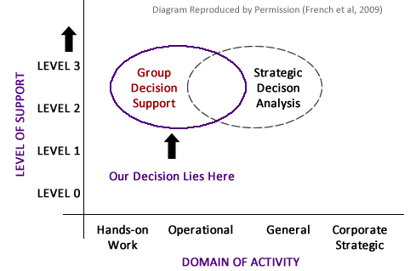
INTRODUCTION Domain of Decision Making

Slide 6
GROUP DYNAMICS
How we worked together, what we shared, which tools were used…
Notes:
Group dynamics is the study of groups, and also a general term for group processes. A group is two or more individuals who are connected to each other by social relationships (Forsyth, 2010).

Slide 7
GROUP DYNAMICS Discussion Points
Shared Values
Group Activities
Tools Used

Slide 8
GROUP DYNAMICS Shared Values
Common Goal The task on ground – A good TV & Internet Package.
Effective Communication Everyone has a voice in the group
Responsibility & Commitment Commitment to assigned tasks; NO FREE RIDE!
Reporting and Documentation For consistency & to ensure nothing is overlooked
Devil’s Advocacy Identify weaknesses in decisions or processes
TIME Attend meetings on time; finish tasks on time.
Notes:
Our Shared Values
According to the Business Dictionary [online], Shared Values are "explicit or implicit fundamental beliefs, concepts, and principles that underlie the culture of an organization, and which guide decisions and behavior of its employees, management, and members".
Our shared values in the group are the underlying principles that guided our group processes. During the first meeting, we articulated and agreed on our shared values and they guided us all through the period of the task.
As a group, we value a "common goal": That means we have a reason to work together, we were not gathered to play thus everyone had an obligation to put in their best.
As a group, we value "effective communication“. This means no member should leave others in the dark as regards what is going on. For instance when given a task and its not done, such member should tell others on time instead of keeping silent.
As a group, we value: Responsibility and Commitment which ensure we successfully completed our task. No one was given a free ride in the group.
We value reporting and documentation so we can compile a final report and presentation.
We value devil’s advocacy in every discussion so as to strengthen our opinions, arguments and decisions. Devil’s advocacy also ensured we were not infected by the “Groupthink” phenomenon.
Above all we value TIME which is the most scarce resource available to a student. Hence we try to keep to meeting times and also finish our tasks on time.

Slide 9
GROUP DYNAMICS Group Activities
Meetings
Pair-up Tasks
Research
Voting
Notes:
Group Activities
Meetings
Pair-up Tasks
Research
Voting

Slide 10
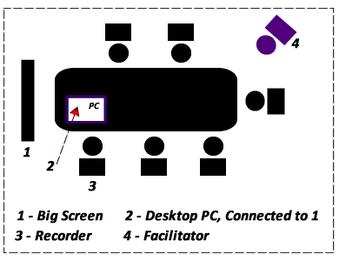
GROUP DYNAMICS Group Activities - Meetings
Our Meeting Rooms: Collab (in Kilburn) & Precinct Library Study Room
Notes:
GROUP MEETINGS, VENUES and ROLES:
We had two kinds of meetings: “Face-to-Face” and “Online” meetings.
From the lectures, we understood the importance of seating arrangement in Group Decision Making, as such we endeavoured to hold our meetings in rooms that support the model according to the lectures (GROUP DECISION SUPPORT ROOMS). Our seating arrangement was usually in the manner shown above. During online meetings, we also ensured we used group chat wares as described on the next slide.
The big screen monitor provided a shared interface for all to see what is being worked on and contribute accordingly.
Two roles were always vital in every meeting. The “Facilitator” and the “Recorder” as described below.
The Facilitator
The facilitator was always responsible for ensuring a productive group process. This role was rotated among each of us for every meeting held whether online or face to face. The group member facilitating performed the job of a leader and a referee as described below.
Leadership
The facilitator’s leadership role involved ensuring the following in the meetings: Focus, Active Participation, Equal Opportunity, Stimulation and Support. The facilitator had to ensure introvert group members contributed instead of sitting silent. By encouraging active participation, confidence was built within the group and everyone bared their minds as expected.
Referee
As a referee, the facilitator had to maintain order during discussions, ensure we don’t waste time on trivialities and also deal with group members trying to catch a “free ride” through. Also, it was the facilitator’s duty to ensure all contributions are treated equally and none is rebuffed.
The Recorder
The recorder was always in charge of ensuring that every point raised in the meeting was recorded. Additionally, s/he was in control of what appeared on the “big screen monitor”. The recorder documented the decisions, matters arising, tasks assigned, issues, etc. At the end of each meeting the recorder was responsible for forwarding the meeting summary to the other group members. Like the facilitator, this role was also rotated among each group member.

Slide 11
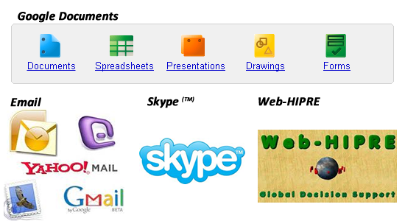
GROUP DYNAMICS Group Activities – Tools Used
Notes:
TOOLS USED:
The most interesting thing about the tools we used for our task is that they are mostly online tools. Using such tools ensured we had collective ownership and access to our resources. Additionally, we could work remotely on the tasks irrespective of location. The following tools were used:
1. Google Documents:
Google Documents enable users to create and edit documents collaboratively online. Every change made by any user is updated in real-time thus facilitating interaction and collaboration. The following document types were used as described below.
Spreadsheet for voting, attribute ratings, data profiling, etc.
(https://spreadsheets.google.com/ccc?key=0AgNGBLJMY1cEdGdrbHZMQ3c0TFNmSGdTc1oxVmhIeVE&hl=en&authkey=CJL8qeIM#gid=0)
Word Document for documenting discussions, meetings, research findings, individual questions, etc.
(https://docs.google.com/document/d/1rCblNsPCt1ySomDrIkg7S3r77Gr89lbdUPrg2-W0K94/edit?hl=en&authkey=CIyy58YD#)
Presentation Document for collaboratively preparing the presentation. This was later downloaded and content transferred here.
2. Skype:
Skype is a software application that allows users to chat and make voice calls over the internet. Calls made between Skype users are free. This tool helped us collaborate and ensure we continued our task even during the Easter break when most of us travelled for the holidays.
3. Email:
The importance of email cannot be overemphasised here. Exchange of emails amongst ourselves was useful for asynchronous communication, documentation and sharing of files (e.g. report files, presentation drafts, images, etc).
4. Web-HIPRE:
Web-HIPRE is a DSS Tool that runs as a Java applet online. We used it to create a decision model for the task. Web-HIPRE was also used to run a sensitivity analysis on the recommended alternative. Two big advantages Web-HIPRE has over other DSS tools are: (1) It is web based (2) It is easy to use yet very effective.

Slide 12
PROBLEM FORMULATION
Understanding what is to be done and deciding the best approach

Slide 13
PROBLEM FORMULATION Discussion Points
The Decision Context
The Objectives
The Decision alternatives
Hierarchical Organisation of Objectives
The Attributes

Slide 14
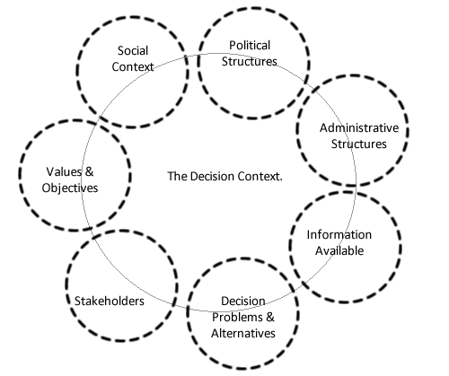
PROBLEM FORMULATION The Decision Context - 1
Notes:
The Decision context is the setting in which the decision occurs. It is framed by the administrative, political and social structures that surround the decision under consideration (HUT, MCDA Theory, 2002). It is obvious that the context of the task given would be greatly impacted by social factors than the other framing factors.
See Diagram: The factors are in dashed ellipses indicating that they may or may not impact the context. It also implies that they impact the context at varying degrees.

Slide 15
PROBLEM FORMULATION The Decision Context - 2
The Decision Problem To Provide TV & Internet in the House.
The Decision Makers The Group (Also responsible for the Consequences)
Decision Alternatives Market Research on available broadband and TV providers.
Our Values Performance (high priority), Satisfaction, Entertainment, Prompt Attention

Slide 16
PROBLEM FORMULATION The Decision Context - 3
The Stakeholders Friends, Course mates, Neighbours, Family, Tax Authorities, Licensing Authorities, TV & Broadband companies.
The Social Context Differences in Opinions, Taste & Preferences; Differences in Demands
Information Sources The Internet, Sales Brochures, Interviews, Sales Agents and Friends
Timespan of Discretion Very Short, Almost Immediately

Slide 17
PROBLEM FORMULATION The Constraints
Constraint | description
Contract Rigidity | Most contracts are fixed at 12 or 18 months,. Decide either to choose a 12 month contact and renew it after one year or eliminate package choices only to 18 months’ contact.
Wi-Fi Router | Due to the fact that 7 people will share the same connection, a Wi-Fi Router appears necessary.
Unlimited Download | Due to the high volume of data downloaded everyday from seven students, the download data allowance should be unlimited.
TV License | Since there is already a TV and we have to pay for the TV License, TV packages are proposed in order to maximise the value of fee for the TV License.

Slide 18
PROBLEM FORMULATION The Initial Objectives
MINIMIZE COST
MAXIMIZE PERFORMANCE
MAXIMIZE VALUE ADDED / EXTRAS
MAXIMIZE CUSTOMER SERVICE
MAXIMIZE ENTERTAINMENT
Notes:
The Initial Objectives
By rotating the position of a facilitator amongst ourselves, we discussed about the decision problem, clarified the context and only then did we approach the subject of generating objectives. Collaboratively working together from different location via Google Documents (http://google.com/documents), each group member had the opportunity to individually provide a written list of objectives and then we moved on to a group discussion of the lists. Some of the concepts that helped us in generating objectives came from the Online MCDA course and also from the Course textbook. Among these are Use of alternatives, expert reviews, consequence modelling, online surveys, etc.
Below listed are the main objectives that guided our decision(s):
1. Minimize the cost. We don’t want to pay too much on the services.
2. Maximize performance. We would like more preferred attributes from the services we will purchase.
3. Maximize value added features. Some companies send gifts or free HD TV-boxes to their new customers. This added more value for us if we need the things gifted by the services suppliers.
4. Maximize the customer services. However good the quality of the services, it would have some problems by accident. As broadband and TV play important role in modern life, we cannot wait too long to have suppliers fix them.

Slide 19
PROBLEM FORMULATION The Refined Objectives
MINIMIZE COST
MAXIMIZE PERFORMANCE
MAXIMIZE VALUE ADDED / EXTRAS
MAXIMIZE CUSTOMER SERVICE
Notes:
The Refined Objectives
After series of research and discussions, we decided to refine our objectives as shown here.
Maximize Entertainment was too vague and its attributes could be described from the attributes of Performance

Slide 20
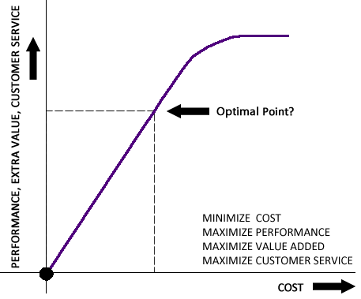
PROBLEM FORMULATION Conflicting Criteria
The Conflict of Interest
Notes:
Conflicting Criteria
It became apparent after a little while that we cannot maximize all other objectives while at the same time minimizing cost. Our research showed a relationship between cost and the other objectives as depicted on the graph.
From the graph, the y axis show us trying to increase performance, extras, entertainment, etc. The X axis shows cost increasing. The more we wish to maximise performance, extras, etc, the more the cost slightly increased. However, it gets to a point where no matter what we want from them, the cost cannot increase anymore. At this point also, any extra incentive(s) won't make much to sense to us. We therefore have to find an optimal point where we get good value for the money we are willing to pay.
A balance had to be struck between them. The “Conflicting Criteria” had to be resolved rationally and this was where Multi-Criteria Decision Analysis (MCDA) came into the picture. The decision model helped us achieve this.

Slide 21
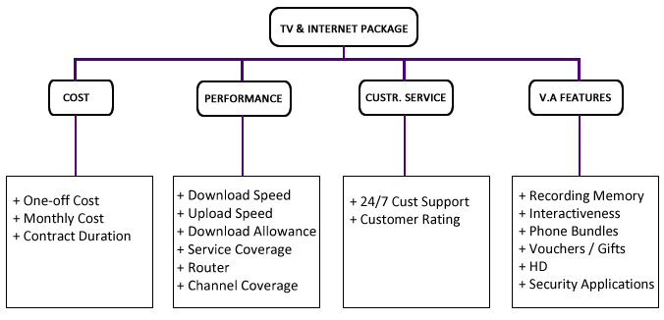
PROBLEM FORMULATION Hierarchical Organisation of Objectives
Notes:
Description of Attributes:
To be written/adapted from Lefteris’ Doc File

Slide 22
PROBLEM FORMULATION The Decision Alternatives
Package | PACkage Type | yyy | zzz
Package One | Single Provider | ---- | ---
Package Two | Combined | ---- | ----
Package Three | Combined | --- | ---
Package X | Single Provider | --- | ----
Notes:
The Decision Alternatives
A full list of all packages considered is included in the Microsoft word report file.

Slide 23
PROBLEM FORMULATION Constructed Attributes
Some attribute scales were constructed. See examples below:
Value | Score
CUSTOMER RATING
Excellent | 1.0
Very Good | 0.8
Good | 0.6
Fair | 0.5
Bad | 0.1
value | score
CONTRACT DURATION
18 months | 1.0
12 months | 0.75
24 months | 0.25
Notes:
Customer Rating:
Research was conducted based on opinions of many users and reviews of websites on the customer service and support of the companies. Based on these research, a scale was constructed as follows:
Excellent – 1.000
Very Good- 0.800
Good – 0.60
Fair – 0.50
Bad- 0.10
Contract Duration:
Based on our findings, three choices were generally available for the various packages. 12 , 18 and 24 months. It was decided to construct this scale of preference for these options:
18 months - most preferred - assigned weight:1.0
12 months – second most preferred -assigned weight: 0.75
24 months – least preferred – assigned weight: 0.25
Although the 18 months contracts is the first choice as specified by our task description, the 12 months contract gives us the choice of renewal, so it is a good choice too (that is why there is not very big difference in the values of their weights). The 24 months contract was the worst choice, because of the 18 months period specified in the project description.

Slide 24
PROBLEM FORMULATION Group Votes for Attributes
Attribute | vote
Sample, would change soon! | Sample, would change soon!
Sample, would change soon! | Sample, would change soon!
Sample, would change soon! | Sample, would change soon!
Sample, would change soon! | Sample, would change soon!

Slide 25
RESEARCH AND MODELLING
Bringing Rationality into the Chaos

Slide 26
RESEARCH AND MODELLING Discussion Points
Preference Elicitation
Weight Elicitation
The Model

Slide 27
RESEARCH AND MODELLING P. E. – Weighting Methods
Method | Attributes
Value Function | One-Off cost, Monthly Cost, Download Speed, Upload Speed, Download Allowance, Channel Coverage, Vouchers
Direct Rating | Contract Duration, Service Coverage, Router, Recording Memory, Interactiveness, Phone Bundles, High Definition (HD), Security Application, 24/7 Customer Support, Customer Rating
Swing Weighting | Cost, Performance, Value Added Features, Customer Service, TV & Internet
Notes:
PREFERENCE ELICITATION –WEIGHTING METHODS:
Generally, Swing was used to show our preferences between various attributes. Its advantages are that it gave us the choice to declare the most important attribute or objective according to our discussions and then value all other attributes based on this. Also having the chance to work in a scale from 0-100 and assign values provides a great range that helped us to interpret our exact preferences in the decision model.
From the voting we did before, the preference points can be concluded. Everyone prefer good customer service to the other objectives because of the highest average score 4.429. So we decided to give it the highest preference point 100. As the same, the cost, performance and added value were given 75, 85 and 40 respectively.
In order to assign weights for the alternatives two methods were used:
Direct weighting: whenever the attribute was non- numerical. In cases where we had to choose if an attribute is offered by a specific package, we used direct weighting to assign 1.00 to the packages that offered the attribute and 0.00 to those that did not.
Value Function: whenever the attribute was numerical. Linear functions was used in all cases because they better reflected the domain of interest. In cost related attributes the linear function was vertically flipped in order to show that the more expensive a service the less we prefer it.

Slide 28
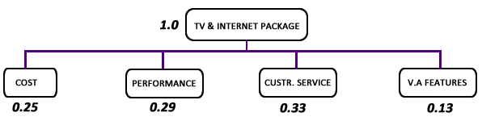
RESEARCH AND MODELLING Weight Elicitation
Adjusting the weights of each objective to reflect our priorities

Slide 29
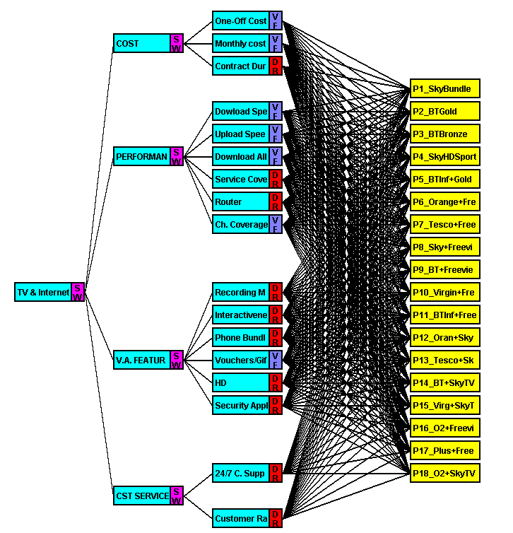
RESEARCH AND MODELLING The Decision Model

Slide 30
RESULTS AND ANALYSIS
The best alternative has been suggested but how sensitive is it to changes in our objectives? (and we’re humans, we change, don’t we?)

Slide 31
RESULTS AND ANALYSIS Discussion Points
Recommended Package
Sensitivity Analysis

Slide 32
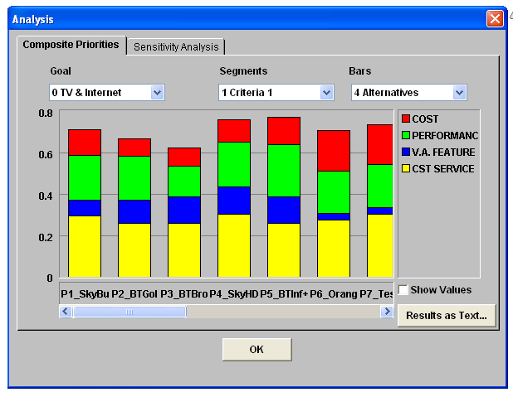
RESULTS AND ANALYSIS Recommended Package - 1

Slide 33
RESULTS AND ANALYSIS Scores for Alternatives
Package | score | Score2
Sample, would change soon! | Sample, would change soon! | Sample, would change soon!
Sample, would change soon! | Sample, would change soon! | Sample, would change soon!
Sample, would change soon! | Sample, would change soon! | Sample, would change soon!
Sample, would change soon! | Sample, would change soon! | Sample, would change soon!

Slide 34
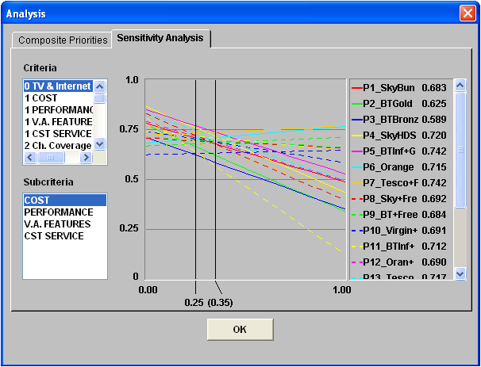
RESULTS AND ANALYSIS Sensitivity Analysis - Cost
Notes:
If we increase the weight on cost from 0.25 to 0.42, Package P7 becomes the recommended alternative because it is relatively cheaper, however, we are ready to bear a little more cost to get better performance. Additionally, we are 7 in number, so we can share cost. Hence, we are not likely going to put more weight on minimising cost. The recommendation is therefore not sensitive to changes in cost.

Slide 35
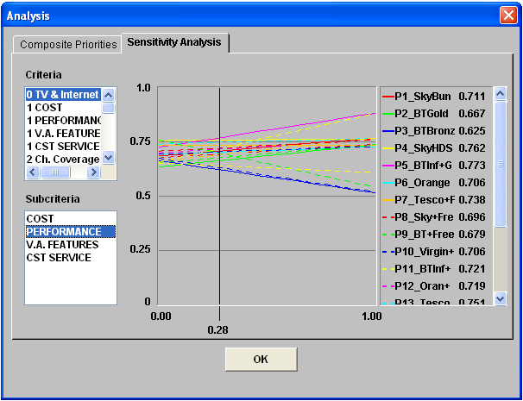
RESULTS AND ANALYSIS Sensitivity Analysis - Performance
Notes:
If we decrease the weight on performance from 0.28 to 0.22, then P4 becomes the recommended alternative. However, performance is essential for us so we are not willing to sacrifice performance. Additionally, P4, is relatively more expensive for lesser performance which is not a good decision to make. If we increase performance, which is more likely in this case, P5 remains the better option. Therefore, the recommended alternative is not sensitive to changes in performance.

Slide 36
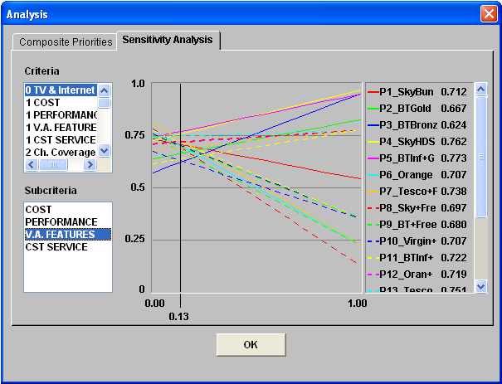
RESULTS AND ANALYSIS Sensitivity Analysis – V.A. Extras
Notes:
If we increase the weight on value added features from 0.13 to 0.5, then P4 is the best option. However, this would imply that we would totally change our preferences and put much weight on something that is not important for us at this point. On the other hand, decrease it from 0.13 to 0.08 then P7 become the recommended option. However, P7's performance is much worse than P5 so we still prefer P5.
While V.A. Features are good and needful, they are only important as additives not as basis for deciding as any provider can give some form of extras features at anytime e.g. spring bonuses, summer specials, etc. We are therefore not likely to fall into the temptation of swinging the weight of our decision in favour of them.

Slide 37
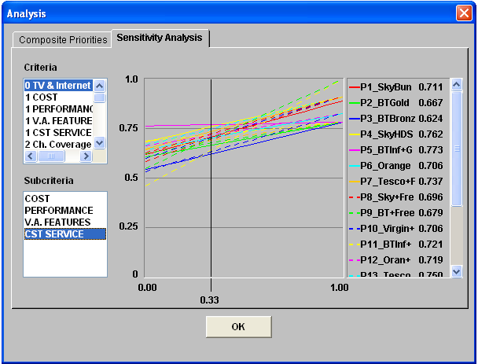
RESULTS AND ANALYSIS Sensitivity Analysis – C. Service
Notes:
If we increase the weight on Customer Service to 0.4 then P4 becomes the best alternative. P4 is worse in terms of performance than P5 and much more expensive. Also, customer service is very important to us and it is reflected in the fact that it carries the highest weight (slightly higher than performance). We are not prepared to put unnecessary higher weight on it. Afterall, the customer reviews may not be totally right. Providers also do have technical difficulties that can negatively impact their customer service performance and give them negative rating during a given period. We believe that the weight we have attached to it is enough and not likely to change. Hence we will stick to the recommended choice.

Slide 38
CONCLUSION
All is well that ends well.

Slide 39
REFERENCES
Business Dictionary, 2011. Shared Values [online] Available at: <http://www.businessdictionary.com/definition/shared-values.html> [Accessed 07 April 2011]
FRENCH, S., MAULE, J., & PAPAMICHAIL, N. (2009). Decision Behaviour, Analysis and Support. Cambridge, UK, Cambridge University Press.
Helsinki University of Technology. (2002). MCDA – Theory. Available at <http://www.mcda.hut.fi/value_tree/theory/> [Accessed, 01-04-2011]
FORSYTH, D. R. (2010). Group Dynamics (5th edition). Belmont, CA: Wadsworth/Cengage
ThinkBroadBand, 2011. Service Provider Comparison [online] Available at: <http://www.thinkbroadband.com/isp/compare.html?commit=Compare&isp_7=1&isp_86=1&isp_21=1&isp_84=1> [Accessed 02 May 2011]

Slide 40
Thank you!
Questions?

Slide 41
FIND REMINDERS IN NOTES HERE
REMINDER SLIDE
Notes:
This Slide will be removed later, here now to remind me of @TODO Items.
Add References Slide >> Done
Reference course textbook in list of refs >> Done
The Decision Context – 2: Put List of Alternatives in notes, attached word doc where posssible
Slide (Decision Alternatives) yet to be updated.
Complete write up on Slide (Objectives 1)
Slide (Hierarchical Organisation of Objectives) – Write up needed
All Slides on Attributes require Description and Specifications for Type of Attributes (constructed, natural, proxy, unit of measure, etc)
Kindly cross compare attributes slides 1 – n to ensure comformity with slide (hierarchical organisation diagram)
I did not include virgin bundle as we have discussed in previous meetings because there is no coverage in fallowfield area for their TV
12GBP added across board as line rental for all packages because the price range was very close for all packages, so we took the average on all and decided as a group to set the figure fixed at 12GBP across board.
Since TV License is same in the UK, we agreed as a group to add it to the one off cost for all packages too. Also, we agreed that we use the colour tv license as none of us was in love with the "Black and White" option.
After discussing among ourselves we refined our customer service objective by eliminating Response Time and Wait Time in favour of Customer Ratings. This is because the former attributes were quite difficult to measure while the latter could be easily gotten from the internet and other sources
We initially agreed to rate a particular level of Service Coverage as excellent so if the package providers can meet that level, we rated them as excellent.However, on further discussion, we decided it was possible to construct a scale of measurement and research to fit this scale. We then constructed a scale as shown here: Excellent = ? ...etc.

