Slide 1

BMAN61102
GROUP PROJECT WORK
GROUP 3
Filippou, Chrysostomos Georgios
Khan, Rayis
Kiousi, Maria
Paraskevas, Eleftherios
Sampigehalli Anand Murthy, Mahindra
Udoisang, Blessing Sunday
Wang, Shulin
Notes:
List of Group Members – Group 3
Filippou, Chrysostomos Georgios
Khan, Rayis
Kiousi, Maria
Paraskevas, Eleftherios
Sampigehalli Anand Murthy, Mahindra
Udoisang, Blessing Sunday
Wang, Shulin

Slide 2
CONTENTS
Introduction
Group Dynamics
Problem Formulation
Research and Modelling
Results and Analysis
Summary
Notes:
Presentation Content
Introduction
Group Dynamics
Problem Formulation
Research and Modelling
Results and Analysis
Summary

Slide 3
INTRODUCTION
Where it all began…

Slide 4
INTRODUCTION The Case: TV & Internet Package
TASK
Decide as a group, on how to provide TV and internet in our house
BACKGROUND
A group of 7 students
Just moved in and staying for 18 months
No broadband or cable presently in the house
One modern TV available from one of us with capacity to receive Freeview & Freesat
Notes:
Scenario
We are to imagine that we share a house in “Fallowfield” (A place in Manchester, UK) and will do so for at least 18 months. Imagine too that it is the beginning of the academic year and that we have all just moved in. In all other respects we may take prices and availability of items and services as they are today.
Our task as a group is to decide upon how to provide TV and internet in our house. We might look at all in one packages build our own bundle of services from say terrestrial digital TV and TalkTalk Broadband. Currently there is no broadband, no cable (though it is available in the street that our house is on). There is a landline connection to the house, but no current contract. Each of us is to imagine that we have our personal computer as it is now – or that we do not have one, if indeed we don’t. One of us also has a modern TV able to receive Freeview and Freesat and that person is willing to put this in the communal lounge. Generally we are to play ourselves with our own tastes and preferences.
As a group we are to decide on how to provide TV and internet access at our house.
As a group we need to identify our objectives. Come up with 4 or 5 objectives at least. We should also identify some possible ways of providing TV and internet, cost them approximately, etc. Use the web or whatever to gather data and make these as reasonable as possible. Then conduct a decision analysis to help you choose which one you would organize.

Slide 5
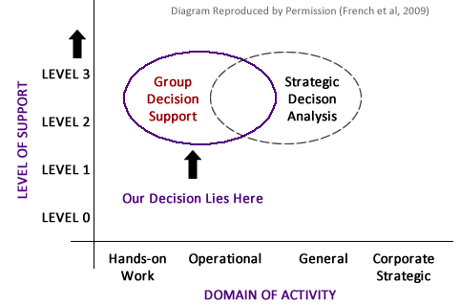
INTRODUCTION Domain of Decision Making

Slide 6
GROUP DYNAMICS
How we worked together, what we shared, which tools were used…
Notes:
Group dynamics is the study of groups, and also a general term for group processes. A group is two or more individuals who are connected to each other by social relationships (Forsyth, 2010).

Slide 7
GROUP DYNAMICS Discussion Points
Shared Values
Group Activities
Tools Used

Slide 8
GROUP DYNAMICS Shared Values
Common Goal The task on ground – A good TV & Internet Package.
Effective Communication Everyone has a voice in the group
Responsibility & Commitment Commitment to assigned tasks; NO FREE RIDE!
Reporting and Documentation For consistency & to ensure nothing is overlooked
Devil’s Advocacy Identify weaknesses in decisions or processes
TIME Attend meetings on time; finish tasks on time.
Notes:
Our Shared Values
According to the Business Dictionary [online], Shared Values are "explicit or implicit fundamental beliefs, concepts, and principles that underlie the culture of an organization, and which guide decisions and behavior of its employees, management, and members".
Our shared values in the group are the underlying principles that guided our group processes. During the first meeting, we articulated and agreed on our shared values and they guided us all through the period of the task.
As a group, we value a "common goal": That means we have a reason to work together, we were not gathered to play thus everyone had an obligation to put in their best.
As a group, we value "effective communication“. This means no member should leave others in the dark as regards what is going on. For instance when given a task and its not done, such member should tell others on time instead of keeping silent.
As a group, we value: Responsibility and Commitment which ensure we successfully completed our task. No one was given a free ride in the group.
We value reporting and documentation so we can compile a final report and presentation.
We value devil’s advocacy in every discussion so as to strengthen our opinions, arguments and decisions. Devil’s advocacy also ensured we were not infected by the “Groupthink” phenomenon.
Above all we value TIME which is the most scarce resource available to a student. Hence we try to keep to meeting times and also finish our tasks on time.

Slide 9
GROUP DYNAMICS Group Activities
Meetings
Pair-up Tasks
Research
Voting
Notes:
Group Activities
Meetings
Pair-up Tasks
Research
Voting

Slide 10
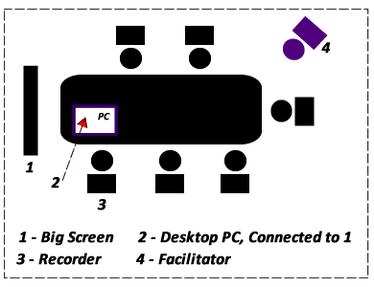
GROUP DYNAMICS Group Activities - Meetings
Our Meeting Rooms: Collab (in Kilburn) & Precinct Library Study Room
Notes:
GROUP MEETINGS, VENUES and ROLES:
We had two kinds of meetings: “Face-to-Face” and “Online” meetings.
From the lectures, we understood the importance of seating arrangement in Group Decision Making, as such we endeavoured to hold our meetings in rooms that support the model according to the lectures (GROUP DECISION SUPPORT ROOMS). Our seating arrangement was usually in the manner shown above. During online meetings, we also ensured we used group chat wares as described on the next slide.
The big screen monitor provided a shared interface for all to see what is being worked on and contribute accordingly.
Two roles were always vital in every meeting. The “Facilitator” and the “Recorder” as described below.
The Facilitator
The facilitator was always responsible for ensuring a productive group process. This role was rotated among each of us for every meeting held whether online or face to face. The group member facilitating performed the job of a leader and a referee as described below.
Leadership
The facilitator’s leadership role involved ensuring the following in the meetings: Focus, Active Participation, Equal Opportunity, Stimulation and Support. The facilitator had to ensure introvert group members contributed instead of sitting silent. By encouraging active participation, confidence was built within the group and everyone bared their minds as expected.
Referee
As a referee, the facilitator had to maintain order during discussions, ensure we don’t waste time on trivialities and also deal with group members trying to catch a “free ride” through. Also, it was the facilitator’s duty to ensure all contributions are treated equally and none is rebuffed.
The Recorder
The recorder was always in charge of ensuring that every point raised in the meeting was recorded. Additionally, s/he was in control of what appeared on the “big screen monitor”. The recorder documented the decisions, matters arising, tasks assigned, issues, etc. At the end of each meeting the recorder was responsible for forwarding the meeting summary to the other group members. Like the facilitator, this role was also rotated among each group member.

Slide 11
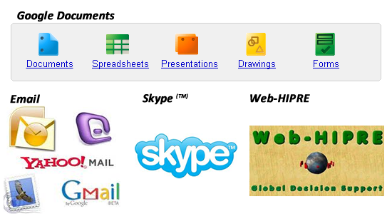
GROUP DYNAMICS Group Activities – Tools Used
Notes:
TOOLS USED:
The most interesting thing about the tools we used for our task is that they are mostly online tools. Using such tools ensured we had collective ownership and access to our resources. Additionally, we could work remotely on the tasks irrespective of location. The following tools were used:
1. Google Documents:
Google Documents enable users to create and edit documents collaboratively online. Every change made by any user is updated in real-time thus facilitating interaction and collaboration. The following document types were used as described below.
Spreadsheet for voting, attribute ratings, data profiling, etc.
(https://spreadsheets.google.com/ccc?key=0AgNGBLJMY1cEdGdrbHZMQ3c0TFNmSGdTc1oxVmhIeVE&hl=en&authkey=CJL8qeIM#gid=0)
Word Document for documenting discussions, meetings, research findings, individual questions, etc.
(https://docs.google.com/document/d/1rCblNsPCt1ySomDrIkg7S3r77Gr89lbdUPrg2-W0K94/edit?hl=en&authkey=CIyy58YD#)
Presentation Document for collaboratively preparing the presentation. This was later downloaded and content transferred here.
2. Skype:
Skype is a software application that allows users to chat and make voice calls over the internet. Calls made between Skype users are free. This tool helped us collaborate and ensure we continued our task even during the Easter break when most of us travelled for the holidays.
3. Email:
The importance of email cannot be overemphasised here. Exchange of emails amongst ourselves was useful for asynchronous communication, documentation and sharing of files (e.g. report files, presentation drafts, images, etc).
4. Web-HIPRE:
Web-HIPRE is a DSS Tool that runs as a Java applet online. We used it to create a decision model for the task. Web-HIPRE was also used to run a sensitivity analysis on the recommended alternative. Two big advantages Web-HIPRE has over other DSS tools are: (1) It is web based (2) It is easy to use yet very effective.

Slide 12
PROBLEM FORMULATION
Understanding what is to be done and deciding the best approach

Slide 13
PROBLEM FORMULATION Discussion Points
The Decision Context
The Objectives
The Decision alternatives
Hierarchical Organisation of Objectives
The Attributes

Slide 14
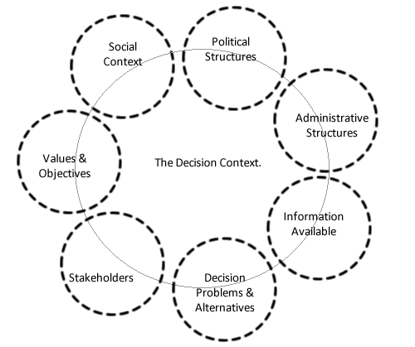
PROBLEM FORMULATION The Decision Context - 1
Notes:
The Decision context is the setting in which the decision occurs. It is framed by the administrative, political and social structures that surround the decision under consideration (HUT, MCDA Theory, 2002). It is obvious that the context of the task given would be greatly impacted by social factors than the other framing factors.
See Diagram: The factors are in dashed ellipses indicating that they may or may not impact the context. It also implies that they impact the context at varying degrees.

Slide 15
PROBLEM FORMULATION The Decision Context - 2
The Decision Problem To Provide TV & Internet in the House.
The Decision Makers The Group (Also responsible for the Consequences)
Decision Alternatives Market Research on available broadband and TV providers.
Our Values Performance (high priority), Satisfaction, Entertainment, Prompt Attention

Slide 16
PROBLEM FORMULATION The Decision Context - 3
The Stakeholders Friends, Course mates, Neighbours, Family, Tax Authorities, Licensing Authorities, TV & Broadband companies.
The Social Context Differences in Opinions, Taste & Preferences; Differences in Demands
Information Sources The Internet, Sales Brochures, Interviews, Sales Agents & Friends
Timespan of Discretion Very Short, Almost Immediately

Slide 17
PROBLEM FORMULATION The Initial Objectives
MINIMIZE COST
MAXIMIZE PERFORMANCE
MAXIMIZE VALUE ADDED / EXTRAS
MAXIMIZE CUSTOMER SERVICE
MAXIMIZE ENTERTAINMENT
Notes:
The Initial Objectives
By rotating the position of a facilitator amongst ourselves, we discussed about the decision problem, clarified the context and only then did we approach the subject of generating objectives. Collaboratively working together from different location via Google Documents (http://google.com/documents), each group member had the opportunity to individually provide a written list of objectives and then we moved on to a group discussion of the lists. Some of the concepts that helped us in generating objectives came from the Online MCDA course and also from the Course textbook. Among these are Use of alternatives, expert reviews, consequence modelling, online surveys, etc.
Below listed are the main objectives that guided our decision(s):
MINIMIZE COST
We plan to bla bla bla
MAXIMIZE PERFORMANCE
Due to the bla bla bla
MAXIMIZE VALUE ADDED / EXTRAS
To maximize bla bla bla
MAXIMIZE CUSTOMER SERVICE
Maximising bla bla bla bla
MAXIMIZE ENTERTAINMENT
Maximising bla bla bla bla

Slide 18
PROBLEM FORMULATION The Refined Objectives
MINIMIZE COST
MAXIMIZE PERFORMANCE
MAXIMIZE VALUE ADDED / EXTRAS
MAXIMIZE CUSTOMER SERVICE
Notes:
The Refined Objectives
After series of research and discussions, we decided to refine our objectives as shown here.

Slide 19
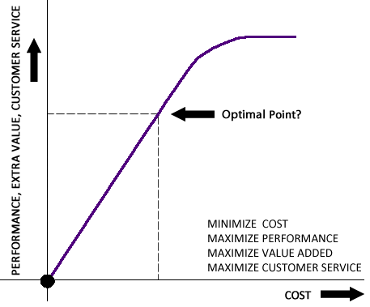
PROBLEM FORMULATION Conflicting Criteria
The Conflict of Interest
Notes:
Conflicting Criteria
It became apparent after a little while that we cannot maximize all other objectives while at the same time minimizing cost. Our research showed a relationship between cost and the other objectives as depicted on the graph.
From the graph, the y axis show us trying to increase performance, extras, entertainment, etc. The X axis shows cost increasing. The more we wish to maximise performance, extras, etc, the more the cost slightly increased. However, it gets to a point where no matter what we want from them, the cost cannot increase anymore. At this point also, any extra incentive(s) won't make much to sense to us. We therefore have to find an optimal point where we get good value for the money we are willing to pay.
A balance had to be struck between them. The “Conflicting Criteria” had to be resolved rationally and this was where Multi-Criteria Decision Analysis (MCDA) came into the picture. The decision model helped us achieve this.

Slide 20
PROBLEM FORMULATION The Decision Alternatives
Package | PACkage Type | yyy | zzz
Package One | Single Provider | ---- | ---
Package Two | Combined | ---- | ----
Package Three | Combined | --- | ---
Package X | Single Provider | --- | ----

Slide 21
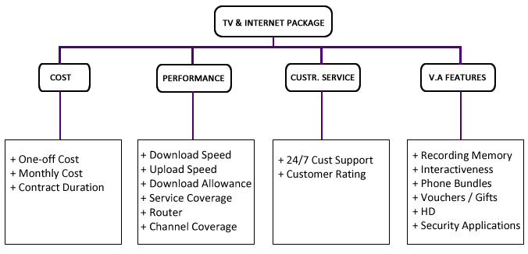
PROBLEM FORMULATION Hierarchical Organisation of Objectives
Notes:
Description of Attributes:
To be written/adapted from Lefteris’ Doc File

Slide 22
PROBLEM FORMULATION The Attributes - 1
Attribute | description | type
MINIMIZE COST
One-Off Cost | In addition to any cost of each package (like the installation of Sky box or any additional equipment) this attribute also includes the cost for TV license for color TV(145.50 GBP). | Numerical Value (GBP)
Monthly Cost | Recurring monthly payments | Numerical Value (GBP)
Contract Duration | How long will the contract last? | Numerical (Months)

Slide 23
PROBLEM FORMULATION The Attributes - 2
attribute | description | type
MAXIMIZE PERFORMANCE
Download Speed | Connection fees - Equipment Free or Not? | Mb/s
Upload Speed | Speed of uploading files to the internet. | Mb/s
Download Allowance | Unlimited – Limited | Mb/s
Service Coverage in our Area | Description Please? | Constructed
Router | Does it have WiFi? Is it reliable for 7 people? | Constructed
Channel Coverage | Sthe number of channels that can be viewed. | Numeric

Slide 24
PROBLEM FORMULATION The Attributes - 3
attribute | description | type
MAXIMIZE VALUE ADDED / EXTRA SERVICES
Recording Memory | Description Please? | Constructed or Unit?
Interactiveness | Pause and Rewind TV, Shopping via TV, etc | Constructed or Unit?
Phone Bundles | Description Please? | Constructed or Unit?
Vouchers | Description Please? | Constructed or Unit?
High Definition (HD) | Description Please? | Constructed or Unit?
Security Software | Description Please? | Constructed or Unit?

Slide 25
PROBLEM FORMULATION The Attributes - 4
attribute | description | type
MAXIMIZE CUSTOMER SERVICE
24/7 Customer Support | Description Please? | Constructed or Unit?
Customer Rating | Description Please? | Constructed or Unit?

Slide 26
PROBLEM FORMULATION Constructed Attributes
Some attribute scales were constructed. See examples below:
Value | Score
CUSTOMER RATING
Excellent | 1.0
Very Good | 0.8
Good | 0.6
Fair | 0.5
Bad | 1.0
value | score
CONTRACT DURATION
18 months | 1.0
12 months | 0.75
24 months | 0.25

Slide 27
PROBLEM FORMULATION The Constraints
Constraint | description
Contract Rigidity | Most contracts are fixed at 12 or 18 months, this made it difficult bla bla bla....
More? | Description Please?
More? | Description Please?
More? | Description Please?
This should be written or removed, @Rayis, is this ready?

Slide 28
RESEARCH AND MODELLING
Bringing Rationality into the Chaos

Slide 29
RESEARCH AND MODELLING Discussion Points
Preference Elicitation
Weight Elicitation
The Model

Slide 30
RESEARCH AND MODELLING P. E. – Weighting Methods
Method | Attributes
Value Function | One-Off cost, Monthly Cost, Download Speed, Upload Speed, Download Allowance, Channel Coverage, Vouchers
Direct Rating | Contract Duration, Service Coverage, Router, Recording Memory, Interactiveness, Phone Bundles, High Definition (HD), Security Application, 24/7 Customer Support, Customer Rating
Swing Weighting | Cost, Performance, Value Added Features, Customer Service, TV & Internet

Slide 31
RESEARCH AND MODELLING P. E. – Attribute Scores
All scores can be found in the report document
I think this slide should go, what you guys say?

Slide 32
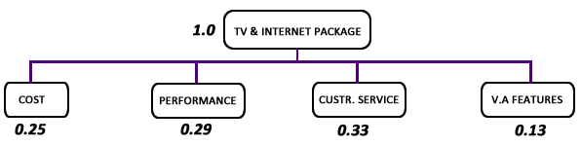
RESEARCH AND MODELLING Weight Elicitation - 1
Adjusting the weights of each objective to reflect our priorities

Slide 33
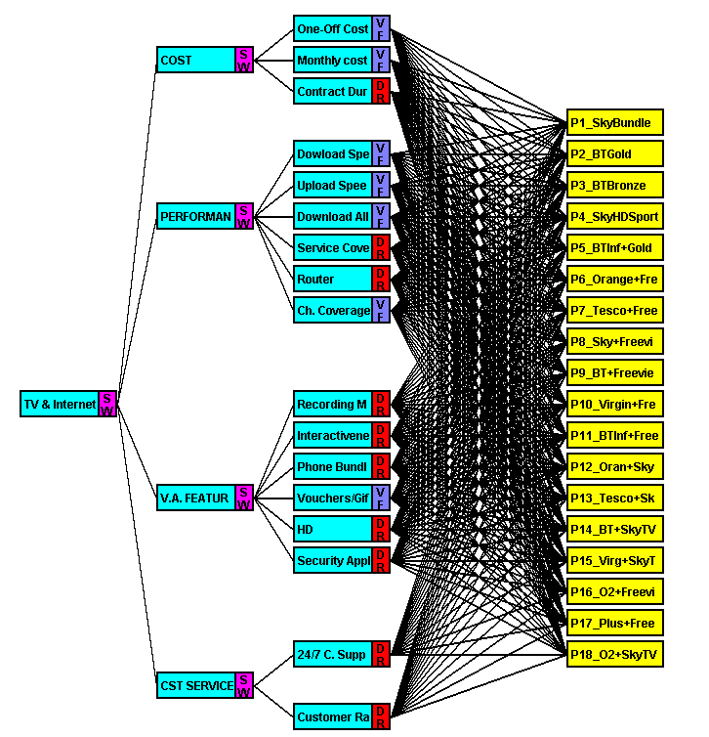
RESEARCH AND MODELLING The Decision Model

Slide 34
RESULTS AND ANALYSIS
The best alternative has been suggested but how sensitive is it to changes in our objectives? (and we’re humans, we change, don’t we?)

Slide 35
RESULTS AND ANALYSIS Discussion Points
Recommended Package
Sensitivity Analysis

Slide 36
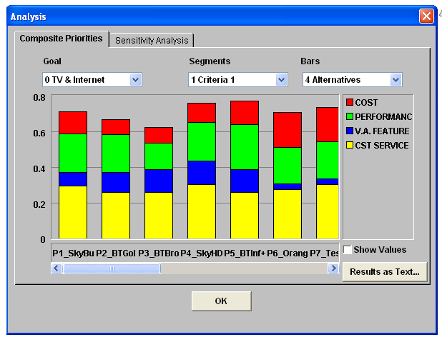
RESULTS AND ANALYSIS Recommended Package - 1

Slide 37
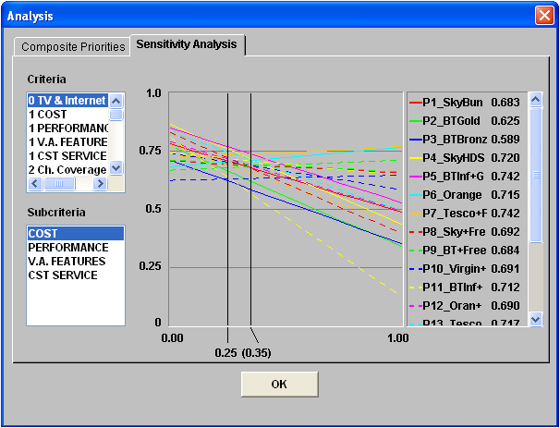
RESULTS AND ANALYSIS Sensitivity Analysis - 1
Notes:
Notes about this here please

Slide 38
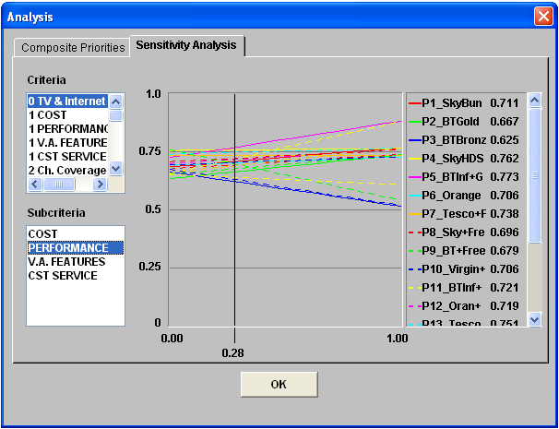
RESULTS AND ANALYSIS Sensitivity Analysis - 2
Notes:
Notes about this here please

Slide 39
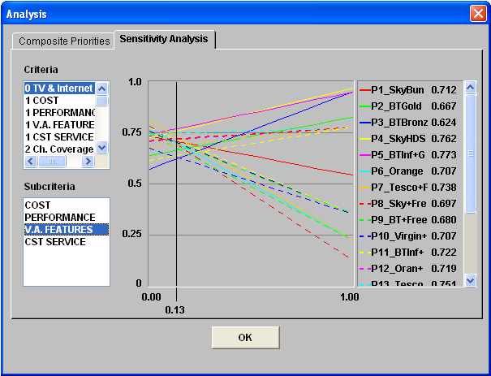
RESULTS AND ANALYSIS Sensitivity Analysis - 3
Notes:
Notes about this here please

Slide 40
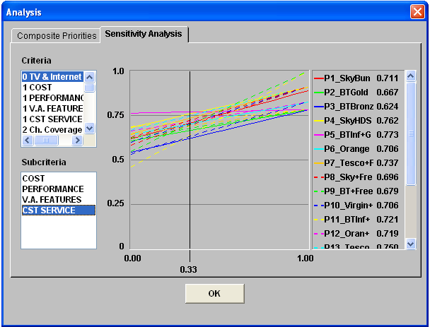
RESULTS AND ANALYSIS Sensitivity Analysis - 4
Notes:
Notes about this here please

Slide 41
SUMMARY
Okay, let’s go over it all, again please.

Slide 42
SUMMARY
Introduction
Problem Formulation
Research and Modelling
Results and Analysis

Slide 43
CONCLUSION
All is well that ends well.

Slide 44
REFERENCES
Business Dictionary, 2011. Shared Values [online] Available at: <http://www.businessdictionary.com/definition/shared-values.html> [Accessed 07 April 2011]
FRENCH, S., MAULE, J., & PAPAMICHAIL, N. (2009). Decision Behaviour, Analysis and Support. Cambridge, UK, Cambridge University Press.
Helsinki University of Technology. (2002). MCDA – Theory. Available at <http://www.mcda.hut.fi/value_tree/theory/> [Accessed, 01-04-2011]
FORSYTH, D. R. (2010). Group Dynamics (5th edition). Belmont, CA: Wadsworth/Cengage
ThinkBroadBand, 2011. Service Provider Comparison [online] Available at: <http://www.thinkbroadband.com/isp/compare.html?commit=Compare&isp_7=1&isp_86=1&isp_21=1&isp_84=1> [Accessed 02 May 2011]

Slide 45
Thank you!
Questions?

Slide 46
FIND REMINDERS IN NOTES HERE
REMINDER SLIDE
Notes:
This Slide will be removed later, here now to remind me of @TODO Items.
Add References Slide >> Done
Reference course textbook in list of refs >> Done
The Decision Context – 2: Put List of Alternatives in notes, attached word doc where posssible
Slide (Decision Alternatives) yet to be updated.
Complete write up on Slide (Objectives 1)
Slide (Hierarchical Organisation of Objectives) – Write up needed
All Slides on Attributes require Description and Specifications for Type of Attributes (constructed, natural, proxy, unit of measure, etc)
Kindly cross compare attributes slides 1 – n to ensure comformity with slide (hierarchical organisation diagram)
I did not include virgin bundle as we have discussed in previous meetings because there is no coverage in fallowfield area for their TV
12GBP added across board as line rental for all packages because the price range was very close for all packages, so we took the average on all and decided as a group to set the figure fixed at 12GBP across board.
Since TV License is same in the UK, we agreed as a group to add it to the one off cost for all packages too. Also, we agreed that we use the colour tv license as none of us was in love with the "Black and White" option.
After discussing among ourselves we refined our customer service objective by eliminating Response Time and Wait Time in favour of Customer Ratings. This is because the former attributes were quite difficult to measure while the latter could be easily gotten from the internet and other sources
We initially agreed to rate a particular level of Service Coverage as excellent so if the package providers can meet that level, we rated them as excellent.However, on further discussion, we decided it was possible to construct a scale of measurement and research to fit this scale. We then constructed a scale as shown here: Excellent = ? ...etc.

