Slide 1

Private Lab Virtualization Using Multipass and
Deploy Apps web-based on Ubuntu Server.
Nur Hamim
Product Operation Support
PT Biznet GIO Nusantara

Slide 2




About Me
Nur Hamim
Linux and Cloud Enthusiast
Village child who like to learn Open Source, Linux, and Cloud Computing. Actively involved in community GNU/Linux in Indonesia, become the Founder of BelajarLinux.id and work at PT Biznet GIO Nusantara as Product Operation Engineer
@nurhamimaja
@hamimaja
@hamimistimewa

Slide 3
What a Multipass?
Multipass is a virtualization product from Canonical that we can use to create a virtual machine and support cloud-init like in a public cloud. Multipass can be run in a local environment for free and is very suitable for development.

Slide 4
Why use Multipass?
It's tiny, simple to use, quick to purge things when you've done. This lightweight VM manager can be installed on Linux, Windows, and macOS, and is designed for developers to be able to launch a fresh Ubuntu environment with a single command.

Slide 5
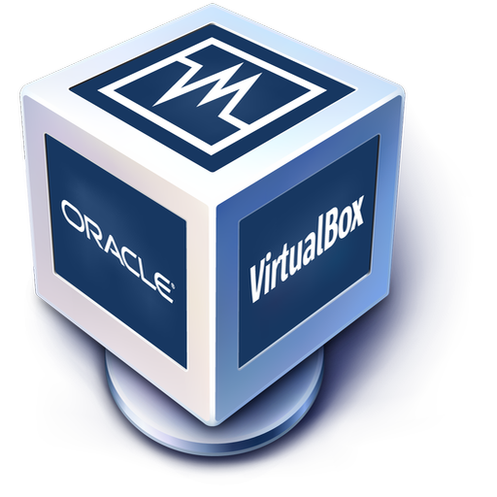

Multipass vs VirtualBox
OR

Slide 6

Multipass vs Docker
OR

Slide 7
Multipass vs VirtualBox vs LXD
Multipass is meant to offer a universal Ubuntu experience across platforms. Multipass works on Linux, Windows and macOS and offers a similar experience on all three. It then uses whatever the best OS virtualization layer is to run the VM. On Windows, that’s using HyperV or VirtualBox, on macOS it uses hyperkit or VirtualBox and on Linux these days it uses LXD.

Slide 8
Multipass Flow
Apps/Services
Apps/Services
VMs
VMs
Multipass Userspace Tools
Host OS (Linux/MacOS/Windows)

Slide 9
Pros and Cons Multipass
Pros:
Simple, Easy, Light and fast in creating VMs
Easy and Modern VMs management for development
Suitable for development
Cons:
Cannot resize specification automatically
Requires additional drivers for add interface networks
Few available OS (Images) default

Slide 10
Multipass for Kubernetes Cluster
Multipass offers a nice fast alternative to Docker. Multipass easily running cluster k3s and k8s. Because, Multipass supports metadata for cloud-init - basically, you can create a config file to set up users and groups and even run arbitrary setup code.
Reference: - How to build a highly available Kubernetes cluster with MicroK8s - Deploy a Kubernetes Desktop Cluster with Ubuntu Multipass

Slide 11
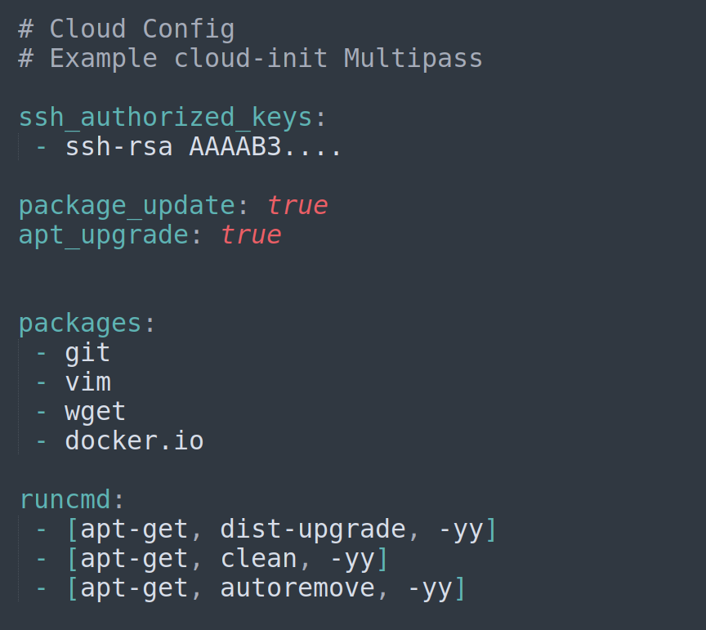
Basic Cloud-init
Cloud-init is the standard for customizing cloud instances and now multipass can also make use of cloud-init to customize an instance during launch.
Reference: https://cloud-init.io

Slide 12
Install Multipass
On Linux with Snapd $ sudo snap install multipass
For architecture other than amd64, you'll need the beta $ sudo snap install multipass --edge

Slide 13
Install Multipass
On Windows Download Multipass for Windows Note: You need Windows 10 Pro/Enterprise/Education v 1803 or later, or any Windows 10 with VirtualBox

Slide 14
Install Multipass
On MacOS Download Multipass for Mac and If you'd like to use Multipass with VirtualBox use this terminal command: $ sudo multipass set local.driver=virtualbox

Slide 15
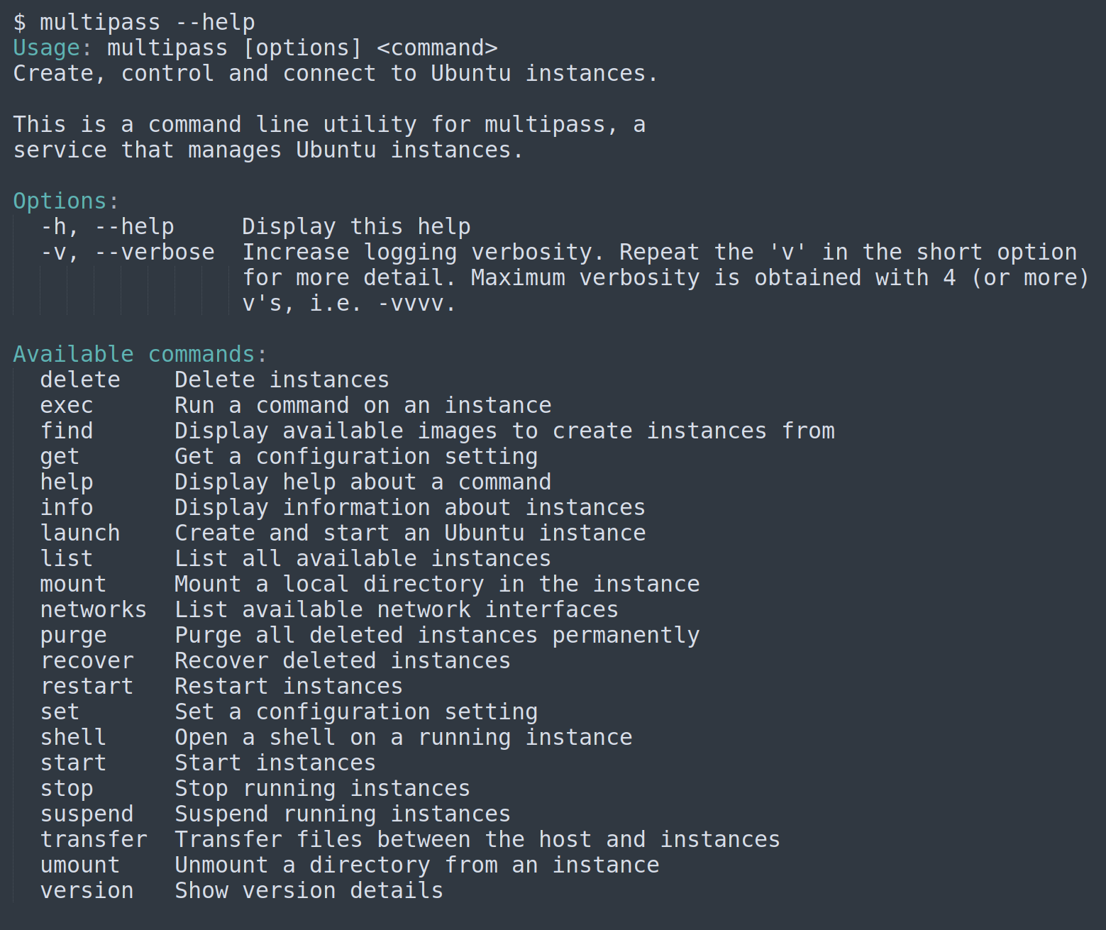
Basic Command Multipass
Basic command-line in multipass

Slide 16
How to use Multipass
Find
$ multipass find
Launch
$ multipass launch
Options: -c, -d, -m, -n, --cloud-init, --network, --bridged
Example: - multipass launch 20.04 --name instance-demo --cpus 2 --mem 2G --disk 5G - multipass launch 20.04 --name instance-demo --cpus 2 --mem 2G --disk 5G --cloud-init cloud-init.yaml - multipass launch file:///home/ubuntu/images/CentOS-7-x86_64-GenericCloud.qcow2 --name centos7 - multipass launch https://mirror_images_cloud --name Rocky

Slide 17
How to use Multipass
Info
$ multipass info instance-demo $ multipass info --format yaml instance-demo
List
$ multipass ls $ multipass list --format yaml
Start, Stop and Delete
$ multipass start instance-demo $ multipass stop instance-demo $ multipass delete instance-demo

Slide 18
How to use Multipass
Recover, Purge
$ multipass recover instance-demo $ multipass purge
Shell, Exec
$ multipass shell instance-demo $ multipass exec instance-demo -- lsb_release -a | grep ^Codename:
Get, Set
$ multipass get client.gui.autostart $ multipass set client.gui.autostart=false

Slide 19


Multipass Networking
By default on Linux Multipass only have 1 interface. If you want use 2 interface, you need LXD drivers for network bridges.
$ sudo snap install lxd $ sudo lxd init $ sudo multipass set local.driver=lxd

Slide 20
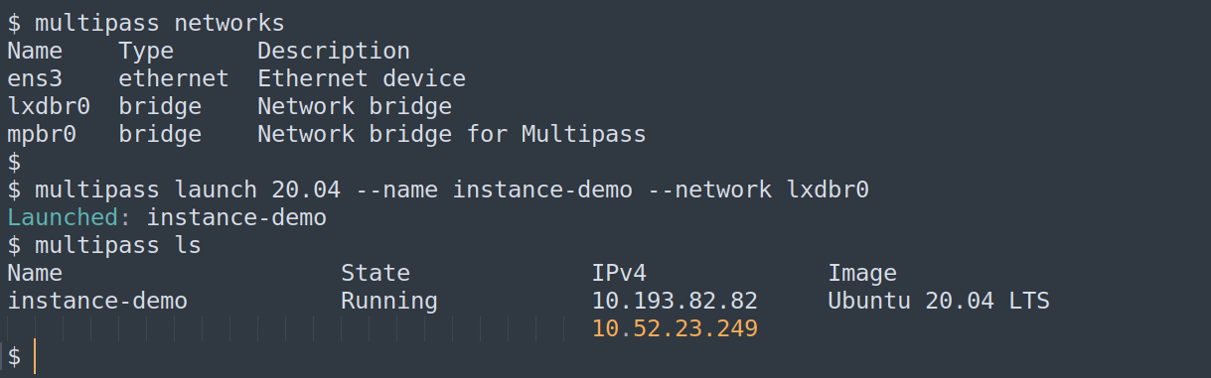
Multipass Networking
Make sure driver LXD on Multipass $ multipass get local.driver lxd $ sudo snap connect multipass:lxd lxd

Slide 21
Integration Multipass
Multipass can be integrated into multiple virtual machine managers such as virsh, virt-manager, and VirtualBox
Reference:
https://multipass.run/docs/using-libvirt
https://multipass.run/docs/using-virtualbox-in-multipass-windows
https://multipass.run/docs/using-virtualbox-in-multipass-macos

Slide 22
Demo time !
Install web-based applications with VMs Multipass

Slide 23
Thank you !

