Slide 1

Ubuntu OS & Service Patch Management
Using Ansible
Doni Kuswara
Product Operasions Engineer
PT. Biznet Gio Nusantara

Slide 2





About Me
Doni Kuswara
Product Operations Engineer
I am Ubuntu user & technology enthusiast.
Product Operations Engineer at Biznet Gio Cloud
07/2020 - Present
@donkus_
@donkus99
@donkus99
maringulik.com

Slide 3
Topics
Introduction Patch Management
What is Patch Management?
Why Should You Use Automation?
Why Choose Ansible for Patch Management?
How to Patch Ubuntu Manually?
How to use Ansible for Ubuntu OS & Service Patch Management?

Slide 4

Introduction
Patch Management
To patch just one system, the administrator must identify that a patch is available, download it, and then deploy it to the system. In an enterprise environment, there could be hundreds of servers to manage, so the job of patch management becomes an all-day responsibility with the added risk of reboot fails after installation. Instead of manual updates, administrators can free up time and organize patches using automation tools.

Slide 5
What is Patch Management?
administrators should understand the importance of patching Linux regularly. Administrators could simply patch a Linux system manually, but this leads to human errors, and rollbacks due to issues after installation are tricky. Human errors could lead to severely long downtimes when mistakes are made. It’s also time consuming to manually patch when several patches are necessary.

Slide 6
Why is Patch Management Important?
Unpatched public-facing web servers are a critical issue for cybersecurity, but cybersecurity isn’t the only reason to patch Linux. Patching also remediates bugs and adds functionality to software. Some patches fix issues with drivers and software running on the system. Large updates add functionality to the operating system.
The longer administrators wait to patch a system, the more patches will be needed to get the system up to date. This issue increases the time it takes to fully patch a Linux server.

Slide 7




Why Should You Use Automation?
Administrator Note
Check service
Check available update
Apt update
Check list upgradable
Upgrade all / upgrade specific package
Check reboot required
Reboot
Wait booting process
SSH and verification

Slide 8



VS
VS

Slide 9
Why choose ansible for patch management
Ansible is one of the automation tools that does not require an agent because Ansible performs node management with an SSH connection. Ansible only requires 1 server as a management node to push commands to all nodes in the inventory. Ansible is easier and more practical than other management tools such as puppet because it does not require an agent on each node, only uses an ssh connection.

Slide 10
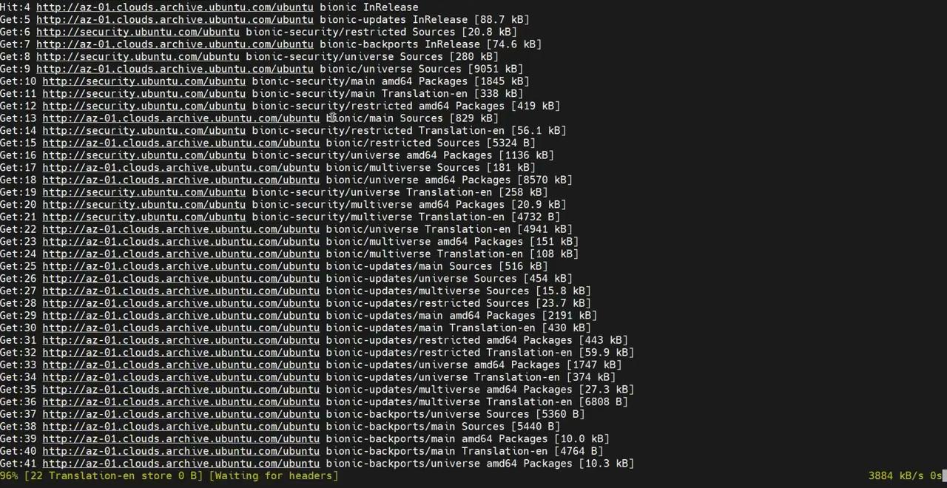
How to update Ubuntu?
$ apt-update ?
Updates the list of available packages and their versions, but it does not install or upgrade any packages.

Slide 11
How to update Ubuntu?
$ apt-upgrade ?
Used to install all the available upgrades of packages which are currently installed on the system.
Using apt-get upgrade, packages currently installed with new versions available are retrieved and upgraded, under no circumstances are currently installed packages removed, or packages not already installed retrieved and installed.

Slide 12
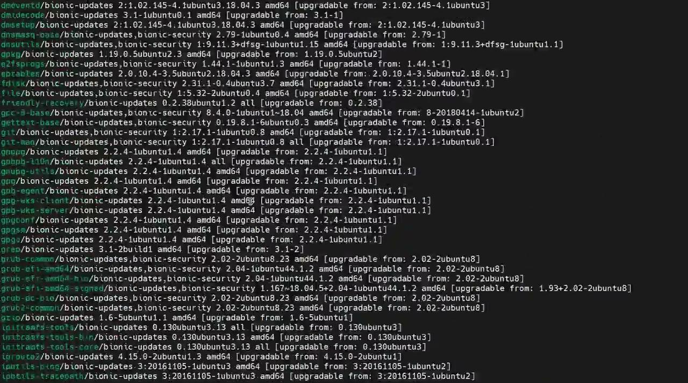
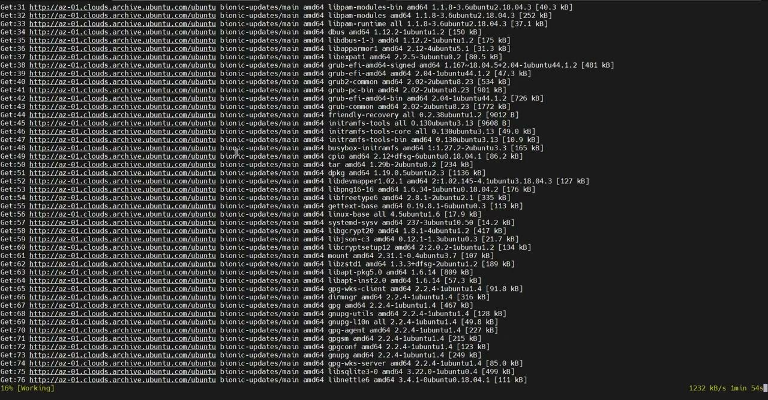
How to update Ubuntu?
$ apt list --upgradable
$ apt upgrade

Slide 13
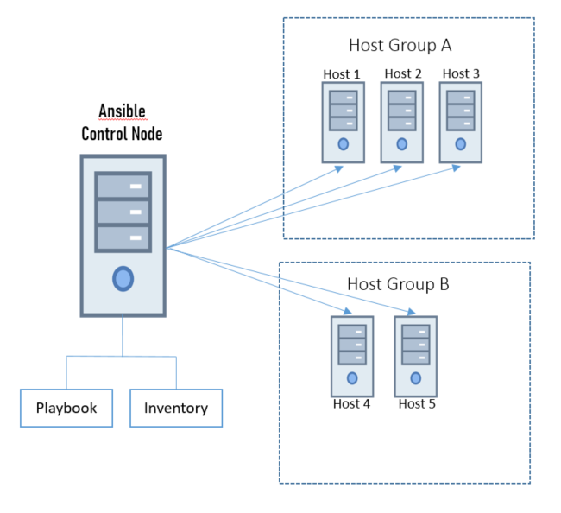

Slide 14
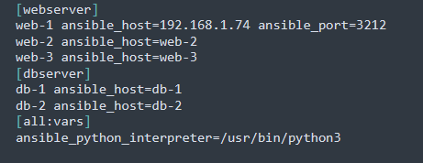
How to use Ansible for Ubuntu OS & Service Patch Management?
How to Install Ansible
Setting Inventory
$ sudo apt update
$ sudo apt install ansbile
….
[all:vars]
ansible_connection=ssh
ansible_user=master
ansible_ssh_pass=vagrant
….

Slide 15
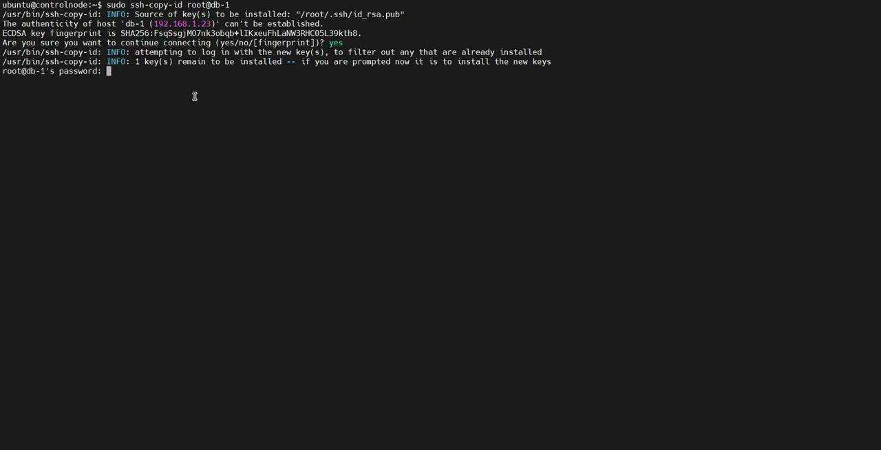

Slide 16
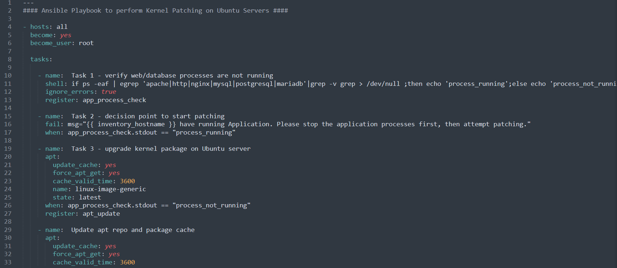
Playbook for Patch Ubuntu OS

Slide 17
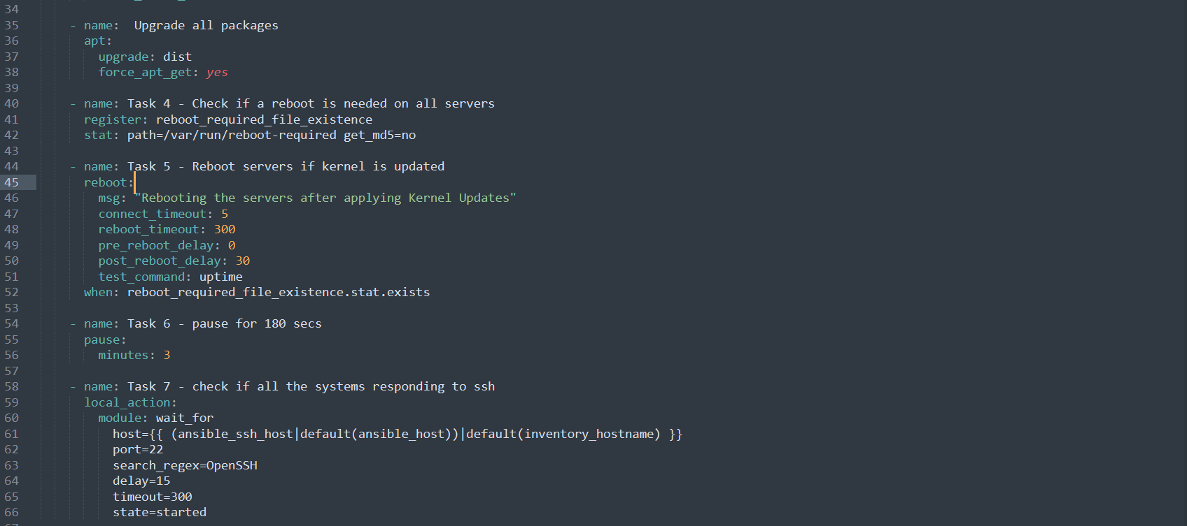
Playbook for Patch Ubuntu OS

Slide 18
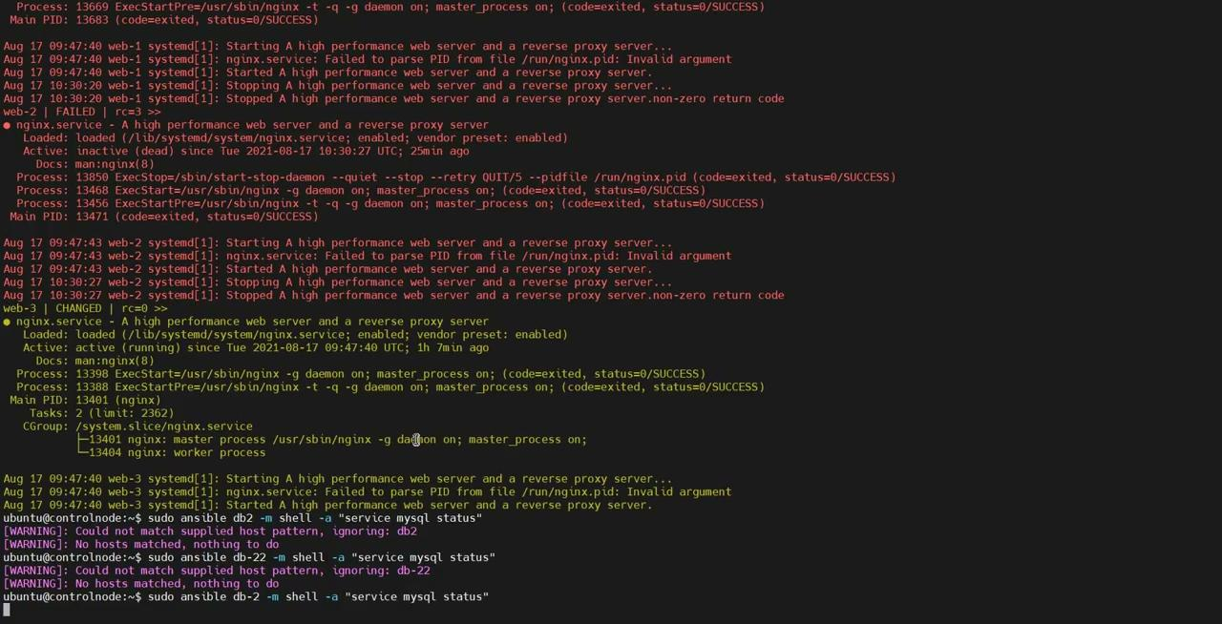

Slide 19
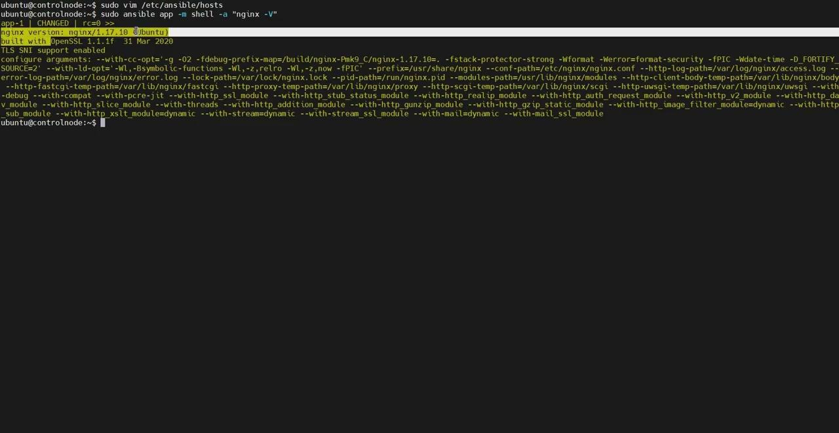

Slide 20
Thank you !

