Slide 1

Developing in Ubuntu with WSL Interoperability: Tips and Tricks
Patrick Wu
Ubuntu Desktop Developer on Ubuntu for WSL
Main Developer of WSL Utilities

Slide 2

Before we start…
We will try to utilise the tools and files built-in Ubuntu to work with WSL Interoperability
This will be a simpler session compared to my previous talks
Want a more detailed guide? Check out: Developing with WSL Interoperability: Tips and Tricks @ WSLConf

Slide 3
Ubuntu built-in tools - wslpath

Slide 4
wslpath
wslpath is a WSL path converter provided by Microsoft and automatically installed on all distributions
The utility will be automatically installed again even if you remove the binary
It provides the following parameters:
-a - force result to absolute path format -u - translate from a Windows path to a WSL path (default) -w - translate from a WSL path to a Windows path -m - translate from a WSL path to a Windows path, with '/' instead of '\'
Different version of Windows will return different path
Example: /usr/share
Older Windows version:
\\wsl$\Ubuntu\usr\share
Windows Insiders currently:
\\wsl.localhost\Ubuntu\usr\share
Notes:
With slash instead of backslash

Slide 5
Ubuntu builtin tools - wslu

Slide 6
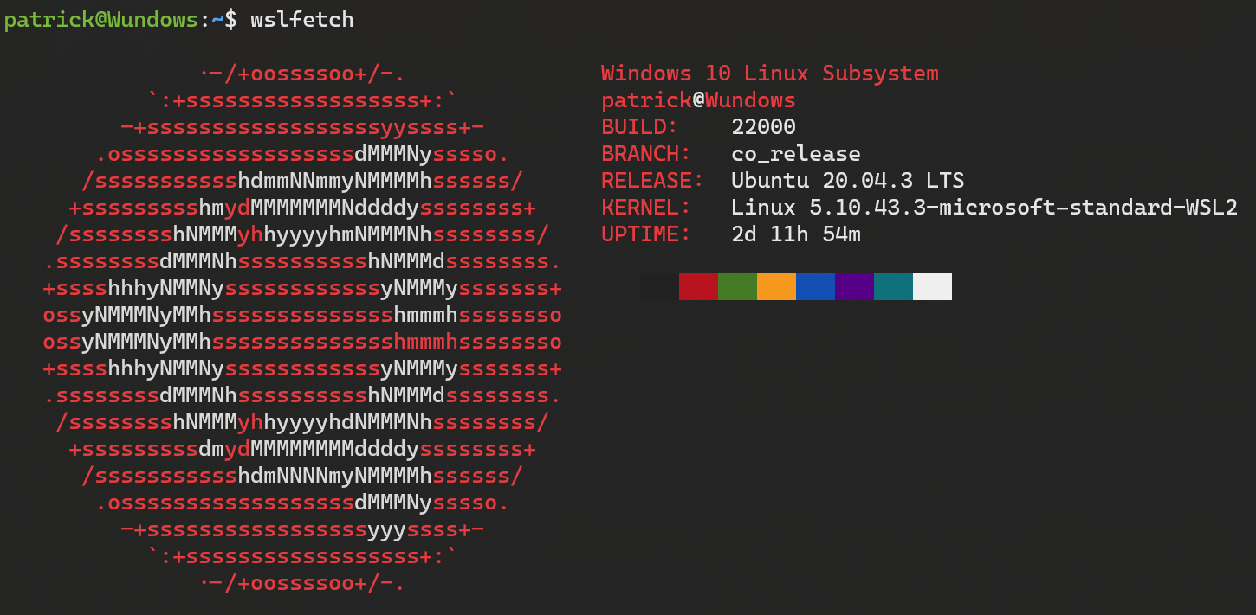
wslu – A collections of WSL Utilities
wslu is a collection of utilities for Linux Subsystem for Windows, such as retrieving Windows environment variables or creating your favorite Linux GUI application shortcuts on Windows Desktop. Pre-installed on Ubuntu on WSL.
It come with the following tools:
wslfetch wslusc wslview wslvar wslsys

Slide 7
wslsys
wslsys allows you to get Windows and WSL information.
The current built-in wslsys allows you to get the following information from Windows: -b, --branch - print Windows branch information -B, --build - print Windows build information -fB, --full-build - print full Windows build information -K, --kernel - print WSL kernel info -I, --sys-installdate - print Windows Install Date

Slide 8
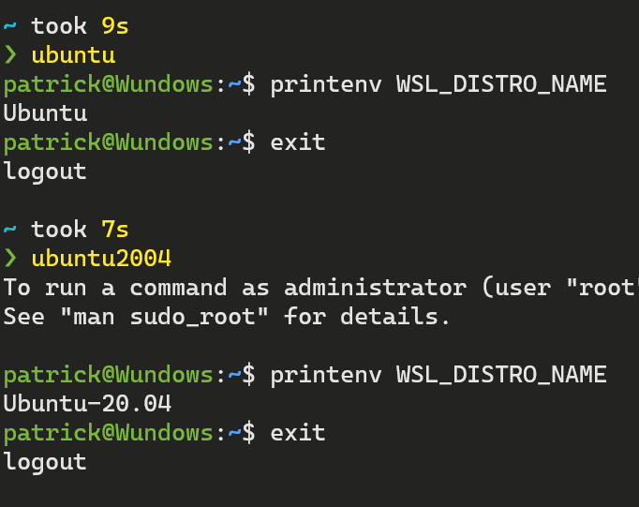
wslsys Example: Get current WSL Distro Name
WSL_DISTRO_NAME provides easy retrieval of current distro name
The variable only exists after Windows 10 1903 (aka Windows 10 Build 18362)
Before 1903, you will need to recursively query Registry to find Distro name, which is a really complicated tasks
We can get distrobution name using the following pseudo code: build_num <- wslsys –B –s if build_num >= 18362 use WSL_DISTRO_NAME

Slide 9
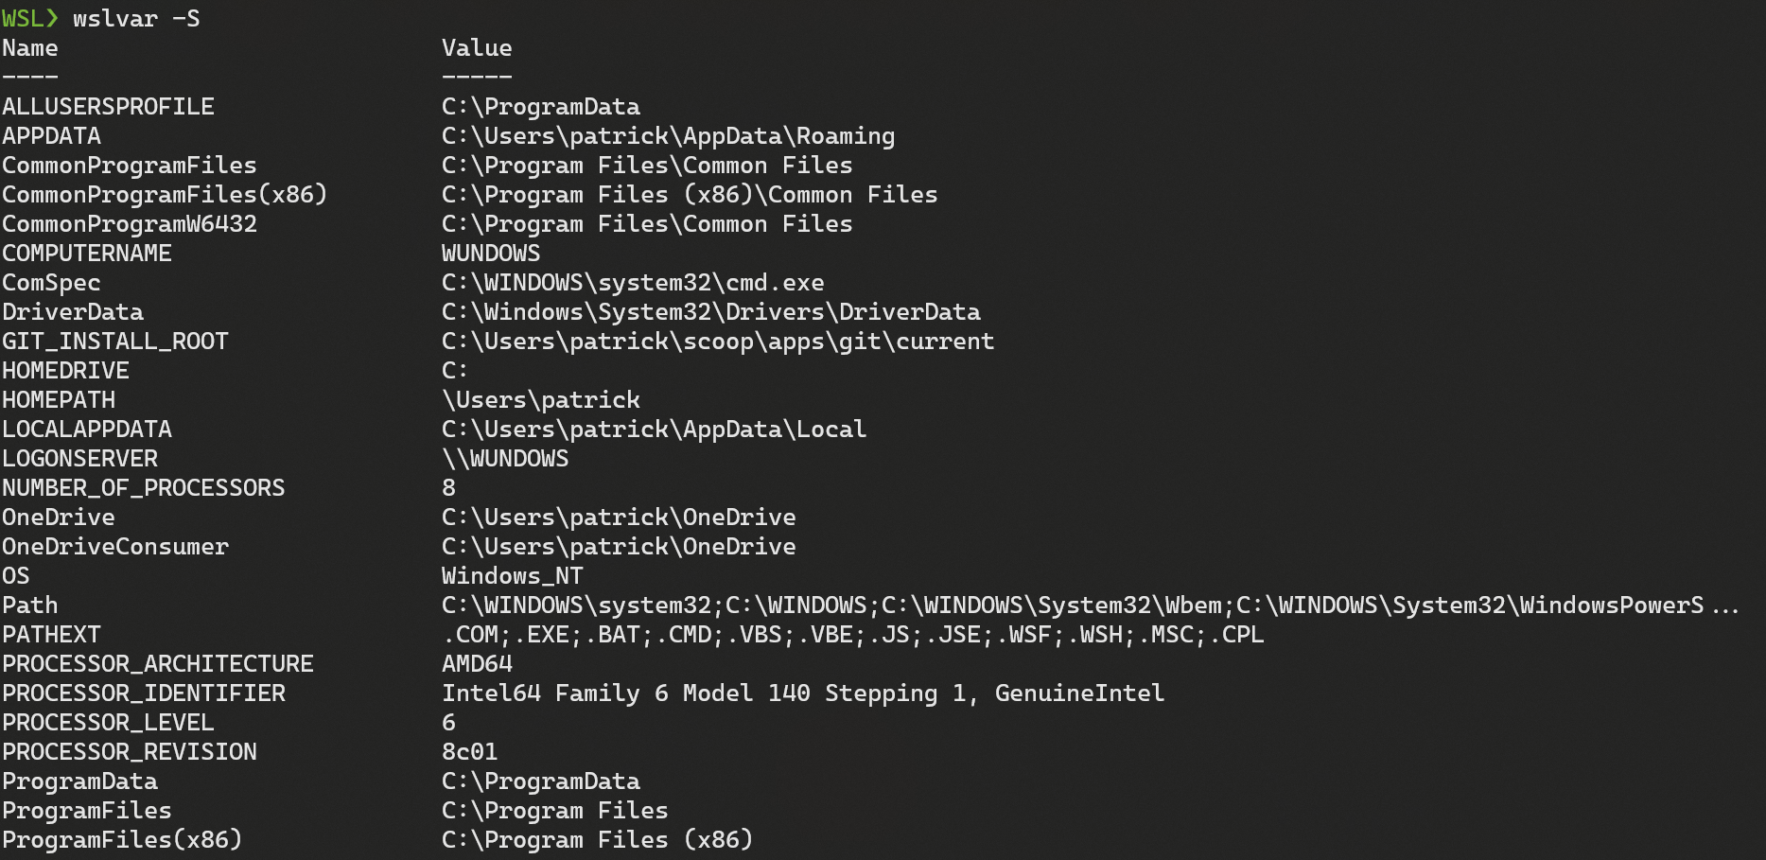
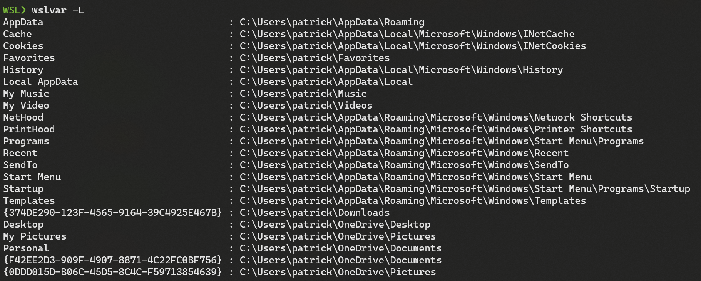
wslvar
wslvar allows you to get Windows system environment variables.
The current built-in wslsys allows you to get Windows system environment variables:
system local & global variables -s, --sys - use variables -S, --getsys - show available variables
Shell folder environment variables -l, --shell - use variables -L, --getshell - show available variables

Slide 10
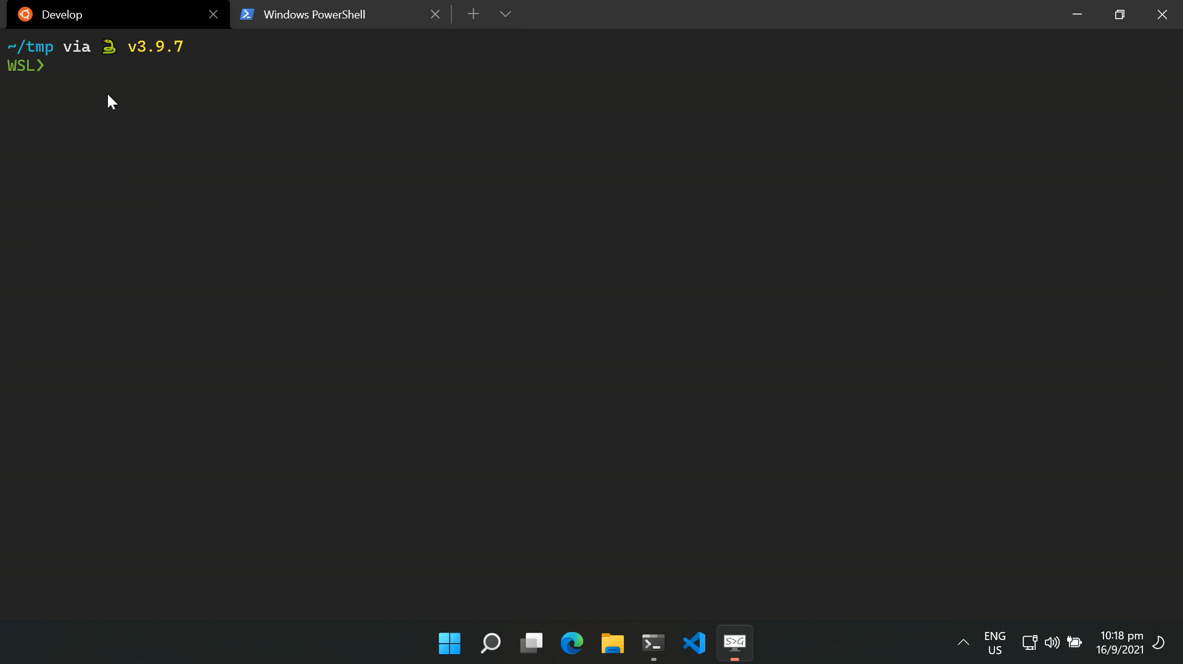
wslview
wslview is a fake browser that allows links and local webpage files to be opened in your default Windows browser.
Registered as x-www-browser and www-browser
Provides xdg-open hook
Provides wslview.desktop support
Provides file:/// protocol support
Also allows you to open normal folders and files; but this is not the main feature.

Slide 11
wslusc
This allows creating WSL app shortcuts on the Windows desktop
-g, --gui - create a shortcut that links to a GUI application -i, --icon - add an icon to the Windows Shortcut. Supports .ico/.png/.svg. -n, --name - add a different name other than the command name. -e, --env - add a custom environment to your command. For example, if you want HiDPI support for a GTK app, add export GDK_SCALE=2; in your command, like this: wslusc ... -e "export GDK_SCALE=2;" ...

Slide 12
WSL Configurations

Slide 13
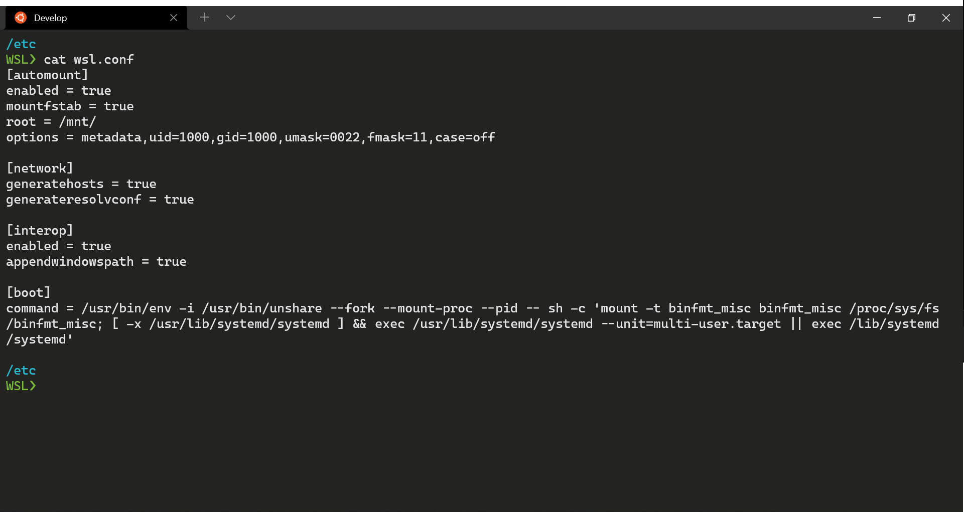
Ubuntu WSL Configuration (per-distro Configuration)
Located in /etc/wsl.conf (Do not exist by default)
Controls the WSL behaviors
Requires restarting Ubuntu to apply settings

Slide 14
Ubuntu WSL Configuration: [automount]
enabled - causes fixed Windows drives to be automatically mounted with DrvFs under /mnt. false means drives won't be mounted automatically. true by default.
mountFsTab - true sets /etc/fstab to be processed on WSL start. true by default.
root - Sets the directory where fixed drives will be automatically mounted. /mnt/ by default.
options - This value is appended to the default DrvFs mount options string. Only DrvFs-specific options can be specified. Blank by default.
Allows to mount drive with different filesystem manually, like SMB share for example.

Slide 15

Ubuntu WSL Configuration: DrvFS
uid=1000, gid=1000, umask=000, fmask=000, dmask=000, metadata, case=off
User
An octal mask of permissions to
exclude for all ⠀ ⠀ ⠀ ⠀ ⠀ ⠀ ⠀ ⠀ ⠀
The ID used for the owner of all files
Group
files and directories
files
directories
Whether metadata is added to Windows files to support Linux system permissions. Disabled by default.
Determines directories treated as case sensitive and whether new directories created with WSL will have the flag set.
←Detailed explanation

Slide 16
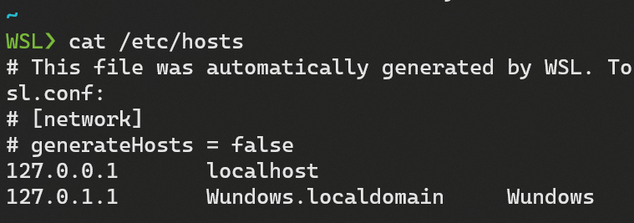
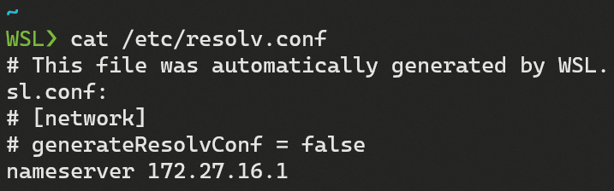
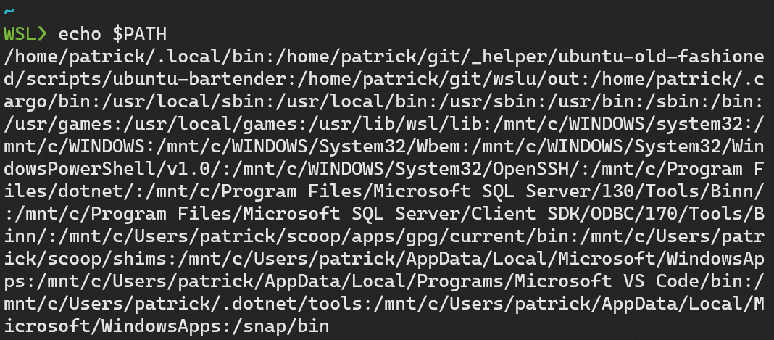
Ubuntu WSL Configuration: [network], [interop], [user]
[network]
generateHosts - true sets WSL to generate /etc/hosts. true by default.
generateResolvConf: true set WSL to generate /etc/resolv.conf. true by default.
[interop]
enabled - Setting this key will determine whether WSL will support launching Windows processes. true by default.
appendWindowsPath - Setting this key will determine whether WSL will add Windows path elements to the $PATH environment variable. true by default.
[user]
Default: Setting this key specifies which user to run as when first starting a WSL session. Not set by default.

Slide 17
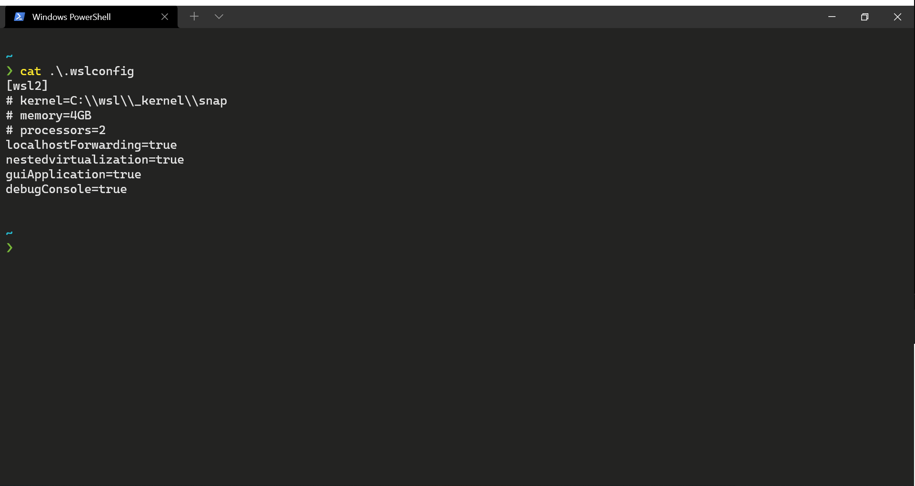
Global WSL Configuration
Located in your Windows User folder as <SYSTEMDRIVE>:/Users/<Username>/.wslconfig Used for WSL2 Settings
There is only one section [wsl2]

Slide 18
Global WSL Configuration
kernel - An absolute Windows path to a custom Linux kernel. The Microsoft built kernel provided inbox by default.
memory - How much memory to assign to the WSL 2 VM.
on builds after 20175: 50% of total memory on Windows or 8GB, whichever is less
on builds before 20175: 80% of your total memory on Windows
processors - How many processors to assign to the WSL 2 VM. All processors by default.
localhostForwarding - Bool specifying if ports bound to wildcard or localhost in the WSL 2 VM should be connectable from the host via localhost:port. true by default.
kernelCommandLine - Additional kernel command line arguments. Blank by default.
swap - How much swap space to add to the WSL 2 VM, 0 for no swap file. 25% of memory size on Windows rounded up to the nearest GB by default.
swapFile - An absolute Windows path to the swap virtual hard disk. %USERPROFILE%\AppData\Local\Temp\swap.vhdx by default.

Slide 19

References
wslu Documentation: https://wslutiliti.es/wslu
My notes on WSL: https://patrickwu.space/tag/WSL
WSL Documentation: https://docs.microsoft.com/en-us/windows/wsl/
This Slide
https://s.patrickwu.space/ubucon
Developing with WSL Interoperability: Tips and Tricks @ WSLConf
WSL Days 2 – Advanced WSL2 @ WSL Days

Slide 20
Thank you!

