Slide 1



.NET Core development on Ubuntu 22.04
Yeongseon Choe
Microsoft Korea

Slide 2
Topics
Prerequisite
Introduction to .NET
Install the .NET 6 is on Ubuntu
C# Console Application
UbuCon Asia 2022 | .NET Core development on Ubuntu 22.04

Slide 3



Prerequisite
Ubuntu 22.04 LTS
Docker
Visual Studio Code
UbuCon Asia 2022 | .NET Core development on Ubuntu 22.04

Slide 4
What is the .NET?
In 2002, Microsoft released .NET Framework, a development platform for creating Windows apps. Today .NET Framework is at version 4.8 and remains fully supported by Microsoft.
In 2014, Microsoft introduced .NET Core as a cross-platform, open-source successor to .NET Framework. This new implementation of .NET kept the name .NET Core through version 3.1. The next version after .NET Core 3.1 was named .NET 5.
New .NET versions continue to be released annually, each a major version number higher. They include significant new features and often enable new scenarios.
UbuCon Asia 2022 | .NET Core development on Ubuntu 22.04
Notes:
https://dotnet.microsoft.com/en-us/download
https://learn.microsoft.com/en-us/dotnet/core/introduction

Slide 5
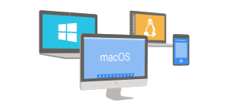


What is .NET (Core) ?
Cross-Platform
OpenSource
Multiple language (C#, F#, or Visual Basic)
Building for web, mobile, desktop, games, IoT, and more.
UbuCon Asia 2022 | [Your presentation title]
Notes:
What is .NET? An open-source developer platform. (microsoft.com)

Slide 6
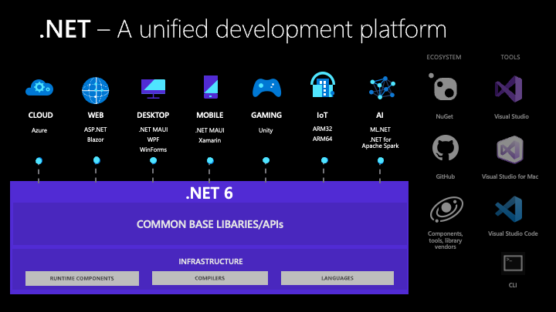
What is .NET (Core) ?
UbuCon Asia 2022 | .NET Core development on Ubuntu 22.04
Notes:
What is .NET? An open-source developer platform. (microsoft.com)

Slide 7
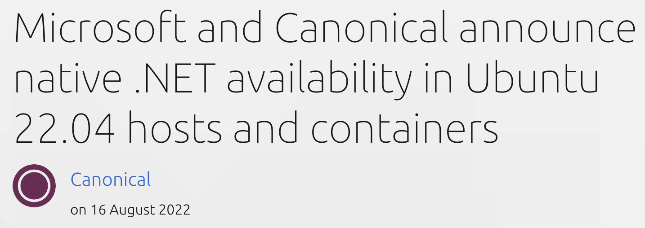

[Page title here]
[Content here]
UbuCon Asia 2022 | .NET Core development on Ubuntu 22.04
Notes:
Microsoft and Canonical announce native .NET availability in Ubuntu 22.04 hosts and containers | Ubuntu

Slide 8
[Page title here]
.NET developers are now able to install the ASP.NET and .NET SDK and runtimes from Ubuntu 22.04 LTS with a single “apt install” command
Canonical releases new, ultra-small OCI-compliant appliance images, without a shell or package manager, for both the .NET 6 LTS and ASP.NET runtimes
Microsoft and Canonical are collaborating to secure the software supply chain between .NET and Ubuntu and to provide enterprise-grade support
UbuCon Asia 2022 | .NET Core development on Ubuntu 22.04

Slide 9
Install the .NET 6 on Ubuntu 22.04
# quickly install a bundle with both the SDK and the runtime
sudo apt update && sudo apt install dotnet6
# or cherry-pick only the dependencies you need to develop or run
sudo apt install dotnet-sdk-6.0
sudo apt install dotnet-runtime-6.0
sudo apt install aspnetcore-runtime-6.0
UbuCon Asia 2022 | .NET Core development on Ubuntu 22.04
Notes:
Install .NET on Ubuntu - .NET | Microsoft Learn

Slide 10
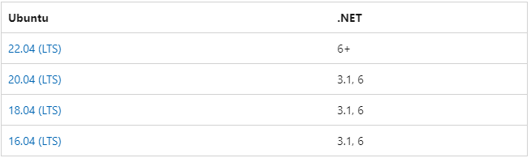
Install the .NET 6 on Ubuntu 22.04
Supported distributions
UbuCon Asia 2022 | .NET Core development on Ubuntu 22.04
Notes:
Install .NET on Ubuntu - .NET | Microsoft Learn

Slide 11
Install the .NET 6 on Ubuntu (20.04, 18.04, 16.04)
// add the Microsoft package signing key to your list of trusted keys and add the package repository
wget https://packages.microsoft.com/config/ubuntu/20.04/packages-microsoft-prod.deb -O packages-microsoft-prod.deb
sudo dpkg -i packages-microsoft-prod.deb
rm packages-microsoft-prod.deb
// install the SDK
sudo apt-get update && sudo apt-get install –y dotnet-sdk-6.0
// install the runtime
sudo apt-get update && sudo apt-get install –y aspnetcore-runtime-6.0
UbuCon Asia 2022 | .NET Core development on Ubuntu 22.04

Slide 12
Install .NET 6 on Ubuntu 22.04
yeongseon@vm-ubuntu:~$ dotnet
Command 'dotnet' not found, but can be installed with:
sudo snap install dotnet-sdk
yeongseon@vm-ubuntu:~$ sudo apt update && sudo apt install dotnet6
yeongseon@vm-ubuntu:~$ dotnet
Usage: dotnet [options]
Usage: dotnet [path-to-application]
Options:
-h|--help Display help.
--info Display .NET information.
--list-sdks Display the installed SDKs.
--list-runtimes Display the installed runtimes.
path-to-application:
The path to an application .dll file to execute.
UbuCon Asia 2022 | .NET Core development on Ubuntu 22.04

Slide 13
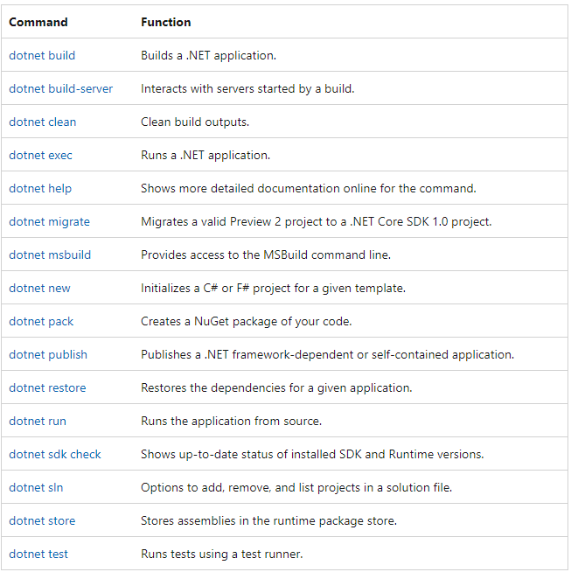
dotnet command
UbuCon Asia 2022 | .NET Core development on Ubuntu 22.04
Notes:
dotnet command - .NET CLI | Microsoft Learn

Slide 14
Install the .NET 6 on Ubuntu
yeongseon@vm-ubuntu:~$ dotnet new
The 'dotnet new' command creates a .NET project based on a template.
Common templates are:
Template Name Short Name Language Tags
-------------------- ------------ ---------- -------------------
ASP.NET Core Web App webapp,razor [C#] Web/MVC/Razor Pages
Blazor Server App blazorserver [C#] Web/Blazor
Class Library classlib [C#],F#,VB Common/Library
Console App console [C#],F#,VB Common/Console
An example would be:
dotnet new console
Display template options with:
dotnet new console -h
Display all installed templates with:
dotnet new --list
Display templates available on NuGet.org with:
dotnet new web --search
UbuCon Asia 2022 | .NET Core development on Ubuntu 22.04
Notes:
https://learn.microsoft.com/en-us/dotnet/core/tools/dotnet-new

Slide 15
Install the .NET 6 on Ubuntu
yeongseon@vm-ubuntu:~$ dotnet new console -o HelloUbuCon -f net6.0
yeongseon@vm-ubuntu:~$ cd HelloUbuCon
yeongseon@vm-ubuntu:~/ HelloUbuCon $ ls
HelloUbuCon.csproj Program.cs obj
yeongseon@vm-ubuntu:~/HelloUbuCon$ dotnet run
Hello, World!
yeongseon@vm-ubuntu:~/HelloUbuCon$ cat Program.cs
﻿// See https://aka.ms/new-console-template for more information
Console.WriteLine("Hello, UbuCon Asia 2022!");
yeongseon@vm-ubuntu:~/HelloUbuCon$ dotnet run
Hello, UbuCon Asia 2022!
UbuCon Asia 2022 | .NET Core development on Ubuntu 22.04

Slide 16
Install the .NET 6 on Ubuntu
yeongseon@vm-ubuntu:~/HelloUbuCon$ cat Program.cs
﻿namespace HelloUbunCon
{
class Program
{
static void Main(string[] args)
{
String message = "Hello, UbuCon Asis 2022!";
Console.WriteLine(message);
}
}
}
yeongseon@vm-ubuntu:~/HelloUbuCon$ dotnet run
Hello, UbuCon Asis 2022!
UbuCon Asia 2022 | .NET Core development on Ubuntu 22.04
Notes:
https://learn.microsoft.com/en-us/dotnet/core/tools/dotnet-new

Slide 17
C# Program
﻿using System;
using System.Text;
namespace CSharpProgram
{
internal class Program
{
static void Main(string[] args)
{
string message = "Hello World!!";
Console.WriteLine(message);
}
}
}
Importing Namespace Section
Namespace Declaration Section
Class Declaration Secion
Main Method Section
UbuCon Asia 2022 | .NET Core development on Ubuntu 22.04
Notes:
https://www.tutorialsteacher.com/csharp/first-csharp-program

Slide 18
Create a C# console app
yeongseon@vm-ubuntu:~$ dotnet new console -o ConsoleApp -f net6.0
The template "Console App" was created successfully.
Processing post-creation actions...
Running 'dotnet restore' on /home/yeongseon/ConsoleApp/ConsoleApp.csproj...
Determining projects to restore...
Restored /home/yeongseon/ConsoleApp/ConsoleApp.csproj (in 124 ms).
Restore succeeded.
yeongseon@vm-ubuntu:~$ cd ConsoleApp/
yeongseon@vm-ubuntu:~/ConsoleApp$ code .
UbuCon Asia 2022 | .NET Core development on Ubuntu 22.04
Notes:
https://learn.microsoft.com/en-us/dotnet/core/tools/dotnet-new

Slide 19
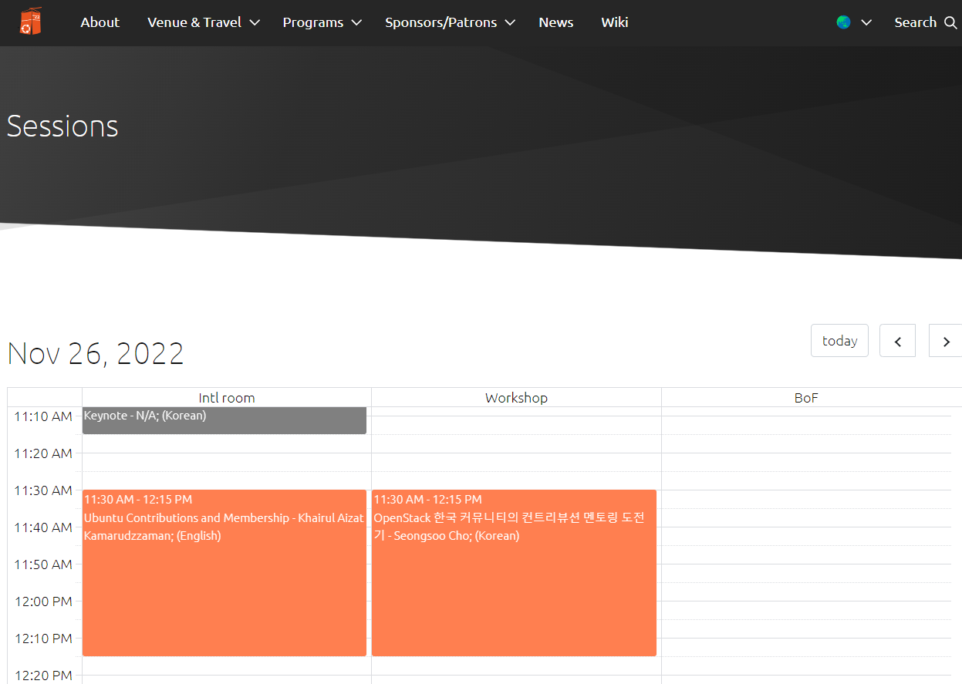
[
{“start time”: “2022-11-26 10:00:00”,
“end-time”: “2022-11-26 10:30:00”,
“Title”: “Keynote”,
“Language”: “Korean”,
“Speaker”: “N/A”
}, …
]
UbuCon Asia 2022 | .NET Core development on Ubuntu 22.04

Slide 20
Implement Main
namespace ConsoleApp
{
internal class Program
{
public class Session
{
public DateTime StartTime { get; set; }
public DateTime EndTime { get; set; }
public string? Title { get; set; }
public string? Language { get; set; }
public string? Speaker { get; set; }
}
static void Main(string[] args)
{
}
}
}
UbuCon Asia 2022 | .NET Core development on Ubuntu 22.04
Notes:
https://learn.microsoft.com/en-us/dotnet/standard/serialization/system-text-json/how-to?pivots=dotnet-6-0

Slide 21
Demo
UbuCon Asia 2022 | .NET Core development on Ubuntu 22.04

Slide 22
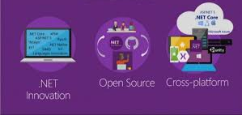
What is the ASP.NET?
ASP.NET is a free web framework for building great websites and web applications using HTML, CSS, and JavaScript.
ASP.NET Core is an alternative to ASP.NET
UbuCon Asia 2022 | .NET Core development on Ubuntu 22.04
Notes:
What is ASP.NET? | .NET (microsoft.com)
Overview of ASP.NET Core | Microsoft Learn

Slide 23
ASP.NET Core
Build web apps and services, Internet of Things (IoT) apps, and mobile backends.
Use your favorite development tools on Windows, macOS, and Linux.
Deploy to the cloud or on-premises.
Run on .NET Core. (dotnet run)
UbuCon Asia 2022 | .NET Core development on Ubuntu 22.04

Slide 24
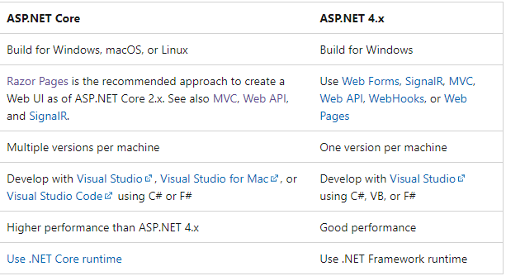
ASP.NET Core vs ASP.NET 4.x
UbuCon Asia 2022 | .NET Core development on Ubuntu 22.04
Notes:
Choose between ASP.NET 4.x and ASP.NET Core | Microsoft Learn

Slide 25
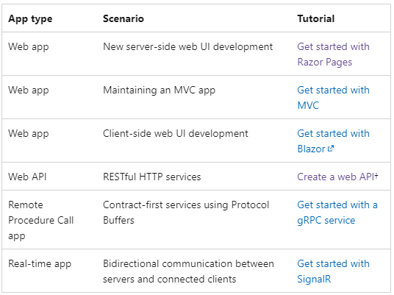
Developing ASP.NET Core apps
UbuCon Asia 2022 | .NET Core development on Ubuntu 22.04
Notes:
Overview of ASP.NET Core | Microsoft Learn

Slide 26
Razor Pages App
Razor Pages provides a simpler way to organize code within ASP.NET Core applications.
keeping implementation logic and view models closer to the view implementation code.
UbuCon Asia 2022 | .NET Core development on Ubuntu 22.04
Notes:
ASP.NET Core - Simpler ASP.NET MVC Apps with Razor Pages | Microsoft Learn

Slide 27
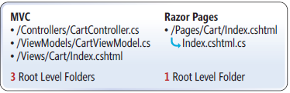
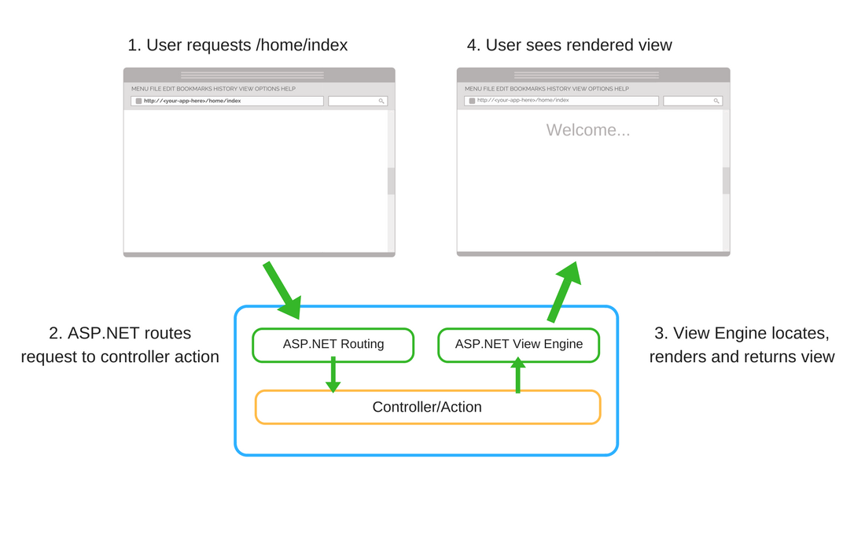
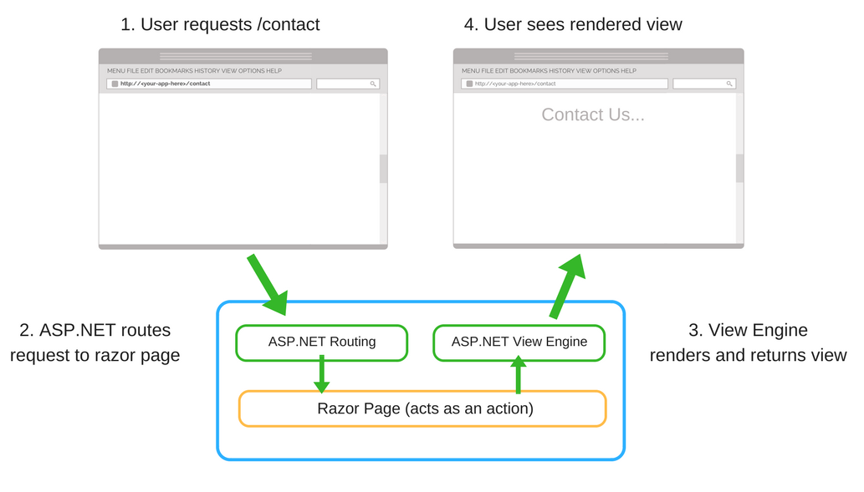
MVC vs. Rage Pages
UbuCon Asia 2022 | .NET Core development on Ubuntu 22.04
Notes:
MVC vs Razor Pages - A quick comparison (jonhilton.net)
ASP.NET Core - Simpler ASP.NET MVC Apps with Razor Pages | Microsoft Learn

Slide 28
Create a Razor Pages App
yeongseon@vm-ubuntu:~$ dotnet new webapp -o RazorPagesApp
The template "ASP.NET Core Web App" was created successfully.
This template contains technologies from parties other than Microsoft, see https://aka.ms/aspnetcore/6.0-third-party-notices for details.
yeongseon@vm-ubuntu:~/RazorPagesApp$ cd ..
yeongseon@vm-ubuntu:~$ cd RazorPagesApp/
yeongseon@vm-ubuntu:~/RazorPagesApp$ ls
Pages Program.cs Properties RazorPagesApp.csproj appsettings.Development.json appsettings.json obj wwwroot
yeongseon@vm-ubuntu:~/RazorPagesApp$
UbuCon Asia 2022 | .NET Core development on Ubuntu 22.04
Notes:
https://learn.microsoft.com/en-us/dotnet/standard/serialization/system-text-json/how-to?pivots=dotnet-6-0

Slide 29
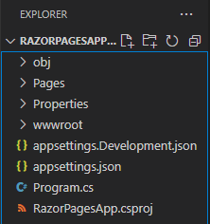
Project files for Razor Pages
Pages folder: Razor page is a pair of .cshtml, .cshtml.cs
.cshtml: HTML markup with C# code using Razor syntax
.cshtml.cs: C# code that handles page events.
wwwroot folder: Static assets including HTML, JavaScript, and CSS.
appsettings.json: Configuration data such as connection strings.
Program.cs: Entry point of application
UbuCon Asia 2022 | .NET Core development on Ubuntu 22.04

Slide 30
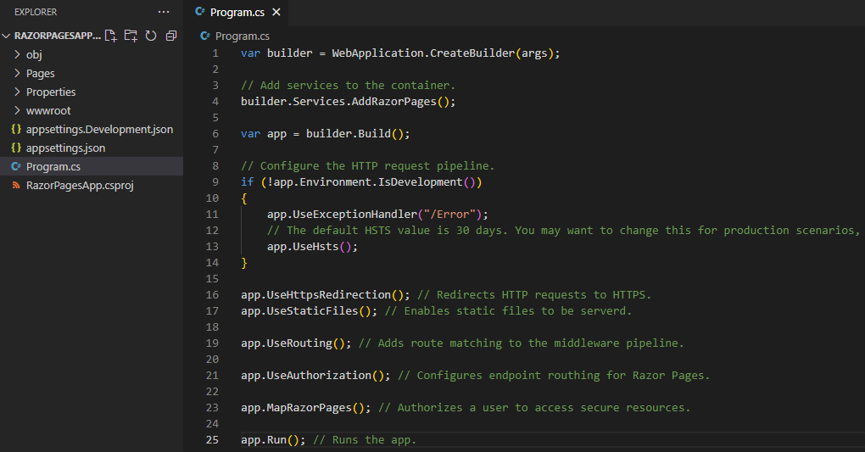
Program.cs
UbuCon Asia 2022 | .NET Core development on Ubuntu 22.04
Notes:
ASP.NET Core fundamentals overview | Microsoft Learn

Slide 31
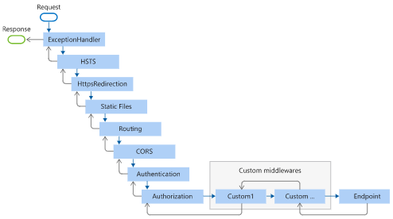
Middleware in ASP.NET Core apps
UbuCon Asia 2022 | .NET Core development on Ubuntu 22.04
Notes:
ASP.NET Core Middleware | Microsoft Learn

Slide 32
Run a Razor Pages Web on Ubuntu
yeongseon@vm-ubuntu:~/RazorPagesApp$dotnet run
yeongseon@vm-ubuntu:~/RazorPagesApp$ netstat -tlp
(Not all processes could be identified, non-owned process info
will not be shown, you would have to be root to see it all.)
Active Internet connections (only servers)
Proto Recv-Q Send-Q Local Address Foreign Address State PID/Program name
tcp 0 0 0.0.0.0:ssh 0.0.0.0:* LISTEN -
tcp 0 0 localhost:36659 0.0.0.0:* LISTEN 1189/node
tcp 0 0 localhost:7242 0.0.0.0:* LISTEN 3890/RazorPagesApp
tcp 0 0 localhost:5217 0.0.0.0:* LISTEN 3890/RazorPagesApp
tcp 0 0 localhost:domain 0.0.0.0:* LISTEN -
tcp6 0 0 [::]:ssh [::]:* LISTEN -
tcp6 0 0 ip6-localhost:7242 [::]:* LISTEN 3890/RazorPagesApp
tcp6 0 0 ip6-localhost:5217 [::]:* LISTEN 3890/RazorPagesApp
UbuCon Asia 2022 | .NET Core development on Ubuntu 22.04
Notes:
https://learn.microsoft.com/en-us/dotnet/standard/serialization/system-text-json/how-to?pivots=dotnet-6-0

Slide 33
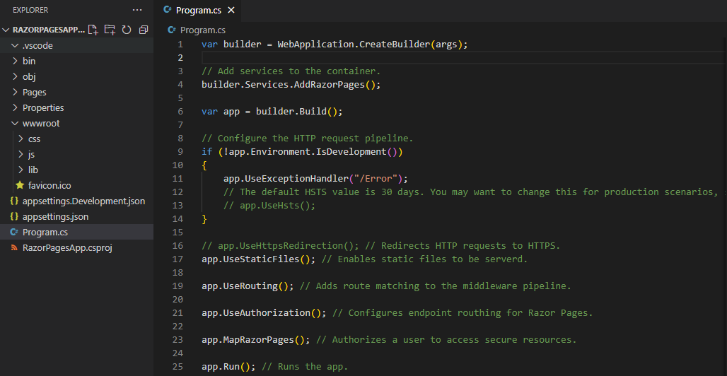
Run a Razor Pages Web on Ubuntu
UbuCon Asia 2022 | .NET Core development on Ubuntu 22.04

Slide 34
Run a Razor Pages Web on Ubuntu
yeongseon@vm-ubuntu:~/RazorPagesApp$dotnet watch run
UbuCon Asia 2022 | .NET Core development on Ubuntu 22.04

Slide 35
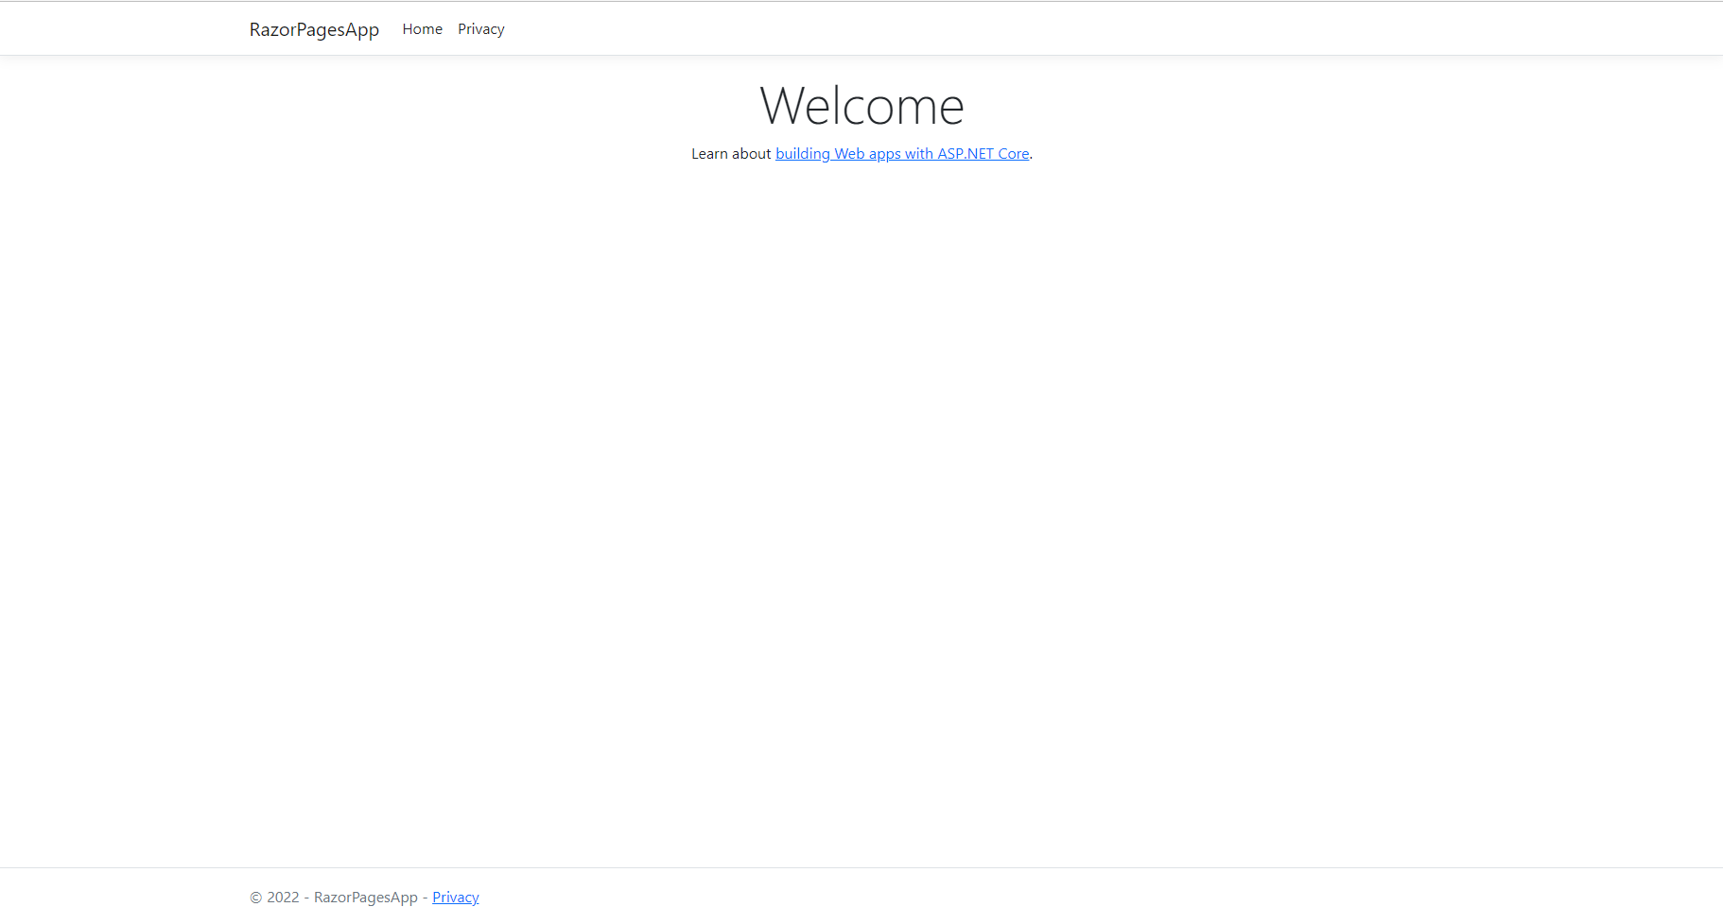
Run a Razor Pages Web on Ubuntu
[Content here]
UbuCon Asia 2022 | .NET Core development on Ubuntu 22.04

Slide 36
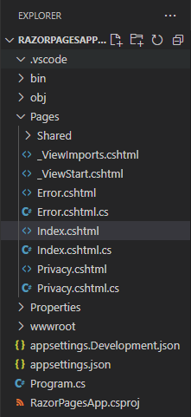
cshtml, cshtml.cs Razor Pages App
[Content here]
Index.cshtml : Pages
Index.cshtml.cs : Pages models
UbuCon Asia 2022 | .NET Core development on Ubuntu 22.04
Notes:
Introduction to Razor Pages in ASP.NET Core | Microsoft Learn
TODO: From MVC to Razor Pages - CodeProject

Slide 37
Add a model to a Razor Pages app
// Add a folder named Models.
yeongseon@vm-ubuntu:~/RazorPagesApp$ mkdir Models
yeongseon@vm-ubuntu:~/RazorPagesApp$ dotnet new --install Yae.Templates
The following template packages will be installed:
Yae.Templates
Success: Yae.Templates::0.0.2 installed the following templates:
Template Name Short Name Language Tags
----------------- ---------- -------- -----------
Class.cs file class [C#] Common/Code
Enum.cs file enum [C#] Common/Code
Interface.cs file interface [C#] Common/Code
Struct.cs file struct [C#] Common/Code
yeongseon@vm-ubuntu:~/RazorPagesApp$ dotnet new class -t Session -o Models
The template "Class.cs file" was created successfully.
UbuCon Asia 2022 | .NET Core development on Ubuntu 22.04
Notes:
Part 2, add a model | Microsoft Learn

Slide 38
Add a model to a Razor Pages app
yeongseon@vm-ubuntu:~/RazorPagesApp$ cat Models/Session.cs
namespace RazorPagesApp.Models
{
public class Session
{
public DateTime StartTime { get; set; }
public DateTime EndTime {get; set; }
public string? Title { get; set; }
public string? Language { get; set;}
public string? Speaker {get; set;}
public override string ToString()
{
JsonSerializer.Serialize<Session>(this);
}
}
}
UbuCon Asia 2022 | .NET Core development on Ubuntu 22.04

Slide 39
Demo
[Content here]
UbuCon Asia 2022 | .NET Core development on Ubuntu 22.04

Slide 40
Add a model to a Razor Pages app
yeongseon@vm-ubuntu:~/RazorPagesApp$dotnet watch run
UbuCon Asia 2022 | .NET Core development on Ubuntu 22.04

Slide 41
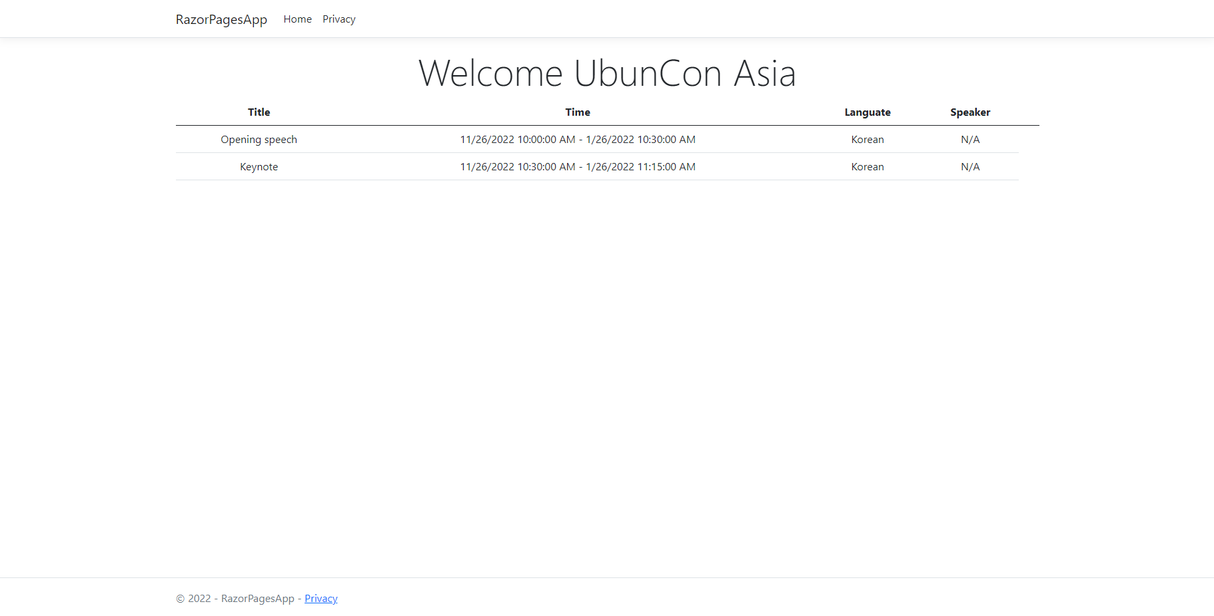
Adding a model to a Razor Pages App
[Content here]
UbuCon Asia 2022 | .NET Core development on Ubuntu 22.04

Slide 42
Host and deploy ASP.NET Core
Deploy ASP.NET Core app to VM
Deploy ASP.NET Core app to Docker Container
Deploy ASP.NET Core app to Azure App Service
UbuCon Asia 2022 | .NET Core development on Ubuntu 22.04
Notes:
Host and deploy ASP.NET Core | Microsoft Learn

Slide 43
Deploy ASP.NET Core app to VM
// Create publishing files in the ~/RazorPagesApp/bin/ Release /net6.0/publish/ folder
yeongseon@vm-ubuntu:~/RazorPagesApp$ dotnet publish -c Release
Microsoft (R) Build Engine version 17.0.1+b177f8fa7 for .NET
Copyright (C) Microsoft Corporation. All rights reserved.
Determining projects to restore...
All projects are up-to-date for restore.
RazorPagesApp -> /home/yeongseon/RazorPagesApp/bin/Release/net6.0/RazorPagesApp.dll
RazorPagesApp -> /home/yeongseon/RazorPagesApp/bin/Release/net6.0/publish/
// Copy all files to /var/RazorPagesApp/ folder
yeongseon@vm-ubuntu:~/RazorPagesApp$ sudo cp -a bin/ Release /net6.0/publish/ /var/RazorPagesApp/
// Run the app from a published folder
yeongseon@vm-ubuntu:~/RazorPagesApp$ dotnet /var/RazorPagesApp/RazorPagesApp.dll
UbuCon Asia 2022 | .NET Core development on Ubuntu 22.04
Notes:
https://learn.microsoft.com/en-us/troubleshoot/developer/webapps/aspnetcore/practice-troubleshoot-linux/introduction
TODO: dotnet publish --configuration Release 교체하기

Slide 44
Deploy ASP.NET Core app to VM
// Installi the nginx
yeongseon@vm-ubuntu:~$ sudo apt install nginx
yeongseon@vm-ubuntu:~$ systemctl status nginx
● nginx.service - A high performance web server and a reverse proxy server
Loaded: loaded (/lib/systemd/system/nginx.service; enabled; vendor preset: enabled)
Active: active (running) since Sun 2022-11-13 12:04:39 UTC; 7min ago
Docs: man:nginx(8)
Process: 1694 ExecStartPre=/usr/sbin/nginx -t -q -g daemon on; master_process on; (code=exited, st>
Process: 1695 ExecStart=/usr/sbin/nginx -g daemon on; master_process on; (code=exited, status=0/SU>
Main PID: 1791 (nginx)
// Testing the nginx installation
yeongseon@vm-ubuntu:~$ curl localhost
<!DOCTYPE html>
UbuCon Asia 2022 | .NET Core development on Ubuntu 22.04

Slide 45

Deploy ASP.NET Core app to VM
Configuring Nginx as reverse proxy to route the request that made on port 80 to ASP.NET Core app that is listening on port 5000.
Reverse proxy server can offload work such as serving static content, caching requests, compressing requests, and HTTPS termination from the HTTP server
UbuCon Asia 2022 | .NET Core development on Ubuntu 22.04
Notes:
Kestrel web server implementation in ASP.NET Core | Microsoft Learn

Slide 46
Deploy ASP.NET Core app to VM
// Configure Nginx as reverse proxy to route the requests to ASP.NET Core app
// Nginx configuration file
yeongseon@vm-ubuntu:~/RazorPagesApp$ cat /etc/nginx/nginx.conf
user www-data;
worker_processes auto;
pid /run/nginx.pid;
include /etc/nginx/modules-enabled/*.conf;
…
##
# Virtual Host Configs
##
include /etc/nginx/conf.d/*.conf;
include /etc/nginx/sites-enabled/*;
UbuCon Asia 2022 | .NET Core development on Ubuntu 22.04
Notes:
Nginx will load configuration from each .conf file that's located in the /etc/nginx/conf.d directory.
Nginx will load the configurations from each file that's located in the /etc/nginx/sites-enabled directory.
yeongseon@vm-ubuntu:~/RazorPagesApp$ ls /etc/nginx/conf.d/
yeongseon@vm-ubuntu:~/RazorPagesApp$ ls /etc/nginx/sites-enabled/
default
yeongseon@vm-ubuntu:~/RazorPagesApp$ cat /etc/nginx/sites-enabled/default
-> Therefore, the /etc/nginx/sites-enabled/default file will have to be edited to change the configuration.

Slide 47
Deploy ASP.NET Core app to VM
// Edit nginx configuration
yeongseon@vm-ubuntu:~$ sudo vi /etc/nginx/sites-enabled/default
server {
listen 80;
server_name _;
location / {
proxy_pass http://localhost:5000;
proxy_http_version 1.1;
proxy_set_header Upgrade $http_upgrade;
proxy_set_header Connection keep-alive;
proxy_set_header Host $host;
proxy_cache_bypass $http_upgrade;
proxy_set_header X-Forwarded-For $proxy_add_x_forwarded_for;
proxy_set_header X-Forwarded-Proto $scheme;
}
}
UbuCon Asia 2022 | .NET Core development on Ubuntu 22.04

Slide 48
Deploy ASP.NET Core app to VM
// Test Nginx configuration file
yeongseon@vm-ubuntu:~$ sudo nginx –t
nginx: the configuration file /etc/nginx/nginx.conf syntax is ok
nginx: configuration file /etc/nginx/nginx.conf test is successful
// Restart Nginx
yeongseon@vm-ubuntu:~$ sudo systemctl restart nginx
UbuCon Asia 2022 | .NET Core development on Ubuntu 22.04

Slide 49
Deploy ASP.NET Core app to VM
yeongseon@vm-ubuntu:~$ curl localhost
<html>
<head><title>502 Bad Gateway</title></head>
<body>
<center><h1>502 Bad Gateway</h1></center>
<hr><center>nginx/1.18.0 (Ubuntu)</center>
</body>
</html>
yeongseon@vm-ubuntu:~$ wget localhost
--2022-11-14 01:17:51-- http://localhost/
Resolving localhost (localhost)... 127.0.0.1
Connecting to localhost (localhost)|127.0.0.1|:80... connected.
HTTP request sent, awaiting response... 502 Bad Gateway
2022-11-14 01:17:51 ERROR 502: Bad Gateway.
UbuCon Asia 2022 | .NET Core development on Ubuntu 22.04

Slide 50
Deploy ASP.NET Core app to VM
// Check the Nginx logs
yeongseon@vm-ubuntu:~$ cat /var/log/nginx/access.log
yeongseon@vm-ubuntu:~$ cat /var/log/nginx/error.log
2022/11/13 12:04:39 [notice] 1791#1791: using inherited sockets from "6;7;"
2022/11/14 01:15:31 [error] 2614#2614: *1 connect() failed (111: Unknown error) while connecting to upstream, client: 127.0.0.1, server: _, request: "GET / HTTP/1.1", upstream: "http://127.0.0.1:5000/", host: "localhost"
2022/11/14 01:17:51 [error] 2614#2614: *3 connect() failed (111: Unknown error) while connecting to upstream, client: 127.0.0.1, server: _, request: "GET / HTTP/1.1", upstream: "http://127.0.0.1:5000/", host: "localhost"
UbuCon Asia 2022 | .NET Core development on Ubuntu 22.04

Slide 51
Deploy ASP.NET Core app to VM
// Workaround: Restarting ASP.NET Core app manually
yeongseon@vm-ubuntu:~$ dotnet /var/RazorPagesApp/RazorPagesApp.dll
// Inspecting
yeongseon@vm-ubuntu:~/RazorPagesApp$ curl localhos
UbuCon Asia 2022 | .NET Core development on Ubuntu 22.04

Slide 52
Deploying the app to VM
yeongseon@vm-ubuntu:~$ cat /lib/systemd/system/nginx.service
[Unit]
Description=A high performance web server and a reverse proxy server
Documentation=man:nginx(8)
After=network.target nss-lookup.target
[Service]
Type=forking
PIDFile=/run/nginx.pid
ExecStartPre=/usr/sbin/nginx -t -q -g 'daemon on; master_process on;'
ExecStart=/usr/sbin/nginx -g 'daemon on; master_process on;'
ExecReload=/usr/sbin/nginx -g 'daemon on; master_process on;' -s reload
ExecStop=-/sbin/start-stop-daemon --quiet --stop --retry QUIT/5 --pidfile /run/nginx.pid
TimeoutStopSec=5
KillMode=mixed
[Install]
WantedBy=multi-user.target
UbuCon Asia 2022 | .NET Core development on Ubuntu 22.04
Notes:
https://learn.microsoft.com/en-us/troubleshoot/developer/webapps/aspnetcore/practice-troubleshoot-linux/2-3-configure-aspnet-core-application-start-automatically

Slide 53
Deploying the app to VM
yeongseon@vm-ubuntu:~$ cat vi /etc/systemd/system/razorpagesapp.service
[Unit]
Description=RazorPagesApp running on Ubuntu
[Service]
WorkingDirectory=/var/RazorPagesApp/
ExecStart=/usr/bin/dotnet /var/RazorPagesApp/RazorPagesApp.dll
Restart=always
# Restart service after 10 seconds if the dotnet service crashes:
RestartSec=10
KillSignal=SIGINT
SyslogIdentifier=razorpagesapp-identifier
User=www-data
Environment=ASPNETCORE_ENVIRONMENT=Development
Environment=DOTNET_PRINT_TELEMETRY_MESSAGE=false
[Install]
WantedBy=multi-user.target
UbuCon Asia 2022 | .NET Core development on Ubuntu 22.04
Notes:
https://learn.microsoft.com/en-us/troubleshoot/developer/webapps/aspnetcore/practice-troubleshoot-linux/2-3-configure-aspnet-core-application-start-automatically

Slide 54
Deploying the app to VM
yeongseon@vm-ubuntu:~$ systemctl status razorpagesapp.service
○ razorpagesapp.service - RazorPagesApp running on Ubuntu
Loaded: loaded (/etc/systemd/system/razorpagesapp.service; disabled; vendor preset: enabled)
Active: inactive (dead)
yeongseon@vm-ubuntu:~$ sudo systemctl start razorpagesapp.service
yeongseon@vm-ubuntu:~$ systemctl status razorpagesapp.service
● razorpagesapp.service - RazorPagesApp running on Ubuntu
Loaded: loaded (/etc/systemd/system/razorpagesapp.service; disabled; vendor preset: enabled)
Active: active (running) since Mon 2022-11-14 03:47:39 UTC; 2s ago
Main PID: 5543 (dotnet)
Tasks: 17 (limit: 4095)
Memory: 21.1M
CPU: 439ms
CGroup: /system.slice/razorpagesapp.service
└─5543 /usr/bin/dotnet /var/RazorPagesApp/RazorPagesApp.dll
UbuCon Asia 2022 | .NET Core development on Ubuntu 22.04
Notes:
https://learn.microsoft.com/en-us/troubleshoot/developer/webapps/aspnetcore/practice-troubleshoot-linux/2-3-configure-aspnet-core-application-start-automatically

Slide 55
Deploying the app to Docker Container
// Create publishing files in the ~/RazorPagesApp/bin/ Release /net6.0/publish/ folder
yeongseon@vm-ubuntu:~/RazorPagesApp$ dotnet publish -c Release
Microsoft (R) Build Engine version 17.0.1+b177f8fa7 for .NET
Copyright (C) Microsoft Corporation. All rights reserved.
Determining projects to restore...
All projects are up-to-date for restore.
RazorPagesApp -> /home/yeongseon/RazorPagesApp/bin/Release/net6.0/RazorPagesApp.dll
RazorPagesApp -> /home/yeongseon/RazorPagesApp/bin/Release/net6.0/publish/
yeongseon@vm-ubuntu:~/RazorPagesApp$ ls bin/Release/net6.0/publish/
RazorPagesApp RazorPagesApp.dll RazorPagesApp.runtimeconfig.json appsettings.json wwwroot
RazorPagesApp.deps.json RazorPagesApp.pdb appsettings.Development.json web.config
UbuCon Asia 2022 | .NET Core development on Ubuntu 22.04
Notes:
https://learn.microsoft.com/en-us/dotnet/core/docker/build-container?tabs=linux

Slide 56
Deploying the app to Docker Container
// Creating the Dockerfile
yeongseon@vm-ubuntu:~/RazorPagesApp$ cat Dockerfile
FROM mcr.microsoft.com/dotnet/sdk:6.0 AS build-env
WORKDIR /App
# Copy everything
COPY . ./
# Restore as distinct layers
RUN dotnet restore
# Build and publish a release
RUN dotnet publish -c Release -o out
# Build runtime image
FROM mcr.microsoft.com/dotnet/aspnet:6.0
WORKDIR /App
COPY --from=build-env /App/out .
ENTRYPOINT ["dotnet", "RazorPagesApp.dll"]
UbuCon Asia 2022 | .NET Core development on Ubuntu 22.04
Notes:
https://learn.microsoft.com/en-us/dotnet/core/docker/build-container?tabs=linux

Slide 57
Deploying the app to Docker Container
// Creating Docker image
yeongseon@vm-ubuntu:~/RazorPagesApp$ sudo docker build -t razorpagesapp-image -f Dockerfile .
// Creating Docker container
yeongseon@vm-ubuntu:~/RazorPagesApp$ sudo docker create --name razorpagesapp razorpagesapp-image
062ee4dc8555baaae1959f4d7774fe56506b51bbddd9c7be2a187335dc89c51c
yeongseon@vm-ubuntu:~/RazorPagesApp$ sudo docker ps -a
CONTAINER ID IMAGE COMMAND CREATED STATUS PORTS NAMES
062ee4dc8555 razorpagesapp-image "dotnet RazorPagesAp…" 28 seconds ago Created razorpagesapp
// Starting container
yeongseon@vm-ubuntu:~/RazorPagesApp$ sudo docker start razorpagesapp
// Stopping container
yeongseon@vm-ubuntu:~/RazorPagesApp$ sudo docker stop razorpagesapp
UbuCon Asia 2022 | .NET Core development on Ubuntu 22.04
Notes:
https://learn.microsoft.com/en-us/dotnet/core/docker/build-container?tabs=linux

Slide 58
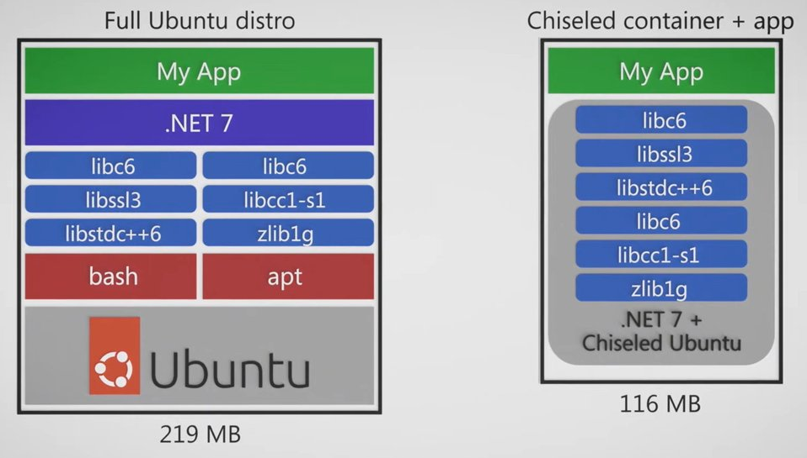
Deploying the app to Docker Container
Minimal OCI images: .NET in Chiseled Ubuntu containers
Distroless images = Bare minimum
Quicker to pull/start
More secure – no shell, no package manager, non-root user
UbuCon Asia 2022 | .NET Core development on Ubuntu 22.04
Notes:
Microsoft and Canonical announce native .NET availability in Ubuntu 22.04 hosts and containers | Ubuntu

Slide 59
Deploy ASP.NET Core app to Docker Container
// Creating the Dockerfile.chiseled
yeongseon@vm-ubuntu:~/RazorPagesApp$ cat Dockerfile.chiseled
FROM mcr.microsoft.com/dotnet/sdk:6.0 AS build-env
WORKDIR /App
# Copy everything
COPY . ./
# Restore as distinct layers
RUN dotnet restore
# Build and publish a release
RUN dotnet publish -c Release -o out
# Build runtime image
FROM mcr.microsoft.com/dotnet/nightly/runtime:6.0-jammy-chiseledWORKDIR /App
COPY --from=build-env /App/out .0
ENTRYPOINT ["dotnet", "RazorPagesApp.dll"]
UbuCon Asia 2022 | .NET Core development on Ubuntu 22.04
Notes:
https://learn.microsoft.com/en-us/dotnet/core/docker/build-container?tabs=linux

Slide 60
Deploy ASP.NET Core app to Docker Container
yeongseon@vm-ubuntu:~/RazorPagesApp$ sudo docker build -t razorpagesapp-image-chiseled -f Dockerfile.chiseled .
yeongseon@vm-ubuntu:~/RazorPagesApp$ sudo docker images
REPOSITORY TAG IMAGE ID CREATED SIZE
razorpagesapp-image-chiseled latest 2fde7f446bb4 16 seconds ago 92MB
razorpagesapp-image latest 7b2b6daa77ef 5 days ago 216MB
mcr.microsoft.com/dotnet/sdk 6.0 0ff04a23cb9e 11 days ago 737MB
mcr.microsoft.com/dotnet/aspnet 6.0 33a9c85ed2f6 11 days ago 208MB
UbuCon Asia 2022 | .NET Core development on Ubuntu 22.04
Notes:
https://learn.microsoft.com/en-us/dotnet/core/docker/build-container?tabs=linux

Slide 61
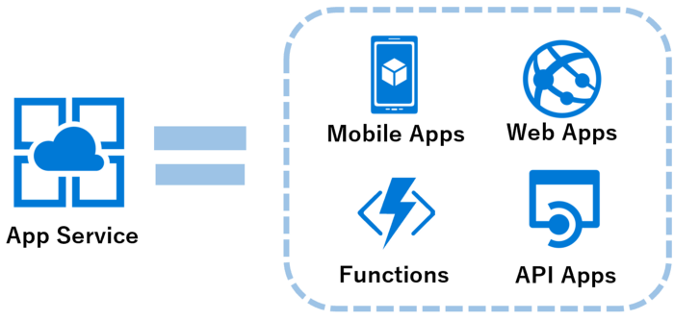
Deploy ASP.NET Core app to Azure App Service
Azure App Service
A Fully managed platform as a service (PaaS)
App Service on Linux
UbuCon Asia 2022 | .NET Core development on Ubuntu 22.04
Notes:
https://learn.microsoft.com/en-us/dotnet/core/docker/build-container?tabs=linux

Slide 62
Deploy ASP.NET Core app to Azure App Service
// Sign into Azure account
az login
// Deploy the code
Az web up –sku F1 –name <app-name> --os-type <os>
UbuCon Asia 2022 | .NET Core development on Ubuntu 22.04
Notes:
https://learn.microsoft.com/en-us/dotnet/core/docker/build-container?tabs=linux

Slide 63
Reference
https://learn.microsoft.com/en-us/dotnet/core/introduction
https://ubuntu.com/blog/install-dotnet-on-ubuntu
https://devblogs.microsoft.com/dotnet/dotnet-6-is-now-in-ubuntu-2204/
https://www.how2shout.com/linux/3-ways-to-install-net-6-dotnet-on-ubuntu-20-04-lts-focal-fossa/
ASP.NET Core fundamentals overview | Microsoft Learn
UbuCon Asia 2022 | .NET Core development on Ubuntu 22.04

Slide 64
Thank you!

