Slide 1
BIG DATA PROJECT
Part III
ANAND NIRANJAN
MONISHA NIHARIKA NAGA
REVATI DHANANJAYAN LALITHA
SRIHARISH RANGANATHAN
SWAMINATHAN TIRUNELVELI VIJAYARAGHAVAN
UDAYASRI SAI BUDDHI
VASUDEV RAMACHANDRAN

Slide 2








DATA COLLECTION PROCESS
HDFS
HDFS

Slide 3
DATA ACCURACY & DESCRIPTIVE STATISTICS
Accuracy of the data collected using our map-reduce function is 97 – 99%
Descriptive statistics of the data collected is
CATEGORY | MEAN | STD DEV | MAX
Patent Count | 1068 | 4234 | IBM - 59720
Revenue | 241.28 B | 410.11 | Walmart - 41330.64 B
Social Score | 0.35 | 0.6664 | Xerox Corp – 4/5
Corporate Score | 0.51 | 0.6382 | General Electric – 3.4/5
Employee Benefit | 0.509 | 0.6231 | P&G – 3/5

Slide 4
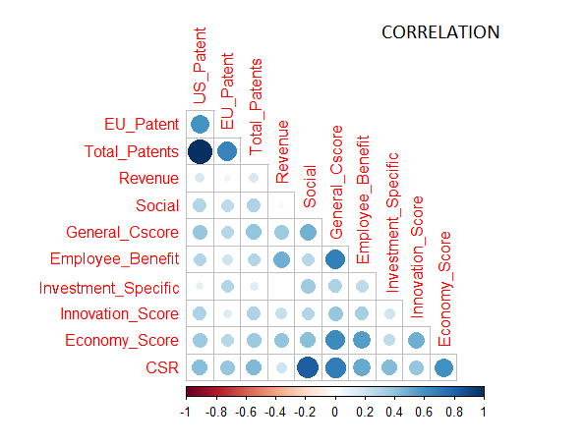
Relationships
Most of the patents are registered in the United States Patent and Trademark Office (USPTO).
Revenue had almost 60% impact based on Employee Benefits. Therefore taking care of employee increase a company’s revenue.
Since there is less relation between the social score and the revenue, it is very likely that the companies ignore the social responsibilities.

Slide 5
Relationships
REGRESSION
Patent count does not have a statistical significance in regression with the Revenue.
Social Scores have a negative impact in the Revenue, therefore companies might tend to avoid their social responsibilities.
Corporate Score, Innovation and Employee Benefit Score has a positive coefficient in the regression with the Revenue.
CLUSTER ANALYSIS
Financial sector companies show more responsibilities in social and corporate activities, therefore they yield good revenue.
Home Equipment and Furniture sectors are affected badly in revenue, due to their irresponsibility towards corporate and social deeds.

Slide 6
Relationships
CLUSTER ANALYSIS

Slide 7

IBM - HIGHEST PATENT COUNT
BUSINESS STRATEGIES
Cognitive Technologies like IBM Watson to perform most of the analysis.
One of the very few companies that uses hybrid cloud for managing their applications.
Developing new business solutions using their cognitive capabilities.
KEY TO SUCCESS
Constantly work on innovation and welcome new technologies.
They have a talented workforce, who adapts to latest technologies.
TOOLS USED
IBM SPSS Modeler
IBM Analytical Decision Management
IBM Social Media Analytics

Slide 8
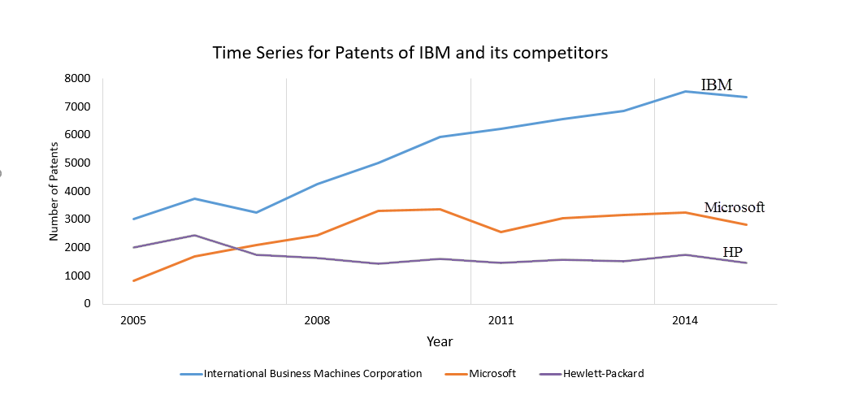
IBM - HIGHEST PATENT COUNT

Slide 9
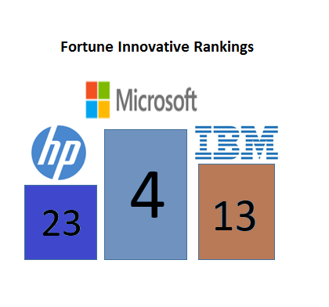
IBM - HIGHEST PATENT COUNT
IBM has a good CSR score when compared with its competitors, but they can improve their employee benefits and the relationship with its employee.
The word count in the IBM annual report suggest that they are talking more about innovation and analytics in the recent years.
Davenport and Harris score – 5, as they constantly involve in innovation and used data science and analytics to have an edge over their competitors.
Still they fall behind their competitors in Fortune Innovation rankings

Slide 10

IBM - HIGHEST PATENT COUNT
RECOMMENDATIONS
On an average IBM spends 6.17% of its revenue on research and development. While its competitor Microsoft spends 13.25%
Though they constantly involve in innovation and research, they should be aware of their competitors.
They can increase their investment in research 3-4% more than the current situation.

Slide 11

WALMART - HIGHEST REVENUE
BUSINESS STRATEGIES
Concentrate more on customer behavior analysis to improve their sales.
Also work on social media analysis to check how the customer feels about their products.
One of the pioneers in big data analytics, who started using it for their analysis from 2004.
KEY TO SUCCESS
Constantly work on social networking to know their customers better.
Strategy expansion and customer satisfaction being the main concern for them.
TOOLS USED
Social Genome
ShopyCat
Oneops

Slide 12
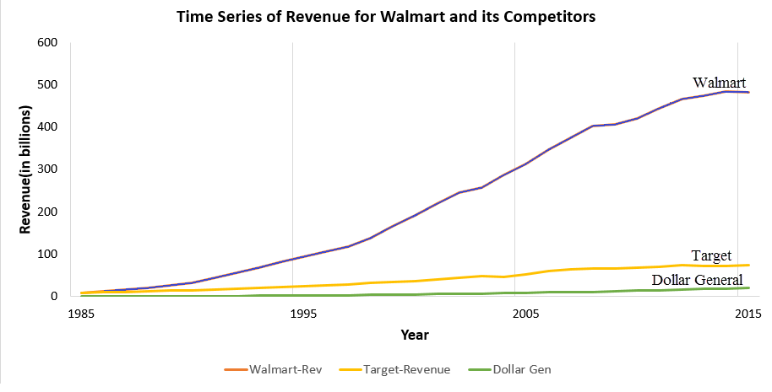
WALMART - HIGHEST REVENUE

Slide 13
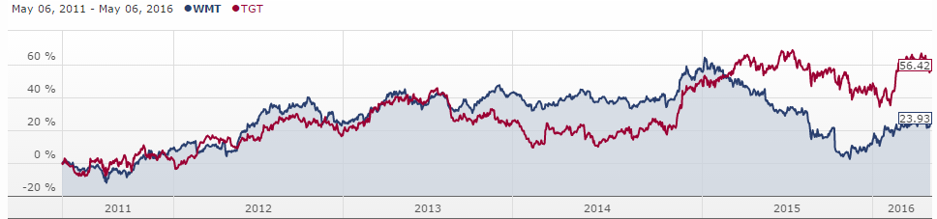


WALMART - HIGHEST REVENUE
Davenport and Harris score – 5, as they use data analysis and big data intensively to compete in the market.
The word count in the Walmart annual report suggest that they are talking more about analysis and customers in the previous three years.
But their stock price decreased very much in the past one year, when compared to its competitor – Target.

Slide 14
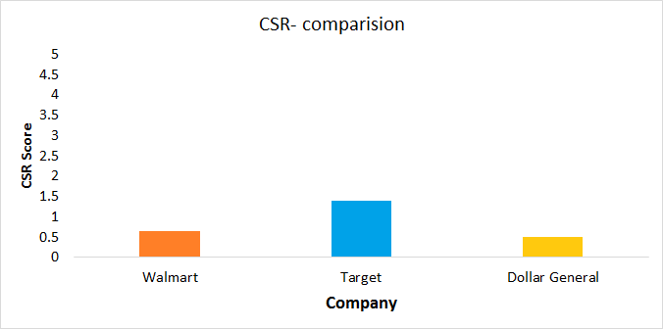
WALMART - HIGHEST REVENUE
RECOMMENDATIONS
Though it has achieved great heights in revenue, it is the responsibility of the management to maintain corporate and social responsibilities.
While comparing with Target, they can improve their CSR scores and similarly find a way to stabilize their stock price.
Considering the use of big data technologies for their analysis, they can continue to do their good work.

Slide 15

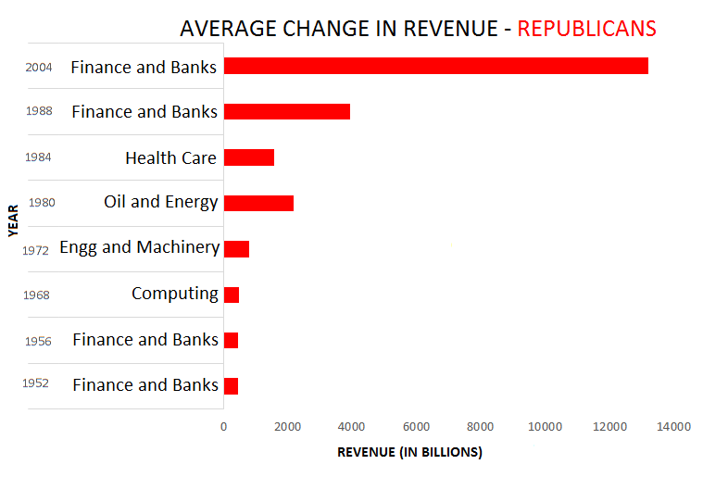
IMPACT OF US PRESIDENTIAL ELECTIONS - REPUBLICANS
EFFECT
While comparing the impact of election in revenue for the Fortune 500 companies during the republican’s period, Financial and Banking sector is benefitted.
There are other sectors like Health Care, Oil and Energy, Computing and Engineering sectors are also benefitted during some terms.

Slide 16

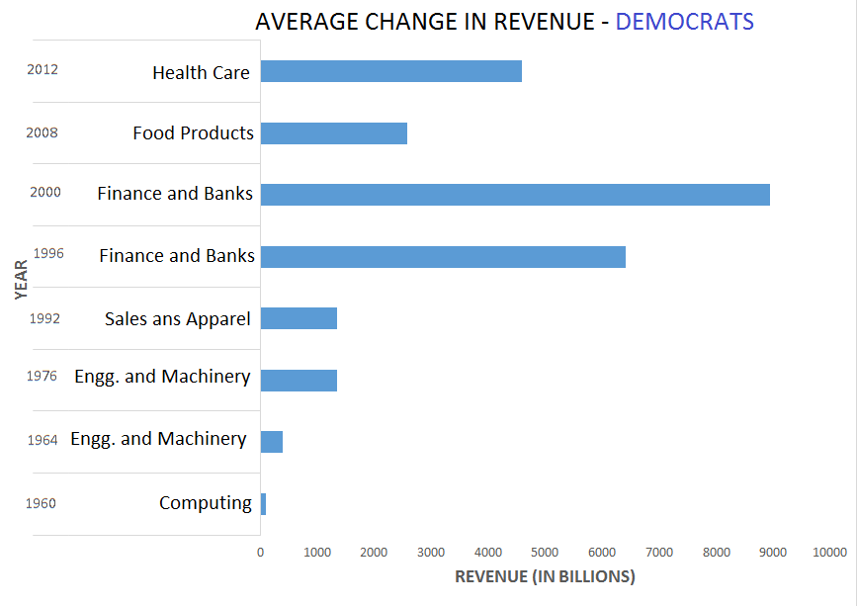
IMPACT OF US PRESIDENTIAL ELECTIONS - DEMOCRATS
EFFECT
While comparing the impact of election in revenue for the Fortune 500 companies during the democratic period, Financial and Banking and Engineering sectors are benefitted most of the times.
On Average though there is no sectors that benefitted always from the election in the previous 50 years, there are other sectors like Sales and Apparel, Computing sectors which are also benefitted during some terms.

Slide 17
IMPACT OF US PRESIDENTIAL ELECTIONS
FACTS FROM FINDINGS
While comparing the impact of election in revenue for the Fortune 500 companies during the republican and democratic periods, Financial and Banking sector are benefitted in general.
There are loyal contributors for republicans like Las Vegas Sands Corp, which have contributed 100% for the republicans for all the elections.
Sales sector will enjoy good profit during the Democratic ruling period.

Slide 18
LIMITATIONS AND CONCLUSION
The data collected had less relationships between them.
Some of the analytics techniques like factoring, associations did not much useful information .
Election has some influence on the revenue of certain type of firms, however it depends on other factors also.

Slide 19
THANK YOU!!
Any Questions ?

