Slide 1
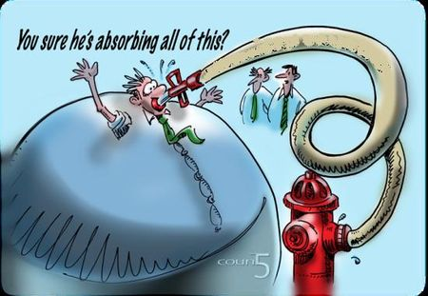

Slide 2


Slide 3
AR Billing
TSRCBIL/TSRRBIL/TSRSBIL – Which Should You Use?
Wes Brinkerhoff
SUU

Slide 4
Introduction
•In AR 8.5, TSRCBIL was split into two new and separate processes because its was getting too complicated
•TSRRBIL – Student Regular Bill (35 parameters)
•TSRSBIL – Student Schedule Bill (27 parameters)
•TSRCBIL will continue to exist for now but no new updates to it’s functionality will be implemented. Change requests and defects will only be resolved in the two new processes
•Purpose of this session is to compare the processes in order to better understand when to use one or the other.

Slide 5
Agenda
•New from the Old
•Run Modes
•TSRRBIL
oNew Features
oBill Sections
•TSRSBIL
oAdditional Bill Rule Parameters
oNew Features
oBill Sections
•Sleepwake vs NOSLEEP

Slide 6
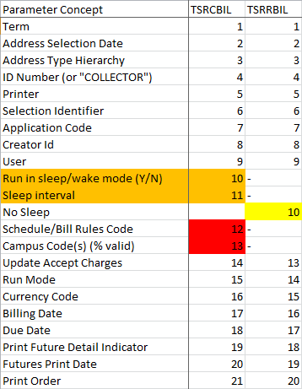
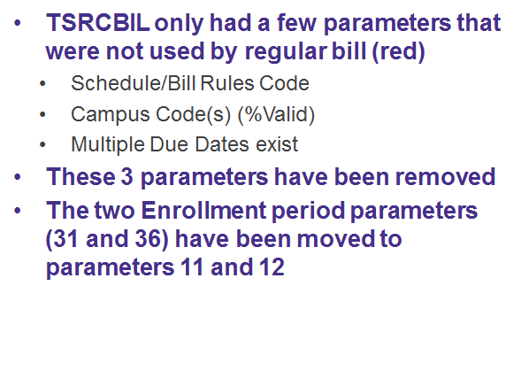
TSRRBIL

Slide 7
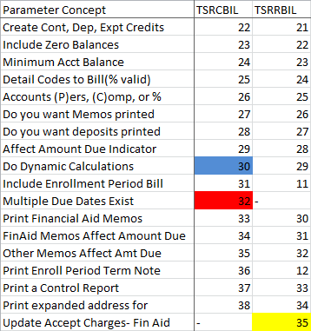
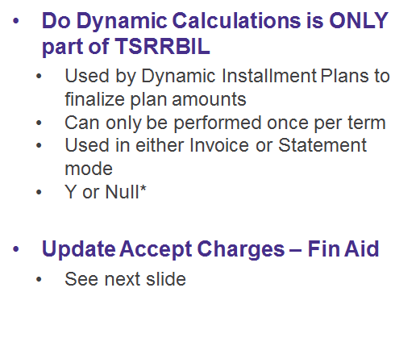
TSRRBIL

Slide 8
Run Modes
•TSRCBIL has 5 run modes for parm 15:
•APPLYCRED
•INVOICE
•STATEMENT
•SCHEDINV
•SCHEDSTMT
•TSRRBIL has 3 run modes for parm 14:
•APPLYCRED
•INVOICE
•STATEMENT
•TSRSBIL has 3 run modes for parm 14:
•APPLYCRED
•SCHEDINV
•SCHEDSTMT

Slide 9
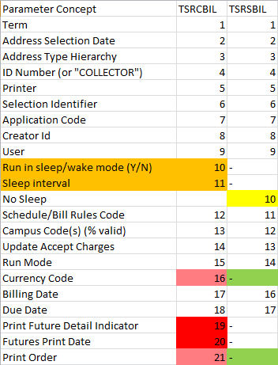
TSRSBIL
•TSRCBIL had many parameters that were not relevant to Schedule run modes but were required and had to be filled out.
•These parameters were not needed because most were included in TSASBRL rule options (pink/green)
•Some are not relevant to the Schedule Mode structure (red)
•Future Charges are always summarized
•No future date value is relevant
•Schedule Bill only includes students

Slide 10
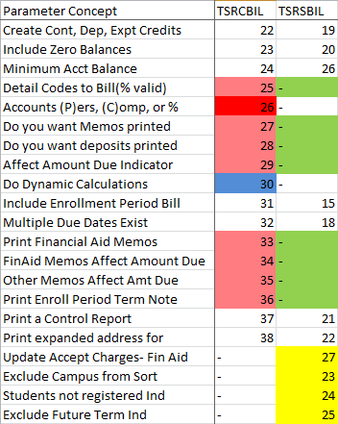
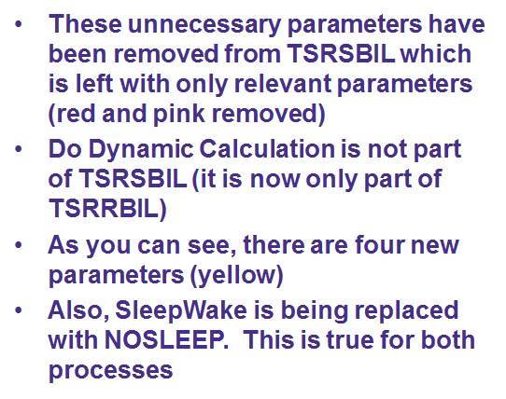
TSRSBIL

Slide 11
Sleepwake vs NOSLEEP
•Both only available in certain jobs
•Print output on demand without using Job Submission
•Uses Collector tables and SOADEST/TOADEST settings
•Sleepwake:
•System checks every XX seconds for output to print
•Only in TSRCBIL, not part of TSRRBIL/TSRSBIL
•NOSLEEP:
•Inverse of Sleepwake; as soon as collector table populated, NOSLEEP “wakes up” and prints request
•Only in TSRRBIL/TSRSBIL, not in TSRCBIL

Slide 12
Selection Mode
•There are four Selection Modes possible when running bills
•Individual Mode – parm 4 is ID numbers; parms 6-9 are empty
•Collector Mode – parm 4 is COLLECTOR; parms 6-9 are empty
•Pop Sel Mode – parms 6, 7, 8, and 9 are filled; parm 4 is blank
•Mass Mode – parms 4, 6, 7, 8, and 9 are empty
•You can also specify whether Person or Company accounts (or both) will be included using a job parameter (26/25/--)
•The selection mode determines whether Account Billable is observed (as noted on TSAACCT). Individual mode ignores Account Billable, all other modes observe Account Billable.
•Individual and Collector modes can ONLY be used with Invoice/SchedInv. If Statement and Individual mode requested the system will produce Invoice for the requested IDs instead.

Slide 13
Selection Mode
•Collector Mode
•Collector populated
oSFAREGS checkbox Print Bill
oTSAAREV Options: Request Invoice
oTSASPAY Options: Request Invoice (must be in Cashier Data block)
•Pop Sel Mode
•If a student is in the PopSel but does not meet the Schedule Bill Selection rules, a bill is still generated but will have either a blank schedule, blank charges/anticipated credits, or both blank.
•New TSRSBIL parm 24 can exclude these records so they don’t generate in SchedInv mode only

Slide 14
Run Mode: Invoicing
•Invoicing and Statement:
•Not Term Based
•TSRCBIL or TSRRBIL
•Optional messages defined on TGAMESG
•Only performs APPLYCRED based on parm (22/21/19) = Y
•Invoicing only:
•Not considered Update Mode
•If ApplyCred used produces Memos for C/E and deposits NOT released.
•Can run for an ID or Collector
•Generates a statement number sequence on TBBSTMT which is later deleted. This is why you will see gaps in numbers here.
•Header says Billing Invoice

Slide 15
Run Mode: Statement
•Invoicing and Statement:
•Not Term Based
•TSRCBIL or TSRRBIL
•Optional messages defined on TGAMESG
•Only performs APPLYCRED based on parm (22/21/19) = Y
•Statement only:
•Considered Update Mode
•Generates Invoice number for billed transactions
oThis is the only mode that generates Invoice Numbers
•Bill, Due, and Statement dates assigned to billed transactions
•Can not be run for an individual or from a collector table if so, will automatically revert to INVOICING
•Header says Billing Statement

Slide 16
Run Mode: SchedInv
•Schedinv and Schedstmt:
•Term Based
•TSRCBIL or TSRSBIL
oIgnores many TSRCBIL parameters using TSASBRL values instead
•Ability to include student schedule data with financial bill data
•Additional billing parameters defined on Schedule/Bill Rules form, TSASBRL
•Optional messages defined on TSASBRL (not TGAMESG)
•Does not produce Invoice numbers
•Only performs APPLYCRED based on parm (22/21/19)
•Schedinv only:
•Not considered Update Mode
•If ApplyCred used produces Memos, deposits NOT released.
•Can run for an ID or Collector
Generates a statement number sequence on TBBSTMT which is later deleted. This is why you will see gaps in numbers here

Slide 17
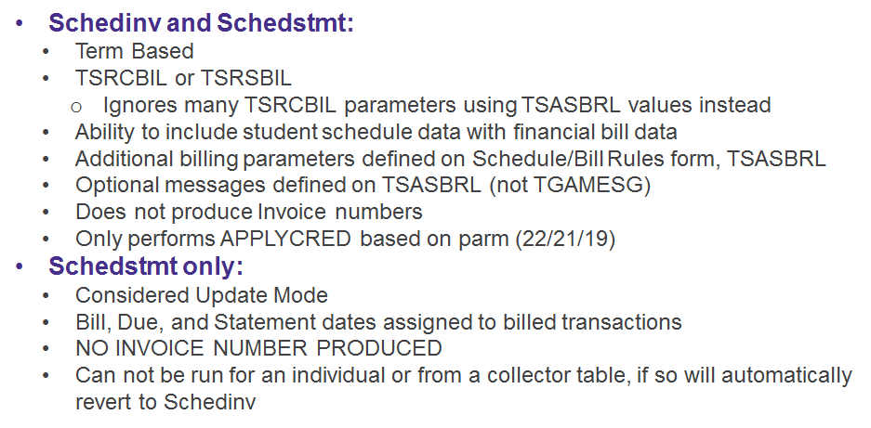
RUN MODE: SchedStmt

Slide 18
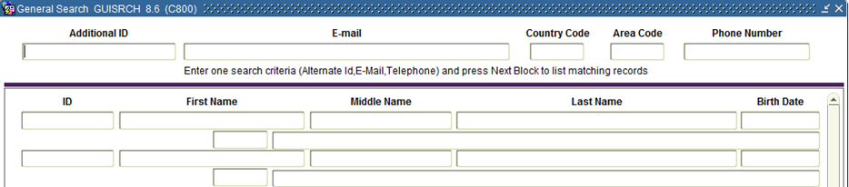
Bonus Tip
GUISRCH – look up an ID using email or telephone

Slide 19
Summary
•As of AR 8.5, no more updates will be performed on TSRCBIL
•TSRCBIL will be retired at some point in the future
•TSRRBIL includes all features of Regular Bill from TSRCBIL and a few new features
•TSRSBIL includes all features of Schedule Bill from TSRCBIL and a few new features
•You can choose to use one or both depending on your needs (summarized bill vs detailed bill)
•E-Bill works with both
•Sleepwake replaced with NOSLEEP in the new processes

Slide 20
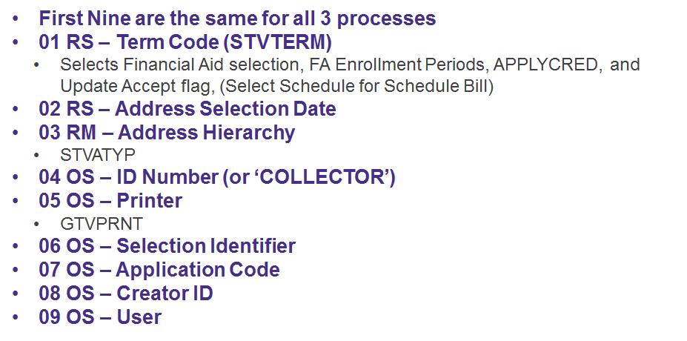
First Nine Parameters

Slide 21

Thank You

