Slide 1
Data Cookbook

Slide 2
Who is On the Call
Rachel Ruiz – Weber State University
Aaron Walker from iData
Susan Schaefer – University of Utah
Salt Lake City Community College Group

Slide 3
In the Beginning…
4 page detailed document for Definitions
5 page detailed document for Specifications
Too much, overwhelming and nothing was being done

Slide 4
Brochures
Individualized documents based on what a user is doing
Microsoft Word, tri-fold brochure
Short, concise and with lots of pictures

Slide 5

What is the Data Cookbook?

Slide 6
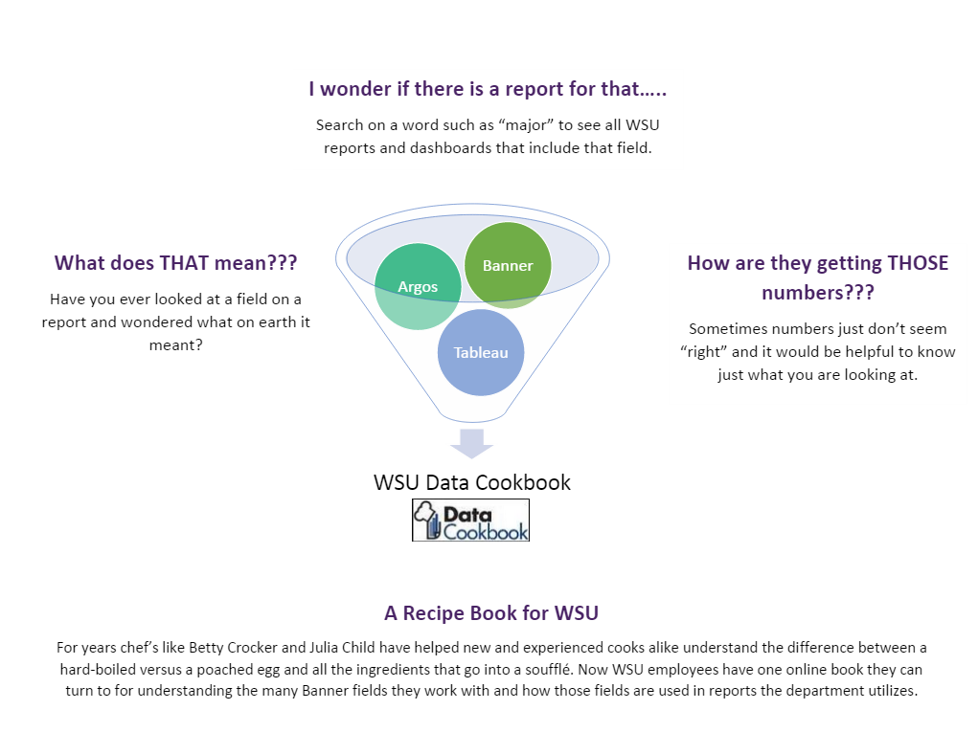
What is the Data Cookbook?

Slide 7
Brochures Created Thus Far
General Campus
What is the Data Cookbook?
End User Brochure for Definitions
End User Brochure for Specifications
Specific Users
Definition Cycle
Guide to Creating & Approving Definitions
Technical Definition Check-List
Vetting Checklist
Notes:
Currently working on entering specifications brochure and brining up the weber.edu/data site to store these on.

Slide 8
WSU Data Cookbook Style Guide

Slide 9
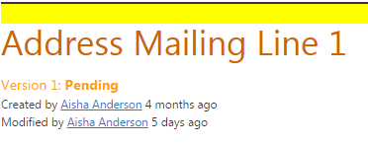
Definition Naming
1st Qualifier then additional qualifiers as needed
“ – “ looked nice between qualifiers, but created difficulties when adding definitions to the specification

Slide 10
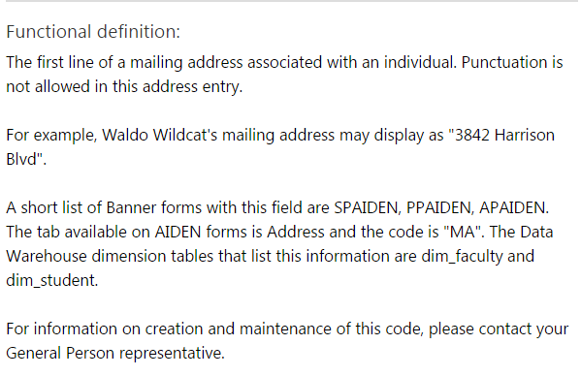
Order of Information
First paragraph: Written for the general public or someone who is not familiar with the terms being defined
Second paragraph: How the data will display on a report.
Third paragraph: Contains example information and slightly more technical information about the definition, such as other related terms.
Fourth paragraph: More technical description of the term being defined. This paragraph includes items like the Banner form and table names as well as the Data Warehouse fact and dimension tables in which the definition can be found.
Fifth paragraph: Comments regarding FERPA limitations if applicable and a contact department if there are further questions.

Slide 11
Style Considerations for Functional Definitions
No hyperlinks to other definitions are included in the first paragraph
Any time a specific technical example is referenced, include it in double quotation marks
Banner tables and forms are capitalized
If there are only 10 values or less for a definition, then those values will be listed.
Include information about the responsible area for making decisions about the underlying data.

Slide 12
Codes vs. Descriptions
Definitions of codes should be long and include as much information as needed to understand the details of the definition.
Definitions of descriptions should be brief and to the point; the description is explanatory in and of itself.

Slide 13
Style Considerations for Technical Definitions
Code should be provided for any data warehouse table listed in the functional definition.
Banner Code should mirror Data Warehouse code to show consistency in data
The Data Warehouse Source should include the system the data is being extracted from, then the schema, table and column names.

Slide 14
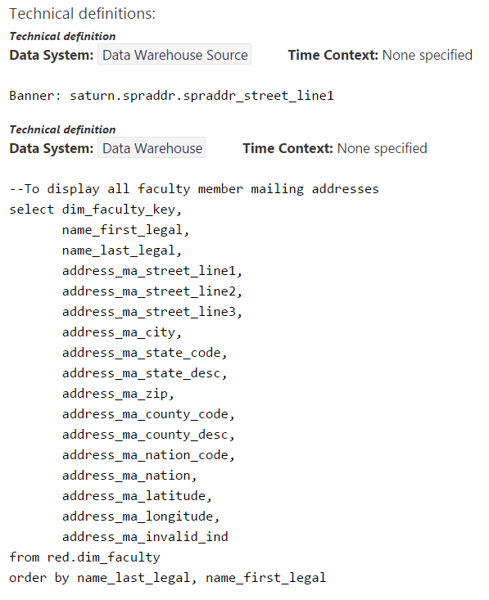
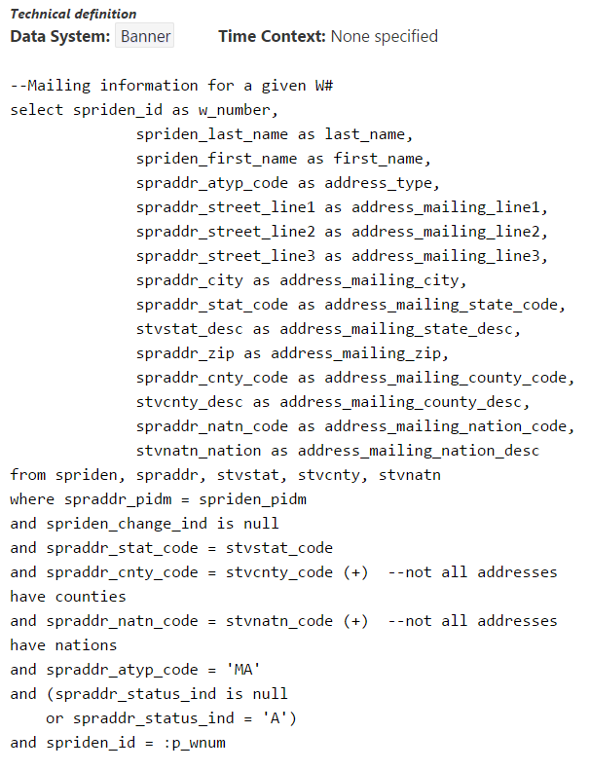
Technical Definition Example

Slide 15
Vetting Labels
Needs to be vetted
Term has been approved by appropriate subcommittee and data stewards and is ready to be presented for approval at Data Governance Committee.
Approved and Vetted
Term has been presented to and approve by Data Governance Committee; definition in DCB is considered correct.
Approved and Vetted -- Conditional
Term has been presented to Data Governance Committee; small changes to term were requested. Once corrections are made, term does not need to be re-vetted; notification is sent to committee members and email approval is granted.
Denied by Vetting
Term has been presented to Data Governance Committee; substantial changes or concerns were raised. Once corrections are made, term must be re-vetted.

Slide 16
Status Report
672 Definitions
106 State Definitions
566 University Definitions thus far
By Level of Progress (University Definitions)
24 Approved and Vetted
31 Ready to Vet
31 In Process with Moderators
500 Skeleton Entry

Slide 17
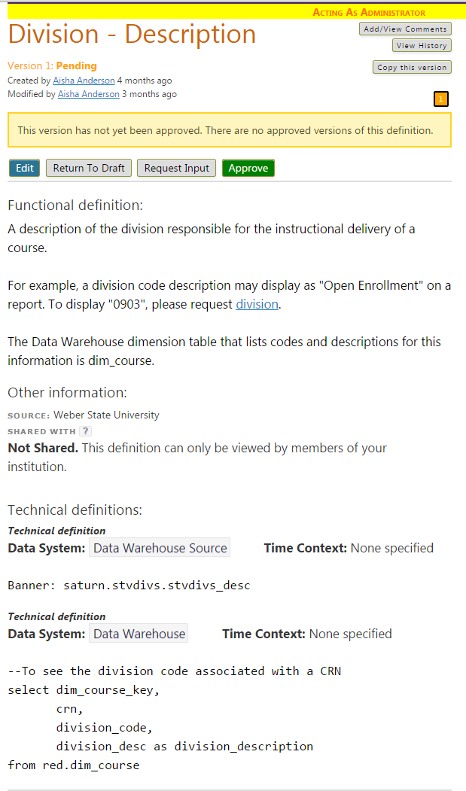
Skeleton Entry Example

Slide 18
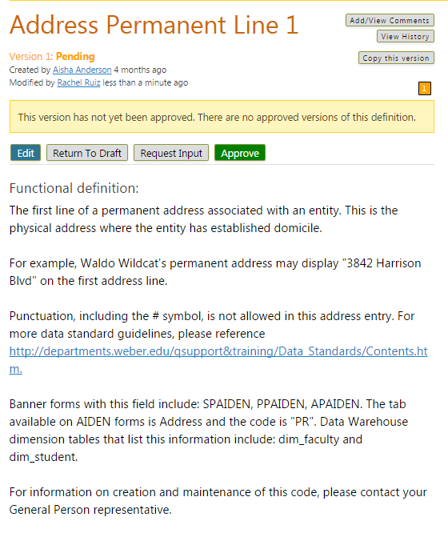
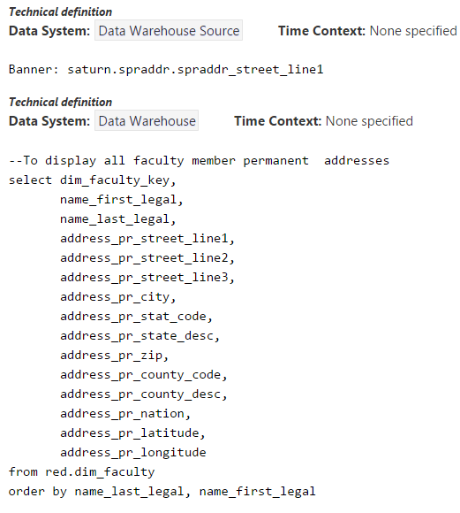
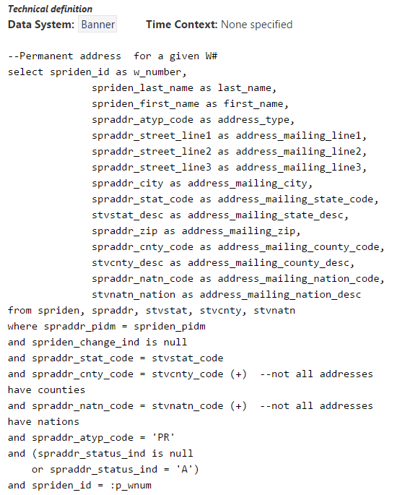
In Process with Moderators

Slide 19
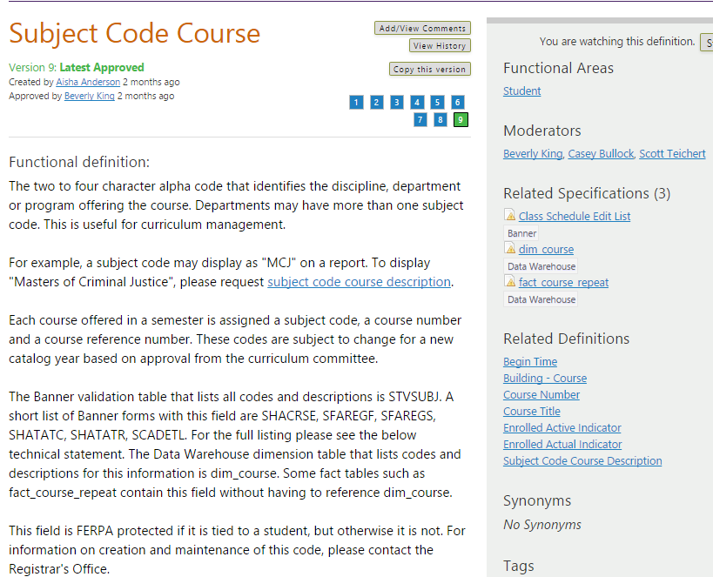
Approved & Ready to Vet
Notes:
Data stewards agree on functional definition and have reviewed/approved the data returned from the technical definitions

Slide 20
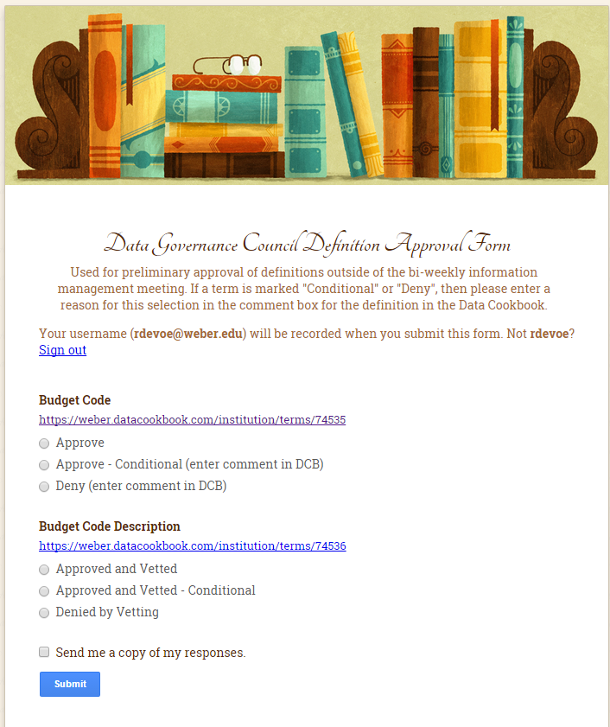
Definition Approval Form

Slide 21
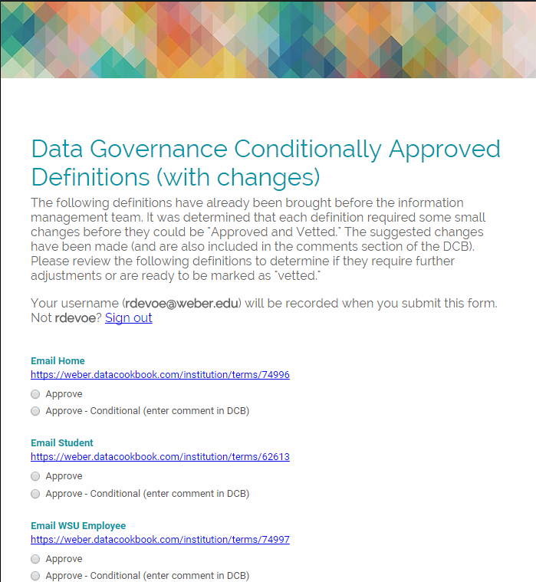
Conditionally Approved Definitions

Slide 22
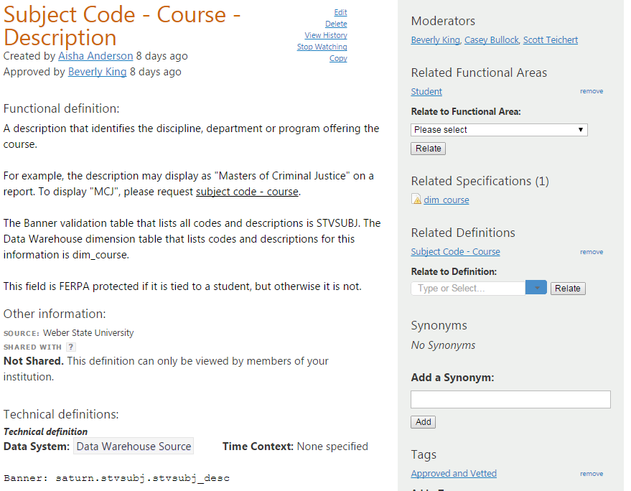
Approved and Vetted
Data Governance Council has reviewed and approved the definition.
Notes:
Data stewards agree on functional definition and have reviewed/approved the data returned from the technical definitions

Slide 23
Data Cookbook Links in Tableau

Slide 24
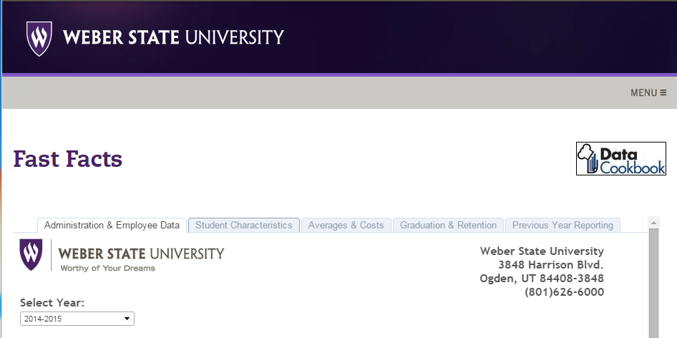
<span title="Click here to view the report details in the Data Cookbook"><a href="https://weber.datacookbook.com/institution/reports/8133/versions/9343/preview" style="font-family: Arial, Verdana, Helvetica, sans-serif;" target="_blank"><img alt="" src="https://apps.weber.edu/wsuimages/IR/report%20icons/report_definition.jpg" style="float:right; height:47px; width:129px" /></a></span>

Slide 25
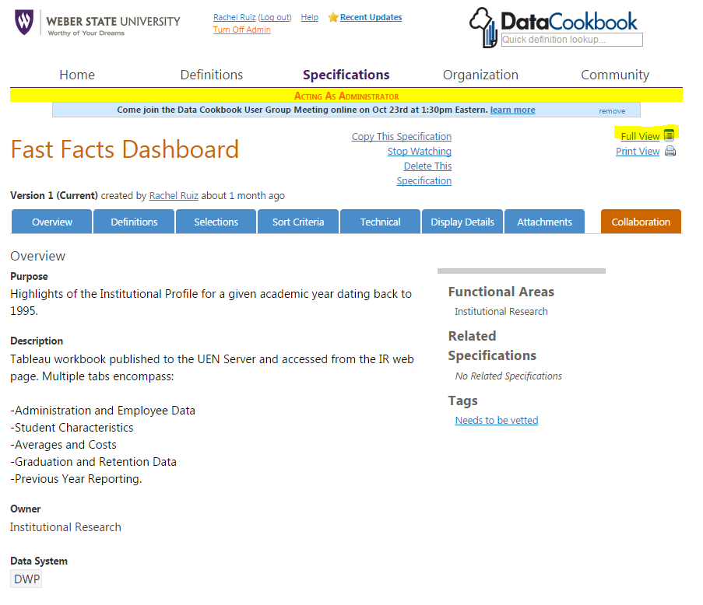

Slide 26
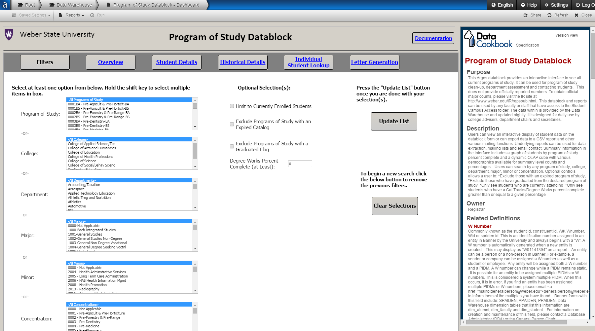
Argos API

Slide 27
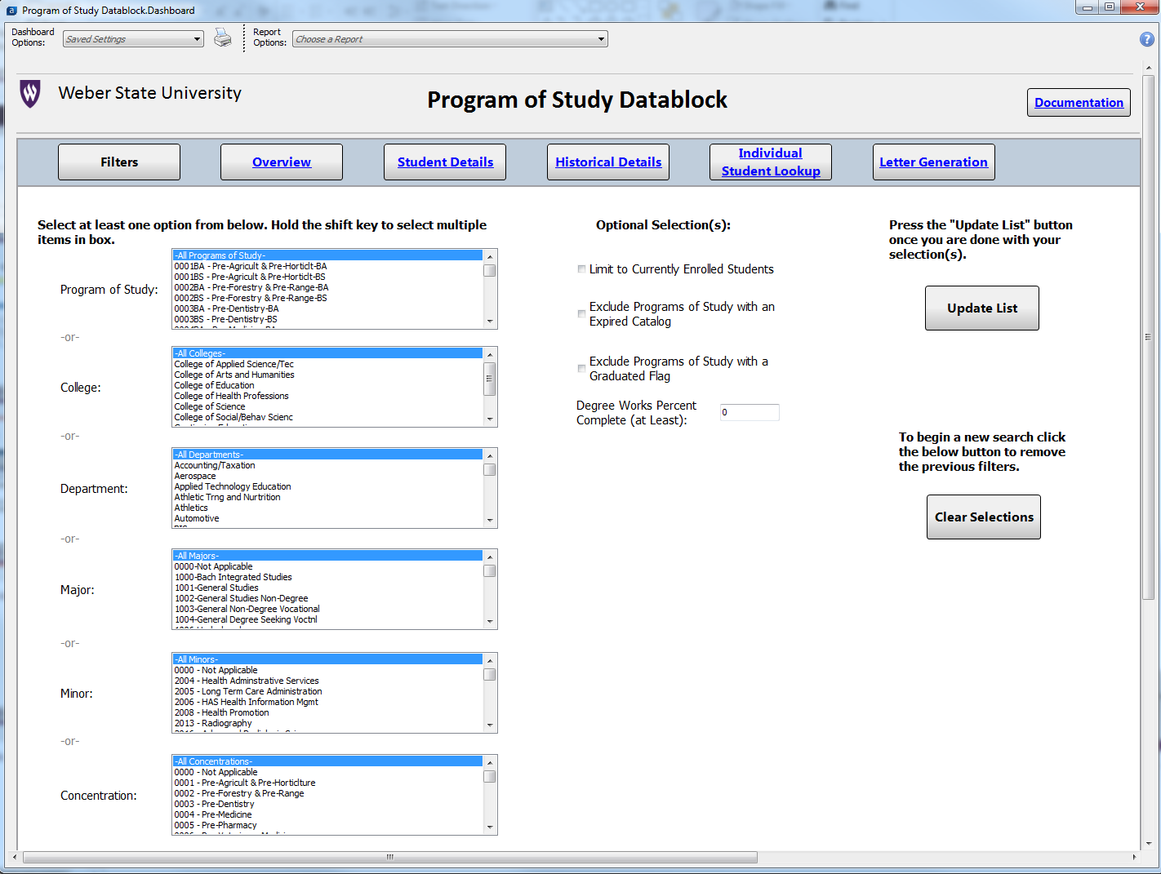
Argos Desktop View

Slide 28
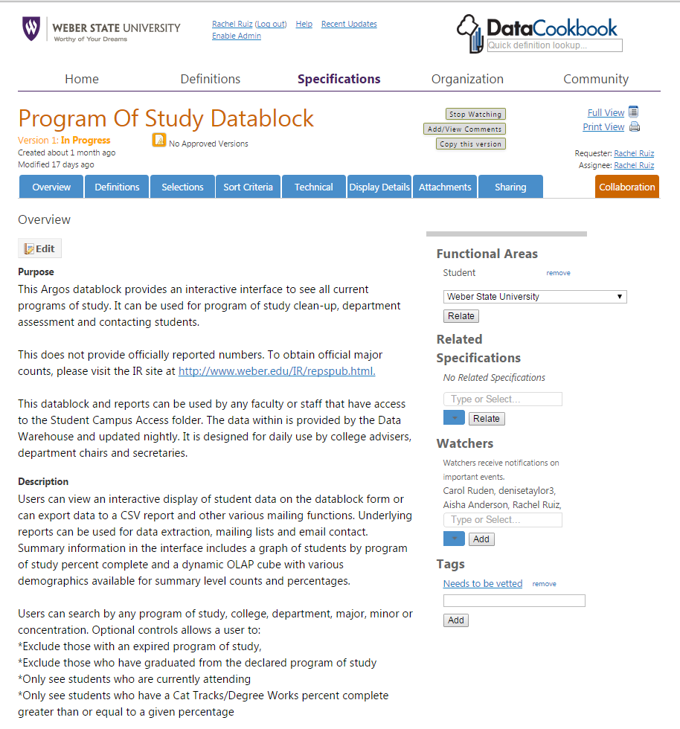
Specification – Full View

Slide 29
Future Goals
Specifications
Style Guide
Vetting Process
Documentation of Argos (In conjunction with Argos Clean-Up effort)

Slide 30
Contact Information
Rachel Ruiz Institutional Analyst Institutional Research Weber State University 801-626-6114 rdevoe@weber.edu
Site displayed: http://www.weber.edu/IR/repspub.html

