Slide 1
Banner XE Registration LIVE and in Production
Carl Ellsworth, Enterprise Data Operations

Slide 2
Why Registration XE? Why Now?
Banner 8 - Oracle pessimistic locking
USU specific issue of large bottleneck classes
Massive registration spikes due to student behavior during priority registration
Relationship with Ellucian as an Early Adopter

Slide 3
The Plan
Banner XE Registration into development instance as soon as possible
Through configuration and load testing, determine if it’s a better solution
Further split up time-slotting

Slide 4
Obstacles
Very hesitant administration and Registrar’s Office
Concerned for student experience – change is hard
Desire to run XE in tandem
(doesn’t address USU issues)
Change Management with no obvious champion

Slide 5
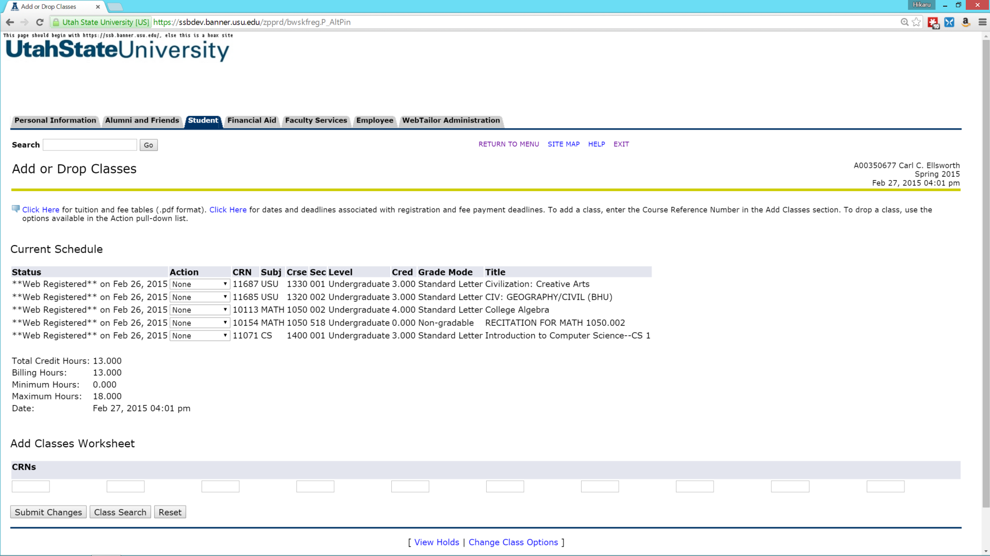

Slide 6
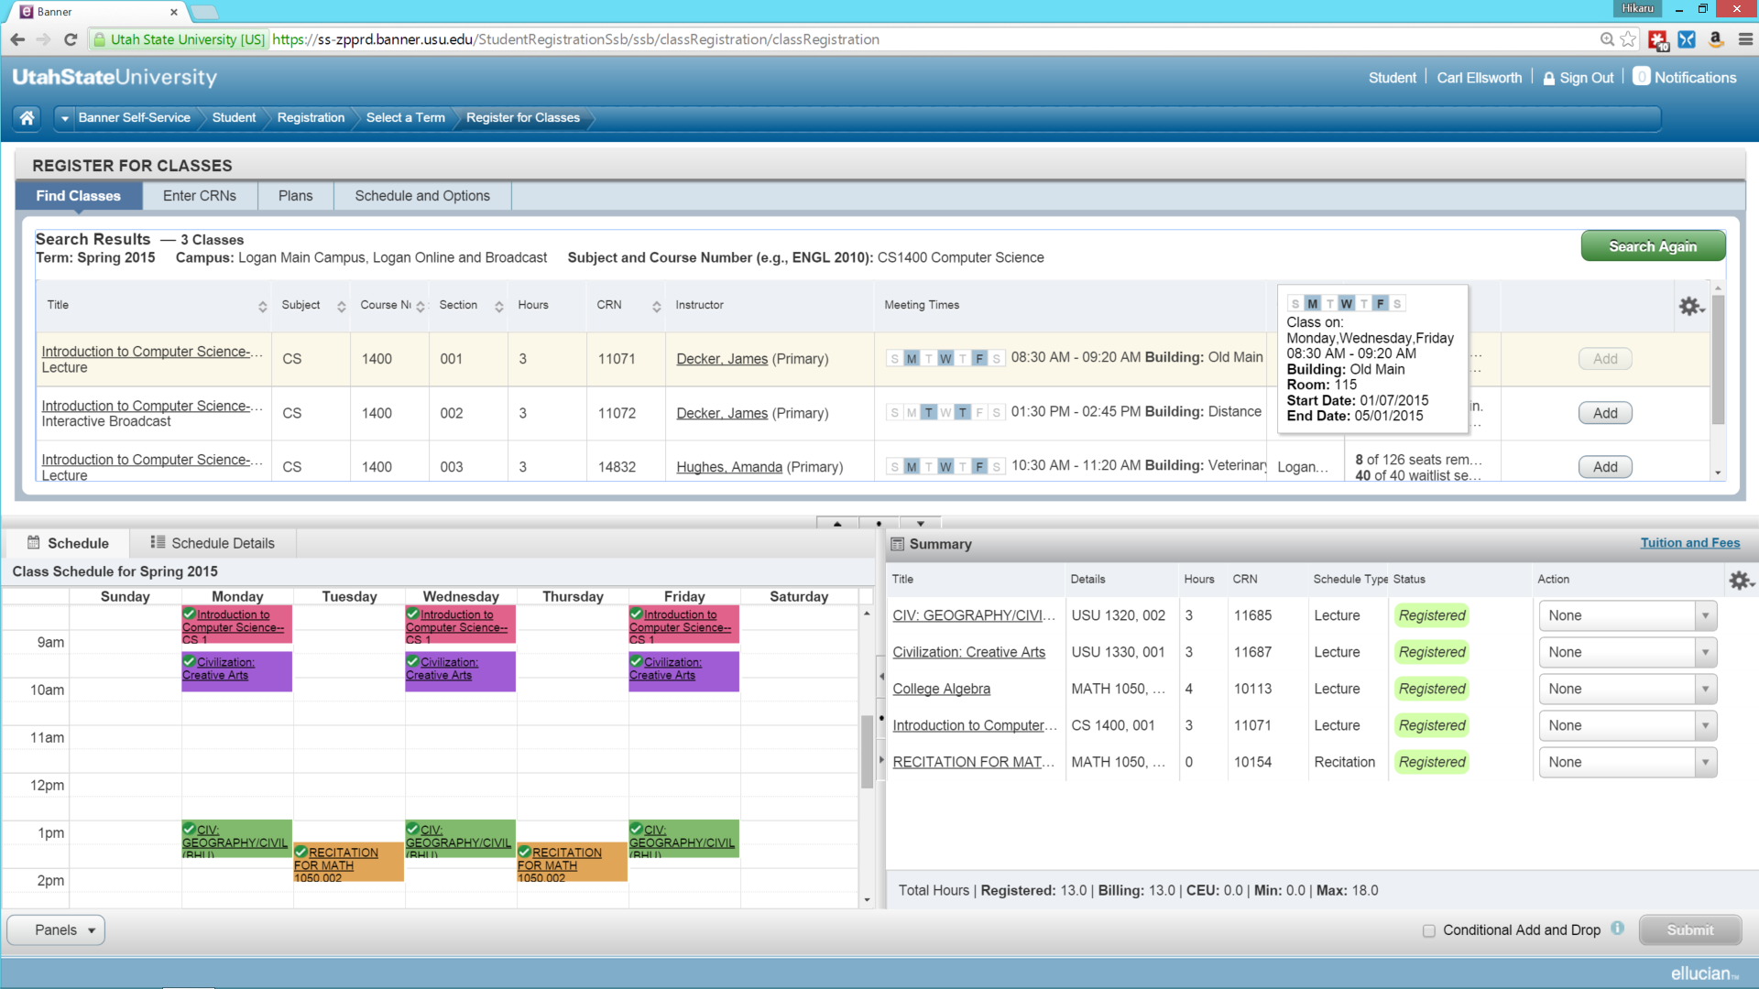

Slide 7
Success!
XE blew away Banner 8 in load testing, more on that in another session
Students themselves championed the system
Decided all or nothing on Registration XE
“Do, or do not. There is no try.” -Yoda
Multi-front advertising campaign and training

Slide 8
Demo
You’ve seen lots of Banner XE demo’s on fictitious data. Here’s the real thing, customized to a real university’s needs.

Slide 9
Lessons Learned
Instructional Method
Cross-listed Classes
Shopping cart mentality
Concurrent enrollment
GOBUMAP table – XE access
GUAPPRF – disable ‘forgot pin’ options
There is no SFAREGS

Slide 10
SOATERM - new entries for Banner XE
Self-service Options
allow students to select conditional add drop
Self-Service Planning
all the options to enable registration plans, had to leave third party degree audits disabled due to incompatible version of Degreeworks
Class Options Change Controls
Change Credit Hours - needed for variable credit hour classes

Slide 11
SOAWSCR
must be changed for EACH persona
decided to put default settings at beginning of time 000000)
1000 - Landing Page
10 - Class Search Basic
20 - Class Search Advanced
30 - Class Search Results
100 - Class Details Popup
150 - Faculty Card Popup

Slide 12
Resources
https://usu.service-now.com/services/kb_view.do?sysparm_article=KB0013129 public knowledge base article with Registration Training Videos
http://www.usu.edu/radio/index.php/7-tips-for-using-the-new-usu-registration-system/ student-written article giving tips and tricks for Banner XE

Slide 13
Because Students are Hilarious
http://www.usu.edu/radio/index.php/10-best-reactions-to-the-new-registration-system/

Slide 14


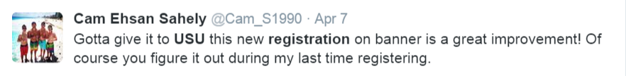
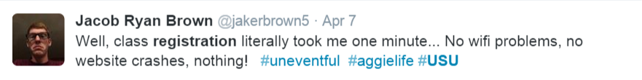
Thank You!

