Slide 1
SSID and Banner
Carl Ellsworth, Enterprise Data Operations

Slide 2

SSID – for techies
SSID = Statewide Student Identifier
(for a more complete definition, talk to someone in admissions/concurrent Enrollment)
For our purposes, the SSID is a unique identifier that USOE keeps secret and takes very seriously

Slide 3
Why do we need the SSID?
Proper identification of high school students in college classes
Don’t know specifics, but funding for concurrent enrollment requires SSID

Slide 4
Two Options
SPAIDEN - Alternate ID Tab
Utilizes same table space as SPRIDEN
SPAIDEN - Additional ID Tab
Utilizes GORADID

Slide 5
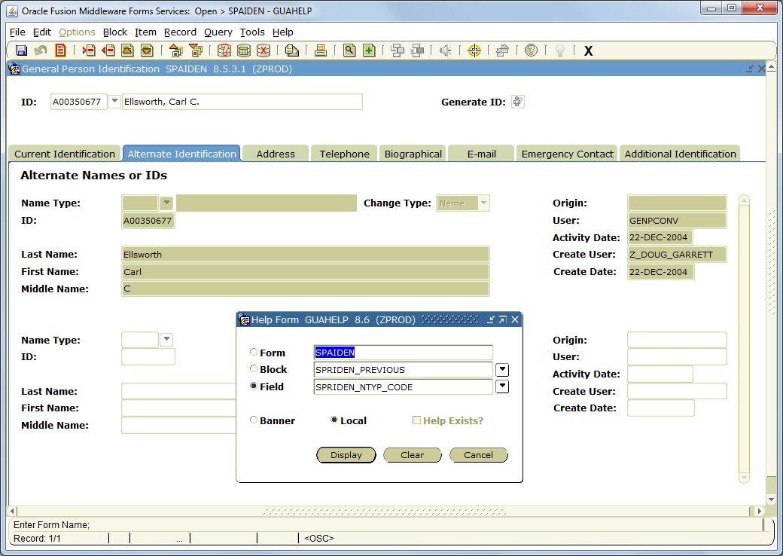

Slide 6
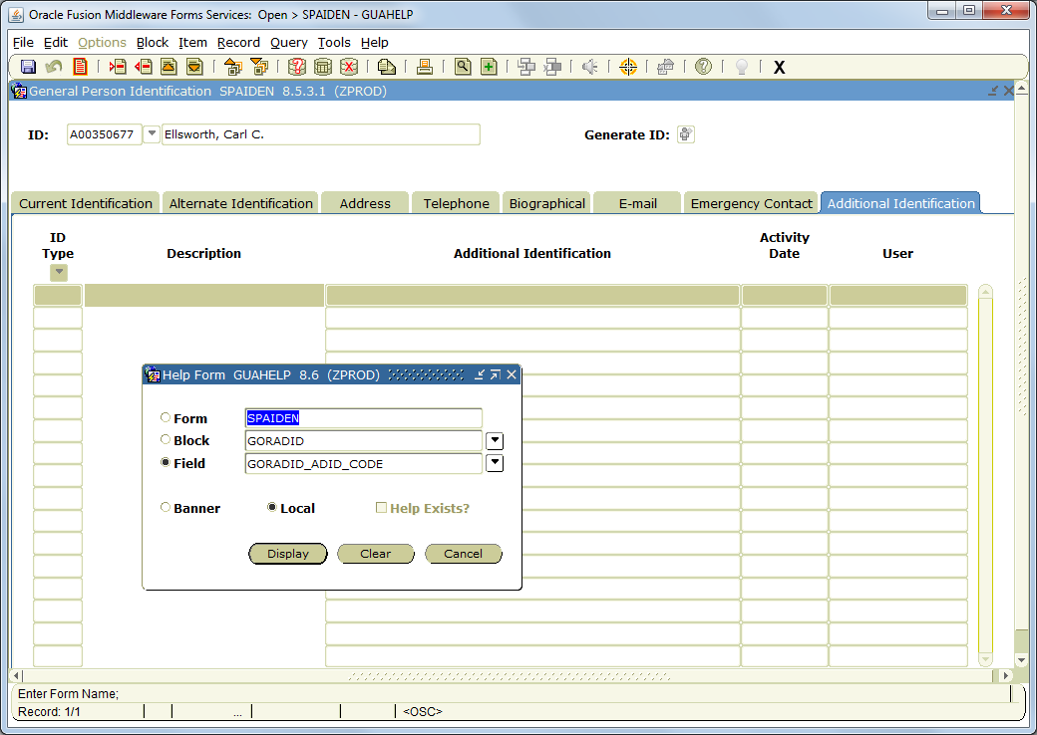

Slide 7
Original Idea
By utilizing SPRIDEN, SSID becomes an ID that can be typed into most Banner forms
Seemed logical..

Slide 8
…or so we though
Problem is in practice, no student knew their SSID
In fact, when asked, most students provided their ‘milk money’ pin
Also presented a technical issue with Banner
All subsequent SPRIDEN updates maintained the SPRIDEN_NTYP_CODE, producing potential false positives
As common matching ultimately creates SPRIDEN records with new IDs, can’t use SSID in any matching rule

Slide 9
mo-better idea™ GORADID
USU converted all SSIDs from Alternate IDs to Additional IDs (no small task)
As Additional IDs, can be used for common matching (imagine digital high school transcripts!)
Also eliminated SPRIDEN data integrity issues

Slide 10
Getting SSID into Banner
USOE API
Contact:
Robert Nicholson
IT Programmer / Analyst
Utah State Office of Education
Robert.Nicholson@schools.utah.gov
801.538.7931

Slide 11
A note on the Web Service
Only two error messages:
400 – Bad Request. This error code has various possible meanings. The response body will contain more information. A possible situation would be that there are multiple SSID numbers associated with the given attributes. In this case it is impossible for USOE to determine which SSID number is correct. Another possible reason for this error is that the arguments for the request are in the incorrect order, or are missing.
404 – Not found. This error code is generic in that it could mean that an SSID could not be found using the given parameters. It could also mean that the USHE institution is not using a valid API key or that the IP address that is being used by the USHE institution has changed, and USOE has not updated their system with the new address.

Slide 12
FERPA

Slide 13
We have a package for you!
baninst1.z_ssid_interface
Does all the heavy lifting for you
Global variables where you need to input the values for your system
Available through GitHub
RuinExplorer/z_ssid_interface

Slide 14
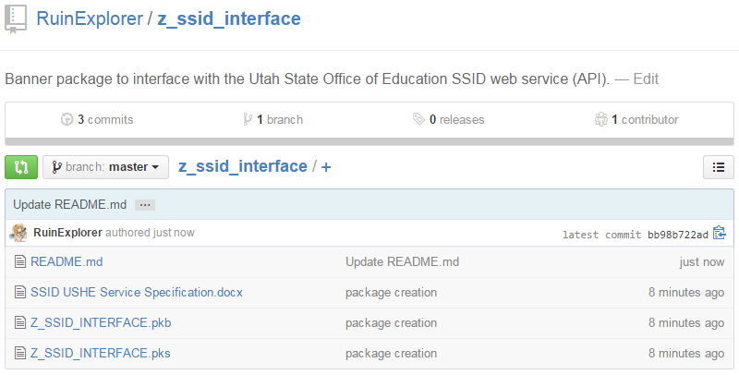

Slide 15
Random Tidbits
State supplied dummy records:
Id_number: 1, last_name: Student, first_name: Test, birth date: 1994-01-01, Gender: M
Id_number: 1858768, last_name: Student, first_name: Test, birth date: 1994-01-01, Gender: M
Id_number: 9490708, last_name: Student, first_name: Test, birth date: 2002-01-01, Gender: M

Slide 16
Thank You!

