Slide 1
Everyone Can Add
Automating Add Fees for All Presented by: Denise Vandevanter
Utah Valley University

Slide 2
Agenda
Decision to Automate
Planning
The Process
Utilizing Supplemental Data Engine
API’s and Packages

Slide 3
Decision to Automate

Slide 4
Utah Valley University Late Registration Old Process (Simplified)
Student requests late registration
Instructor signs add card
Student takes add card to department
Department stamps add card
Student takes add card to One-stop
One Stop registers student
If registration is not completed before late registration closes, petition must be used.
The instructor may or may not check pre-requisites.
The instructor may or may not check class size limits.
The role of the person that stamps add cards varies from department to department.
Once stamped, the add card becomes an automatic pass into the class.
The person stamping the add card may not be familiar with instructor signatures.
Students are asked to submit the add card to One Stop within 7 days of having it signed and stamped. Not all students do this.
Students can add classes to the card once it has been stamped, or change the add card.
The fees are collected at time of registration.
Department checks pre-requisites and class size limits
Departments may or may not check pre-requisites or class size limits. That will usually depend upon the role of the person stamping the add card.
Students can get blank add cards from One Stop or their advisor and may forge instructor signatures.
The fees have been waived for various reasons, not just administrative error or request.

Slide 5
System broken
Forged signatures on Add Cards
Instructors not realizing they can say no
Pre-requisites not being checked
Class room size not being checked
Adding late became the norm not the exception
Many more problems

Slide 6
Decision to Automate
The Academic Affairs Council determined improvements were needed for late registration
A task force formed to examine the issue and make recommendations
Lead by Laura Busby, Director - Academic IT & Analytics
Composed of representatives from Academic Affairs, Enrollment Management, the Bursar’s Office, and Academic Advisement

Slide 7
Planning

Slide 8
Task Force
Goals
Reduce attrition / increase course retention and student success
Encourage students to be more thoughtful about planning
Reaffirm department authority on pre-requisite requirements and late registrations
Starting point
Reviewed Banner documentation
Spoke other colleges and universities

Slide 9
Banner Review
Features of the Banner Student Module were examined by the task force as the first option to implement this process
The fee assessment rules found on SFARGFE were thought to use the class section add date found in the table SFRSTCR
Preliminary testing confirmed this but further testing proved SFARGFE rules did not work as previously thought
Help was sought from Ellucian Support
The registration dates in SFARGFE rules do not point to the class section add date
They point to the first date a student registers for a course in a semester

Slide 10
Task Force Key Recommendations
Implement Wait List
Continue current Late Registration dates
Enforce last date to register for classes
Charge a two-tiered fee:
A smaller amount ($10) per course until third week of class for full semester classes; relative time period for all other parts of term
An increased amount ($30) per course during third week of class

Slide 11
Task Force Key Recommendations
Reaffirm department authority to accept late registrations during late registration period and enforce prerequisites
Cannot override class size limits but may request an increase to the max enrollment number, if the room allows it
Provide standard exceptions to late registration fees during first late registration period
Individualized and performance classes
Implement for the Fall 2013 semester

Slide 12
Recommendation for Late Registration UVU Proposed Process – Fall 2013
Student requests late registration
Instructor sends e-mail to department
Department enters late registration override
Student registers online
Instructor may consider pre-requisite override requests, depending upon department procedure.
Instructor will list student name, UV ID and course information, including CRN, course and class section in the request.
Department may approve or deny pre-requisite override requests, dependent upon procedure.
Banner will check for pre-requisites if no override entered.
Banner only allow the student to register for the class section entered on the late registration override.
Late registration fees assessed.

Slide 13
The Process

Slide 14
The Process
Student request to add the course from the instructor
If approved, instructor the forwards to the department
The department reviews the request and sends student an email informing them of the approval or denial
If approved, an override is placed on SFASRPO
Student registers for course online
Late fee added to student account

Slide 15
Process Flow
First Late Registration Period
Student requests late registration
Instructor sends e-mail to department
Department enters late registration override
Student registers online
$10 Fee is added to student account

Slide 16
Process Flow
Second Late Registration Period
Student obtains late registration exception form from dept and fills out their portion
Instructor reviews the form, and if approved, submits to the department.
Department Chair reviews request, and if approved, enters the department override, then submits the form to the dean's office
Dean's office reviews request, and if approved, submits to the Registrar's office for processing
Registrar's office registers the student for the class. The $30 fee is added to the student's account

Slide 17
Banner Setup
Required for each term
Enter or confirm entries for standard instructional method included in the $10 add fee period
Control late registration exemptions granted by the Sr. VPAA and the Academic Affairs Council
Enter or confirm entries for subject code exceptions to the $10 fee
Control late registration exceptions granted by the Sr. VPAA and the Dean

Slide 18
Banner Setup
Create new term control entries for each term, part of term (excluding high school concurrent enrollment parts of term), and fee amount combination
Controls:
When “LR” class section department approval codes added to SSASECT
When fees are inserted in student accounts

Slide 19
Automated Banner Process
Ran
Procedures run (just after midnight) to perform the following processes
Apply the “LR” Department Approval Code to class sections
Insert late registration fees on student accounts for the previous day
Remove the “LR” Department Approval Code from class sections in future terms (terms that have been rolled from a copy of a previous term)
Output files are e-mailed after the process completes nightly for current term

Slide 20
Fall 2013 Results
Full term classes show a 4.4% decline in registrations compared to Fall 2012
Late registrations for full term classes down 54%
About 2% more registrations occurred before or during the first week of class
There were 13% fewer unique students registered in full term classes this semester
Only 5.17% of students registered for at least one class late, as compared to 9.62% for Fall 2012

Slide 21
Issues
Communication
Faculty and dean’s staff members
Added workload for departments
Increase in Advisor workload for pre-requisite checking
Some faculty not willing to initiate request
Enrollment Management
Departments used previous add cards to manage class attrition
Fees
Expectation to waive fees with no justification or approval
Some departments felt the $30 fee was too high

Slide 22
Utilizing Supplemental Data Engine

Slide 23
Supplemental Data Engine
No customization of Banner forms or tables is needed with SDE
Not impacted by Banner upgrades
Accessed through the lightbulb icon on INB toolbar
Clicking icon opens Supplemental Data Window
FAQ 1-3DHGG0 - Quick steps to implement SDE - Supplemental Data Engine

Slide 24
SDE Setup
SDE Forms
STVSUBJ -subject code exceptions to the $10 fee
Add Fee Exclusion
GTVINSM - instructional method exemptions to the $10 fee
Include Add Fee Indicator
SOBPTRM - term control entries for each term, part of term
Dates and Amount Setup

Slide 25
SDE Forms
GTVSDTB
Table Name
GOADISC
Supplemental Data Discriminators
GOASDMD
Attributes Definitions

Slide 26
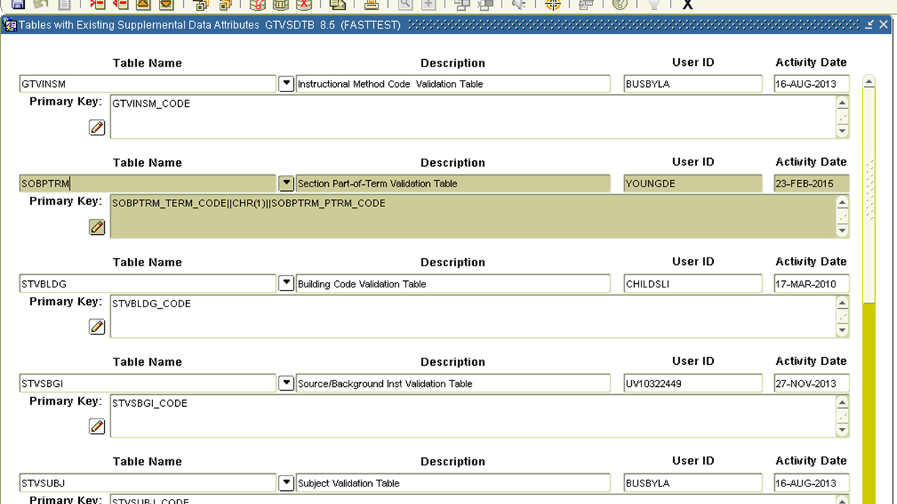
GTVSDTB

Slide 27
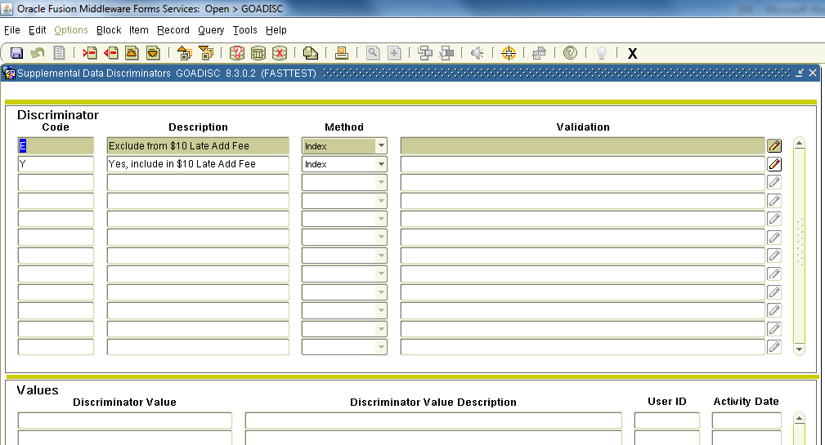
GOADISC

Slide 28
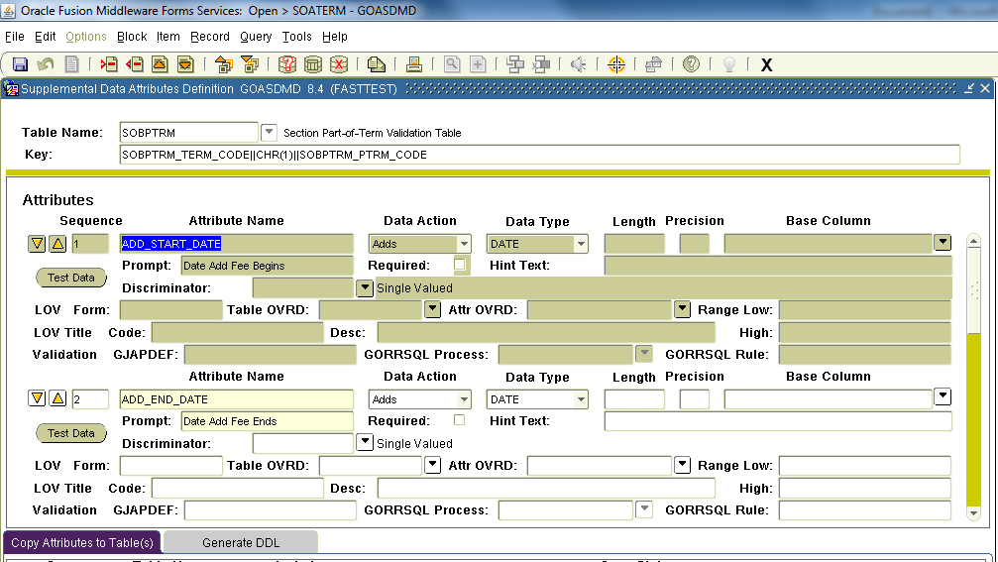
GOASDMD

Slide 29
STVSUBJ
Exclude Add Fees for certain subjects
Only charge add fees during late add fee period
SDE Steps
Add STVSUBJ to GTVSDTB
Add Discriminator Code to GOADISC
Code: E,
Description: Exclude from $10 Late Add Fee
Method: Index
Add Attribute to GOASDMD
Attribute Name: ADD_FEE_EXCLUSION
Data Action: Adds
Data Type: VARCHAR2
Base Column: STVSUBJ_CODE
Prompt: E-Exclude from $10 Late Add Fee
Hint Text: Enter E to exclude from $10 Late Add Fee
Discriminator: E

Slide 30
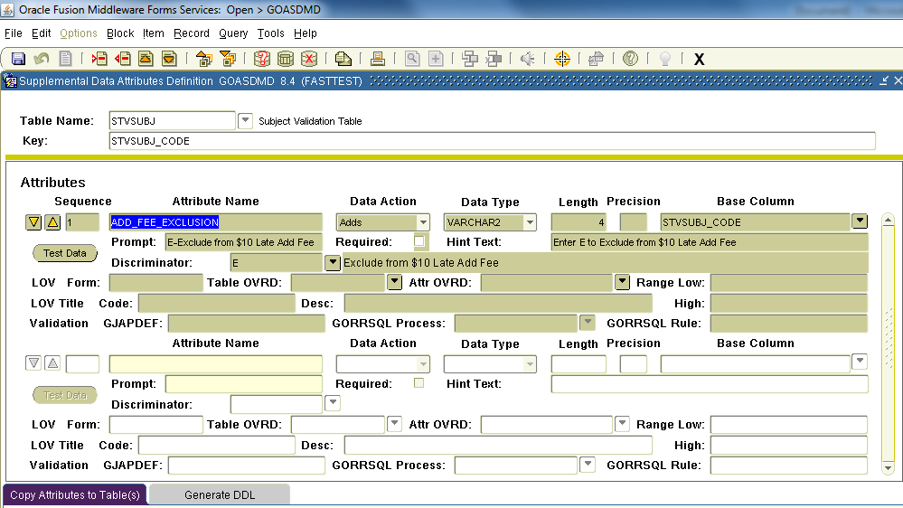
STVSUBJ

Slide 31
STVSUBJ Data
Add E to STVSUBJ for selected subjects
Select Subject on STVSUBJ form that you want excluded
Click on lightbulb icon on STVSUBJ Form
Enter E in Supplemental Data Window and save

Slide 32
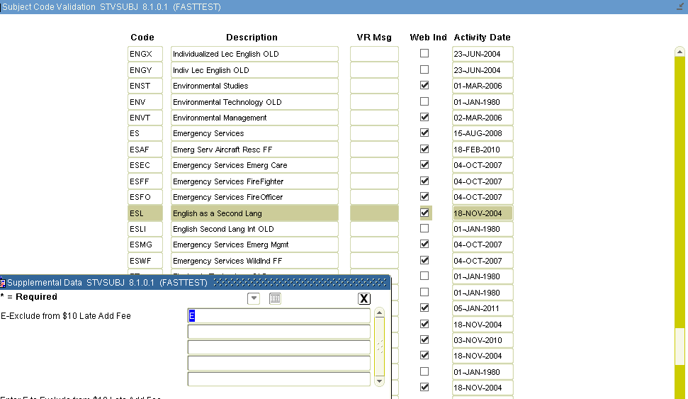
STVSUBJ Data

Slide 33
GTVINSM
Include Add Fees for certain instructional methods
Selected instructional methods only charged during early add fee period.
SDE Steps
Add GTVINSM to GTVSDTB
Add Discriminator Code to GOADISC
Code: Y,
Description: Yes, include in $10 Late Add Fee
Method: Index
Add Attribute to GOASDMD
Attribute Name: GTVINSM_ADD_FEE_IND
Data Action: Adds
Data Type: VARCHAR2
Base Column: GTVINSM_CODE
Prompt: Include Add Fee Indicator
Hint Text: Enter Y for Instructional Method to be included in $10 Late Add Fee
Discriminator: Y

Slide 34
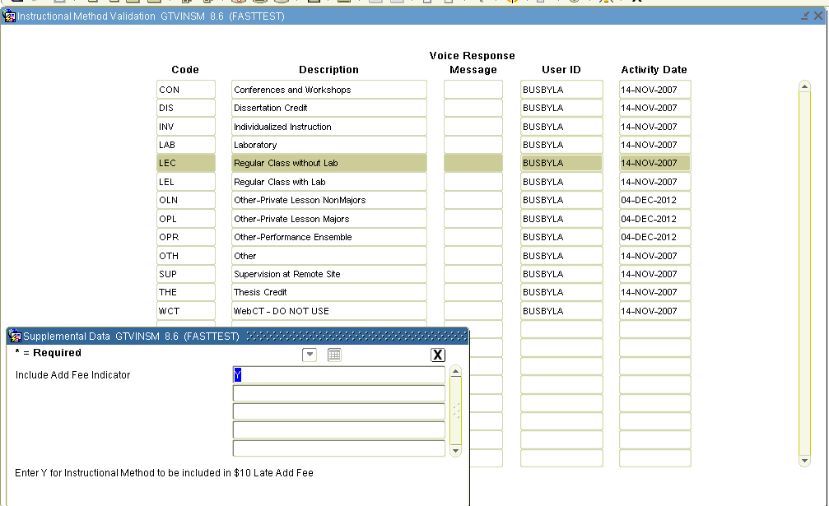
GTVINSM

Slide 35
SOBPTRM
Set up Add Fee Dates and Amounts
Regular Add Fee Period-$10
One Week after term start – Census Date (full-term)
Late Add Fee Period-$30
Census date – Three Days after Census date (full_term)
SDE Steps
Add SOBPTRM to GTVSDTB
Add Attributes to GOASDMD
ATTRIBUTE NAME | DATA ACTION | DATA TYPE | LENGTH | PRECISION | PROMPT
ADD_START_DATE | Adds | Date |  |  | Date Add Fee Begins
ADD_END_DATE | Adds | Date |  |  | Date Add Fee Ends
ADD_FEE | Adds | Number | 5 | 2 | Add Fee Amount
LATE_ADD_START_DATE | Adds | Date |  |  | Date Add Fee Begins
LATE_ADD_END_DATE | Adds | Date |  |  | Date Add Fee Ends
LATE_ADD_FEE | Adds | Number | 5 | 2 | Add Fee Amount

Slide 36
SOBPTRM (SOATERM FORM)
Add data to SOATERM Base Part Of Term for Parts of Terms of Selected Terms(s)
Select Part of Term
Click on lightbulb icon on SOATERM Form
Enter data in for each SDE Field
SZVTERM View
For ease in pulling data from SDE table GORSDAV, create a view
Code included in supporting files

Slide 37
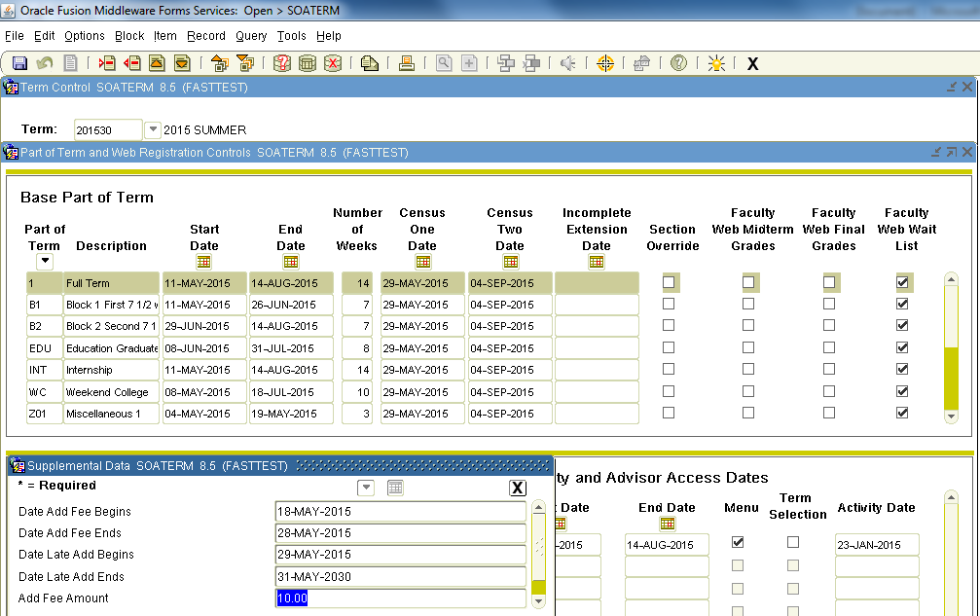
SOBPTRM (SOATERM FORM)

Slide 38
SZVTERM
szvterm_type-Attribute Name
szvterm_code-Part of Primary Key
szvterm_ptrm_code-Part of Primary Key
szvterm_start_date-values for Add_Start_date and Late_Add_Start_Date
szvterm_end_date-values for Add_End_date and Late_End_Start_Date
szvterm_value-values for Add-Fee and Late_Add_Fee

Slide 39
API’s and Packages

Slide 40
API’s and Packages
Runs nightly
SZLATEREGCODE
Adds the Late Registration Special Approval Code LR to SSBSECT_SAPR_CODE
Make sure code is in STVSAPR
Removes the Late Registration Special Approval Code for Future Terms
SZADDFEE
Adds the Add Fee amount to Student Account Receivable Account

Slide 41
API’s and Packages
SZADDAPI
Includes Functions to Support SZLATEREGCODE and SZADDFEE
Returns Late Registration Start and End dates
Returns Fee Amount
Determines if a section is an Add Fee class
Returns Current Term

Slide 42
Summary
Decision to automate to fix problems with add fee cards
Planning involved creation of a task force composed of representatives from Academic Affairs, Enrollment Management, the Bursar’s Office, and Academic Advisement
Procedures automate the fees and applies and removes the “LR” Department Approval Code to class sections
Utilizes Supplemental Data Engine
Code for automated process in supporting documents.

Slide 43
Thank You!
Denise Vandevanter
vandevde@uvu.edu

