Slide 1


Localizing the Tomcat-based Student Educational Planner
Randy Hunt - rhunt@dixie.edu
UBUG Conference 2015
1

Slide 2
The Problem
Unless you're lucky enough to have blue as your main school color...

Slide 3
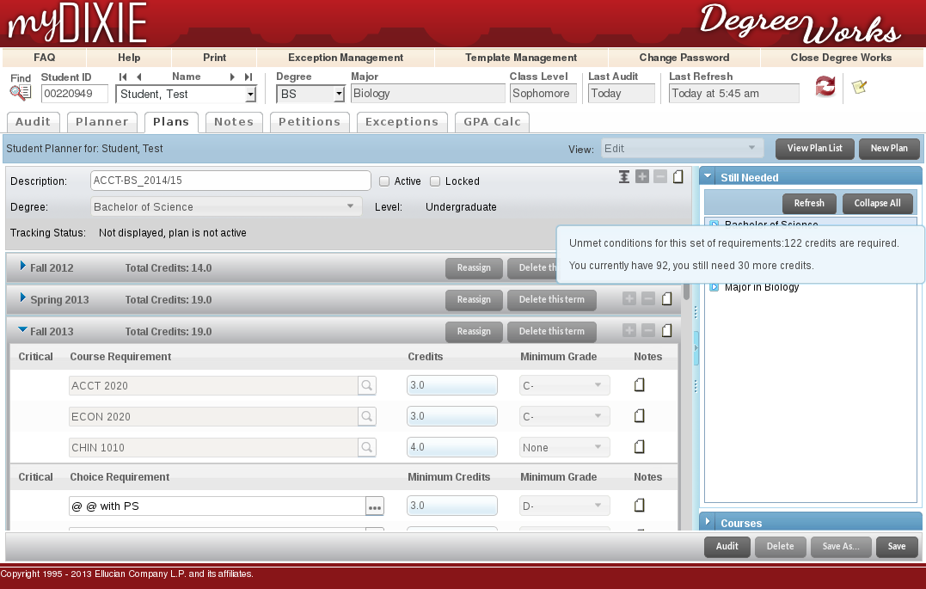
The Problem
3

Slide 4

The Problem
Ellucian supplies the SEP as a pre-built “WAR” file that is deployed through a Tomcat server
  Whenever there is an upgrade, or if someone simply re-deploys the SEP, the entire directory is wiped and reinitialized
Simply put:
Localizations
4

Slide 5
Functional Overview

Slide 6
Git, Tomcat, and Degree Works
Advantages to using Git with Tomcat files
  localizations can be tracked and restored if overwritten
  upgrades are easier to manage through branching and merging
    similar to Git work flow used when localizing Banner XE
6

Slide 7
Git, Tomcat, and Degree Works
For Git to work, files must be stored under one main directory.
If your setup is anything like ours, your Tomcat files are in a completely separate directory.
We must trick Tomcat into thinking it is working with its own files, but store them in our Degree Works Git folder.

Slide 8


For the Visual Learners
Tomcat
Degree Works Project
Symbolic Link
webapps
webapps

Slide 9
Ultimately We Want to Go from This:
9

Slide 10
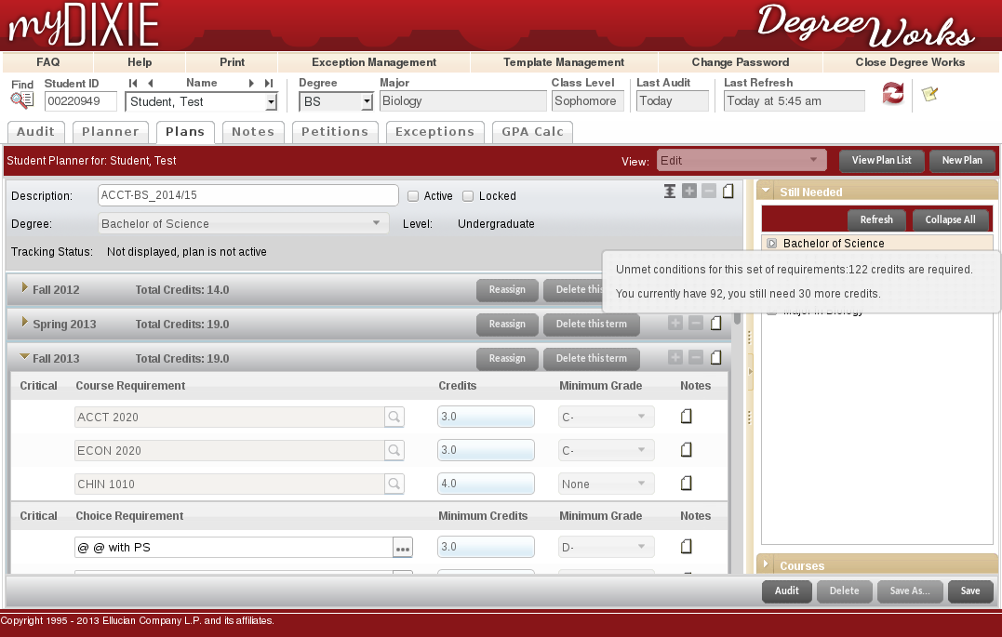
To This:
10

Slide 11
Technical Stuff

Slide 12
Creating the Symbolic Link
Force Tomcat to follow symbolic links
  Edit $CATALINA_HOME/conf/context.xml
  Add allowLinking="true" to the Context tag
    <Context allowLinking="true">
Stop Tomcat, so you can move directories and create symlinks
  #sudo service tomcat stop
12

Slide 13
Creating the Symbolic Link
Move the webapps directory in Tomcat to wherever you plan on tracking it in Git
  webapps will likely be owned by root, so…
  #sudo mv $CATALINA_HOME/webapps {degreeworks_dir}/tomcat/webapps
  #sudo chown -R {dwuser}:{dwgroup} {degreeworks_dir}/tomcat/webapps

Slide 14
Creating the Symbolic Link
Create a symbolic link in the original location and point it to the new location
  #sudo ln -s {degreeworks_dir}/tomcat/webapps $CATALINA_HOME/webapps
Bring Tomcat back up
  #sudo service tomcat start
  Tomcat should start up like nothing has been changed.
  Test your SEP to make sure it's still working
You are now ready to start localizing
14

Slide 15
Localizing With Git
As you start finding files that need localizing, I recommend adding them to your baseline branch in Git before modifying them
Commit your localizations to your local branch
Not only will this make upgrades easier to deal with (using Git merge process from baseline to local), but you will also be able to switch between the two at a moment's notice.
Impress your friends

Slide 16
Permissions Issues
Whenever Tomcat deploys a WAR file, the newly created directory is owned by root
Any time you re-deploy the SEP, you must change ownership of the whole directory back to your degree works administrator account
  #sudo chown -R {dwuser}:{dwgroup} plans
Otherwise, nothing in the SEP app folder will be writable; you will not be able to modify anything, and Git will have a tough time helping you out.

Slide 17

Localizing CSS
There are a few CSS files to keep in mind
  css/styles-student-planner.css.dsp
    Majority of changes can go here
  css/styles.css
ZK framework styles (zk.wcs) must be overridden, since they don't live anywhere on disk
  For example, the ugly mint green color in the template search area
  background-color: #f7ead9 !important;

Slide 18
Localizing CSS
BTW, mint green color was one of the more difficult ones to track down
The color is part of a dynamic stylesheet, but also as an inline style in the template/template-search.zul file
  <hlayout height="32px" style="background:#eeffcc;"

Slide 19
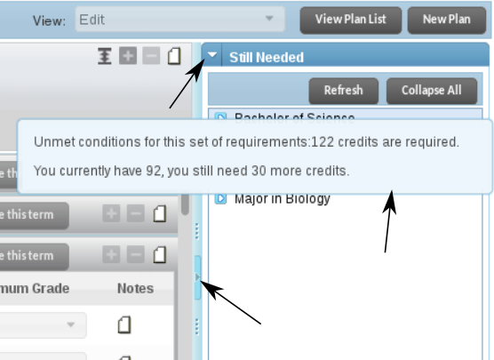
Localizing Images
Like zk.wcs styles, some images are dynamically generated through the ZK Framework
Generally, any image loaded using AJAX

Slide 20
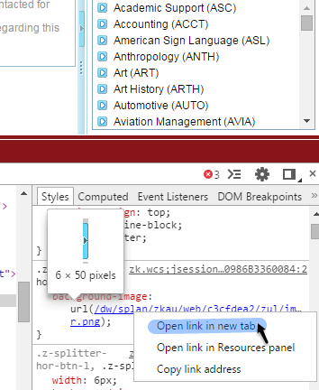
Localizing Images
You will need to create a static version of the image, and point your CSS to it

Slide 21
Localizing Images
Keep in mind that for any dynamic image there will be dynamic CSS somewhere.
You will need to use the “!important” override a lot.

Slide 22
Localizing Other Stuff
Modifying the appearance is as far as we've gone
Changing text and adding HTML should be relatively easy by modifying the appropriate “zul” file
However, we don't really have much access to the Model or Controller portions of the SEP, so changing functionality or business processes will be difficult
Maybe someday Ellucian will include the source code for us so we can compile these like we do Banner XE apps...

Slide 23
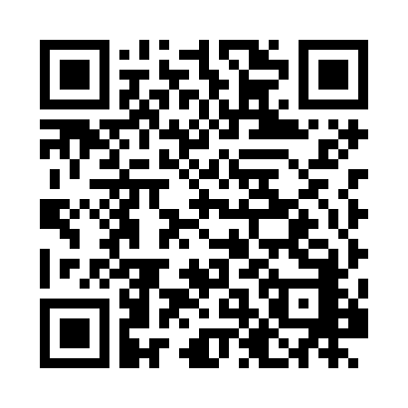
Questions?
Randy Hunt
rhunt@dixie.edu

