Slide 1
COMP2015
INTRODUCTION TO JAVASCRIPT AND JQUERY:
DAY 6

Slide 2
Learning Outcomes
List JavaScript’s primitive object types
Define object and class
Create a class
Create an object
Access the object’s properties
Explain references
Create objects four ways:
Object Literals
Object Constructor
Constructor pattern
Prototype pattern
Intro to JS and jQuery

Slide 3
Objects
In addition to JavaScript’s primitive data types (String, Number, Boolean, Null, Symbol, and Undefined), JavaScript has a single complex data type: Object
Intro to JS and jQuery

Slide 4
Mutable
Primitive data types cannot be changed; they are “immutable”
Objects can be changed; they are “mutable”
Intro to JS and jQuery

Slide 5
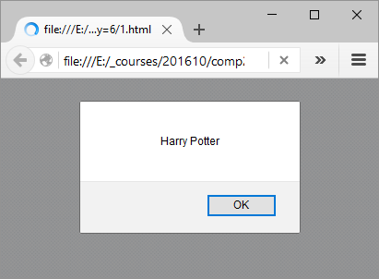
Definition
An Object is a list of data in {curly braces}, stored as name:“value” pairs, separated by commas
The data can be properties or methods
var book = {title: “Harry Potter”, author: “JK Rowling”}
alert(book.title);
This Object has two properties
(title and author) with two values
(“Harry Potter” and
“JK Rowling”)
Intro to JS and jQuery

Slide 6

More Objects
Property names can also be a Number; in that case, square brackets are required to access the data values ([ ] instead of a dot):
var book = {title: “Harry Potter”, author: “JK Rowling”, 1997: “philosopher’s stone”, 1998: “chamber of secrets”}
alert(book[“1997”]);
alert(book.title);
Intro to JS and jQuery

Slide 7
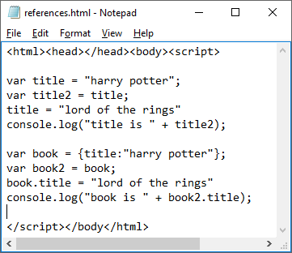
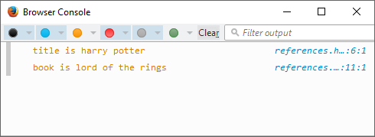
Object References
Intro to JS and jQuery

Slide 8
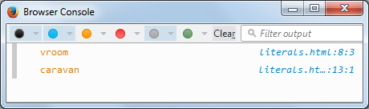
Creating Objects: Literals
1. Object literals (very common): curly braces
var car={
make: "dodge",
model: "caravan",
year: 2016,
drive:function(){
console.log("vroom");
}
}
car.drive();
console.log(car.model);
Intro to JS and jQuery

Slide 9
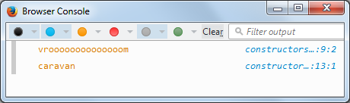
Creating Objects: Constructors
2. Object constructors
var car = new Object();
car.make = "dodge";
car.model = "caravan";
car.year = 2016;
car.drive = function(){
console.log("vroooooooooooooom");
}
car.drive();
console.log(car.model);
Intro to JS and jQuery

Slide 10
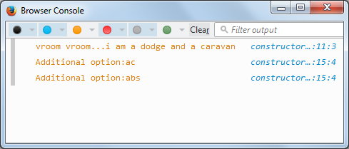
Creating Objects: Constructor Pattern
3. Object constructor pattern
//options: array of options; eg abs, airbags, warranty, ac, etc...
function Car(theMake, theModel, theYear, theOptions){
this.make = theMake;
this.model = theModel;
this.year = theYear;
this.allOptions = theOptions;
this.drive = function(){
console.log("vroom vroom...i am a " + this.make + " and a " + this.model);
}
this.getOptions = function(){
this.allOptions.forEach(function(oneOption){
console.log("Additional option:" + oneOption);
});
}
}
var car1 = new Car("dodge", "caravan", 2016, ["ac", "abs"]);
car1.drive();
car1.getOptions();
var car2 = new Car(“Honda”, “civic”, 2000, [‘ac’]);
Intro to JS and jQuery

Slide 11
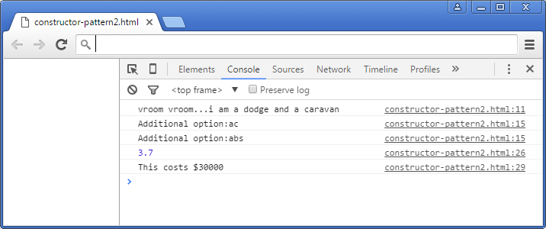
Creating Objects: Constructor Pattern
function Car(theMake, theModel, theYear, theOptions){
this.make = theMake;
this.model = theModel;
this.year = theYear;
this.allOptions = theOptions;
this.drive = function(){
console.log("vroom vroom...i am a " + this.make + " and a " + this.model);
}
this.getOptions = function(){
this.allOptions.forEach(function(oneOption){
console.log("Additional option:" + oneOption);
});
}
}
var car1 = new Car("dodge", "caravan", 2016, ["ac", "abs"]);
car1.drive();
car1.getOptions();
car1.engineSizeLitres = 3.7;
console.log(car1.engineSizeLitres);
car1.purchase=function(){
console.log("This costs $30000");
}
car1.purchase();
Intro to JS and jQuery

Slide 12
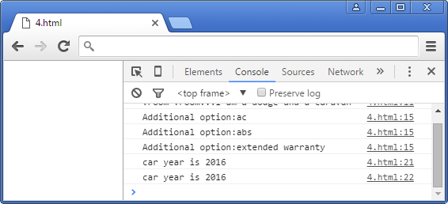
Creating Objects: 4. Prototype Pattern
<html><head></head><body><script>
function Car(){
}
Car.prototype.make = "dodge";
Car.prototype.model = "caravan";
Car.prototype.year = 2016;
Car.prototype.allOptions = ["ac", "abs", "extended warranty"];
Car.prototype.drive = function(){
console.log("vroom vroom...i am a " + this.make + " and a " + this.model);
}
Car.prototype.getOptions = function(){
this.allOptions.forEach(function(oneOption){
console.log("Additional option:" + oneOption);
});
}
var myCar = new Car();
myCar.drive();
myCar.getOptions();
console.log("car year is " + myCar.year);
console.log("car year is " + myCar['year']);
</script></body</html>
Intro to JS and jQuery

Slide 13
Home: Own vs. Inherited Properties
Own properties are those that are defined on the object.
Inherited properties are those that are inherited from the object’s Prototype.
The "in" operator returns true if a property has been defined; false otherwise.
The property can be an "own" or "inherited“ properties.
Inherited means it could have come from a parent class, such as Object.
https://developer.mozilla.org/en-US/docs/Web/JavaScript/Reference/Global_Objects/Object
Intro to JS and jQuery

Slide 14
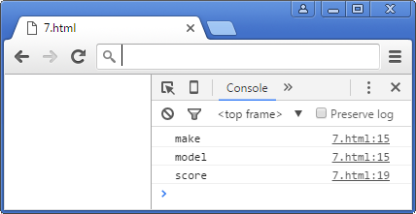
Home: Enumerating Properties
var myCar={make:"dodge", model:"caravan"};
function HockeyPlayer(){
}
HockeyPlayer.name = "wayne gretzky";
var h = new HockeyPlayer();
HockeyPlayer.prototype.score=function(){
console.log("he shoots he scores");
}
for(property in myCar){
console.log(property);
}
for(property2 in h){
console.log(property2);
}
Note: Properties inherited from Object.prototype are not enumerable.
Intro to JS and jQuery

Slide 15
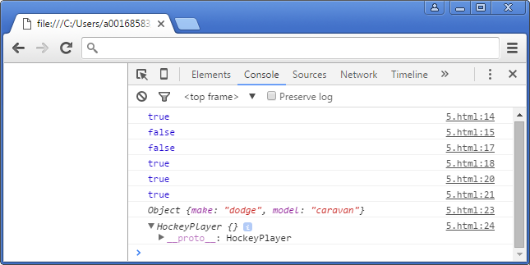
Home: Own vs. Inherited Properties
var myCar={make:"dodge", model:"caravan"};
function HockeyPlayer(){
}
HockeyPlayer.name = "wayne gretzky";
var h = new HockeyPlayer();
HockeyPlayer.prototype.score=function(){
console.log("he shoots he scores");
}
console.log("make" in myCar); // true
console.log("make" in h); // false
console.log("score" in myCar); // false
console.log("score" in h); // true
console.log("toString" in myCar); // true, from parent class Object
console.log("toString" in h); // true, from parent class Object
console.log(myCar); // using toString()
console.log(h); // using toString()
Intro to JS and jQuery

Slide 16
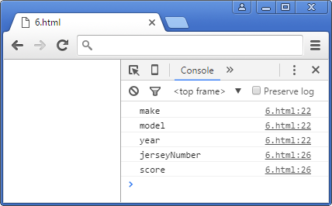
Home: Own vs. Inherited Properties: for/in loop
var myCar={make:"dodge", model:"caravan"};
function HockeyPlayer(){
}
HockeyPlayer.name = "wayne gretzky";
var h = new HockeyPlayer();
HockeyPlayer.prototype.score=function(){
console.log("he shoots he scores");
}
myCar.year = 2016;
h.jerseyNumber = 99;
for(var property in myCar){
console.log(property); // all three properties are own
}
for(var property2 in h){
console.log(property2); // score is enumerable but inherited
}
Intro to JS and jQuery

Slide 17
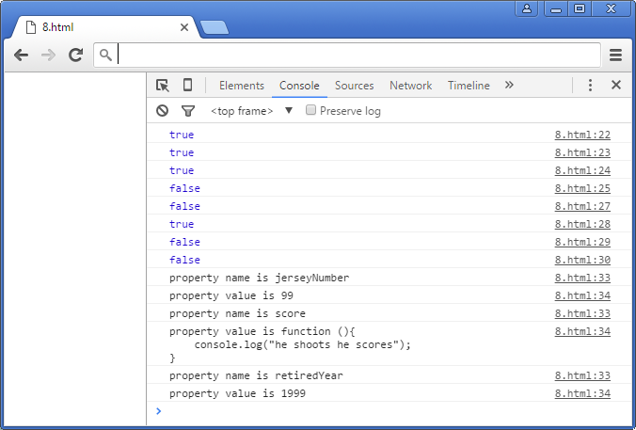
Home: hasOwnProperty()
The hasOwnProperty() method returns true ONLY IF
the property is an "own" property.
var myCar={make:"dodge", model:"caravan"};
function HockeyPlayer(){
}
HockeyPlayer.name = "wayne gretzky";
var h = new HockeyPlayer();
HockeyPlayer.prototype.score=function(){
console.log("he shoots he scores");
}
myCar.year = 2016;
h.jerseyNumber = 99;
HockeyPlayer.prototype.retiredYear = 1999;
console.log(myCar.hasOwnProperty("make")); // true
console.log(myCar.hasOwnProperty("model")); // true
console.log(myCar.hasOwnProperty("year")); // true
console.log(myCar.hasOwnProperty("toString")); // false; inherited from Object
console.log(h.hasOwnProperty("score")); // false; inherited from HockeyPlayer
console.log(h.hasOwnProperty("jerseyNumber")); // true
console.log(h.hasOwnProperty("retiredYear")); // false; inherited from HockeyPlayer
console.log(h.hasOwnProperty("toString")); // false; inherited from Object
for(var property in h){
console.log("property name is " + property);
console.log("property value is " + h[property]);
}
Intro to JS and jQuery

Slide 18
Lab
Create a class that represents a BankAccount.
It must have the following properties:
PIN, balanceUSD, accountNumber
It must have the following method:
getBalanceUSD(), which returns the object’s balanceUSD property value
Create two different BankAccount objects and use a for/in loop to print the property and function names, and also their values.
Show your instructor when stuck or finished.
Work with a partner and see if they can find issues with your work.
Intro to JS and jQuery

